Slide 1
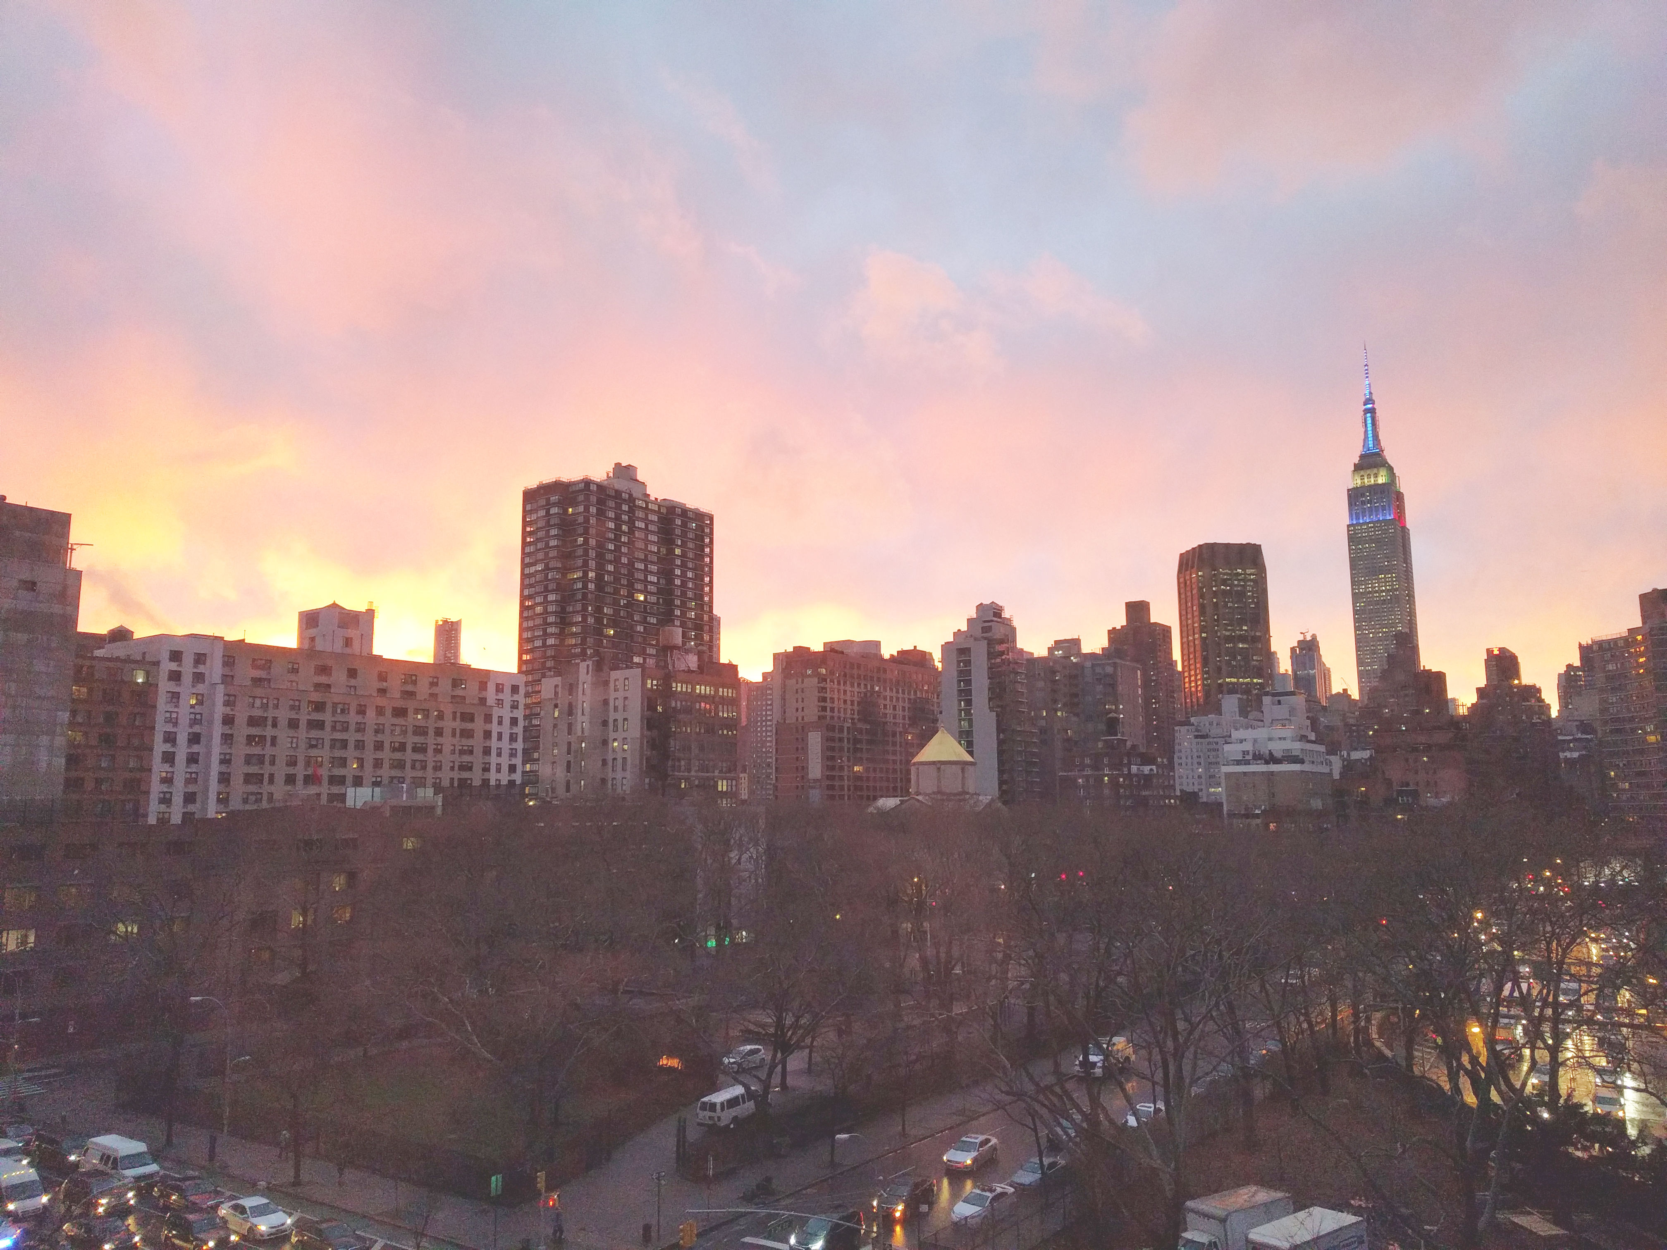


Slide 2
News
Follow us on Twitter: @NYCDotNetDevs
Important security update for ASP.NET Core - Denial of Service possible in AspNetCore.Mvc.Core 1.1.0 http://bit.ly/2lWrA0k
.NET Turns 15. On February 13th, 2002, the first version of .NET was released as part of Visual Studio.NET
Jon Galloway is the new Executive Director of the .NET Foundation
The .NET Language Strategy http://bit.ly/2ksZXyu
.NET Core, .NET Native, and NuGet get updates in VS 2017 RC http://bit.ly/2ku0RMn

Slide 3
Events
Visual Studio 2017 RTM is March 7 and is accompanied by a 2 day launch virtual event (https://launch.visualstudio.com/)
Philly Code Camp - Sat 2/25 - Registrations full but there is a waiting list (https://www.meetup.com/Philly-NET/events/237291594/)
Boston Code Camp - Sat 3/25 - Registration opens 3/1 (https://www.bostoncodecamp.com/CC27/info)

Slide 4
Events
Orchard Harvest Conference 2017
Orchard is an open source .NET CMS
Tuesday, February 21 – Wednesday, February 22
TKP New York Conference Center 109 West 39th Street New York, NY 10018
orchard@microsoft.com
@orchardcms
Use code NYCDOTNET for a discount!

Slide 5
Other NYC Meetings
Tuesday, February 21 - NYC Mobile .NET Developers "New Year, New Xamarin" (https://www.meetup.com/nycmobiledev/)
Wednesday, February 22 - New York ALT.NET Software Development Group "Exploring ASP.NET Core with Erik Noren" (https://www.meetup.com/nyaltnet/)
Tuesday, March 14 - Northern New Jersey .NET User Group (N3UG) Topic TBD (http://n3ug.org/Meetings.aspx)
Wednesday, March 15 - Microsoft Azure User Group – NYC "TBA" (https://www.meetup.com/AzureNYC/events/235636615/)
TBA - Microsoft Makers and App Developers NYC (MMADNYC) (https://www.meetup.com/MMADNYC/)
TBA - Microsoft Makers and App Developers NJ (MMADNJ) (https://www.meetup.com/MMADNJ/)

Slide 6
Announcements
Call for presentations!
Have an idea/topic for a presentation?
Want to give a presentation?
Contact Erik or Brian, or tweet @NYCDotNetDevs
Upcoming meetings
Thursday, March 16th - "DevOps with ASP.NET Core and Entity Framework Core" - Benjamin Day
Thursday, April 20th - "TBA" - Maria Naggaga

Slide 7
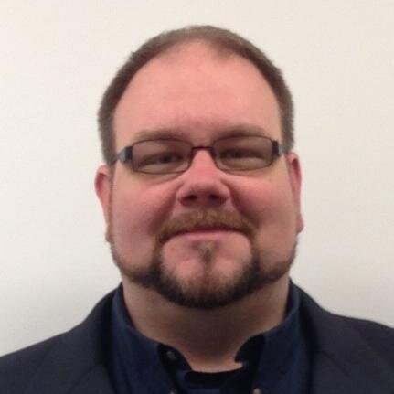
Erik Noren
@ErikNoren
Solutions Architect at Ropes & Gray LLP
20+ years of software development experience
Interested in world languages and most things nerdy

