Slide 1
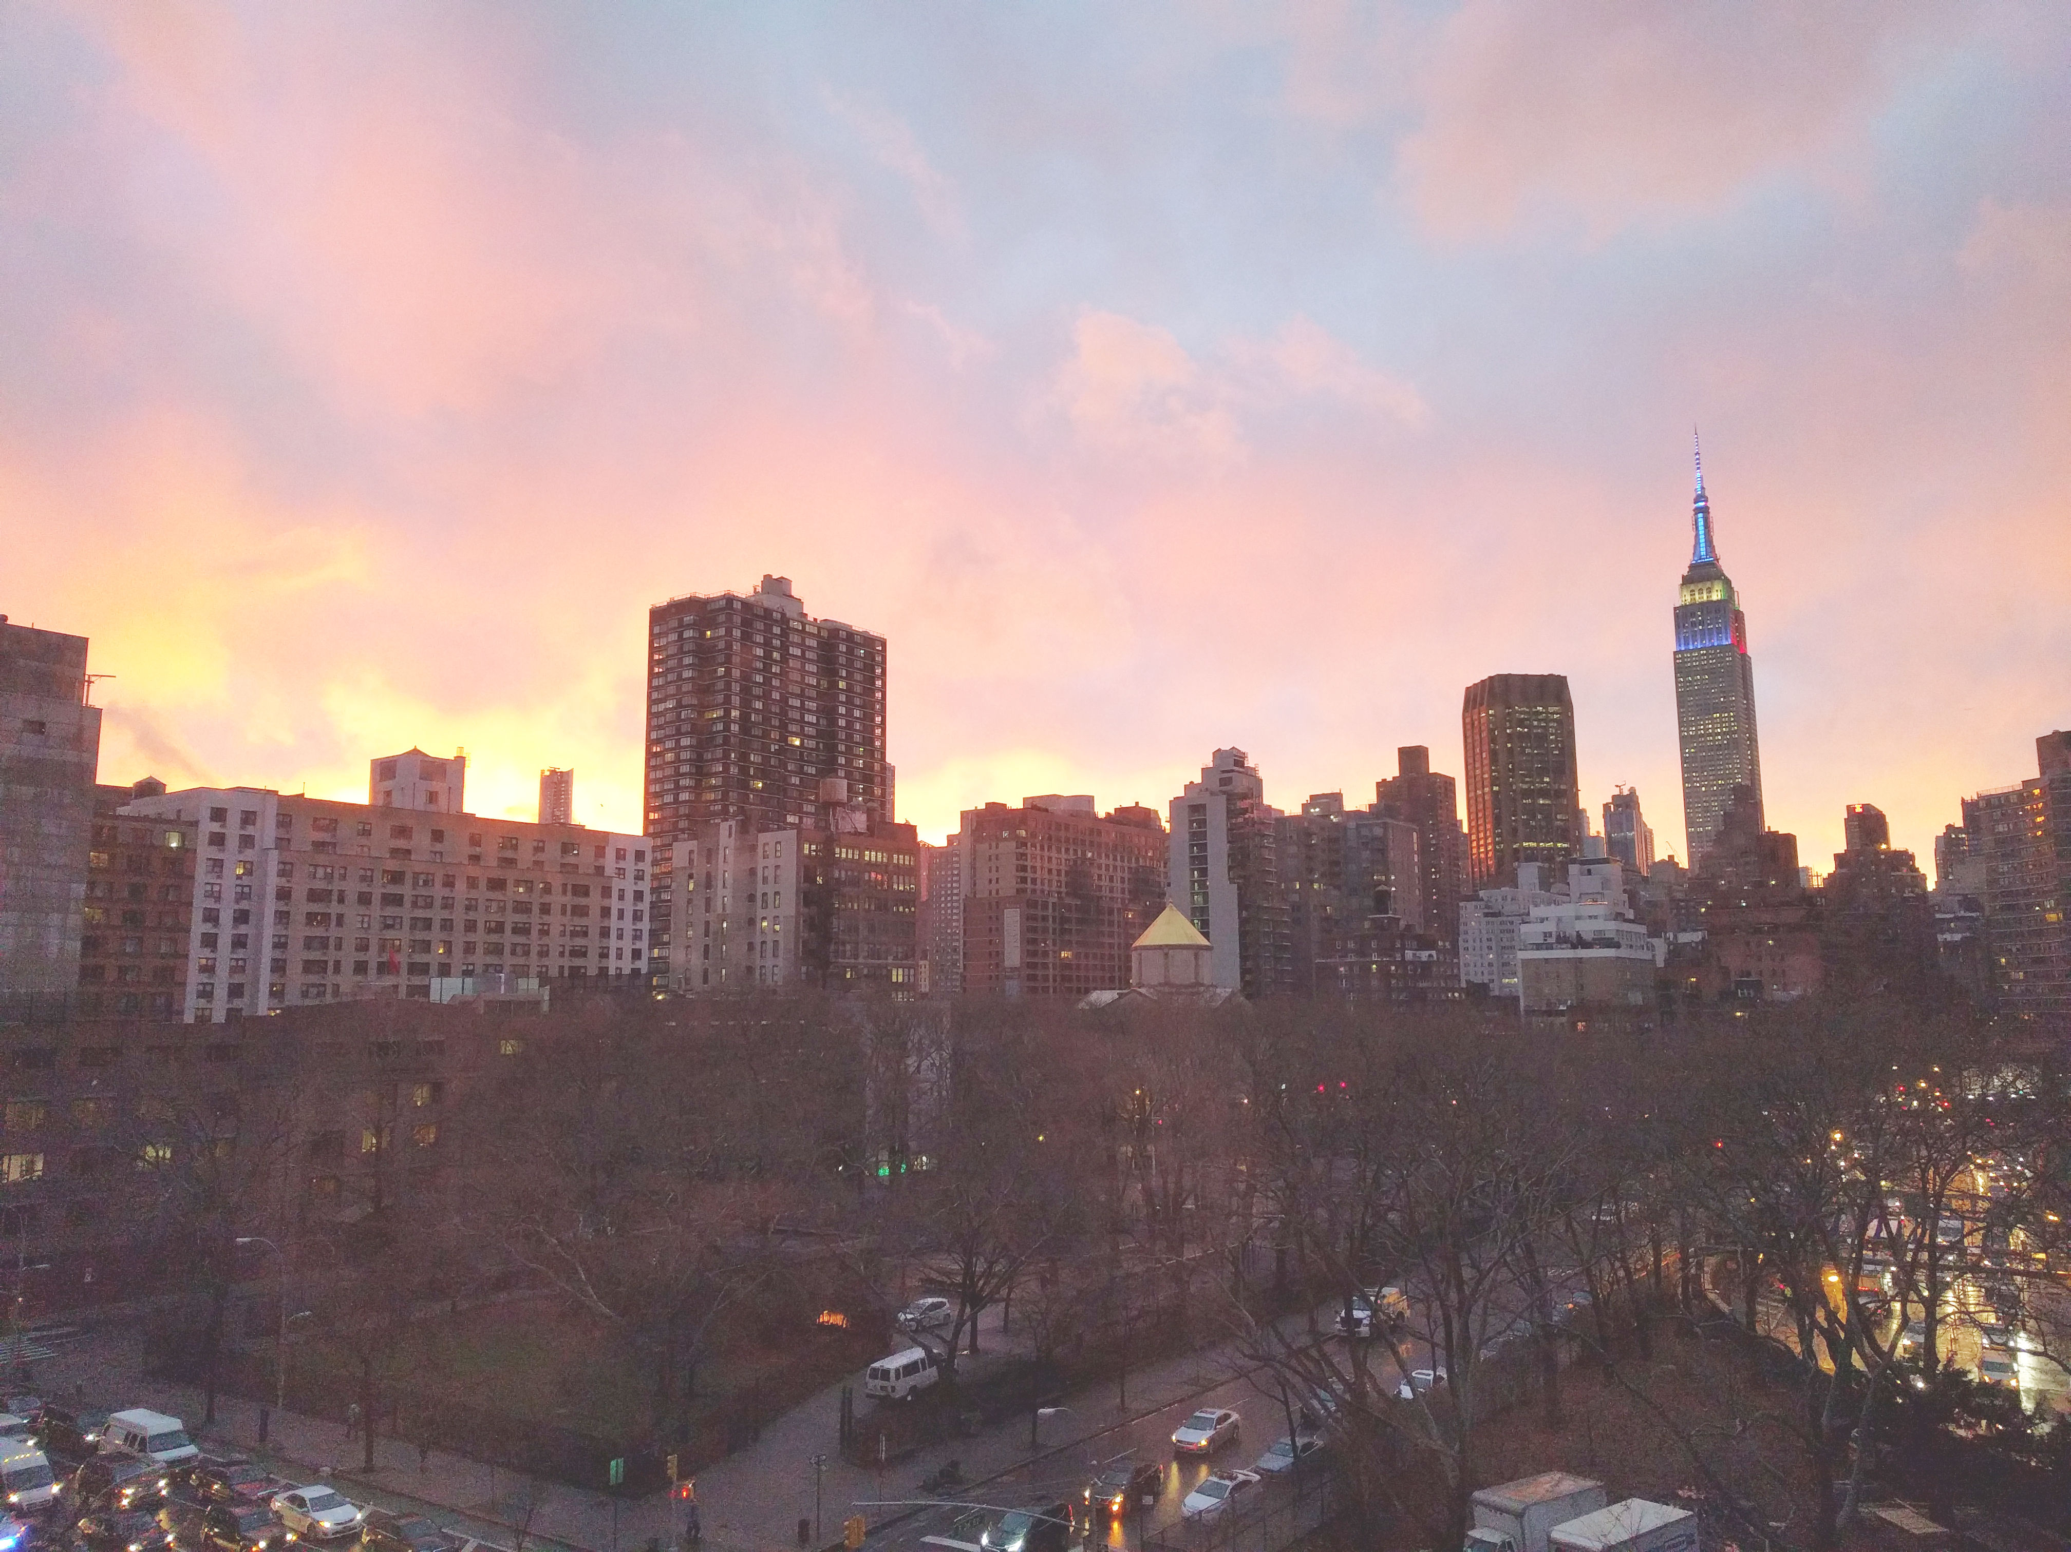


Slide 2
News
Follow us on Twitter: @NYCDotNetDevs
Visual Studio 2017 GA http://bit.ly/2lWrA0k
.NET Core Tools 1.0 http://bit.ly/2mVpGlq
C# 7.0 http://bit.ly/2lIPZeh
Visual Studio for Mac – Preview 4 http://bit.ly/2mTnZ6E

Slide 3
Events
Boston Code Camp - Sat 3/25 - Registration is full but there is a waitlist (https://www.bostoncodecamp.com/CC27/info)

Slide 4
Other NYC Meetings
Monday, March 20th and Monday, March 27th – NY Pluralsight Study Group "Entity Framework Core Parts 4 and 5" (https://www.meetup.com/NYPluralsightStudy/)
Tuesday, March 21st – NYC Mobile .NET "Localization in Mobile App Development" (https://www.meetup.com/nycmobiledev/)
Wednesday, March 22nd – New York ALT.NET Software Development Group "Exploring ASP.NET Core with Erik Noren Part 2" (https://www.meetup.com/nyaltnet/)
Wednesday, April 19 - Microsoft Azure User Group – NYC "Smarter & Cuter Bots" (https://www.meetup.com/AzureNYC/events/235636615/)
TBA – Microsoft Makers and App Developers NYC (MMADNYC) (https://www.meetup.com/MMADNYC/)
Tuesday, March 21st – Microsoft Makers and App Developers NJ (MMADNJ) "Game Development with Unity for the Windows 10 Platform, with Adina Shanholtz" (https://www.meetup.com/MMADNJ/)
Tuesday, March 21st, 28th, April 4th, 11th – NY Microsoft Certification Group (https://www.meetup.com/New-York-Microsoft-Certification-Group/)

Slide 5
Announcements
Call for presentations!
Have an idea/topic for a presentation?
Want to give a presentation?
Contact Erik or Brian, or tweet @NYCDotNetDevs
Upcoming meetings
Thursday, April 20th - "TBA" - Maria Naggaga

Slide 6
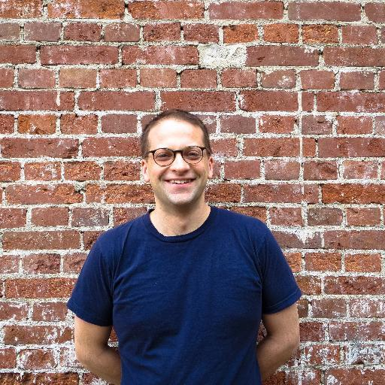
Benjamin Day
@benday
Consultant for TFS, Scrum, and software testing
Visual Studio ALM MVP
Pluralsight author
Jazz musician

