Slide 1
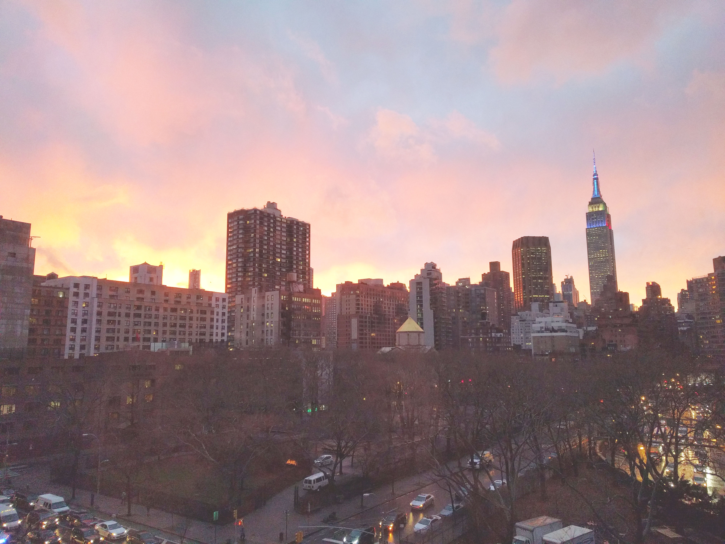


Slide 2
News
Follow us on Twitter: @NYCDotNetDevs
.NET Framework 4.7 Announcement http://bit.ly/2ovkAsu
.NET Reference Experience on docs.microsoft.com http://bit.ly/2pHGtcL
MSTest V2 Open Sourced http://bit.ly/2p03E1d

Slide 3
Events
DeveloperWeek NYC 2017 http://www.developerweek.com/NYC/ NYC's Largest Developer Conference and Expo June 19-21, 2017 (Monday-Wednesday) Expo, Talks, Hiring Mixer, Hackathon Free OPEN Dev Pass: http://bit.ly/2pjyLWh

Slide 4
Other NYC Meetings
Monday, April 24th – NY Pluralsight Study Group "Developing with .NET on Microsoft Azure Part 4" (https://www.meetup.com/NYPluralsightStudy/)
Tuesday, May 16th – NYC Mobile .NET "Conversational UI: Chat Bots for Social Good" (https://www.meetup.com/nycmobiledev/)
Wednesday, April 26th – New York ALT.NET Software Development Group "TBA" (https://www.meetup.com/nyaltnet/)
TBA – Microsoft Azure User Group – NYC (https://www.meetup.com/AzureNYC/)
TBA – Microsoft Makers and App Developers NYC (MMADNYC) (https://www.meetup.com/MMADNYC/)
TBA – Microsoft Makers and App Developers NJ (MMADNJ) (https://www.meetup.com/MMADNJ/)
Tuesday, April 25th, May 2nd, 9th, 16th – NY Microsoft Certification Group (https://www.meetup.com/New-York-Microsoft-Certification-Group/)

Slide 5
Announcements
Call for presentations!
Have an idea/topic for a presentation?
Want to give a presentation?
Contact Erik or Brian, or tweet @NYCDotNetDevs
Upcoming meetings
Thursday, May 18th - "TBA"
Thursday, June 15th - "TBA"

Slide 6
Announcements
Lightning Talks!
Interested in giving a quick talk about a topic? We have interest in doing a lightning talk meeting in July or August.
Discussion Board
Sign up for digest messages for the discussion board
We'll be posting announcements there instead of using emails

Slide 7

Maria Naggaga
@LadyNaggaga
Program Manager for Microsoft
Loves to draw Afros

