Slide 1
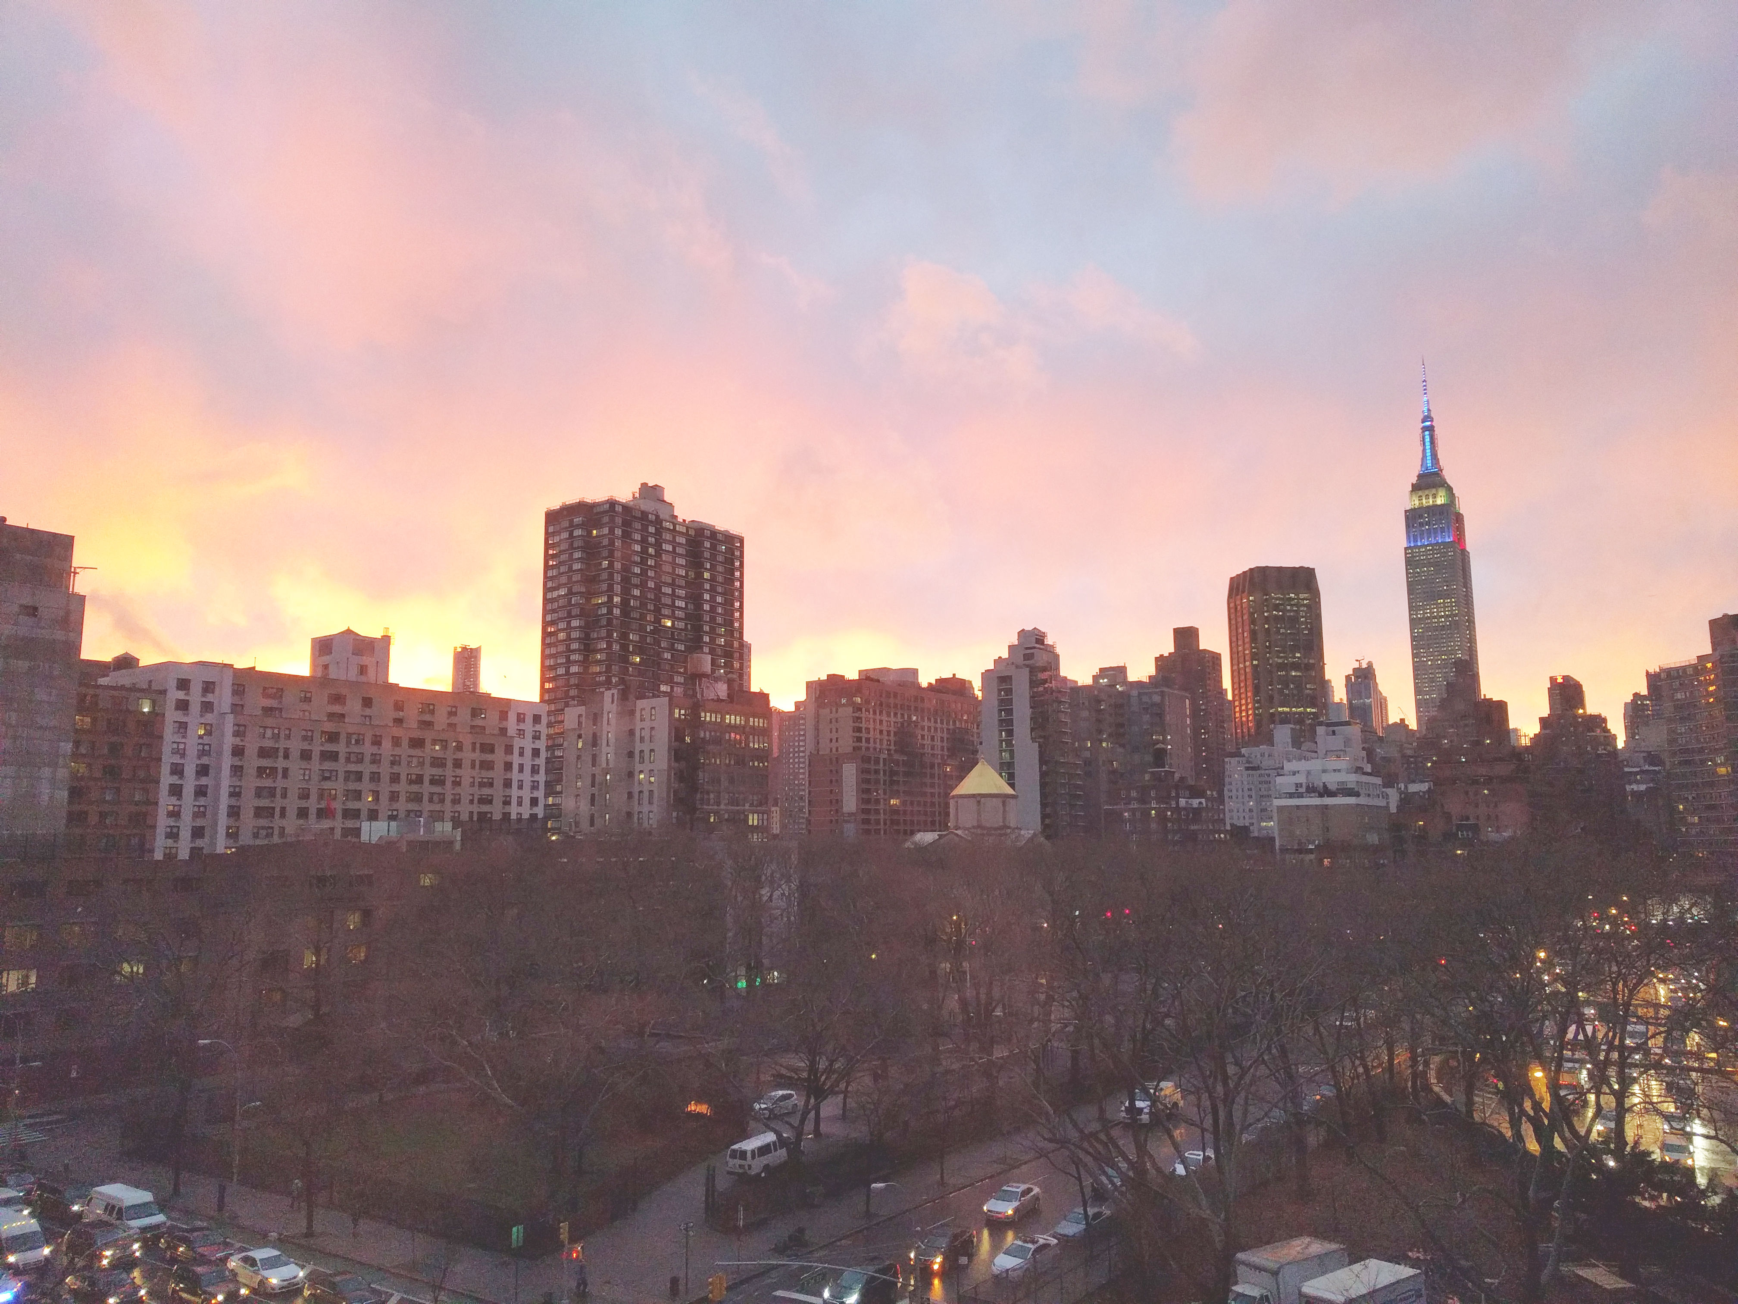


Slide 2
News
Follow us on Twitter: @NYCDotNetDevs
Microsoft Connect(); 2017 - http://bit.ly/2fUfFTL
Visual Studio App Center
Visual Studio Live Share
VSTS Mac Builds
SQL Operations Studio
Visual Studio Tools for AI
TFS 2018
Xamarian Live Player
And more

Slide 3
Events
nopCommerce Day 2017 http://days17.nopcommerce.com/ Thursday and Friday, November 16-17th, 2017
Full-Day F# http://bit.ly/2zKYvjA Saturday, November 18, 2017

Slide 4
Other NYC Meetings
Monday, November 20th, 27th, December 4th, 11th – NY Pluralsight Study Group "Integrating Angular with ASP.NET Core RESTful Services" (https://www.meetup.com/NYPluralsightStudy/)
Tuesday, November 21st – NYC Mobile .NET "Building Scalable Applications with the Actor Model" (https://www.meetup.com/nycmobiledev/)
Tuesday, November 21st – New York ALT.NET Software Development Group "Building Scalable Applications with the Actor Model" (https://www.meetup.com/nyaltnet/)
Monday, December 11th - NYC PowerShell Meetup "Dynamic Diagrams, Machine Learning & PowerShell" (https://www.meetup.com/NycPowershellMeetup/)
TBA – Microsoft Azure User Group – NYC "TBD" (https://www.meetup.com/AzureNYC/)
TBA – Microsoft Makers and App Developers NYC (MMADNYC) "TBD" (https://www.meetup.com/MMADNYC/)
TBA – Microsoft Makers and App Developers NJ (MMADNJ) "TBD" (https://www.meetup.com/MMADNJ/)
TBA – NY Microsoft Certification Group (https://www.meetup.com/New-York-Microsoft-Certification-Group/)

Slide 5
Announcements
Call for presentations!
Have an idea/topic for a presentation?
Want to give a presentation?
Contact Erik or Brian, or tweet @NYCDotNetDevs
Upcoming meetings
Thursday, December 14th - "Azure Application Insights" * (Not regular 3rd Thursday)

Slide 6
Announcements
Lightning Talks!
Interested in giving a quick talk about a topic? We have interest in doing a lightning talk meeting before the end of the year. Please visit the discussion board: http://bit.ly/2pWb3fi
Hackathon?
Interested in participating a hackathon? Let us know on the discussion board: http://bit.ly/2pYXuLk
Discussion Board
Sign up for digest messages for the discussion board
We'll be posting announcements there instead of using emails

Slide 7
Job Announcements
Looking for a job?
Looking to hire a developer?

Slide 8
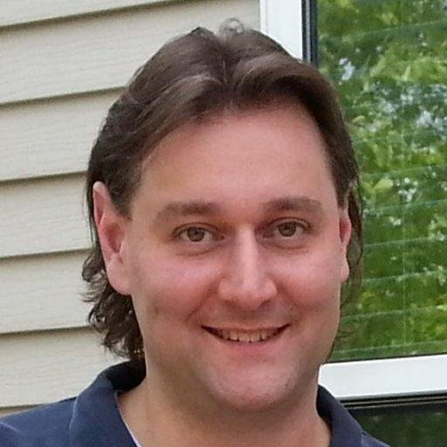
John Baluka
https://www.linkedin.com/in/johnbaluka/
Software Developer at ICompare Solutions
Featured on Developer On Fire podcast

