Slide 1


Download the slides at: https://github.com/bjablonsky/NYCDotNetDevSlides/tree/master/Slides

Slide 2
Introductions
Co-Organizers
Who’s new?
Brian Jablonsky
Erik Noren

Slide 3
News
Follow us on Twitter: @NYCDotNetDevs
.NET Core 3.0 Preview 9 – https://bit.ly/2m7QcIV
EF Core 3.0 Preview 9 – https://bit.ly/2kdAyv4
ASP.NET Core 3.0 Preview 9 – https://bit.ly/2lRufh3
ML.NET 1.4 Preview – https://bit.ly/2kItiHJ

Slide 4
Other NYC Meetings
Monday, September 16th, 23rd – NY Pluralsight Study Group “Eight Week ASP.NET Core Deep Dive” (https://www.meetup.com/NYPluralsightStudy/)
Tuesday, September 24th – NYC Mobile .NET “.Net Conf Announcements + Xamarin.Essentials” (https://www.meetup.com/nycmobiledev/)
Wednesday, September 25th – New York ALT.NET Software Development Group “TBA” (https://www.meetup.com/nyaltnet/)
Wednesday, September 25th – NYC PowerShell Meetup “PowerShell and AWS Back to School” (https://www.meetup.com/NycPowershellMeetup/)

Slide 5
Announcements
Upcoming meetings
Tuesday, October 1st – “NYC .NET Hacktoberfest 2019”
Thursday, November 14th – TBA
Thursday, December 12th – TBA
Call for presentations!
Have an idea/topic for a presentation?
Want to give a presentation?
Contact Erik (erik@nycdotnetdevs.com) or Brian (brian@nycdotnetdevs.com), or tweet @NYCDotNetDevs

Slide 6
Announcements
.NET Happy Hour
An event happening around NYC offering members an open discussion with other developers about anything and everything over drinks and snacks.
Planning regular Happy Hours for 2019 starting in Q1

Slide 7
Announcements
Community Service Hackathon
We’ve been in discussion with the Teaching Artist Project Cohort (TAP Cohort) to develop an interactive platform to serve teaching artists working in public schools and higher education.
Currently working on securing partnerships
Great way to give back to non-profits in NYC-area
Play with new technology
Looks great on your GitHub account/resume
Look out for an announcement for a Hackathon in Q1 2019

Slide 8
.NET Conf
Free – Virtual event
September 23 — 25, 2019
https://www.dotnetconf.net/
.NET Core 3.0 Launches!

Slide 9
NYC .NET Hacktoberfest 2019
Free
Tuesday, October 1st, 2019
6PM – 8PM
Microsoft Offices – 11 Times Square
New York City, NY
https://www.meetup.com/NYC-NET-Developers/events/261325823/

Slide 10
Code Camp NYC 2019
$15 (covers breakfast, lunch, and snacks)
Saturday, October 12th
Microsoft Offices – 11 Times Square
New York City, NY
https://codecampnyc.org/

Slide 11
Philly.NET Code Camp 2019
Save the date!
CFS until October 5th
Friday, October 18th - Saturday, October 19th
Microsoft MTC
Mavern, PA
http://phillydotnet.org/2019-2.html

Slide 12
TechBash 2019
Save the date!
November 12th – 15th
Kalahari Resorts
Pocono Manor, Pennsylvania
https://techbash.com/

Slide 13
Announcements
Join us on Slack!
Join the .NET Core Slack group
Already 6,800+ members including many core team members
http://tattoocoder.com/aspnet-slack-sign-up/
Join the #nyc-dotnet-developers channel

Slide 14
Announcements
Twitter
Got a blog post or article on .NET you’d like retweeted?
Have a .NET job opportunity you’re looking to fill?
Got something .NET related?
Follow us on twitter, email us (brian@nycdotnetdevs.com or erik@nycdotnetdevs.com) or DM us on Twitter (@NYCDotNetDevs) with your tweet, and we’ll retweet it!

Slide 15
Job Announcements
Looking for a job?
Looking to hire a developer?
CUNY Tech Prep new grads and interns are looking for Fall 2019 and Spring/Summer 2020 opportunities

Slide 16

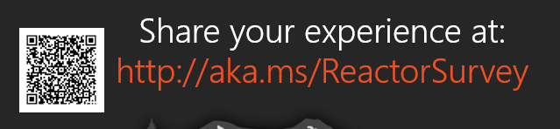
Sponsors
Microsoft Reactor http://microsoftreactor.com
Microsoft Reactors are developer community hubs providing technical events, community networking, and collaboration. They are graciously sponsoring our group in 2019 by providing our meeting space and food! Please fill out the survey at the end of the meeting!

Slide 17

Sponsors
PostSharp http://www.postsharp.net/
Members get a 10% discount on PostSharp licenses (both personal and company orders)
PostSharp is a compiler extension that adds support for patterns to C# and VB. If you’re tired of writing repetitive code, you may want to check it out. It can help you add logging, caching or INotifyPropertyChanged to your codebase without boilerplate, or solve multithreading issues. Customers ranging from Microsoft to Bank of America typically achieve a 15% code reduction thanks to PostSharp.

Slide 18

Sponsors
RevDeBug https://revdebug.com
RevDeBug allows you to inspect past application state and performance profile, even directly from production environments. Trace the root cause of bugs in a matter of seconds, saving your developers' time and sanity.

Slide 19
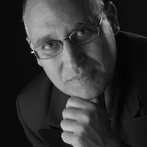
Avi Farah
https://www.linkedin.com/in/avi-farah-82bb901/
VP – Morgan Stanley

Slide 20

Reactor NYC
@MSFTReactor
#ReactorNYC
How was your Meeting?

Slide 21

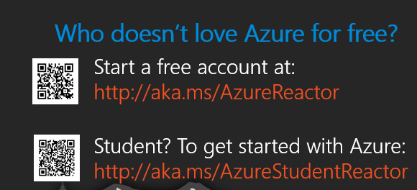

Reactor NYC
@MSFTReactor
#ReactorNYC

