Slide 1



Slide 2
News
Follow us on Twitter: @NYCDotNetDevs
Connect(); 2018 - https://bit.ly/2AJhS8X
.NET Standard 2.1 - https://bit.ly/2RCW2fX
.NET/ASP.NET/EF Core 2.2 - https://bit.ly/2KUE9Hh
Visual Studio 2019 Preview 1 - https://bit.ly/2KT5lGz
.NET Core 3 Preview 1 - https://bit.ly/2FYP2Jx
Blazor 0.7.0 Released - https://bit.ly/2C3865m

Slide 3
Other NYC Meetings
TBD – NY Pluralsight Study Group “TBA” (https://www.meetup.com/NYPluralsightStudy/)
Tuesday, January 15th – NYC Mobile .NET “TBA” (https://www.meetup.com/nycmobiledev/)
Wednesday, January 23rd – New York ALT.NET Software Development Group “TBA” (https://www.meetup.com/nyaltnet/)
Thursday, December 13th – NYC PowerShell Meetup “A night of Stories of Reverse Engineering & Internals for PowerShellers” (https://www.meetup.com/NycPowershellMeetup/)
TBD – NYC AI Users Group “TBA” (https://www.meetup.com/New-York-City-AI-Users-Group/)

Slide 4
Announcements
Call for presentations!
Have an idea/topic for a presentation?
Want to give a presentation?
Contact Erik or Brian, or tweet @NYCDotNetDevs
Upcoming meetings
We’re scheduling January – June 2019!

Slide 5
Announcements
Join us on Slack!
Join the .NET Core Slack group
Already 6,800+ members including many core team members
http://tattoocoder.com/aspnet-slack-sign-up/
Join the #nyc-dotnet-developers channel

Slide 6
Job Announcements
Looking for a job?
Looking to hire a developer?
CUNY Tech Prep new grads and interns are looking for Spring/Summer 2019 opportunities
Full Stack .NET Developer – C#/TypeScript/React – UPTOP https://landlords.liveuptop.com/open-positions/full-stack-developer/

Slide 7

Sponsors
Microsoft Reactor http://microsoftreactor.com
Microsoft Reactors are developer community hubs providing technical events, community networking, and collaboration. They are graciously sponsoring our group into 2019 by providing our meeting space and food! Please fill out the survey at the end of the meeting!

Slide 8

Sponsors
PostSharp http://www.postsharp.net/
Members get a 10% discount on PostSharp licenses (both personal and company orders)
PostSharp is a compiler extension that adds support for patterns to C# and VB. If you’re tired of writing repetitive code, you may want to check it out. It can help you add logging, caching or INotifyPropertyChanged to your codebase without boilerplate, or solve multithreading issues. Customers ranging from Microsoft to Bank of America typically achieve a 15% code reduction thanks to PostSharp.

Slide 9

Sponsors
RevDeBug https://revdebug.com
RevDeBug allows you to inspect past application state and performance profile, even directly from production environments. Trace the root cause of bugs in a matter of seconds, saving your developers' time and sanity.

Slide 10
Giveaway
We’ll have some swag giveaway at the end of the meeting. So stick around!

Slide 11

Mark Sowul
https://www.solsoftsolutions.com/
Managing Consultant at SolSoft Solutions

Slide 12

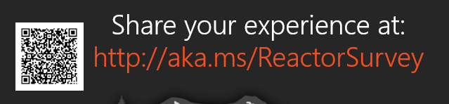
Reactor NYC
@MSFTReactor
#ReactorNYC
How was your Meeting?

Slide 13

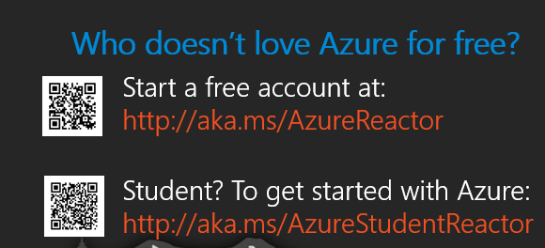

Reactor NYC
@MSFTReactor
#ReactorNYC

