Slide 1



Slide 2
News
Follow us on Twitter: @NYCDotNetDevs
GitHub Announces Free Private Repos - https://bit.ly/2Fcf9vl
.NET Framework January 2019 Rollup - https://bit.ly/2M1wlnT
.NET Core January 2019 Updates - https://bit.ly/2M5ao78

Slide 3
Other NYC Meetings
TBD – NY Pluralsight Study Group “TBA” (https://www.meetup.com/NYPluralsightStudy/)
Tuesday, January 15th – NYC Mobile .NET “TBA” (https://www.meetup.com/nycmobiledev/)
Wednesday, January 23rd – New York ALT.NET Software Development Group “TBA” (https://www.meetup.com/nyaltnet/)
TBD – NYC PowerShell Meetup “TBA” (https://www.meetup.com/NycPowershellMeetup/)

Slide 4
Announcements
Call for presentations!
Have an idea/topic for a presentation?
Want to give a presentation?
Contact Erik (erik@nycdotnetdevs.com) or Brian (brian@nycdotnetdevs.com), or tweet @NYCDotNetDevs
Upcoming meetings
Thursday, February 14th – No Meeting
Thursday, March 14th – TBA
Thursday, April 11th – TBA
Thursday, May 9th – TBA

Slide 5
Announcements
Join us on Slack!
Join the .NET Core Slack group
Already 6,800+ members including many core team members
http://tattoocoder.com/aspnet-slack-sign-up/
Join the #nyc-dotnet-developers channel

Slide 6
Announcements
.NET Happy Hour
A monthly event happening around NYC offering members a lightning talk on how to boost your developer productivity using various .NET tools, and a chance to network with other developers over drinks.
Stay tuned for more information!

Slide 7
Announcements
Hackathons
We’re working on creating a few hackathon events throughout the year
We’re looking to partner with a NYC non-profit to provide on-going development and support with .NET development
If you know of a NYC non-profit in need, let us know!
We’ll be scheduling a Hacktoberfest event in October of this year. Stay tuned for more information!

Slide 8
Announcements
Twitter
Got a blog post or article on .NET you’d like retweeted?
Have a .NET job opportunity you’re looking to fill?
Got something .NET related?
Follow us on twitter, email us (brian@nycdotnetdevs.com or erik@nycdotnetdevs.com) or DM us on Twitter (@NYCDotNetDevs) with your tweet, and we’ll retweet it!

Slide 9
Job Announcements
Looking for a job?
Looking to hire a developer?
CUNY Tech Prep new grads and interns are looking for Spring/Summer 2019 opportunities
Full Stack .NET Developer – C#/TypeScript/React – UPTOP https://landlords.liveuptop.com/open-positions/full-stack-developer/

Slide 10

Sponsors
Microsoft Reactor http://microsoftreactor.com
Microsoft Reactors are developer community hubs providing technical events, community networking, and collaboration. They are graciously sponsoring our group in 2019 by providing our meeting space and food! Please fill out the survey at the end of the meeting!

Slide 11

Sponsors
PostSharp http://www.postsharp.net/
Members get a 10% discount on PostSharp licenses (both personal and company orders)
PostSharp is a compiler extension that adds support for patterns to C# and VB. If you’re tired of writing repetitive code, you may want to check it out. It can help you add logging, caching or INotifyPropertyChanged to your codebase without boilerplate, or solve multithreading issues. Customers ranging from Microsoft to Bank of America typically achieve a 15% code reduction thanks to PostSharp.

Slide 12

Sponsors
RevDeBug https://revdebug.com
RevDeBug allows you to inspect past application state and performance profile, even directly from production environments. Trace the root cause of bugs in a matter of seconds, saving your developers' time and sanity.

Slide 13
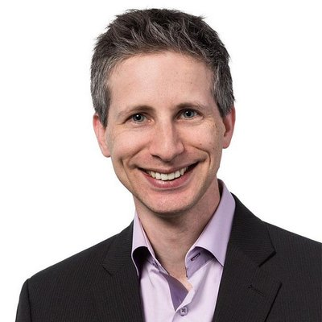
Oren Novotny
https://twitter.com/onovotny
Chief Architect, DevOps and Modern Software at Blue Metal Inc

Slide 14

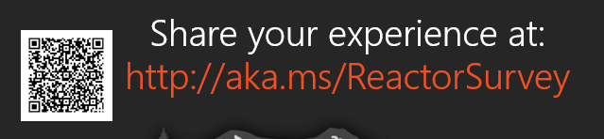
Reactor NYC
@MSFTReactor
#ReactorNYC
How was your Meeting?

Slide 15

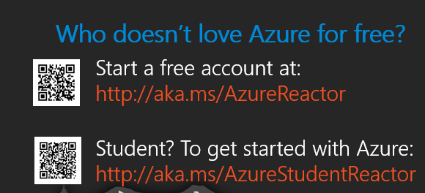

Reactor NYC
@MSFTReactor
#ReactorNYC

