Slide 1


Download the slides at:
https://github.com/bjablonsky/NYCDotNetDevSlides/

Slide 2
Introductions
Co-Organizers
Who’s new?
Brian Jablonsky
Erik Noren

Slide 3
News
Follow us on Twitter: @NYCDotNetDevs
Microsoft Ignite Recap – https://www.microsoft.com/en-us/ignite
Visual Studio Online – https://bit.ly/37dtDG2
ASP.NET Core 3.1 Preview 2 – https://bit.ly/2KjYgje
.NET Core 3.1 Preview 2 – https://bit.ly/32HdPI9
.NET Core with Jupyter Notebooks – https://bit.ly/32RiGqk

Slide 4
Other NYC Meetings
TBA – NY Pluralsight Study Group “TBD” (https://www.meetup.com/NYPluralsightStudy/)
Thursday, November 21st – NYC Mobile .NET Getting started with building a Xamarin.Forms mobile app” (https://www.meetup.com/nycmobiledev/)
Wednesday, November 27th – New York ALT.NET Software Development Group “TBD” (https://www.meetup.com/nyaltnet/)
Thursday, December 12th – NYC PowerShell Meetup “State of the Shell: PowerShell 7” (https://www.meetup.com/NycPowershellMeetup/)

Slide 5
Announcements
Upcoming meetings
Thursday, December 12th – “Black Friday Post-Mortem” with NYC Mobile .NET Developers
Call for presentations!
Have an idea/topic for a presentation?
Want to give a presentation?
Contact Erik (erik@nycdotnetdevs.com) or Brian (brian@nycdotnetdevs.com), or tweet @NYCDotNetDevs

Slide 6
Announcements
Visual Studio For Mac Challenge
Win a free license from GrapeCity, Syncfusion, or Progress, or a $15 voucher for the .NET Foundation store for a t-shirt or sticker pack
Download or update to VS for Mac 8.3
Create or modify an ASP.NET Core site with a web UI
Tweet the UI using @VisualStudioMac along with hashtags #vs4macchallenge #sweepstakes
Started November 5th and goes until November 19th
Winners announced by November 22nd
https://bit.ly/2qdQ7G1

Slide 7
Announcements
.NET Happy Hour
An event happening around NYC offering members an open discussion with other developers about anything and everything over drinks and snacks.
Planning regular Happy Hours for 2019 starting in Q1

Slide 8
Announcements
Community Service Hackathon
We’ve been in discussion with the Teaching Artist Project Cohort (TAP Cohort) to develop an interactive platform to serve teaching artists working in public schools and higher education
Look out for an announcement for a planning session meeting and a Hackathon in Q1 2019
Currently working on securing partnerships
Great way to give back to non-profits in NYC-area
Play with new technology
Looks great on your GitHub account/resume

Slide 9
Announcements
Join us on Slack!
Join the .NET Core Slack group
Already 6,800+ members including many core team members
http://tattoocoder.com/aspnet-slack-sign-up/
Join the #nyc-dotnet-developers channel

Slide 10
Announcements
Twitter
Got a blog post or article on .NET you’d like retweeted?
Have a .NET job opportunity you’re looking to fill?
Got something .NET related?
Follow us on twitter, email us (brian@nycdotnetdevs.com or erik@nycdotnetdevs.com) or DM us on Twitter (@NYCDotNetDevs) with your tweet, and we’ll retweet it!

Slide 11
Job Announcements
Looking for a job?
Looking to hire a developer?
CUNY Tech Prep new grads and interns are looking for Fall 2019 and Spring/Summer 2020 opportunities

Slide 12

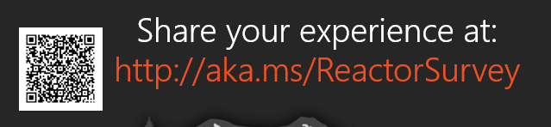
Sponsors
Microsoft Reactor http://microsoftreactor.com
Microsoft Reactors are developer community hubs providing technical events, community networking, and collaboration. They are graciously sponsoring our group in 2019 by providing our meeting space and food! Please fill out the survey at the end of the meeting!

Slide 13

Sponsors
PostSharp http://www.postsharp.net/
Members get a 10% discount on PostSharp licenses (both personal and company orders)
PostSharp is a compiler extension that adds support for patterns to C# and VB. If you’re tired of writing repetitive code, you may want to check it out. It can help you add logging, caching or INotifyPropertyChanged to your codebase without boilerplate, or solve multithreading issues. Customers ranging from Microsoft to Bank of America typically achieve a 15% code reduction thanks to PostSharp.

Slide 14

Sponsors
RevDeBug https://revdebug.com
RevDeBug allows you to inspect past application state and performance profile, even directly from production environments. Trace the root cause of bugs in a matter of seconds, saving your developers' time and sanity.

Slide 15

Alexander Shkabarnya
https://www.linkedin.com/in/ alexander-shkabarnya-296a03a
VP – AQR Capital

Slide 16

Reactor NYC
@MSFTReactor
#ReactorNYC
How was your Meeting?

Slide 17

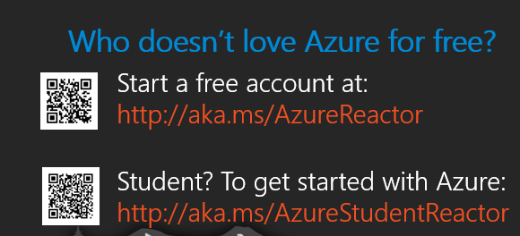

Reactor NYC
@MSFTReactor
#ReactorNYC

