Slide 1
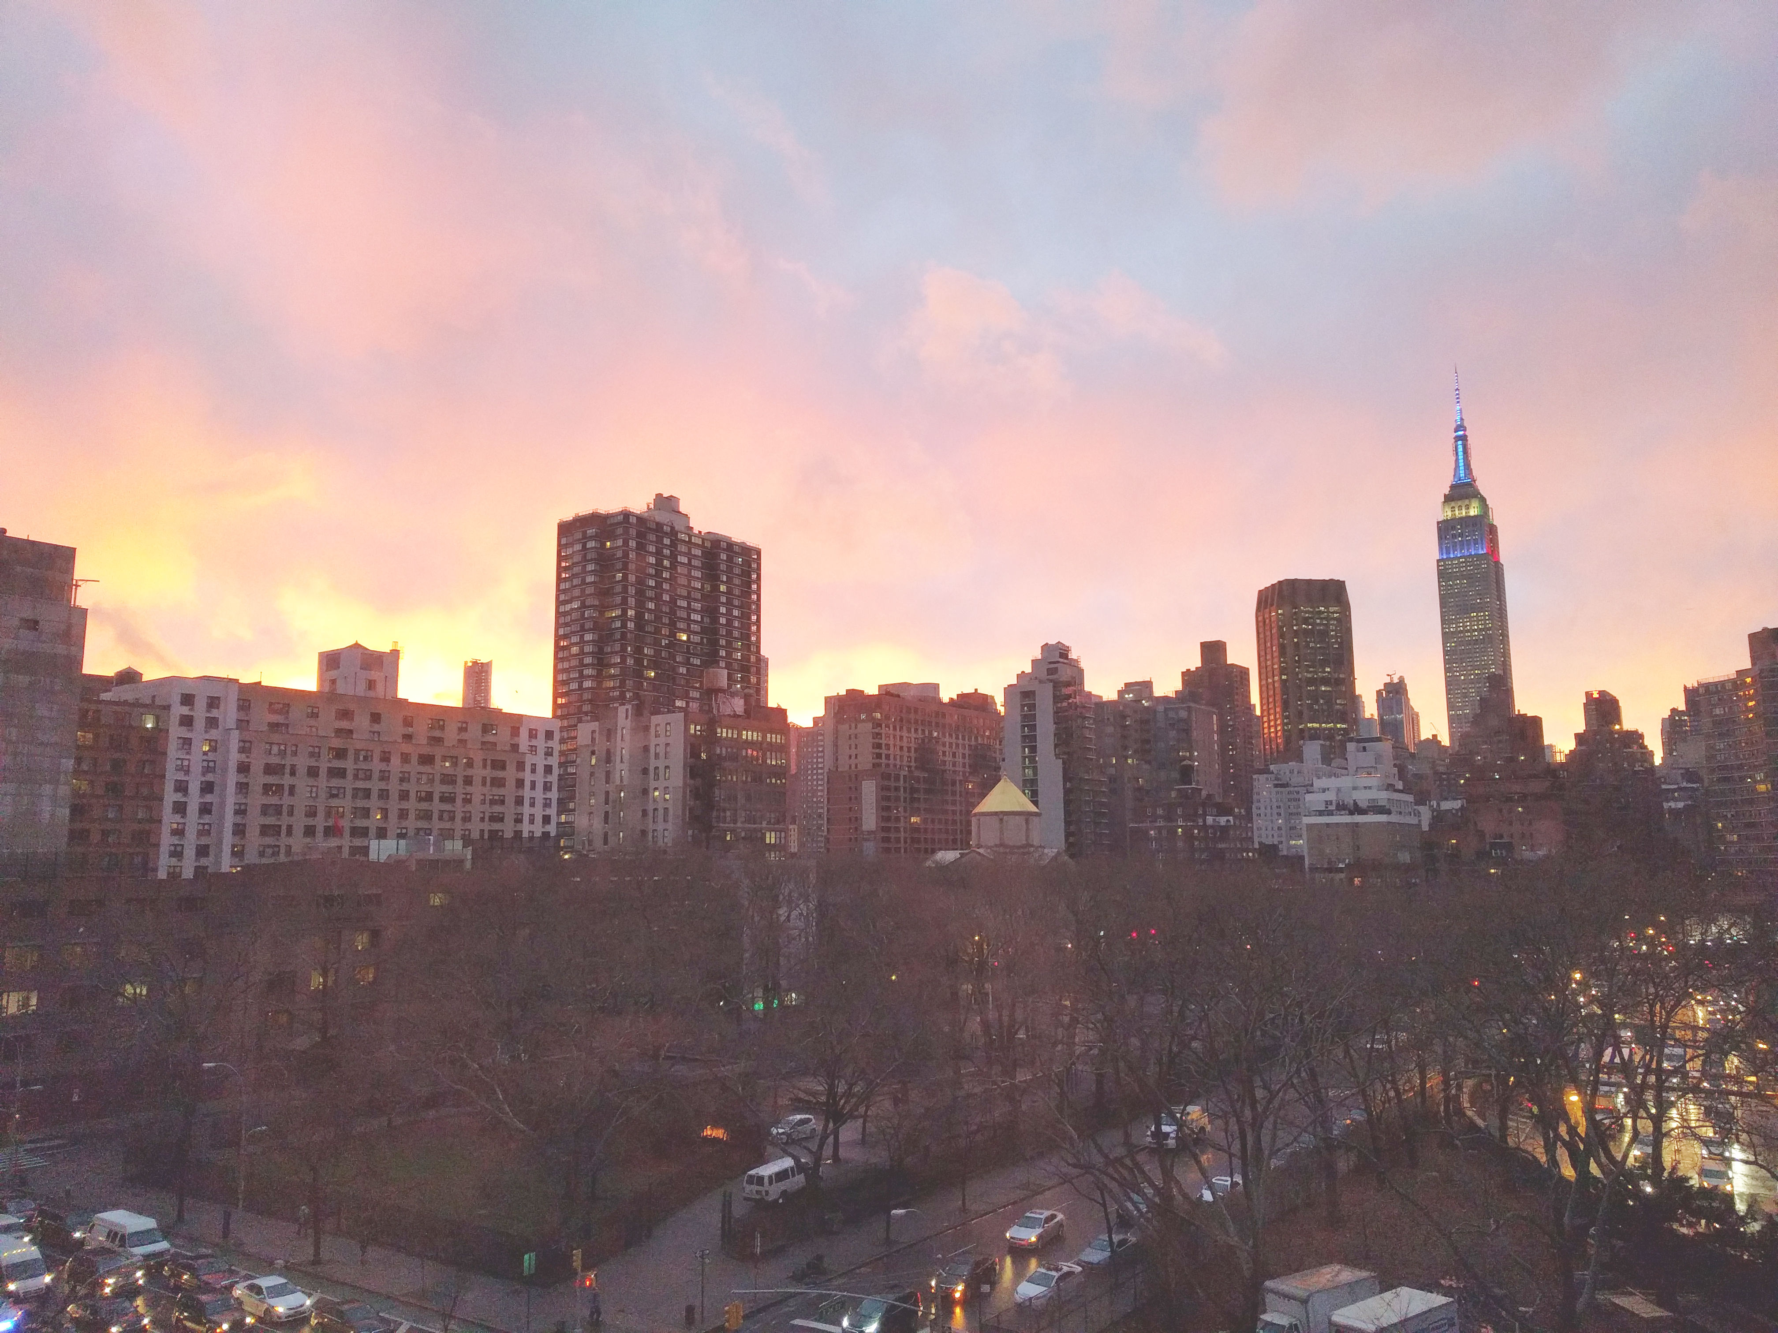


Slide 2
News
Follow us on Twitter: @NYCDotNetDevs
.NET Standard 2.0 - http://bit.ly/2iuekmN
EF Core/ASP.NET/.NET Core 2.0 - http://bit.ly/2fG9D8q
Visual Studio 2017 version 15.3 - http://bit.ly/2n4JCik
Mono 5.2.0 - http://bit.ly/2xwrpi5

Slide 3
Events
Code Camp NYC 2017 http://codecampnyc.org/ Saturday, October 14th, 2017 Session list coming soon!

Slide 4
Events
TechBash 2017 http://techbash.com/ Wednesday, October 4th – Friday, October 6th Pocono Manor, PA $349

Slide 5
Events
AppD Summit NYC 2017 https://summit.appdynamics.com/new-york?ref=meetup Thursday, October 19th Free

Slide 6
Other NYC Meetings
Monday, August 28th and September 4th – NY Pluralsight Study Group "No Meetings – Summer Holiday" (https://www.meetup.com/NYPluralsightStudy/)
Tuesday, September 26th – NYC Mobile .NET "Building a Voice-Driven TV Remote with Azure and Alexa" (https://www.meetup.com/nycmobiledev/)
Wednesday, September 27th – New York ALT.NET Software Development Group "TBD" (https://www.meetup.com/nyaltnet/)
Monday, September 11th - NYC PowerShell Meetup "Windows Server Container Orchestration with Kubernetes" (https://www.meetup.com/NycPowershellMeetup/)
Thursday, August 31st – Microsoft Azure User Group – NYC "Blockchain and Microsoft Azure" (https://www.meetup.com/AzureNYC/)
TBD – Microsoft Makers and App Developers NYC (MMADNYC) "TBD" (https://www.meetup.com/MMADNYC/)
TBD – Microsoft Makers and App Developers NJ (MMADNJ) "TBD" (https://www.meetup.com/MMADNJ/)
Tuesday, August 29th, September 5th, 12th, 19th – NY Microsoft Certification Group (https://www.meetup.com/New-York-Microsoft-Certification-Group/)

Slide 7
Announcements
Call for presentations!
Have an idea/topic for a presentation?
Want to give a presentation?
Contact Erik or Brian, or tweet @NYCDotNetDevs
Upcoming meetings
Thursday, September 21st - "TBA"
Thursday, October 19th - "TBA"
Thursday, November 9th - "TBA" * (Not regular 3rd Thursday)
Thursday, December 14th - "TBA" * (Not regular 3rd Thursday)

Slide 8
Announcements
Lightning Talks!
Interested in giving a quick talk about a topic? We have interest in doing a lightning talk meeting before the end of the year. Please visit the discussion board: http://bit.ly/2pWb3fi
Hackathon?
Interested in participating a hackathon? Let us know on the discussion board: http://bit.ly/2pYXuLk
Discussion Board
Sign up for digest messages for the discussion board
We'll be posting announcements there instead of using emails

Slide 9
Job Announcements
Looking for a job?
Looking to hire a developer?

Slide 10
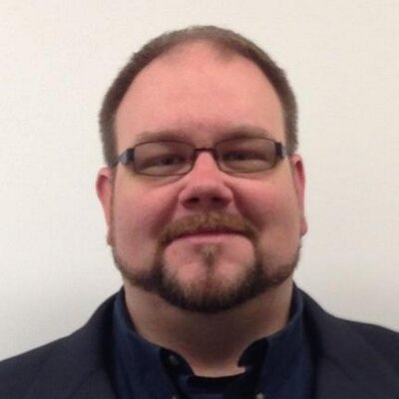
Erik Noren
@ErikNoren
Solutions Architect at Ropes & Gray LLP
20+ years of software development experience
Interested in world languages and most things nerdy

