Slide 1



Slide 2
News
Follow us on Twitter: @NYCDotNetDevs
.NET Framework 4.7.1 - http://bit.ly/2yA4rdQ
Windows 10 Fall Creators Update - http://bit.ly/1FYr6gT
UWP Support for .NET Core 2.0 - http://bit.ly/2xRjtN1
Visual Studio 2017 version 15.4 - http://bit.ly/2y9hjbd

Slide 3
Events
Red Shirt Dev Tour '17 http://aka.ms/newyorkrst Friday, October 20th, 2017 Session list coming soon!

Slide 4
Other NYC Meetings
Monday, October 23rd – NY Pluralsight Study Group "Async and Parallel Programming" (https://www.meetup.com/NYPluralsightStudy/)
Monday, October 23rd – NYC Mobile .NET "Abusing async/await for Fun and Profit" (https://www.meetup.com/nycmobiledev/)
Wednesday, October 25th – New York ALT.NET Software Development Group "TBD" (https://www.meetup.com/nyaltnet/)
Monday, November 13th - NYC PowerShell Meetup "Powershell in Azure Cloud Shell" (https://www.meetup.com/NycPowershellMeetup/)
TBA – Microsoft Azure User Group – NYC "TBD" (https://www.meetup.com/AzureNYC/)
TBA – Microsoft Makers and App Developers NYC (MMADNYC) "TBD" (https://www.meetup.com/MMADNYC/)
TBA – Microsoft Makers and App Developers NJ (MMADNJ) "TBD" (https://www.meetup.com/MMADNJ/)
Tuesday, October 24th, 31st, November 7th, 14th – NY Microsoft Certification Group (https://www.meetup.com/New-York-Microsoft-Certification-Group/)

Slide 5
Announcements
Call for presentations!
Have an idea/topic for a presentation?
Want to give a presentation?
Contact Erik or Brian, or tweet @NYCDotNetDevs
Upcoming meetings
Thursday, November 9th - "Understanding the Real Value of Open Source by Example (nopCommerce)" * (Not regular 3rd Thursday)
Thursday, December 14th - "TBA" * (Not regular 3rd Thursday)

Slide 6
Announcements
Lightning Talks!
Interested in giving a quick talk about a topic? We have interest in doing a lightning talk meeting before the end of the year. Please visit the discussion board: http://bit.ly/2pWb3fi
Hackathon?
Interested in participating a hackathon? Let us know on the discussion board: http://bit.ly/2pYXuLk
Discussion Board
Sign up for digest messages for the discussion board
We'll be posting announcements there instead of using emails

Slide 7
Job Announcements
Looking for a job?
Looking to hire a developer?

Slide 8
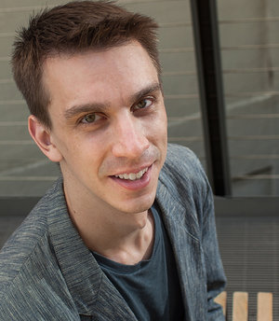
Mark Sowul
https://www.solsoftsolutions.com/
Founder of SolSoft Solutions
Top 5% Overall on Stack Overflow

