Slide 1
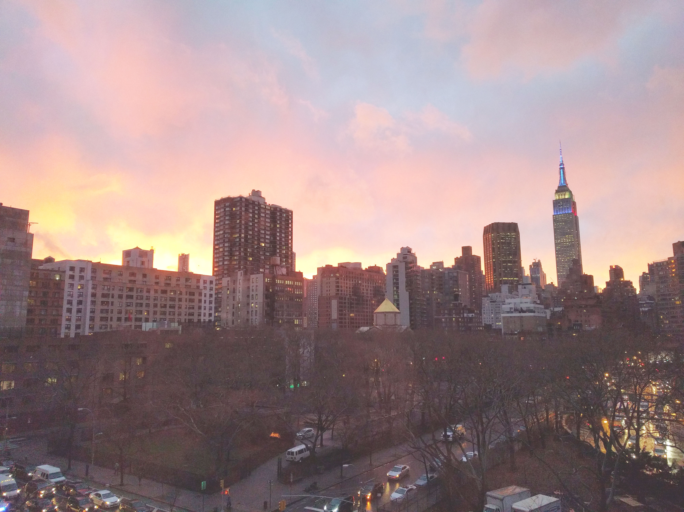


Slide 2
News
Follow us on Twitter: @NYCDotNetDevs
Visual Studio 2017 Version 15.5 - http://bit.ly/2j1N7Fs
Quantum Dev Kit - http://bit.ly/2B4SMFg

Slide 3
Other NYC Meetings
TBA – NY Pluralsight Study Group “TBD" (https://www.meetup.com/NYPluralsightStudy/)
Tuesday, December 19th – NYC Mobile .NET "Monitoring Your Mobile Apps in the Wild" (https://www.meetup.com/nycmobiledev/)
Tuesday, December 27th – New York ALT.NET Software Development Group “TBD" (https://www.meetup.com/nyaltnet/)
Monday, January 8th - NYC PowerShell Meetup "Introduction to Azure LogAnalytics and OMS" (https://www.meetup.com/NycPowershellMeetup/)
TBA – Microsoft Azure User Group – NYC "TBD" (https://www.meetup.com/AzureNYC/)
Tuesday, December 19th – Microsoft Makers and App Developers NYC (MMADNYC) "Reality Mixer, Virtual Escapade, & Augmented Holiday Party” (https://www.meetup.com/MMADNYC/)
Tuesday, December 19th – Microsoft Makers and App Developers NJ (MMADNJ) “Holiday Party" (https://www.meetup.com/MMADNJ/)
TBA – NY Microsoft Certification Group (https://www.meetup.com/New-York-Microsoft-Certification-Group/)

Slide 4
Announcements
Call for presentations!
Have an idea/topic for a presentation?
Want to give a presentation?
Contact Erik or Brian, or tweet @NYCDotNetDevs
Upcoming meetings
In works to get next 6 months scheduled!

Slide 5
Announcements
Lightning Talks!
Interested in giving a quick talk about a topic? We have interest in doing a lightning talk meeting. Please visit the discussion board: http://bit.ly/2pWb3fi
Hackathon?
Interested in participating a hackathon? Let us know on the discussion board: http://bit.ly/2pYXuLk
Sponsorships
Free swag/food coming in 2018!

Slide 6
Job Announcements
Looking for a job?
Looking to hire a developer?

Slide 7
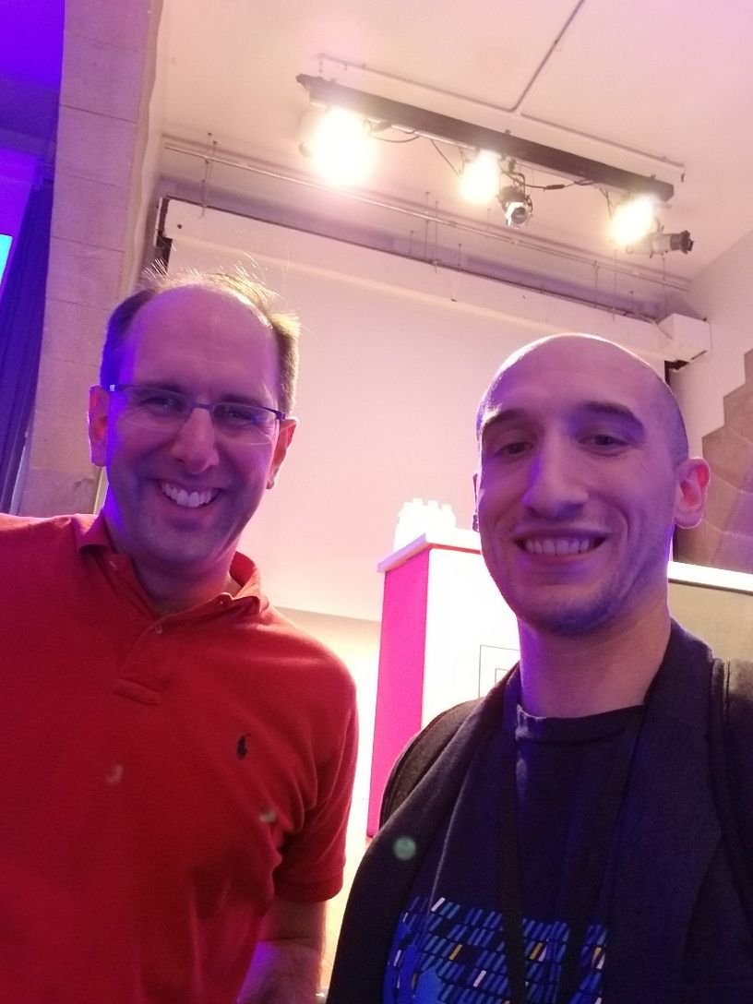
Isaac Levin
https://twitter.com/isaac2004
Application Innovation Engineer at CloudScale Corporation
MCSD and MCSA certified

