Slide 1



Slide 2
News
Follow us on Twitter: @NYCDotNetDevs
.NET Core 2.1 Roadmap - http://bit.ly/2GUXCFg
EF Core 2.1 Roadmap - http://bit.ly/2Hi6k0J
.NET Framework 4.7.2 Early Access build 3052 - http://bit.ly/2EtWOFO
.NET Framework February 2018 Security and Quality Rollup - http://bit.ly/2syr7cZ

Slide 3
Other NYC Meetings
TBA – NY Pluralsight Study Group “TBD" (https://www.meetup.com/NYPluralsightStudy/)
Tuesday, February 20th – NYC Mobile .NET “Signing your code the easy way" (https://www.meetup.com/nycmobiledev/)
Wednesday, February 28th – New York ALT.NET Software Development Group “TBD" (https://www.meetup.com/nyaltnet/)
Monday, March 12th – NYC PowerShell Meetup “Automation Tools for Azure" (https://www.meetup.com/NycPowershellMeetup/)
TBA – Microsoft Azure User Group – NYC "TBD" (https://www.meetup.com/AzureNYC/)
TBA – Microsoft Makers and App Developers NYC (MMADNYC) "TBD" (https://www.meetup.com/MMADNYC/)
TBA – Microsoft Makers and App Developers NJ (MMADNJ) "TBD" (https://www.meetup.com/MMADNJ/)
TBA – NY Microsoft Certification Group (https://www.meetup.com/New-York-Microsoft-Certification-Group/)

Slide 4
Announcements
Call for presentations!
Have an idea/topic for a presentation?
Want to give a presentation?
Contact Erik or Brian, or tweet @NYCDotNetDevs
Upcoming meetings
Tuesday, March 13th – Joint session with NYC Mobile .NET Devs – “Introducing MFractor for Visual Studio Mac” with Matthew Robbins
Thursday, April 19th – “TBD”
Thursday, May 17th – “TBD”
Thursday, June 21st – “TBD”
Thursday, July 19th – “TBD”

Slide 5
Announcements
Lightning Talks!
Interested in giving a quick talk about a topic? We have interest in doing a lightning talk meeting before the end of the year. Please visit the discussion board: http://bit.ly/2pWb3fi
Hackathon?
Interested in participating a hackathon? Let us know on the discussion board: http://bit.ly/2pYXuLk

Slide 6
Moving to Microsoft Reactor?
Is the group interested in moving from 11 Times to Microsoft Reactor?
Microsoft Reactor @ Grand Central Tech 335 Madison Ave New York, NY 10017
Please vote: https://www.meetup.com/NYC-NET-Developers/polls/1262305/ http://bit.ly/2F7aat2

Slide 7
Job Announcements
Looking for a job?
Looking to hire a developer?

Slide 8

Sponsors
PostSharp http://www.postsharp.net/
Members get a 10% discount on PostSharp licenses (both personal and company orders)
PostSharp is a compiler extension that adds support for patterns to C# and VB. If you’re tired of writing repetitive code, you may want to check it out. It can help you add logging, caching or INotifyPropertyChanged to your codebase without boilerplate, or solve multithreading issues. Customers ranging from Microsoft to Bank of America typically achieve a 15% code reduction thanks to PostSharp.

Slide 9
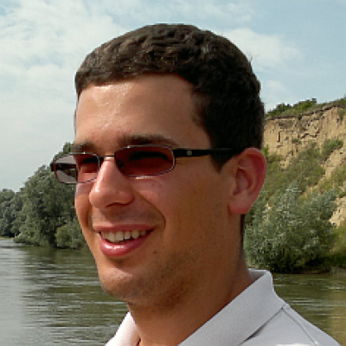
Zoltán Lehóczky
https://twitter.com/zlehoczky
Co-founder at Lombiq Technologies
Open Source contributor to HastLayer, Orchard, and other repos

