Slide 1


Download the slides at: https://github.com/bjablonsky/NYCDotNetDevSlides/tree/master/Slides

Slide 2
Introductions
Co-Organizers
Who’s new?
Brian Jablonsky
Erik Noren

Slide 3
News
Follow us on Twitter: @NYCDotNetDevs
Visual Studio 2019 16.2 – https://bit.ly/2YPOY78
.NET Core 3.0 Preview 7 – https://bit.ly/31rnp1m
EF Core 3.0 Preview 7 – https://bit.ly/2Yx3pgV
ASP.NET Core 3.0 Preview 7 – https://bit.ly/2YVbPdc
ML.NET 1.2 – https://bit.ly/33knjdQ

Slide 4
News
.NET desktop and mobile developer survey
https://bit.ly/2yMPrZa

Slide 5
Other NYC Meetings
TBD – NY Pluralsight Study Group “TBA” (https://www.meetup.com/NYPluralsightStudy/)
Tuesday, August 20th – NYC Mobile .NET “Open Hack Night Study Hours” (https://www.meetup.com/nycmobiledev/)
Wednesday, August 28th – New York ALT.NET Software Development Group “TBA” (https://www.meetup.com/nyaltnet/)
Wednesday, September 25th – NYC PowerShell Meetup “PowerShell and AWS Back to School” (https://www.meetup.com/NycPowershellMeetup/)

Slide 6
Announcements
Upcoming meetings
Thursday, September 12th – TBA
Tuesday, October 1st – “NYC .NET Hacktoberfest 2019”
Thursday, November 14th – TBA
Thursday, December 12th – TBA
Call for presentations!
Have an idea/topic for a presentation?
Want to give a presentation?
Contact Erik (erik@nycdotnetdevs.com) or Brian (brian@nycdotnetdevs.com), or tweet @NYCDotNetDevs

Slide 7
Announcements
.NET Happy Hour
A monthly event happening around NYC offering members a lightning talk on how to boost your developer productivity using various .NET tools, and an open discussion with other developers about anything and everything over drinks and snacks.
In works to plan another!

Slide 8
Announcements
Hackathons
We have 3 non-profits interested in our NYC .NET partnership
Stay tuned for more information!

Slide 9
NYC .NET Hacktoberfest 2019
Free
Tuesday, October 1st, 2019
6PM – 8PM
Microsoft Offices – 11 Times Square
New York City, NY
https://www.meetup.com/NYC-NET-Developers/events/261325823/

Slide 10
Code Camp NYC 2019
Save the date!
CFS until August 31st
Saturday, October 12th
Microsoft Offices – 11 Times Square
New York City, NY
https://codecampnyc.org/

Slide 11
Philly.NET Code Camp 2019
Save the date!
CFS until October 5th
Friday, October 18th - Saturday, October 19th
Microsoft MTC
Mavern, PA
http://phillydotnet.org/2019-2.html

Slide 12
TechBash 2019
Save the date!
November 12th – 15th
Kalahari Resorts
Pocono Manor, Pennsylvania
https://techbash.com/

Slide 13
Announcements
Join us on Slack!
Join the .NET Core Slack group
Already 6,800+ members including many core team members
http://tattoocoder.com/aspnet-slack-sign-up/
Join the #nyc-dotnet-developers channel

Slide 14
Announcements
Twitter
Got a blog post or article on .NET you’d like retweeted?
Have a .NET job opportunity you’re looking to fill?
Got something .NET related?
Follow us on twitter, email us (brian@nycdotnetdevs.com or erik@nycdotnetdevs.com) or DM us on Twitter (@NYCDotNetDevs) with your tweet, and we’ll retweet it!

Slide 15
Job Announcements
Looking for a job?
Looking to hire a developer?
CUNY Tech Prep new grads and interns are looking for Spring/Summer 2019 opportunities
Full Stack .NET Developer – C#/TypeScript/React – UPTOP https://landlords.liveuptop.com/open-positions/full-stack-developer/

Slide 16

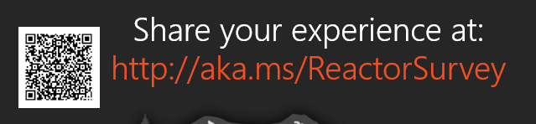
Sponsors
Microsoft Reactor http://microsoftreactor.com
Microsoft Reactors are developer community hubs providing technical events, community networking, and collaboration. They are graciously sponsoring our group in 2019 by providing our meeting space and food! Please fill out the survey at the end of the meeting!

Slide 17

Sponsors
PostSharp http://www.postsharp.net/
Members get a 10% discount on PostSharp licenses (both personal and company orders)
PostSharp is a compiler extension that adds support for patterns to C# and VB. If you’re tired of writing repetitive code, you may want to check it out. It can help you add logging, caching or INotifyPropertyChanged to your codebase without boilerplate, or solve multithreading issues. Customers ranging from Microsoft to Bank of America typically achieve a 15% code reduction thanks to PostSharp.

Slide 18

Sponsors
RevDeBug https://revdebug.com
RevDeBug allows you to inspect past application state and performance profile, even directly from production environments. Trace the root cause of bugs in a matter of seconds, saving your developers' time and sanity.

Slide 19

Luis Quintanilla
https://twitter.com/ljquintanilla
Content Developer - Microsoft
Focusing on AI and ML

Slide 20

Reactor NYC
@MSFTReactor
#ReactorNYC
How was your Meeting?

Slide 21

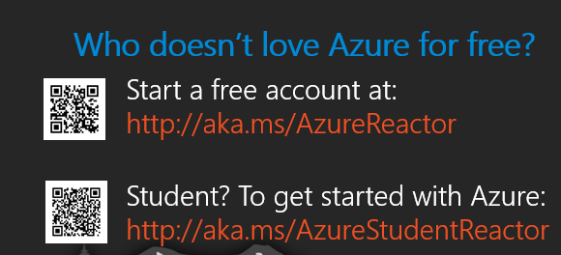

Reactor NYC
@MSFTReactor
#ReactorNYC

