Slide 1



Slide 2
Introductions
Co-Organizers
Who’s new?
Brian Jablonsky
Erik Noren

Slide 3
News
Follow us on Twitter: @NYCDotNetDevs
ML.NET 0.11 Released - https://bit.ly/2O71JSL
.NET Core 3.0 Preview 3 Released - https://bit.ly/2JexJpv
Blazor 0.9.0 Released - https://bit.ly/2TFRTxp
VS 2019 RC Released - https://bit.ly/2T3cWEN

Slide 4
Other NYC Meetings
TBD – NY Pluralsight Study Group “TBA” (https://www.meetup.com/NYPluralsightStudy/)
Tuesday, April 16th – NYC Mobile .NET “Building Xamarin.Forms Mobile Apps Using XAML” (https://www.meetup.com/nycmobiledev/)
Wednesday, March 27th – New York ALT.NET Software Development Group “TBA” (https://www.meetup.com/nyaltnet/)
Tuesday, March 26th – NYC PowerShell Meetup “Azure PowerShell vs. Azure CLI: Duel at the command line” (https://www.meetup.com/NycPowershellMeetup/)

Slide 5
Announcements
Upcoming meetings
Thursday, April 11th – “Azure Pipelines for Developers”
Thursday, May 9th – “Introduction to Kubernetes with Azure Kubernetes Service”
Thursday, June 13th – TBA
Call for presentations!
Have an idea/topic for a presentation?
Want to give a presentation?
Contact Erik (erik@nycdotnetdevs.com) or Brian (brian@nycdotnetdevs.com), or tweet @NYCDotNetDevs

Slide 6
Announcements
.NET Happy Hour
A monthly event happening around NYC offering members a lightning talk on how to boost your developer productivity using various .NET tools, and a chance to network with other developers over drinks.
Tentative dates:
Wednesday, April 17th
Wednesday, May 22nd
Stay tuned for announcement

Slide 7
Announcements
Hackathons
We’ll be scheduling a Hacktoberfest event in October of this year. Stay tuned for more information!
We have 3 non-profits interested in our NYC .NET partnership
We’ll be planning a kick-off event around the summer!
Stay tuned for more information!

Slide 8
Microsoft Build 2019
May 6th – 8th
Washington State Convention Center
Seattle, WA
https://www.microsoft.com/en-us/build

Slide 9
DeveloperWeek NYC
June 17th – 20th
Brooklyn Expo Center
Brooklyn, NYC, NY
https://www.developerweek.com/NYC/

Slide 10
Announcements
Join us on Slack!
Join the .NET Core Slack group
Already 6,800+ members including many core team members
http://tattoocoder.com/aspnet-slack-sign-up/
Join the #nyc-dotnet-developers channel

Slide 11
Announcements
Twitter
Got a blog post or article on .NET you’d like retweeted?
Have a .NET job opportunity you’re looking to fill?
Got something .NET related?
Follow us on twitter, email us (brian@nycdotnetdevs.com or erik@nycdotnetdevs.com) or DM us on Twitter (@NYCDotNetDevs) with your tweet, and we’ll retweet it!

Slide 12
Job Announcements
Looking for a job?
Looking to hire a developer?
CUNY Tech Prep new grads and interns are looking for Spring/Summer 2019 opportunities
Full Stack .NET Developer – C#/TypeScript/React – UPTOP https://landlords.liveuptop.com/open-positions/full-stack-developer/

Slide 13

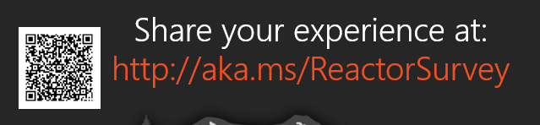
Sponsors
Microsoft Reactor http://microsoftreactor.com
Microsoft Reactors are developer community hubs providing technical events, community networking, and collaboration. They are graciously sponsoring our group in 2019 by providing our meeting space and food! Please fill out the survey at the end of the meeting!

Slide 14

Sponsors
PostSharp http://www.postsharp.net/
Members get a 10% discount on PostSharp licenses (both personal and company orders)
PostSharp is a compiler extension that adds support for patterns to C# and VB. If you’re tired of writing repetitive code, you may want to check it out. It can help you add logging, caching or INotifyPropertyChanged to your codebase without boilerplate, or solve multithreading issues. Customers ranging from Microsoft to Bank of America typically achieve a 15% code reduction thanks to PostSharp.

Slide 15

Sponsors
RevDeBug https://revdebug.com
RevDeBug allows you to inspect past application state and performance profile, even directly from production environments. Trace the root cause of bugs in a matter of seconds, saving your developers' time and sanity.

Slide 16
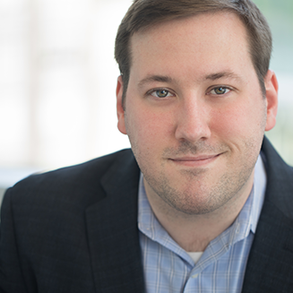
Sean Killeen
https://twitter.com/sjkilleen
.NET Lead at Excella
Currently running for .NET Foundation’s Board of Directors

Slide 17

Reactor NYC
@MSFTReactor
#ReactorNYC
How was your Meeting?

Slide 18
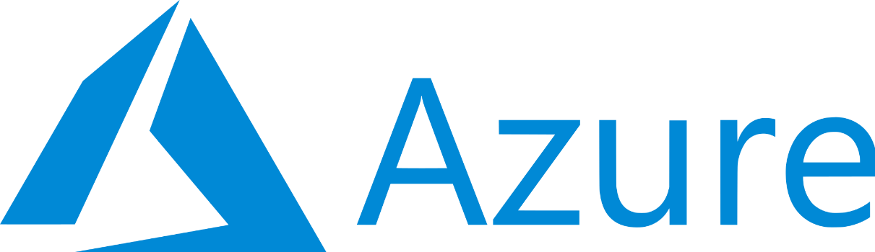
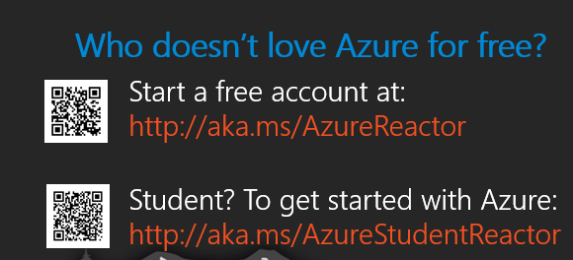

Reactor NYC
@MSFTReactor
#ReactorNYC

