Slide 1



Slide 2
Introductions
Co-Organizers
Who’s new?
Brian Jablonsky
Erik Noren

Slide 3
News
Follow us on Twitter: @NYCDotNetDevs
ML.NET 1.0 RC - https://bit.ly/2UOaMxW
F# 4.6 - https://bit.ly/2KCK33A
Visual Studio 2019 - https://bit.ly/2UGS4Z6
.NET Foundation Board Election - https://bit.ly/2WXFvWG

Slide 4
Other NYC Meetings
Monday, April 15th, April 22nd – NY Pluralsight Study Group “SOLID Principles for C# Developers” (https://www.meetup.com/NYPluralsightStudy/)
Tuesday, April 16th – NYC Mobile .NET “Building Xamarin.Forms Mobile Apps Using XAML” (https://www.meetup.com/nycmobiledev/)
Wednesday, April 24th – New York ALT.NET Software Development Group “TBA” (https://www.meetup.com/nyaltnet/)
Thursday, May 30th – NYC PowerShell Meetup “13 Years in a Shell: Lessons, Practices, and Achievements in PowerShell” (https://www.meetup.com/NycPowershellMeetup/)

Slide 5
Announcements
Upcoming meetings
Thursday, May 9th – “Introduction to Kubernetes with Azure Kubernetes Service”
Thursday, June 13th – TBA
Thursday, July 11th – TBA
Thursday, August 8th – TBA
Thursday, September – TBA
Thursday, October – TBA
Thursday, November 14th – TBA
Thursday, December 12th – TBA
Call for presentations!
Have an idea/topic for a presentation?
Want to give a presentation?
Contact Erik (erik@nycdotnetdevs.com) or Brian (brian@nycdotnetdevs.com), or tweet @NYCDotNetDevs

Slide 6
Announcements
.NET Happy Hour
A monthly event happening around NYC offering members a lightning talk on how to boost your developer productivity using various .NET tools, and a chance to network with other developers over drinks.
Our first .NET Happy Hour: Wednesday, May 22nd
Tentative Dates:
Tuesday, June 18th or 25th
Wednesday, July 24th

Slide 7
Announcements
Hackathons
NYC.NET Hacktoberfest event is confirmed for Tuesday, October 1st, 2019. Official Announcement soon!
We have 3 non-profits interested in our NYC .NET partnership
We’ll be planning a kick-off event around the summer!
Stay tuned for more information!

Slide 8
Microsoft Build 2019
May 6th – 8th
Washington State Convention Center
Seattle, WA
https://www.microsoft.com/en-us/build

Slide 9
Visual Studio 2019 Launch Event
Tuesday, May 21st
7:00 pm – 9:00 pm
Free
Microsoft Technology Center (11 Times Square)
Manhattan, NYC, NY
https://www.meetup.com/nycmobiledev/events/259099870/

Slide 10
OpenHack DevOps
June 17th – 19th
Free
Marriott Marquis Time Square
Manhattan, NYC, NY
https://www.microsoftevents.com/profile/form/index.cfm?PKformID=0x6579112abcd

Slide 11
DeveloperWeek NYC
June 17th – 20th
$495 – After today goes up to $645
Brooklyn Expo Center
Brooklyn, NYC, NY
https://www.developerweek.com/NYC/

Slide 12
TechBash 2019
November 12th – 15th
Kalahari Resorts
Pocono Manor, Pennsylvania
https://techbash.com/

Slide 13
Announcements
Join us on Slack!
Join the .NET Core Slack group
Already 6,800+ members including many core team members
http://tattoocoder.com/aspnet-slack-sign-up/
Join the #nyc-dotnet-developers channel

Slide 14
Announcements
Twitter
Got a blog post or article on .NET you’d like retweeted?
Have a .NET job opportunity you’re looking to fill?
Got something .NET related?
Follow us on twitter, email us (brian@nycdotnetdevs.com or erik@nycdotnetdevs.com) or DM us on Twitter (@NYCDotNetDevs) with your tweet, and we’ll retweet it!

Slide 15
Job Announcements
Looking for a job?
Looking to hire a developer?
CUNY Tech Prep new grads and interns are looking for Spring/Summer 2019 opportunities
Full Stack .NET Developer – C#/TypeScript/React – UPTOP https://landlords.liveuptop.com/open-positions/full-stack-developer/

Slide 16

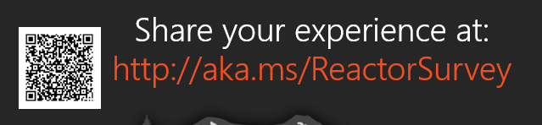
Sponsors
Microsoft Reactor http://microsoftreactor.com
Microsoft Reactors are developer community hubs providing technical events, community networking, and collaboration. They are graciously sponsoring our group in 2019 by providing our meeting space and food! Please fill out the survey at the end of the meeting!

Slide 17

Sponsors
PostSharp http://www.postsharp.net/
Members get a 10% discount on PostSharp licenses (both personal and company orders)
PostSharp is a compiler extension that adds support for patterns to C# and VB. If you’re tired of writing repetitive code, you may want to check it out. It can help you add logging, caching or INotifyPropertyChanged to your codebase without boilerplate, or solve multithreading issues. Customers ranging from Microsoft to Bank of America typically achieve a 15% code reduction thanks to PostSharp.

Slide 18

Sponsors
RevDeBug https://revdebug.com
RevDeBug allows you to inspect past application state and performance profile, even directly from production environments. Trace the root cause of bugs in a matter of seconds, saving your developers' time and sanity.

Slide 19

André Barnes
https://twitter.com/aqbhectic
Independent Consultant
Just got back from a 3 month remote work adventure in India and Sri Lanka

Slide 20

Reactor NYC
@MSFTReactor
#ReactorNYC
How was your Meeting?

Slide 21

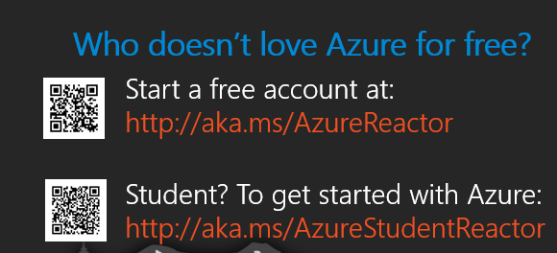

Reactor NYC
@MSFTReactor
#ReactorNYC

