Slide 1



Slide 2
Introductions
Co-Organizers
Who’s new?
Brian Jablonsky
Erik Noren

Slide 3
News
Follow us on Twitter: @NYCDotNetDevs
BUILD 2019 - https://bit.ly/2o5upz4
Visual Studio 2019 16.1 Preview 3 - https://bit.ly/2YnHioN
Windows Terminal - https://bit.ly/2V3Tid1
Windows Subsystem for Linux 2 - https://bit.ly/2V8IU3D
Introducing .NET 5 - https://bit.ly/2vE13Mk
.NET Core is the future of .NET - https://bit.ly/2J41EzN
.NET Core 3.0 Preview 5 - https://bit.ly/2Y9r4zl

Slide 4
Other NYC Meetings
Monday, May 13th – NY Pluralsight Study Group “What’s New in Visual Studio 2019” (https://www.meetup.com/NYPluralsightStudy/)
Tuesday, May 21st – NYC Mobile .NET “Visual Studio 2019 Launch Event” (https://www.meetup.com/nycmobiledev/)
Wednesday, May 22nd – New York ALT.NET Software Development Group “TBA” (https://www.meetup.com/nyaltnet/)
Thursday, May 30th – NYC PowerShell Meetup “13 Years in a Shell: Lessons, Practices, and Achievements in PowerShell” (https://www.meetup.com/NycPowershellMeetup/)

Slide 5
Announcements
Upcoming meetings
Thursday, June 13th – “ML.NET In Action”
Thursday, July 11th – TBA
Thursday, August 8th – TBA
Thursday, September – TBA
Thursday, October – TBA
Thursday, November 14th – TBA
Thursday, December 12th – TBA
Call for presentations!
Have an idea/topic for a presentation?
Want to give a presentation?
Contact Erik (erik@nycdotnetdevs.com) or Brian (brian@nycdotnetdevs.com), or tweet @NYCDotNetDevs

Slide 6
Announcements
.NET Happy Hour
A monthly event happening around NYC offering members a lightning talk on how to boost your developer productivity using various .NET tools, and a chance to network with other developers over drinks.
Our first .NET Happy Hour: Wednesday, May 22nd
Visual Studio Code Live Share
WeWork Penn Station
315 W 36th Street
6PM – 7PM
https://www.meetup.com/NYC-NET-Developers/events/261325891/

Slide 7
Announcements
NYC.NET Hacktoberfest
Tuesday, October 1st, 2019
6PM – 8PM
Microsoft Offices @ 11 Times Square
https://www.meetup.com/NYC-NET-Developers/events/261325823/

Slide 8
Announcements
Hackathons
We have 3 non-profits interested in our NYC .NET partnership
We’ll be planning a kick-off event around the summer!
Stay tuned for more information!

Slide 9
Visual Studio 2019 Launch Event
Tuesday, May 21st
7:00 pm – 9:00 pm
Free
Microsoft Technology Center (11 Times Square)
Manhattan, NYC, NY
https://www.meetup.com/nycmobiledev/events/259099870/

Slide 10
OpenHack DevOps
June 17th – 19th
Free
Marriott Marquis Time Square
Manhattan, NYC, NY
https://www.microsoftevents.com/profile/form/index.cfm?PKformID=0x6579112abcd

Slide 11
DeveloperWeek NYC
June 17th – 20th
PRO Pass - $645
We have free OPEN passes for developers!
Brooklyn Expo Center
Brooklyn, NYC, NY
https://www.developerweek.com/NYC/

Slide 12
TechBash 2019
November 12th – 15th
Kalahari Resorts
Pocono Manor, Pennsylvania
https://techbash.com/

Slide 13
Announcements
Join us on Slack!
Join the .NET Core Slack group
Already 6,800+ members including many core team members
http://tattoocoder.com/aspnet-slack-sign-up/
Join the #nyc-dotnet-developers channel

Slide 14
Announcements
Twitter
Got a blog post or article on .NET you’d like retweeted?
Have a .NET job opportunity you’re looking to fill?
Got something .NET related?
Follow us on twitter, email us (brian@nycdotnetdevs.com or erik@nycdotnetdevs.com) or DM us on Twitter (@NYCDotNetDevs) with your tweet, and we’ll retweet it!

Slide 15
Job Announcements
Looking for a job?
Looking to hire a developer?
CUNY Tech Prep new grads and interns are looking for Spring/Summer 2019 opportunities
Full Stack .NET Developer – C#/TypeScript/React – UPTOP https://landlords.liveuptop.com/open-positions/full-stack-developer/

Slide 16

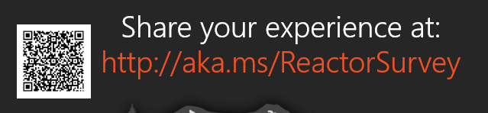
Sponsors
Microsoft Reactor http://microsoftreactor.com
Microsoft Reactors are developer community hubs providing technical events, community networking, and collaboration. They are graciously sponsoring our group in 2019 by providing our meeting space and food! Please fill out the survey at the end of the meeting!

Slide 17

Sponsors
PostSharp http://www.postsharp.net/
Members get a 10% discount on PostSharp licenses (both personal and company orders)
PostSharp is a compiler extension that adds support for patterns to C# and VB. If you’re tired of writing repetitive code, you may want to check it out. It can help you add logging, caching or INotifyPropertyChanged to your codebase without boilerplate, or solve multithreading issues. Customers ranging from Microsoft to Bank of America typically achieve a 15% code reduction thanks to PostSharp.

Slide 18

Sponsors
RevDeBug https://revdebug.com
RevDeBug allows you to inspect past application state and performance profile, even directly from production environments. Trace the root cause of bugs in a matter of seconds, saving your developers' time and sanity.

Slide 19

Jason L. van Brackel
https://twitter.com/JasonvanBrackel
Directory of Community – Rancher Labs
Kubernetes Philly Meetup Organizer

Slide 20

Reactor NYC
@MSFTReactor
#ReactorNYC
How was your Meeting?

Slide 21

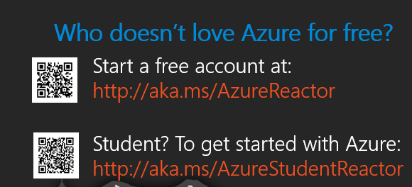

Reactor NYC
@MSFTReactor
#ReactorNYC

