Slide 1
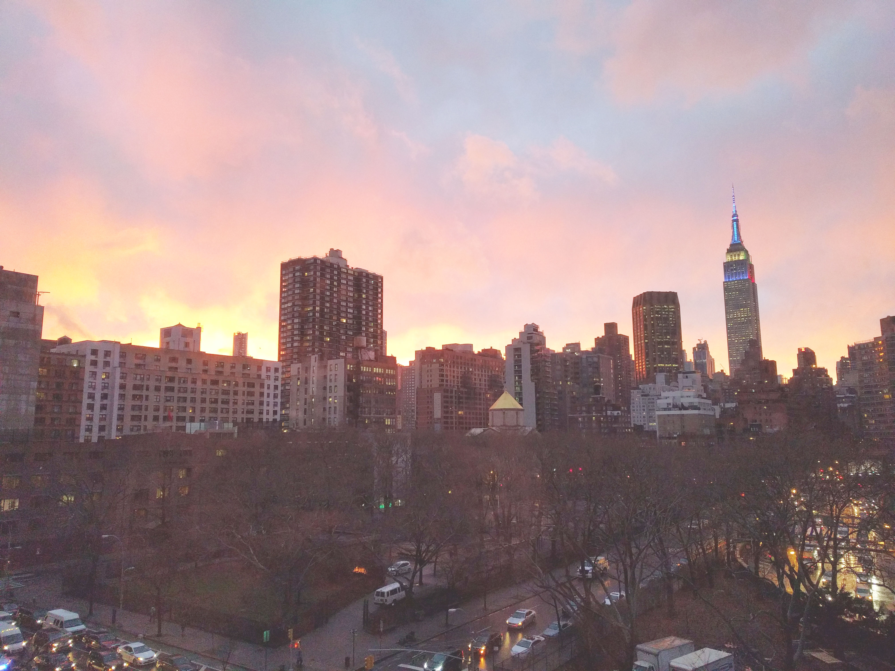

Download the slides at: https://github.com/bjablonsky/NYCDotNetDevSlides/tree/master/Slides

Slide 2
Introductions
Co-Organizers
Who’s new?
Brian Jablonsky
Erik Noren

Slide 3
News
Follow us on Twitter: @NYCDotNetDevs
Visual Studio 2019 16.1 – https://bit.ly/2IeAwfG
.NET Core 3.0 Preview 6 – https://bit.ly/2XIHbE5
ML.NET 1.1 – https://bit.ly/2KTk4TE
Try .NET – https://bit.ly/2LPQlgJ
ASP.NET Core 3.0 Preview 6 – https://bit.ly/2RfM313

Slide 4
Other NYC Meetings
Monday, June 17th – NY Pluralsight Study Group “Using Git for Source Control in Visual Studio 2019” (https://www.meetup.com/NYPluralsightStudy/)
Tuesday, June 18th – NYC Mobile .NET “Open Hack Night Study Hours” (https://www.meetup.com/nycmobiledev/)
Wednesday, June 26th – New York ALT.NET Software Development Group “TBA” (https://www.meetup.com/nyaltnet/)
TBD – NYC PowerShell Meetup “TBA” (https://www.meetup.com/NycPowershellMeetup/)

Slide 5
Announcements
Upcoming meetings
Monday, July 15th – “Observability-Driven Development” *Note: different date*
Thursday, August 8th – TBA
Thursday, September – TBA
Tuesday, October 1st – “NYC .NET Hacktoberfest 2019”
Thursday, November 14th – TBA
Thursday, December 12th – TBA
Call for presentations!
Have an idea/topic for a presentation?
Want to give a presentation?
Contact Erik (erik@nycdotnetdevs.com) or Brian (brian@nycdotnetdevs.com), or tweet @NYCDotNetDevs

Slide 6
Announcements
.NET Happy Hour
A monthly event happening around NYC offering members a lightning talk on how to boost your developer productivity using various .NET tools, and an open discussion with other developers about anything and everything over drinks and snacks.
Our first .NET Happy Hour was Wednesday, May 22nd
Interested in another? Let us know

Slide 7
Announcements
Hackathons
We have 3 non-profits interested in our NYC .NET partnership
We’ll be planning a kick-off event around the summer!
Stay tuned for more information!

Slide 8
OpenHack DevOps
Free
June 17th – 19th
Marriott Marquis Time Square
New York City, NY
https://www.microsoftevents.com/profile/form/index.cfm?PKformID=0x6579112abcd

Slide 9
DeveloperWeek NYC
Free/Paid
June 17th – 20th
Brooklyn Expo Center
Brooklyn, NY
https://www.developerweek.com/NYC/
PRO Pass - $645
We have free OPEN passes for developers!

Slide 10
Insider Dev Tour NYC 2019
Free (includes light breakfast, lunch, snacks, and prizes)
Saturday, June 29th
8AM – 6PM
Microsoft Offices – 11 Times Square
New York City, NY
https://developer.microsoft.com/en-us/windows/campaigns/us-ny-nyc

Slide 11
NYC .NET Hacktoberfest 2019
Free
Tuesday, October 1st, 2019
6PM – 8PM
Microsoft Offices – 11 Times Square
New York City, NY
https://www.meetup.com/NYC-NET-Developers/events/261325823/

Slide 12
Code Camp NYC 2019
Save the date!
Saturday, October 12th
Microsoft Offices – 11 Times Square
New York City, NY
https://codecampnyc.org/

Slide 13
TechBash 2019
Save the date!
November 12th – 15th
Kalahari Resorts
Pocono Manor, Pennsylvania
https://techbash.com/

Slide 14
Announcements
Join us on Slack!
Join the .NET Core Slack group
Already 6,800+ members including many core team members
http://tattoocoder.com/aspnet-slack-sign-up/
Join the #nyc-dotnet-developers channel

Slide 15
Announcements
Twitter
Got a blog post or article on .NET you’d like retweeted?
Have a .NET job opportunity you’re looking to fill?
Got something .NET related?
Follow us on twitter, email us (brian@nycdotnetdevs.com or erik@nycdotnetdevs.com) or DM us on Twitter (@NYCDotNetDevs) with your tweet, and we’ll retweet it!

Slide 16
Job Announcements
Looking for a job?
Looking to hire a developer?
CUNY Tech Prep new grads and interns are looking for Spring/Summer 2019 opportunities
Full Stack .NET Developer – C#/TypeScript/React – UPTOP https://landlords.liveuptop.com/open-positions/full-stack-developer/

Slide 17

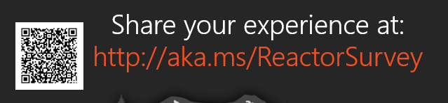
Sponsors
Microsoft Reactor http://microsoftreactor.com
Microsoft Reactors are developer community hubs providing technical events, community networking, and collaboration. They are graciously sponsoring our group in 2019 by providing our meeting space and food! Please fill out the survey at the end of the meeting!

Slide 18

Sponsors
PostSharp http://www.postsharp.net/
Members get a 10% discount on PostSharp licenses (both personal and company orders)
PostSharp is a compiler extension that adds support for patterns to C# and VB. If you’re tired of writing repetitive code, you may want to check it out. It can help you add logging, caching or INotifyPropertyChanged to your codebase without boilerplate, or solve multithreading issues. Customers ranging from Microsoft to Bank of America typically achieve a 15% code reduction thanks to PostSharp.

Slide 19

Sponsors
RevDeBug https://revdebug.com
RevDeBug allows you to inspect past application state and performance profile, even directly from production environments. Trace the root cause of bugs in a matter of seconds, saving your developers' time and sanity.

Slide 20

Luis Quintanilla
https://twitter.com/ljquintanilla
Content Developer - Microsoft
Focusing on AI and ML

Slide 21

Reactor NYC
@MSFTReactor
#ReactorNYC
How was your Meeting?

Slide 22

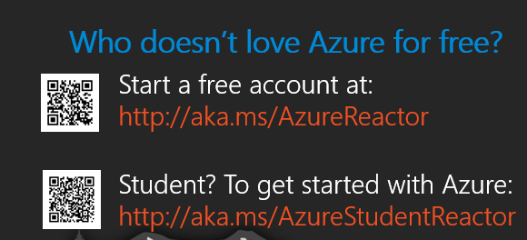

Reactor NYC
@MSFTReactor
#ReactorNYC

