Slide 1
Visual Studio 2022 Productivity Tips and Tricks
https://github.com/bjablonsky/VS2022ProductivityTipsAndTricks-devup2022

Slide 2

About Me
Brian Jablonsky
10+ years of professional experience
.NET Developer
Former Microsoft MVP
Currently @Microsoft
Co-organizer of NYC .NET Dev User Group
@brian_jablonsky
https://github.com/bjablonsky

Slide 3
Overview
Improved Performance
Hot Reload
Updated Languages and Frameworks
Improved Git Tooling
Faster Developer Inner Loop
Better Debugging and Testing
VS Live Share

Slide 4
Improved Performance
VS 2022 is now 64-bit!
Load large projects faster
VS2019: ~40 seconds
VS2022: ~15 seconds
Find in files is now over 3x faster

Slide 5
Hot Reload
While debugging, edit your code without having to restart the debugger!!!!!!!
Basic hot reload works with VS 2022 and most .NET workloads (.NET Framework, .NET Core, .NET 5+), most app types (console, WPF, WinForms, UWP, ASP.NET), and most languages (C++, VS, C#)
Works best with Visual Studio 2022 and .NET 6

Slide 6
Hot Reload

Slide 7
Updated Languages/Frameworks
.NET 6
LTS (3 years updates)
Unified .NET Platform
Massive performance improvements over .NET 5
C# 10/F# 6
New minimal APIs
Top level statements
Improved Blazor functionality (AOT compilation, render components from JS)
HTTP/3
Single File Apps

Slide 8
Updated Languages/Frameworks
.NET MAUI
Build native apps for Android, iOS, macOS, and Windows from a single codebase
Use Blazor hybrid to write you app across web, mobile, and desktop devices
Latest C++ build tools and C++20 support

Slide 9
Multi-repo Branching
Visual Studio now allows you to work on a solution that has projects hosted across multiple repos
No more launching different VS instances to commit your changes
Commit your changes across all the repos with a single click
Manage your branches of different repos all from 1 instance of VS 2022 – amend, stash, branch switching, push, pull, and sync

Slide 10
Git Line Staging
It’s now possible to stage and commit only certain lines of file right from Visual Studio
Helps split your changes across different commits

Slide 11
Microsoft Dev Box
(preview)
New cloud service to provide developers with ready-to-code configurable Windows developer workstations
Have standardized configurations for all kinds of different applications
No more worrying about applying updates that might break your dev box
Scale your development workstations as needed

Slide 12
Edge Developer Tools for VS
(preview)
Use the Edge Developer Tool right inside Visual Studio 2022 to make edits to your CSS/HTML and have those edits save to your underlying source files

Slide 13
IntelliCode
Visual Studio 2022 now supports automatically completing up to an entire line of code based off your:
Variable names and positions
Type of code your writing (based off the libraries your using, etc)
Functions in code nearby
IntelliSense
New support for Quick Action recommendations based off common coding tasks

Slide 14
Web Forms Live Preview
Web Forms now supports having a Web Live Preview pane previewing what the output of your code will look like
Limited initial feature support:
Preview using live data instead of “placeholder” data
Selecting controls on the live preview pane navigates to the source
Live updates from the preview pane back to the source
More features being added

Slide 15
Force Run To Cursor
Finally, you can skip all your breakpoints and force your code to run to a certain area with having to remove or disable your breakpoints with the new “Force Run To Cursor” debugging feature

Slide 16
Breakpoints
New type of breakpoint called Dependent Breakpoints allows you to configure a breakpoint to be enabled only if another breakpoint is hit
New context menu from the Breakpoint Gutter to create advanced breakpoints
New Temporary Breakpoint allows you to create a breakpoint that only triggers once
Now drag and drop breakpoints

Slide 17
Attach to Process Improvements
Added a new “Auto-refresh” checkbox to the Attach to Process dialog
Added command-line and AppPool details to the Attach to Process dialog
Added Azure App Service support!

Slide 18
Sync Namespaces
New context menu option in the Solution Explorer to synchronize your namespaces in your project to match your folder structure

Slide 19
Remove Unused Namespaces
New context menu option in the Solution Explorer to remove all the used namespaces from your code in your project

Slide 20
EditorConfig
A configuration file that you can add to your codebase to enforce consistent coding styles for everyone
Tons of updates for the UI configuration window in VS 2022
Finally, you can force your colleague that loves spaces to use tabs!

Slide 21
Improved Testing Tools
Quickly switch from the editor to the test in the Test Explorer with the new Show in Test Explorer
Test Explorer now supports the output of Console.WriteLine() in the test detail pane
Remote testing with Linux containers, WSL, and over SSH connections
Test your web app’s UI with Playwright whether you’re writing C#, JavaScript, Python, or Java

Slide 22
Live Unit Testing
(preview)
Available in VS 2022 Enterprise
As your coding, Live Unit Testing runs your tests against the code changes your making in the background
Live Unit Testing provides immediate visual feedback if a certain line of code causes your unit tests to pass or fail
Write better and faster code with less bugs

Slide 23
VS Live Share
Not new to VS 2022 but one of the best features ever introduced in Visual Studio
Added text chat in Visual Studio 2022
Debug someone else’s code remotely from your own development setup
Supports VS Code and Visual Studio
Has built-in voice calling
Invite multiple people to a Live Share session

Slide 24
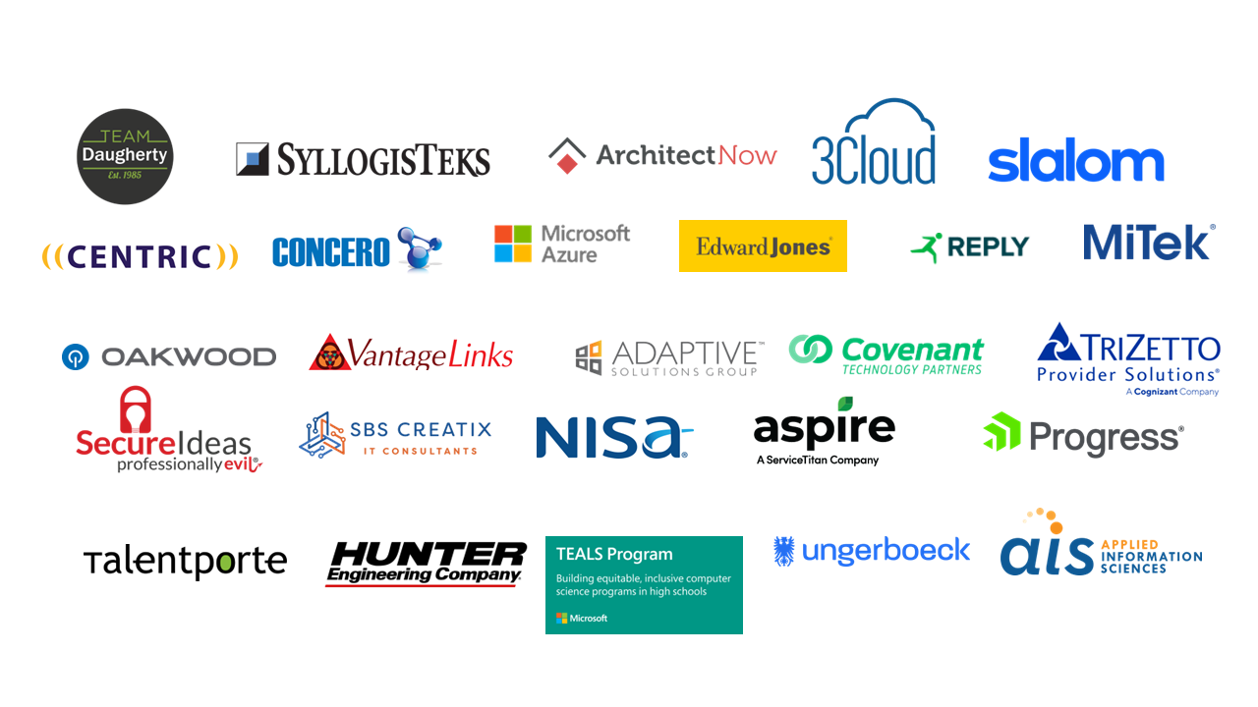
Thanks To Our Sponsors!

Slide 25


Slide 26
Additional Information
Link to slides
https://github.com/bjablonsky/VS2022ProductivityTipsAndTricks-devup2022
Visual Studio Blog
https://devblogs.microsoft.com/visualstudio/
Survey
https://forms.office.com/r/KnTKdX1PNC

