Slide 1
Blazor
An experimental .NET framework for the browser
Brian Jablonsky

Slide 2
Overview
What is Blazor?
How Blazor Works
WebAssembly Crash Course
Why?
Features
Roadmap
FAQ
Code Examples
Questions

Slide 3

DANGER, WILL ROBINSON!
Blazor is experimental!
0.1.0 was released just 28 days ago!
NSFW!

Slide 4
What is Blazor?
A .NET web framework that runs in the browser
Use C#/Razor to author
Runs on a .NET runtime implemented in WebAssembly
Browser + Razor = Blazor

Slide 5
How Blazor Works
C# and Razor code files are compiled into .NET assemblies
Assemblies and .NET runtime are downloaded on the browser
Blazor uses JavaScript to bootstrap the .NET runtime (Mono) loading the required assembly references
Blazor allows DOM manipulation/browser API calls from the .NET runtime via JavaScript interoperability

Slide 6
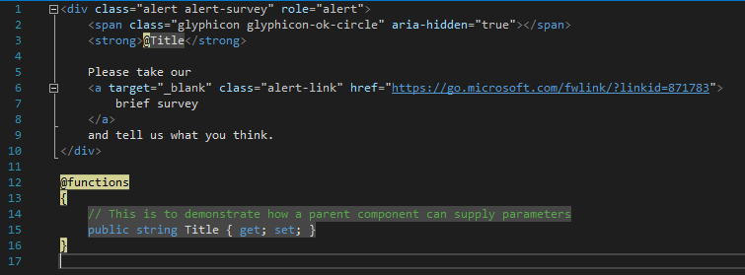
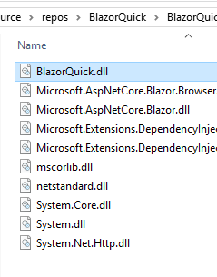
How Blazor Works
C# and Razor code files are compiled into .NET assemblies

Slide 7
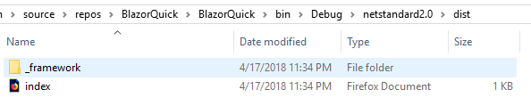
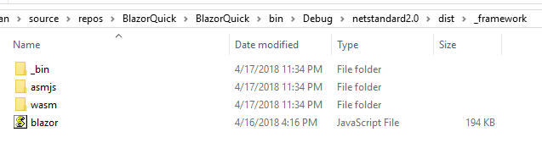
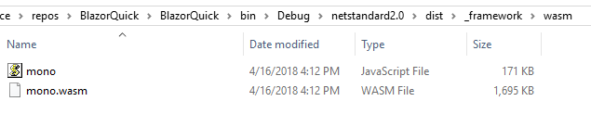
How Blazor Works
Assemblies and .NET runtime are downloaded on the browser

Slide 8
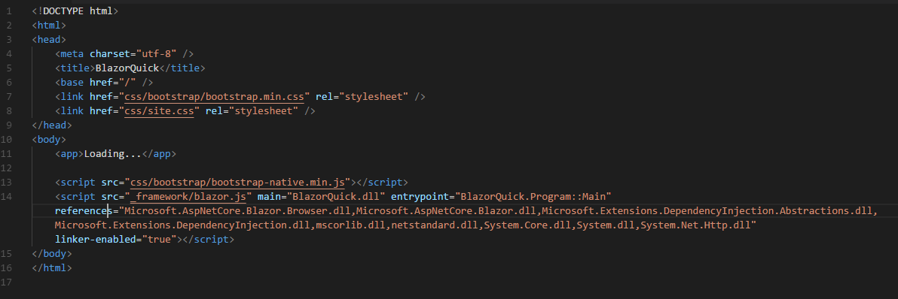
How Blazor Works
Blazor uses JavaScript to bootstrap the .NET runtime loading the required assembly references

Slide 9
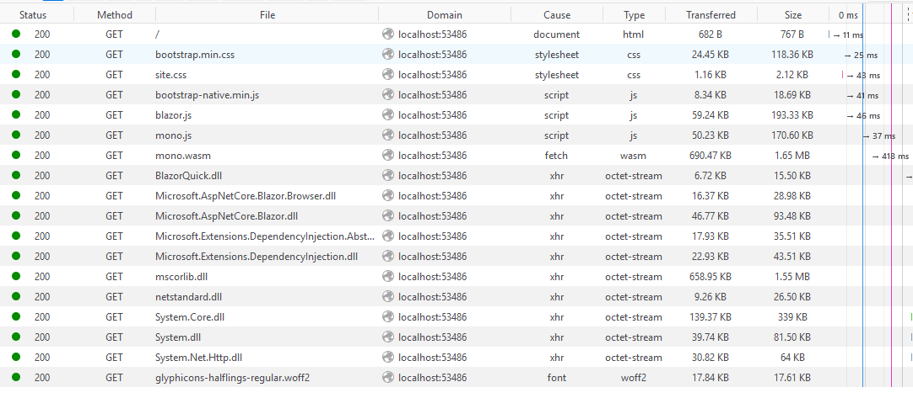
How Blazor Works
Blazor uses JavaScript to bootstrap the .NET runtime loading the required assembly references

Slide 10
How Blazor Works
Blazor allows DOM manipulation/browser API calls from the .NET runtime via JavaScript interoperability
C#
Render Tree
Blazor JavaScript
Change DOM
DOM
C#
Event Trigger
Process Event
Blazor JavaScript
Change DOM
DOM
UI Differences

Slide 11
WebAssembly Crash Course
WebAssembly (wasm) is a binary instruction format for a stack-based virtual machine
New type of code that can be run in a browser
Developed out of performance problems from JavaScript

Slide 12
WebAssembly Crash Course
WebAssembly Goals:
Fast, efficient, and portable
Wasm code can be executed at near-native speed in the browser
Readable and debuggable
Wasm code is a low-level assembly language but is in a human-readable text format
Secure
Designed to run in a safe, sandboxed execution environment like JavaScript in the browser

Slide 13
WebAssembly Crash Course
The web platform consists of two parts:
A virtual machine to run code
Set of APIs to control the browser
Traditionally, the browser’s VM has only been able to load JavaScript
WebAssembly adds an additional VM to run a compact binary format

Slide 14
WebAssembly Crash Course
WebAssembly is not meant to replace JavaScript
Intended to be a compilation target of source languages
WebAssembly can’t directly access the DOM
C/C++/C# source code
wasm module
HTML
Wasm compiler
JavaScript “glue” code

Slide 15
Why?
Full Stack development using C# and .NET
.NET advantages:
High Performance
Scalability
Maintainability
Cross Platform
Visual Studio
Notes:
https://www.techempower.com/benchmarks/#section=data-r15&hw=ph&test=plaintext&l=hra0al

Slide 16
Features
Component model for building composable UI
Routing
Layouts
Forms and validation
Dependency injection
JavaScript interop
Live reloading in the browser during development
Server-side rendering

Slide 17
Features
Full .NET debugging both in browsers and in the IDE
Rich IntelliSense and tooling
Ability to run on older (non-WebAssembly) browsers via asm.js
Publishing and app size trimming

Slide 18
Roadmap
March 2017 – WebAssembly announces 1.0
August 2017 – Mono announces prototype WebAssembly
February 2018 – Blazor is publicly available

Slide 19
Roadmap
March 22, 2018 – Blazor 0.1.0 is released
Support @page with custom route template on components
Standard BCL HttpClient
Add ASP.NET Core hosted project template
VS Blazor editor
Basic JavaScript interop
Publishing
Development host
Compilation

Slide 20
Roadmap
April 17, 2018 – Blazor 0.2.0 is released
Improved event handling
Build reusable component libraries
Improved JavaScript interop

Slide 21
Roadmap
Beyond 0.2.0
Finish Component Model
ASP.NET Core Blazor Language Services for Mac
Forms and Validations
Client-side Debugging
Real-time web client (SignalR/Web Sockets)
Testing/Tests
Routing Enhancements
Security/Authorization
State Management

Slide 22
FAQ
Does Blazor compile my entire .NET assembly into WebAssembly?
No.
Only .NET runtime is compiled into WebAssembly.
Could be support for full static ahead-of-time compilation into WebAssembly in the future.

Slide 23
FAQ
Won’t the app size huge for the .NET runtime?
Not really.
Runs on full Mono Desktop profile right now.
Plans to reduce size by using custom profile.

Slide 24
FAQ
Can I use Blazor without .NET backend?
Yup.
Can be deployed as set of static files.

Slide 25
Setup
WebAssembly compatible browser
https://platform-status.mozilla.org/#web-assembly
.NET Core 2.1 Preview 2 SDK
At least v.2.1.300-preview2-008533
https://www.microsoft.com/net/download/dotnet-core/sdk-2.1.300-preview2
Visual Studio 2017 Preview (15.7)
https://www.visualstudio.com/vs/preview
ASP.NET Core Blazor Language Services extension
https://go.microsoft.com/fwlink/?linkid=870389

Slide 26
Setup
Visual Studio Code/command line
dotnet new -i Microsoft.AspNetCore.Blazor.Templates
dotnet new blazor

Slide 27
Code Example
New Project

Slide 28
Components
Fundamental building block of web apps
Components are self-contained UI
Includes HTML and logic to inject data or respond to events
They can be nested, reused, and shared between projects
Written using C#/Razor and HTML

Slide 29
Code Example
Components

Slide 30
Layouts
Layouts are really just components
Defined in a Razor template
Must implement the Microsoft.AspNetCore.Blazor.Layouts.ILayoutComponent component
Adds a Body property that contains the content to be rendered
Allows for nested layouts

Slide 31
Code Example
Layouts

Slide 32
Routes
Handles internal routing of pages
Router is configured in App.cshtml
Uses the @Page directive defined in the Pages
Can have multiple routes
Can contain parameters

Slide 33
Code Example
Routes

Slide 34
Data Binding
Supports one-way and two-way data binding
Binding using the bind= attribute
Support for binding data types:
Int
String
DateTime
Enums
Bool
If you need another type, you must provide a getter/setter.

Slide 35
Code Example
Data binding

Slide 36
JavaScript Interop
Supports calling JavaScript from inside Blazor
Blazor uses registered functions
Supports calling C# from JavaScript

Slide 37
Code Example
JavaScript Interop

Slide 38
Questions
?

Slide 39
Additional Information
Blazor GitHub
https://github.com/aspnet/Blazor/
Blazor.net
http://blazor.net/docs/
Steve Sanderson’s Intro to Blazor
http://blog.stevensanderson.com/2018/02/06/blazor-intro/
Steve Sanderson’s Demo Video
https://www.youtube.com/watch?v=MiLAE6HMr10

