Slide 1
Exploring Quadrature Rules in Direct Collocation Methods
Brian Jackson

Slide 2
Project Topic
Gain a deeper understanding of direct collocation methods by implementing both trapezoidal and Hermite-Simpson quadrature rules

Slide 3
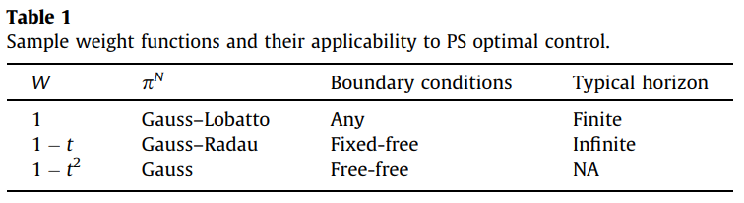
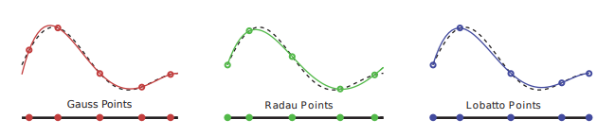

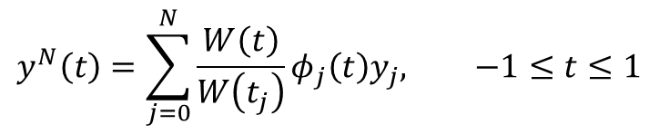
State-of-the-Art: Pseudospectral Methods
Key Idea: Use high-order splines for the approximation
Orthogonal Polynomials
Chebyshev – easy to compute
Legendre – computed numerically
Grid Selection
PS Optimal Control Formulation $$\left\{\begin{matrix} & x_{i}∈𝕏, u_{i}∈𝕌 \\ \text{M}\text{inimize} & J^{N}\left[x\left(π^{N}\right), u\left(π^{N}\right)\right]=E[x_{0}, x_{N}] \\ \text{Subject} \text{to} & \left\|\sum_{j=0 }^{N}{D_{ij}x_{j}−f(x_{i},u_{i})}\right\|≤δ^{N}, i=0,1,…,N \\ & \left\|e\left(x_{0},x_{N}\right)\right\|≤δ^{N}\end{matrix}\right.$$
$$y^{N}\left(t\right)=\sum_{j=0}^{N}{\frac{W\left(t\right)}{W\left(t_{j}\right)}φ_{j}\left(t\right)y_{j}, −1≤t≤1}$$

Slide 4
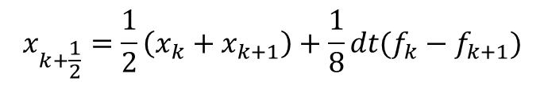

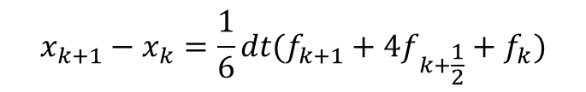
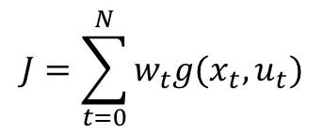
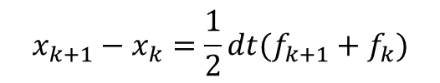



Technical Approach
Step 1: Discretize Time (Uniform Grid)
Step 2: Augment the state
Step 3: Calculate the Constraints at each point
Step 4: Formulate the NLP
Step 5: Interpolate
$$\left[\begin{matrix}t_{0} \\ t_{f}\end{matrix}\right]$$
$$\left[\begin{matrix}x_{t} \\ u_{t}\end{matrix}\right]$$
$$\left[\begin{matrix}x_{N} \\ u_{N}\end{matrix}\right]$$
Dynamics Constraints
$$\left[\begin{matrix}x_{0} \\ u_{0}\end{matrix}\right]$$
$$x_{k+1}−x_{k}=\frac{1}{2}dt(f_{k+1}+f_{k})$$
Trapezoidal:
Trapezoidal
1
2
2
2
2
2
2
2
2
2
1
$$x_{k+1}−x_{k}=\frac{1}{6}dt(f_{k+1}+4f_{k+\frac{1}{2}}+f_{k})$$
Hermite-Simpson
1
4
2
4
2
4
2
4
2
4
1
Hermite-Simpson:
$$J=\sum_{t=0}^{N}{w_{t}g(x_{t}, u_{t})}$$
$$x_{k+\frac{1}{2}}=\frac{1}{2}\left(x_{k}+x_{k+1}\right)+\frac{1}{8}dt(f_{k}−f_{k+1})$$
Cost Function:

Slide 5
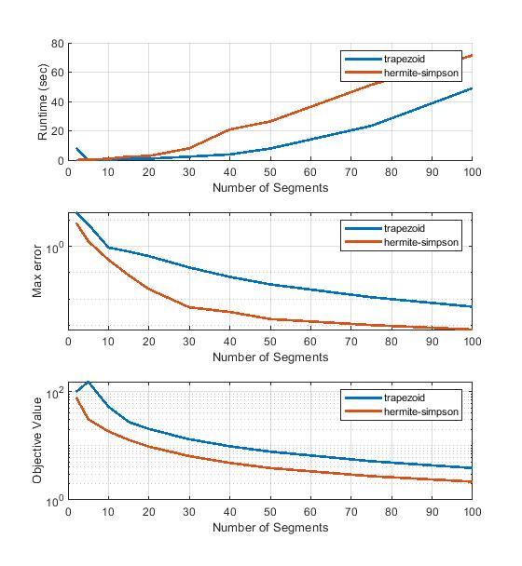
Results & Conclusion

