Slide 1
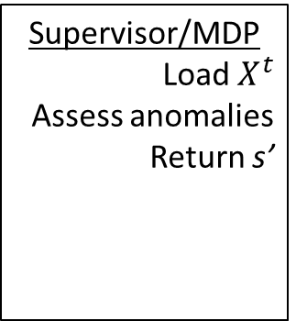
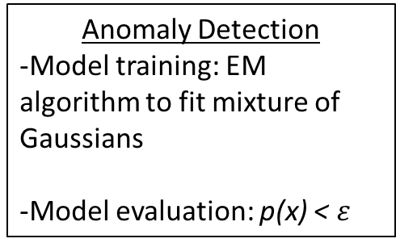
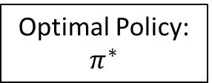
NGSIM Data
Data Pre-processing
-Feature extraction
-Smoothing
Sampling-Sequential
Sampling-Randomization
Principal Component Analysis
Supervisor/MDP
Load $X^{t}$
Assess anomalies
Return s’
Anomaly Detection
-Model training: EM algorithm to fit mixture of Gaussians
-Model evaluation: p(x) < $ε$
-T(s’|s,a)
-R(s,a)
s’, r
a
Agent
Optimal Policy: $π^{∗}$

