Slide 1
Stop creating threads
A presentation

Slide 2
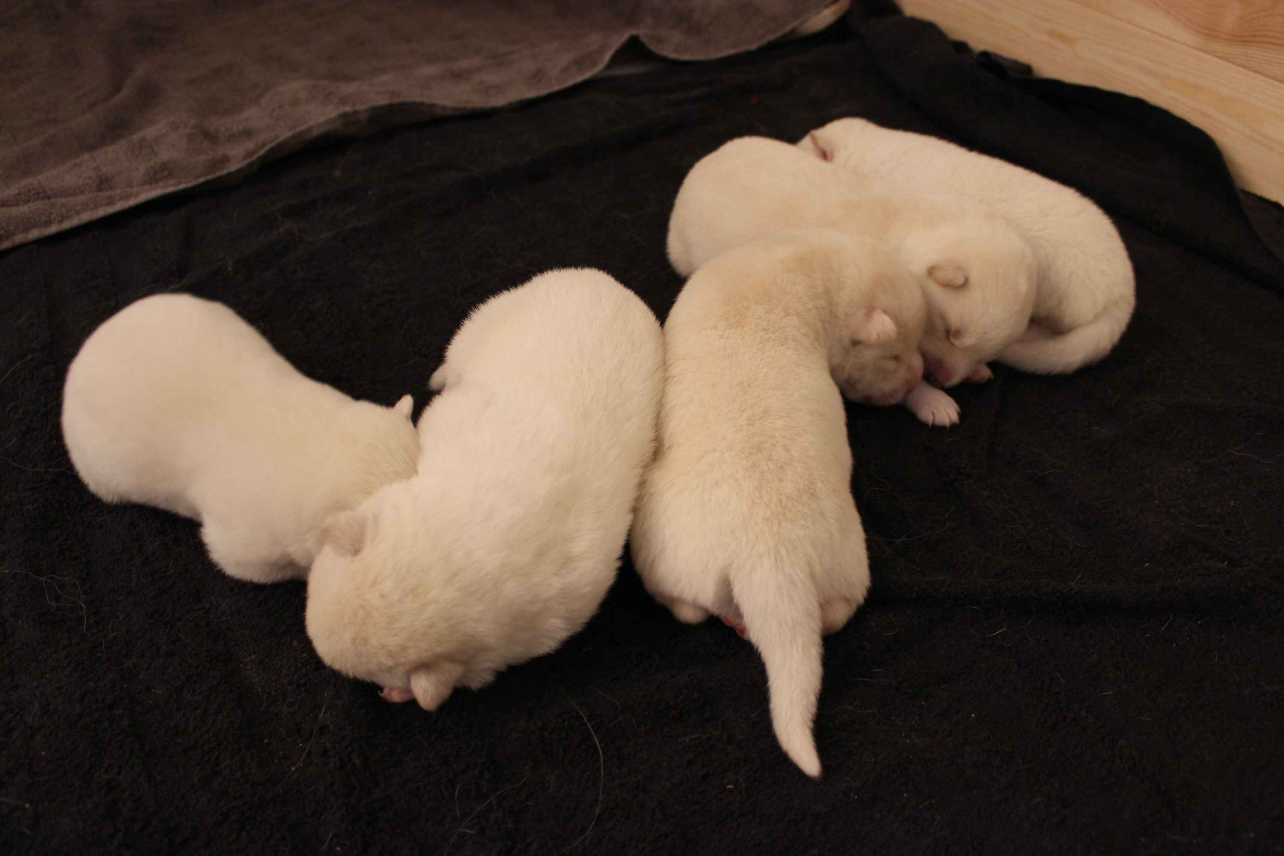
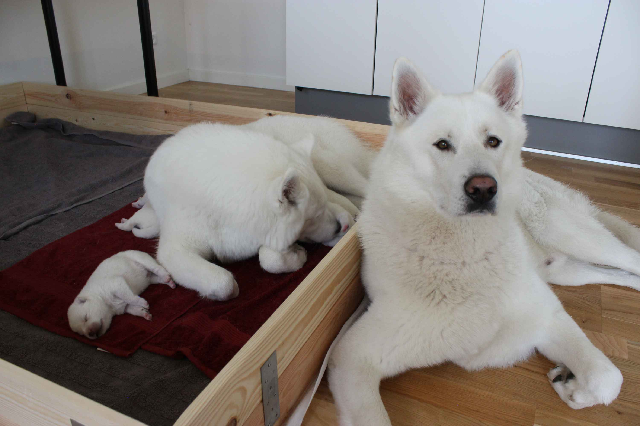
Who am I
I maintain stuff
I work at Nordic Semiconductor

Slide 3

What is zephyr?

Slide 4
What’s an operating system?

Slide 5
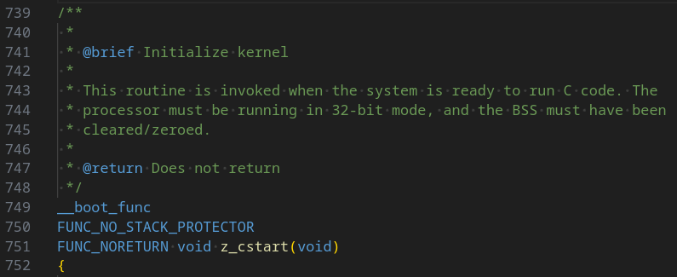
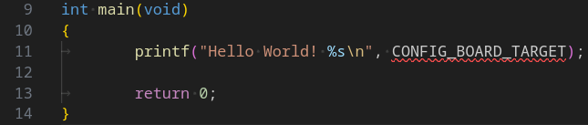
What’s an application?

Slide 6
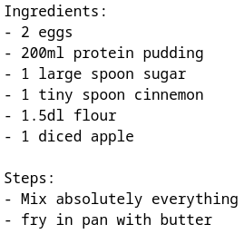
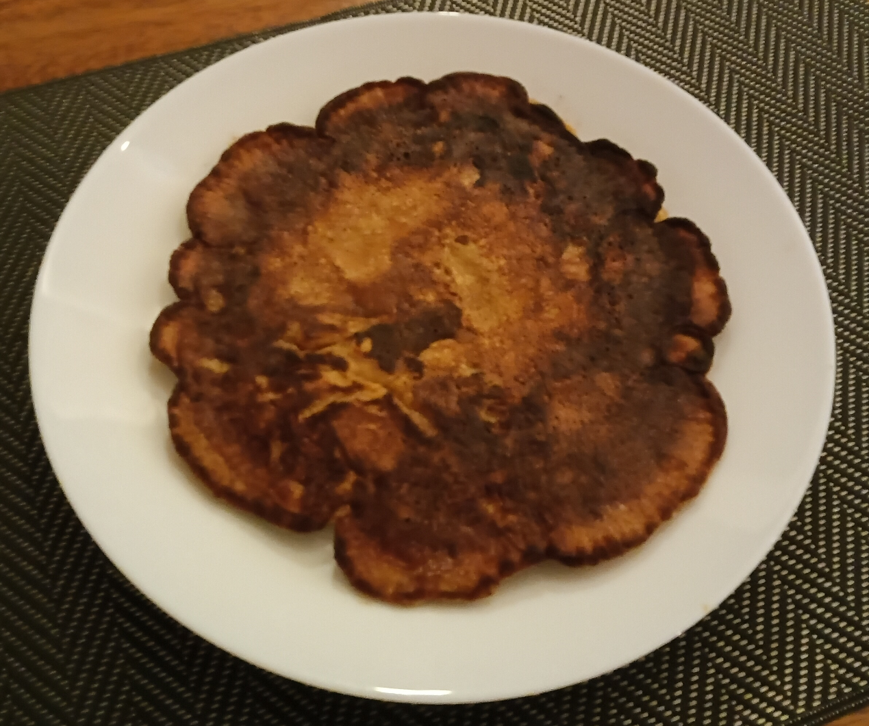
What’s a recipe?

Slide 7
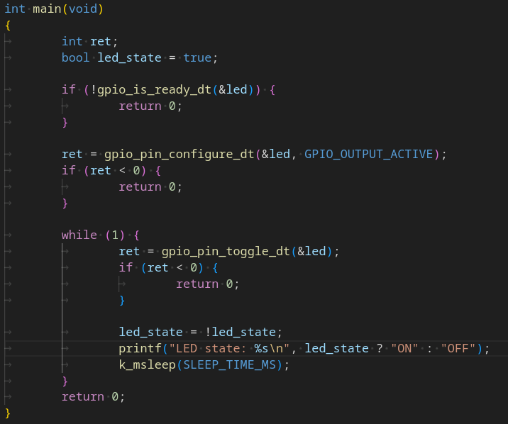
What’s a thread

Slide 8
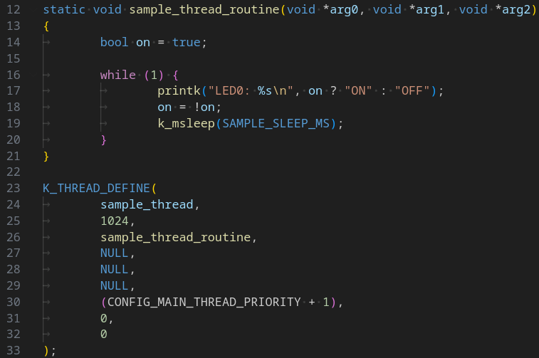
Blinky

Slide 9
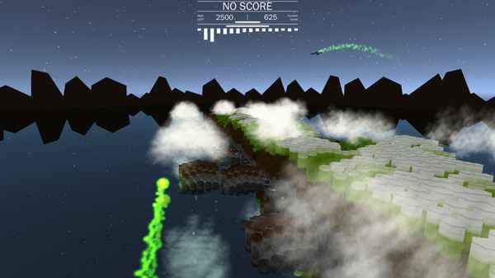
I made a game once

Slide 10
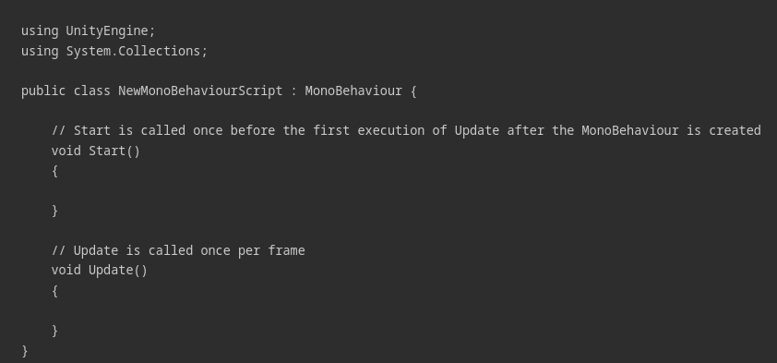
Unity MonoBehavior
Source: https://docs.unity3d.com/6000.0/Documentation/Manual/class-MonoBehaviour.html

Slide 11
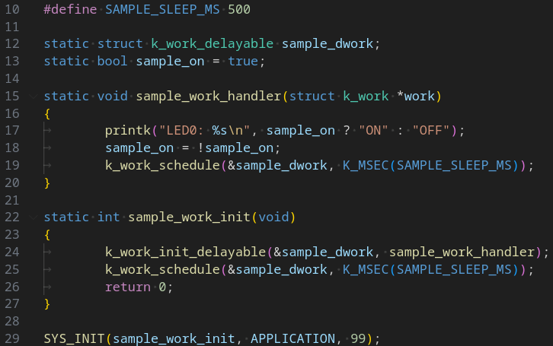
Blinky workqueue

Slide 12
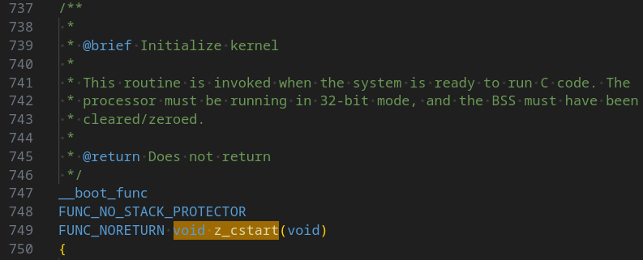
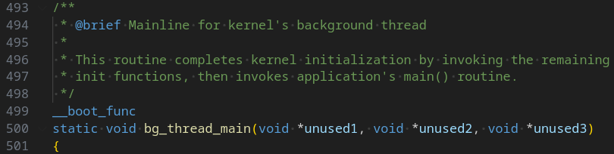
Zephyr’s main

Slide 13
What's up with main?

Slide 14
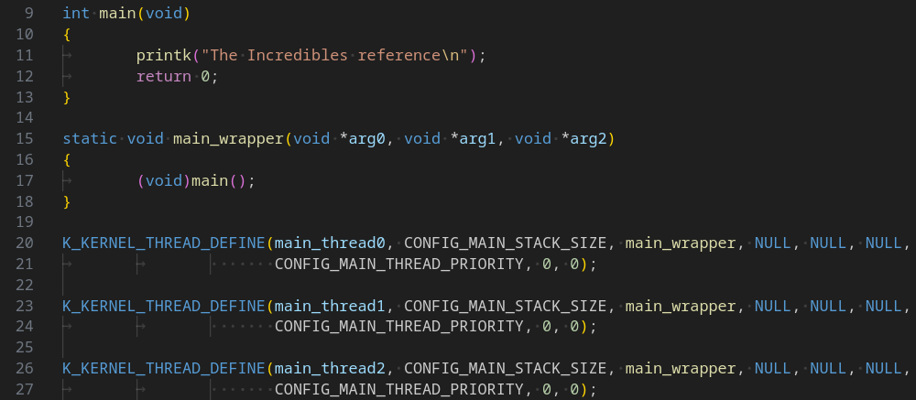
Main main main

Slide 15
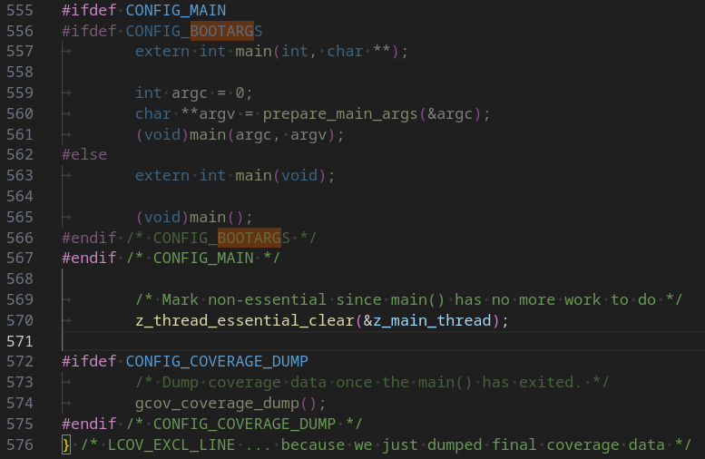
Do we need main?

