Slide 1

CUSTOMER GUIDE
Get your ideas in front of the DataCentral product team
A ten-minute walkthrough of Pulse: finding what has already been asked, submitting a request, and following it to release.
DataCentral Pulse · For customer teams

Slide 2
OVERVIEW
What Pulse does for your team
1
2
3
Ask
Follow
Know
Search existing ideas, then submit a request when nothing matches.
See the status of every request from your organization, in one list.
Get notified when a request moves, and see what has shipped.
Your requests stay private to your organization. DataCentral publishes ideas in customer-safe language, so nobody sees another company's raw request.

Slide 3
SIGNING IN
Open Pulse the way your organization set it up
From DataCentral
Microsoft sign-in
Email passcode
Launch Pulse from your DataCentral portal. You arrive signed in, with no second login.
Use your work account at the Pulse address if your organization signs in directly.
Enter your email, then the six-digit code we send. It works once and expires after 10 minutes.
If you belong to several companies, Pulse asks which one to use after you sign in. You can switch from the company selector in the top bar.

Slide 4
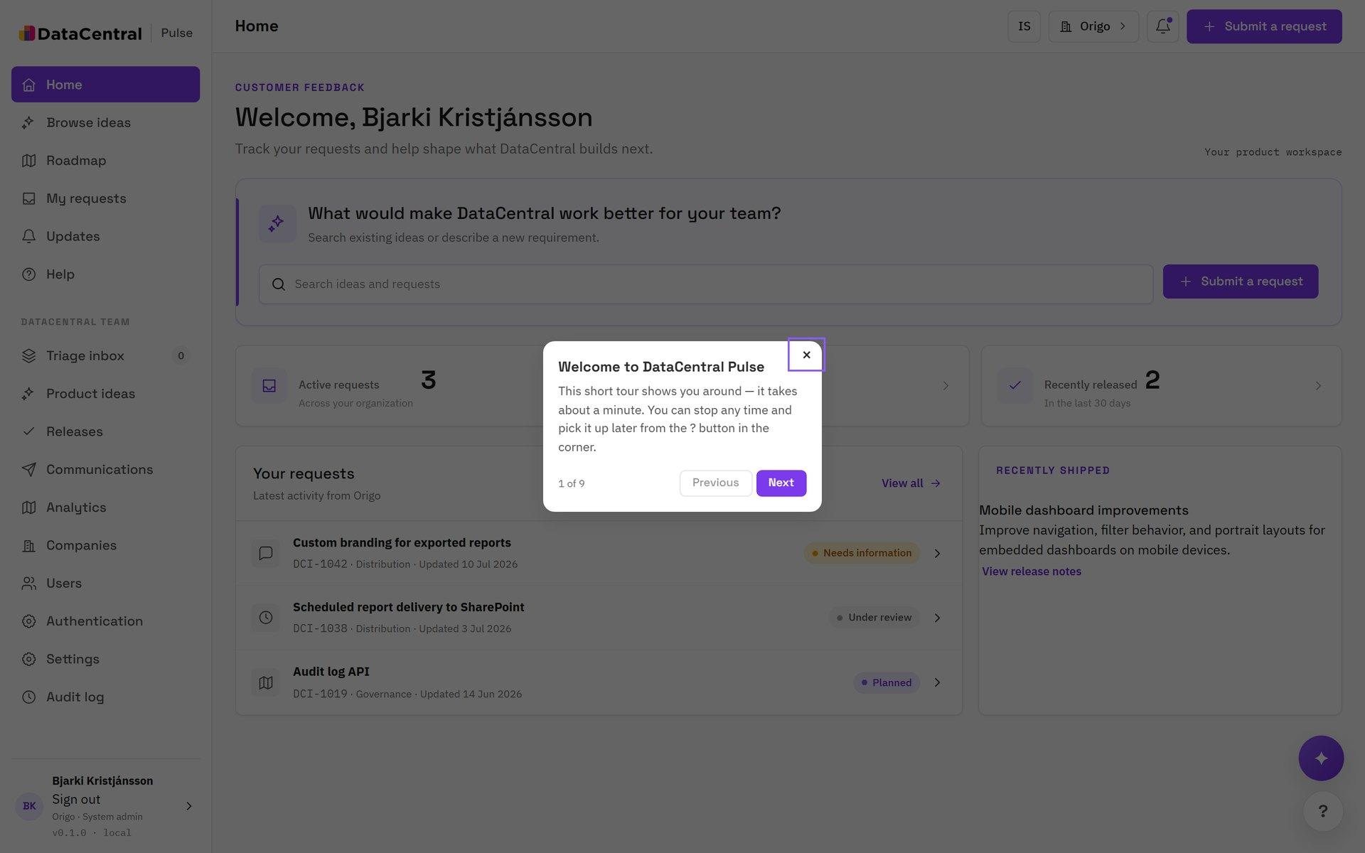
TOUR: WELCOME
Your home page
STEP 1 OF 9
Start from Home
Home shows your organization's active requests, items waiting on you, and what shipped recently. A short guided tour starts the first time you arrive.

Slide 5
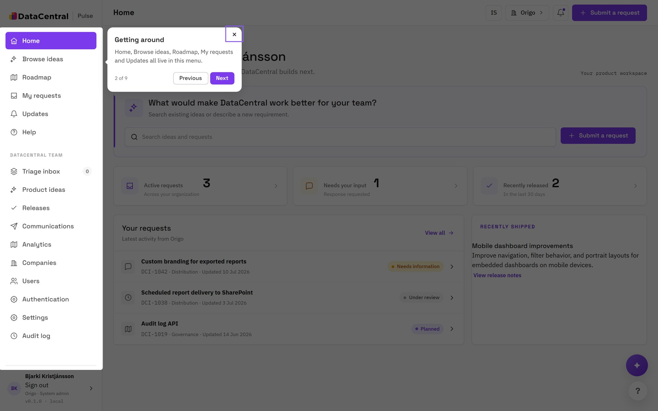
TOUR: WELCOME
Getting around
STEP 2 OF 9
One menu for everything
Home, Browse ideas, Roadmap, My requests and Updates all live in the left menu.
TIP The DataCentral team section appears only for internal staff. Customers never see it.

Slide 6
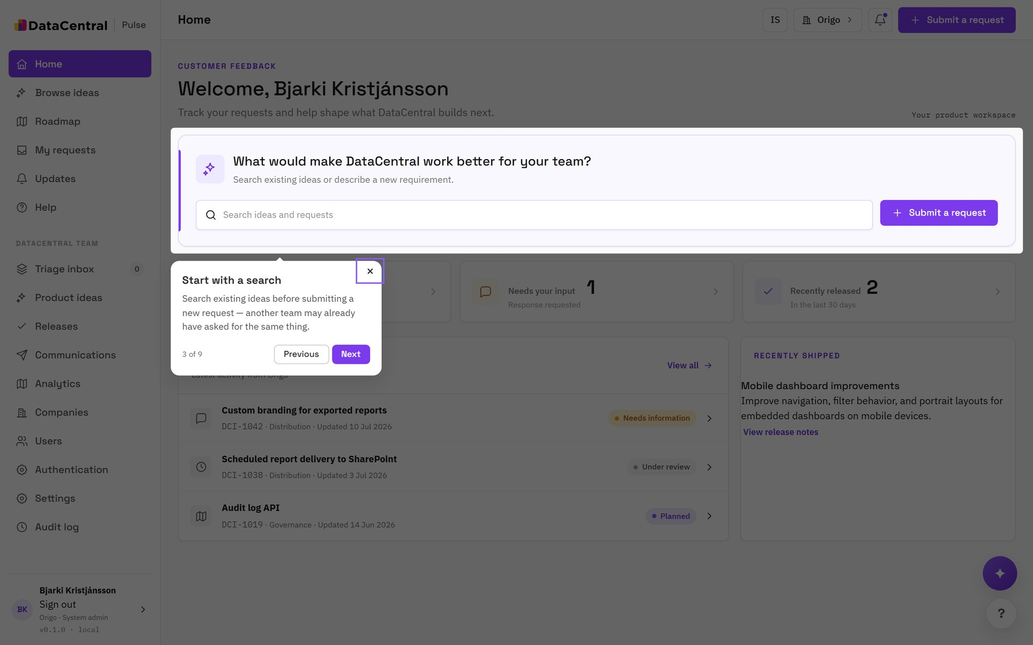
TOUR: WELCOME
Search before you ask
STEP 3 OF 9
Check what already exists
Search existing ideas before you submit. Another team may already have asked for the same thing, and you can add your organization's interest instead.

Slide 7
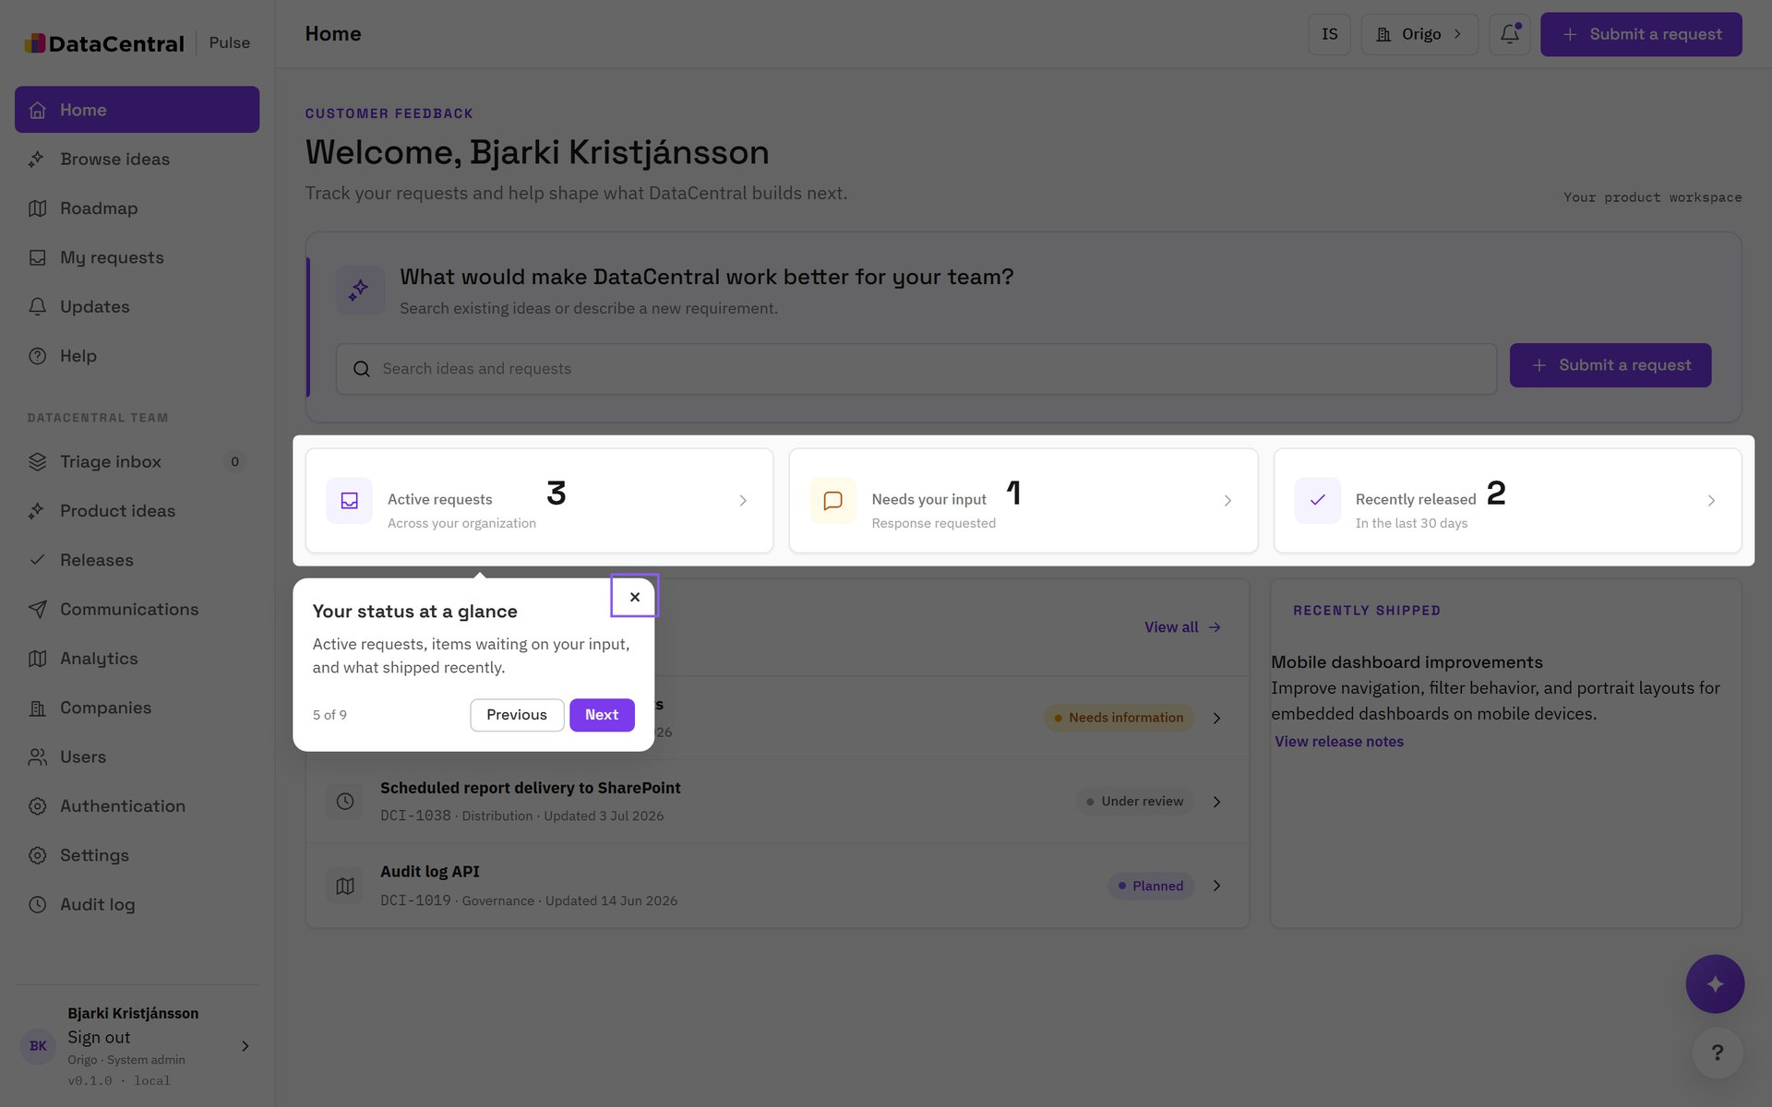
TOUR: WELCOME
Your status at a glance
STEP 5 OF 9
Three numbers that matter
Active requests, requests that need your input, and recently released items. Select a tile to open the matching list.

Slide 8
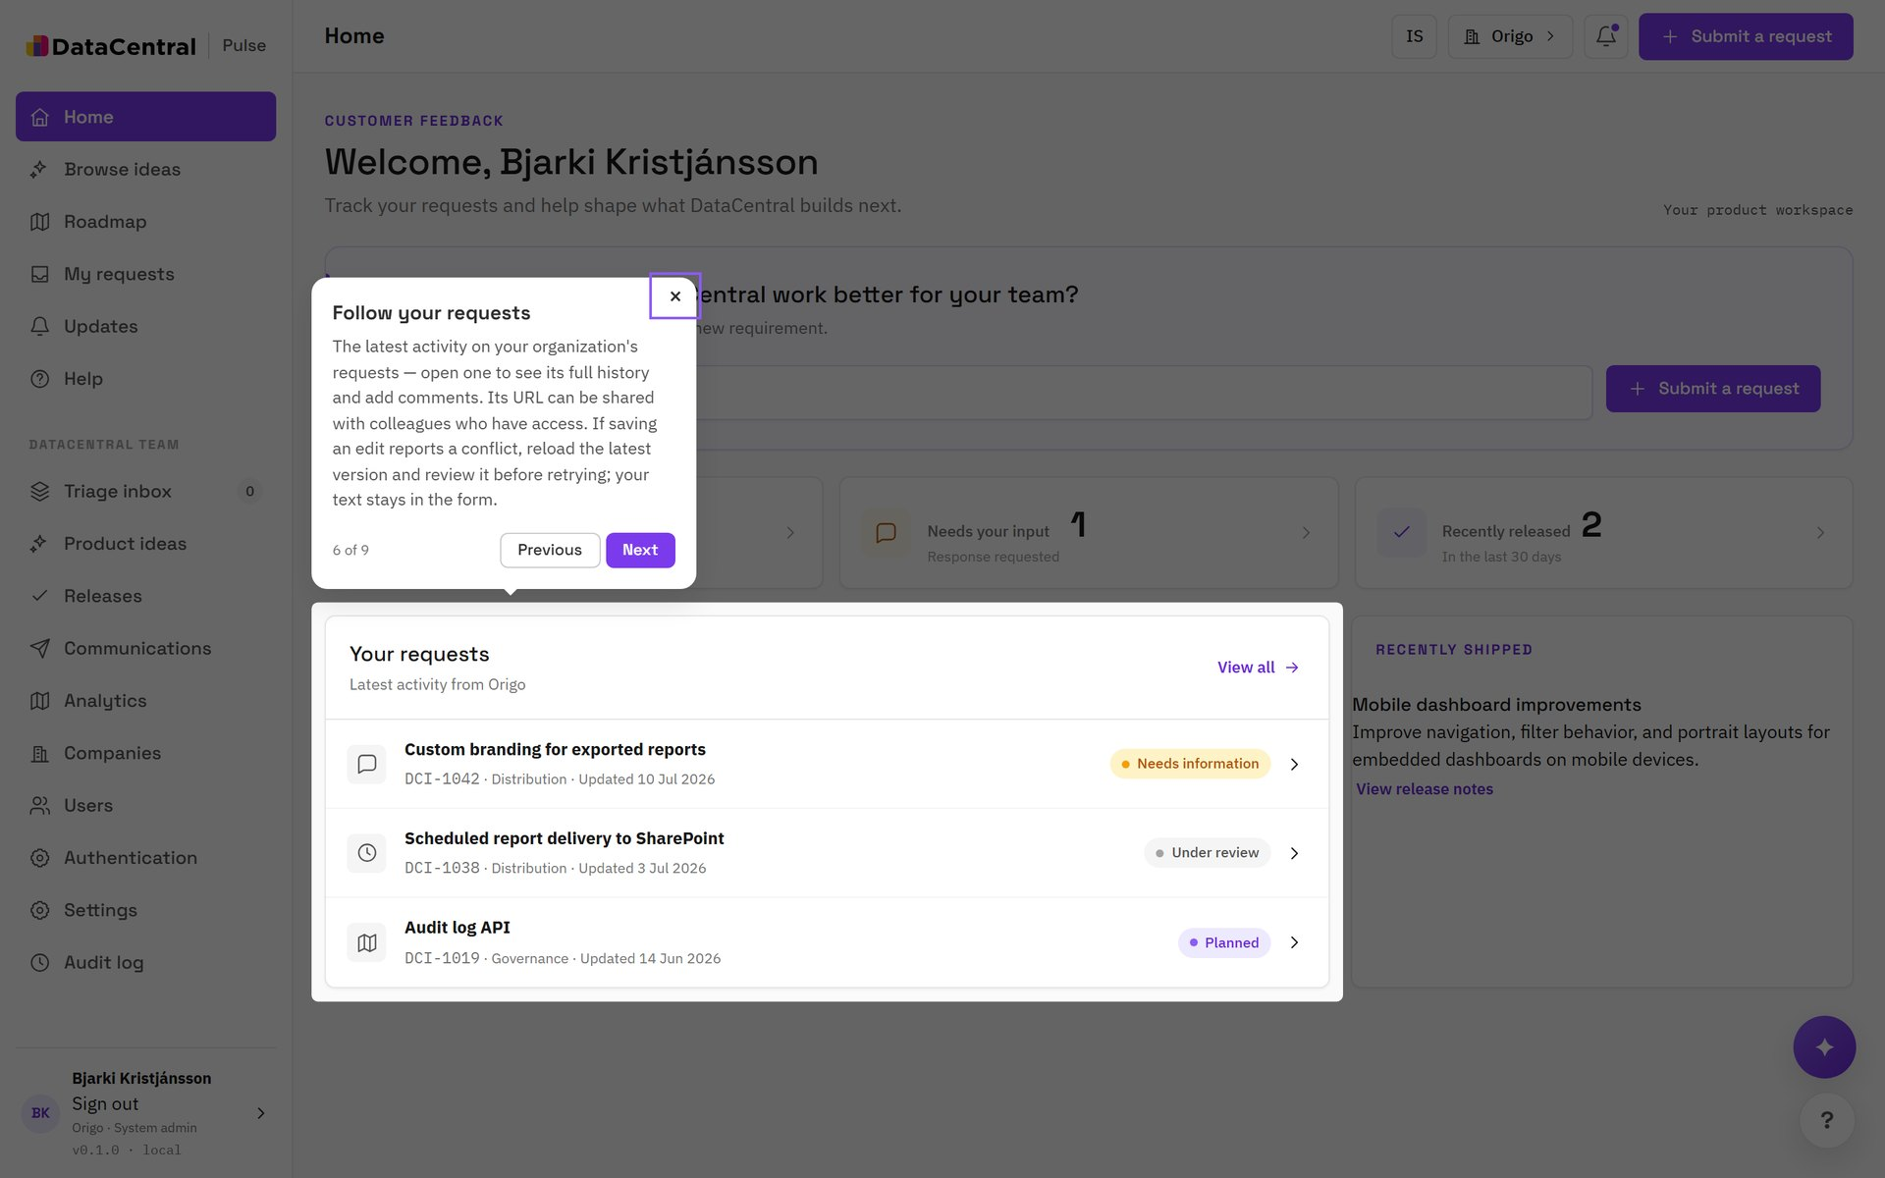
TOUR: WELCOME
Follow your requests
STEP 6 OF 9
The latest activity
Open a request to read comments, see attachments and review its status history. Edits are version-checked, so two colleagues never overwrite each other silently.

Slide 9
01
Submit a request
Four steps, about three minutes.

Slide 10
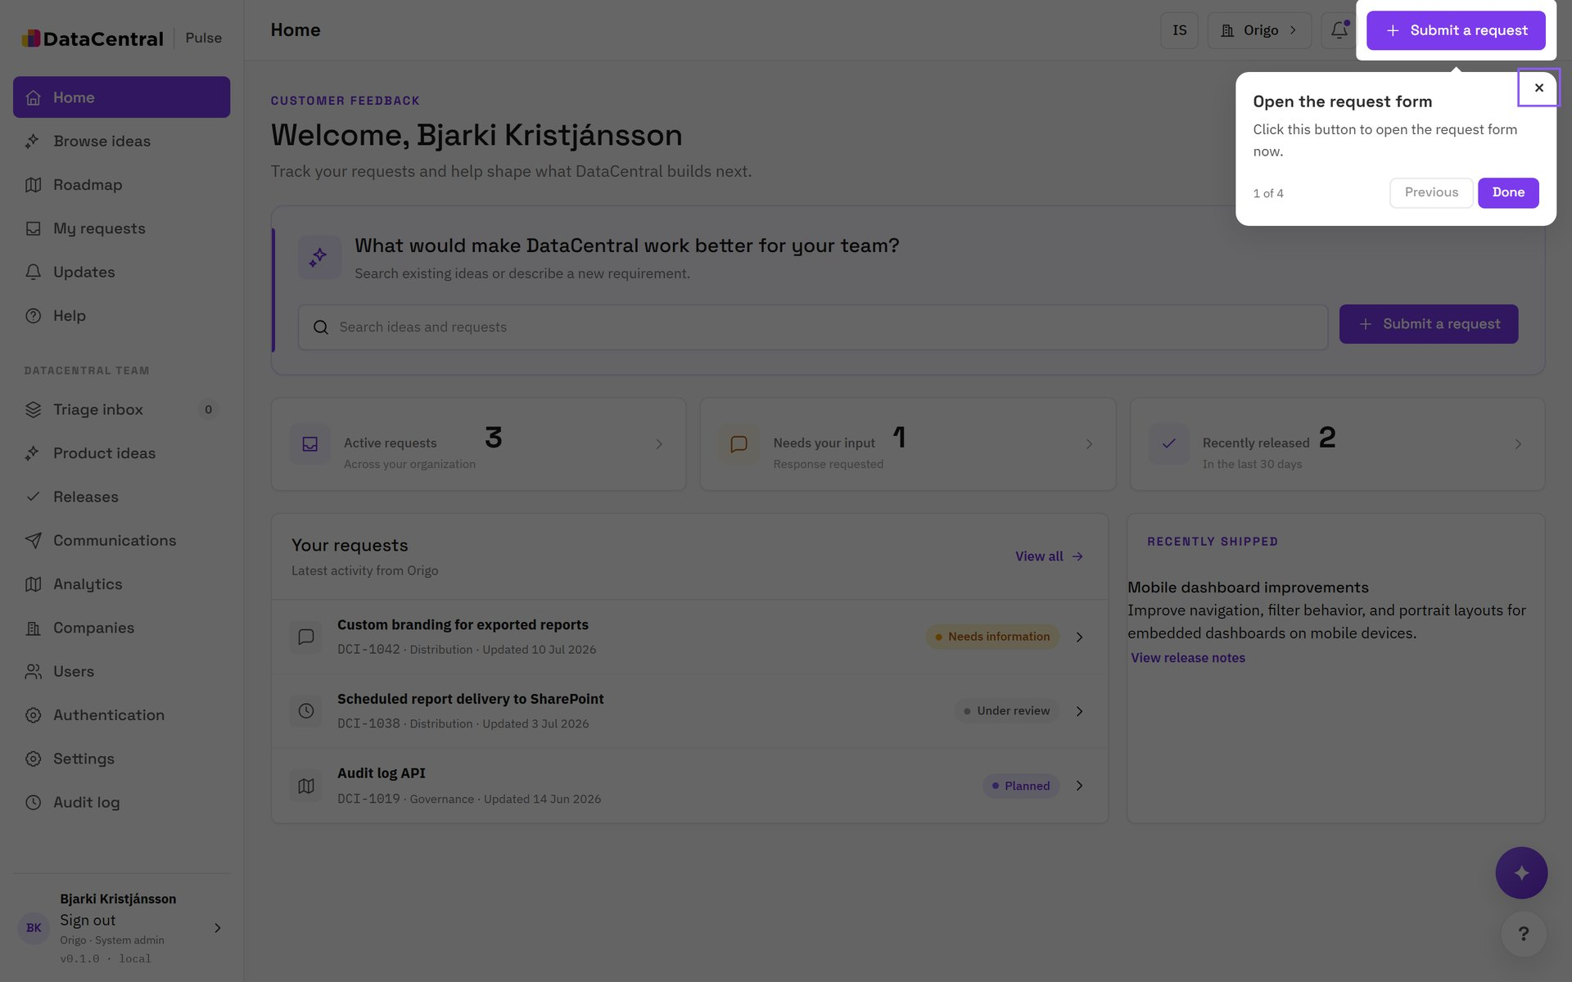
TOUR: SUBMITTING A REQUEST
Open the request form
STEP 1 OF 4
Select Submit a request
The button sits in the top bar on every page, so you can start from wherever you noticed the problem.

Slide 11
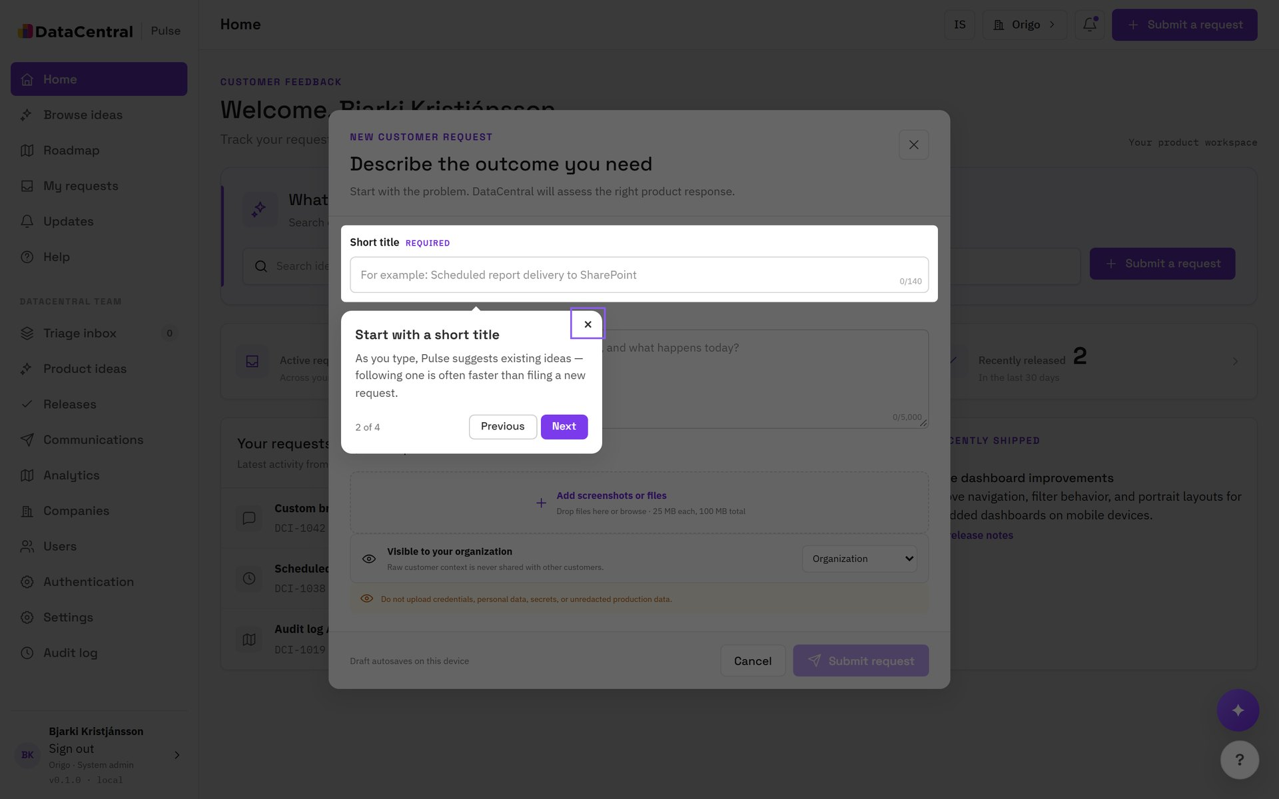
TOUR: SUBMITTING A REQUEST
Start with a short title
STEP 2 OF 4
A sharp title
As you type, Pulse suggests existing ideas that look similar. If one fits, follow it instead of filing a duplicate.
TIP Name the outcome, not the solution: “Scheduled report delivery to SharePoint”.

Slide 12
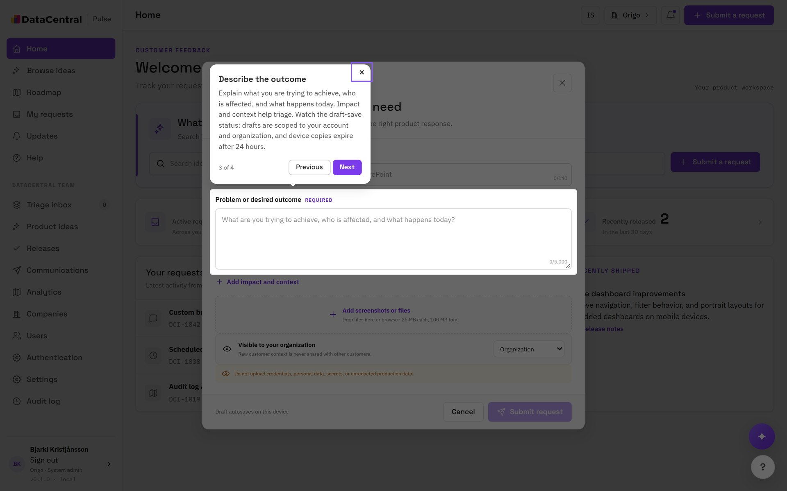
TOUR: SUBMITTING A REQUEST
Describe the outcome
STEP 3 OF 4
What, who and why
Explain what you are trying to achieve, who is affected, and what happens today. Impact and context help triage. Drafts save to your account and organization, and device copies expire after 24 hours.

Slide 13
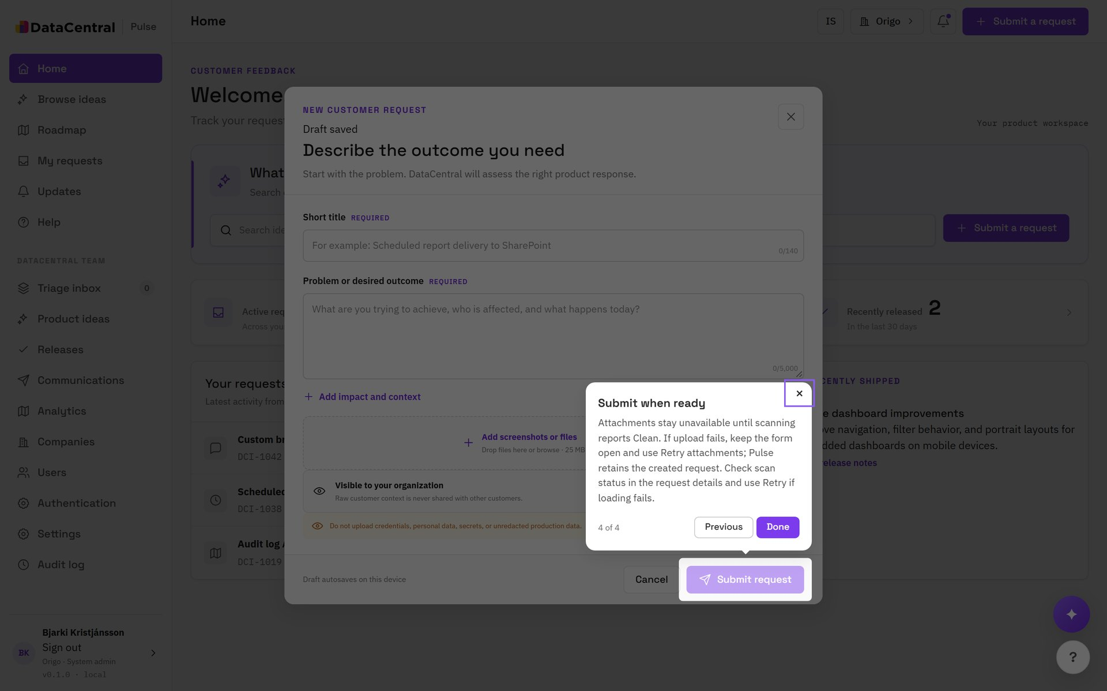
TOUR: SUBMITTING A REQUEST
Submit when ready
STEP 4 OF 4
Attach and send
Add screenshots or files up to 25 MB each. Attachments are scanned before anyone can download them. Choose who in your organization can see the request.
TIP Do not upload credentials, personal data or unredacted production data.

Slide 14
AFTER YOU SUBMIT
What happens to your request
1
2
3
4
Received
In review
Planned
Released
→
→
→
Your request appears in My requests with a DCI number.
DataCentral triages it, may ask for information, or links it to an idea.
The idea is scored and appears on the roadmap.
Release notes and an availability date are attached, and you are notified.

Slide 15
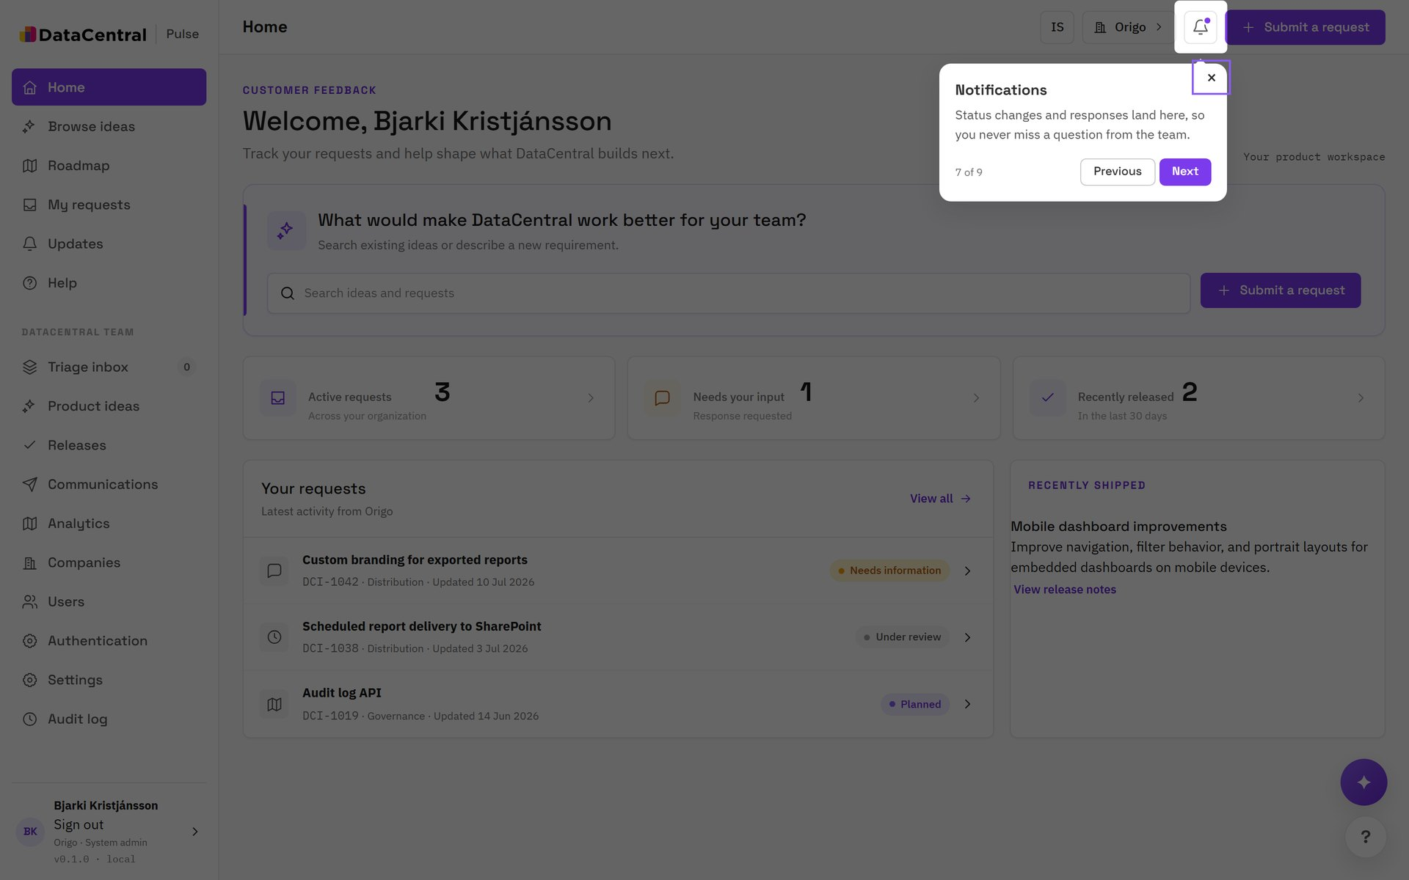
TOUR: WELCOME
Notifications
STEP 7 OF 9
Know when something changes
Status changes and responses land here. Choose which events reach you by email in your notification preferences.

Slide 16
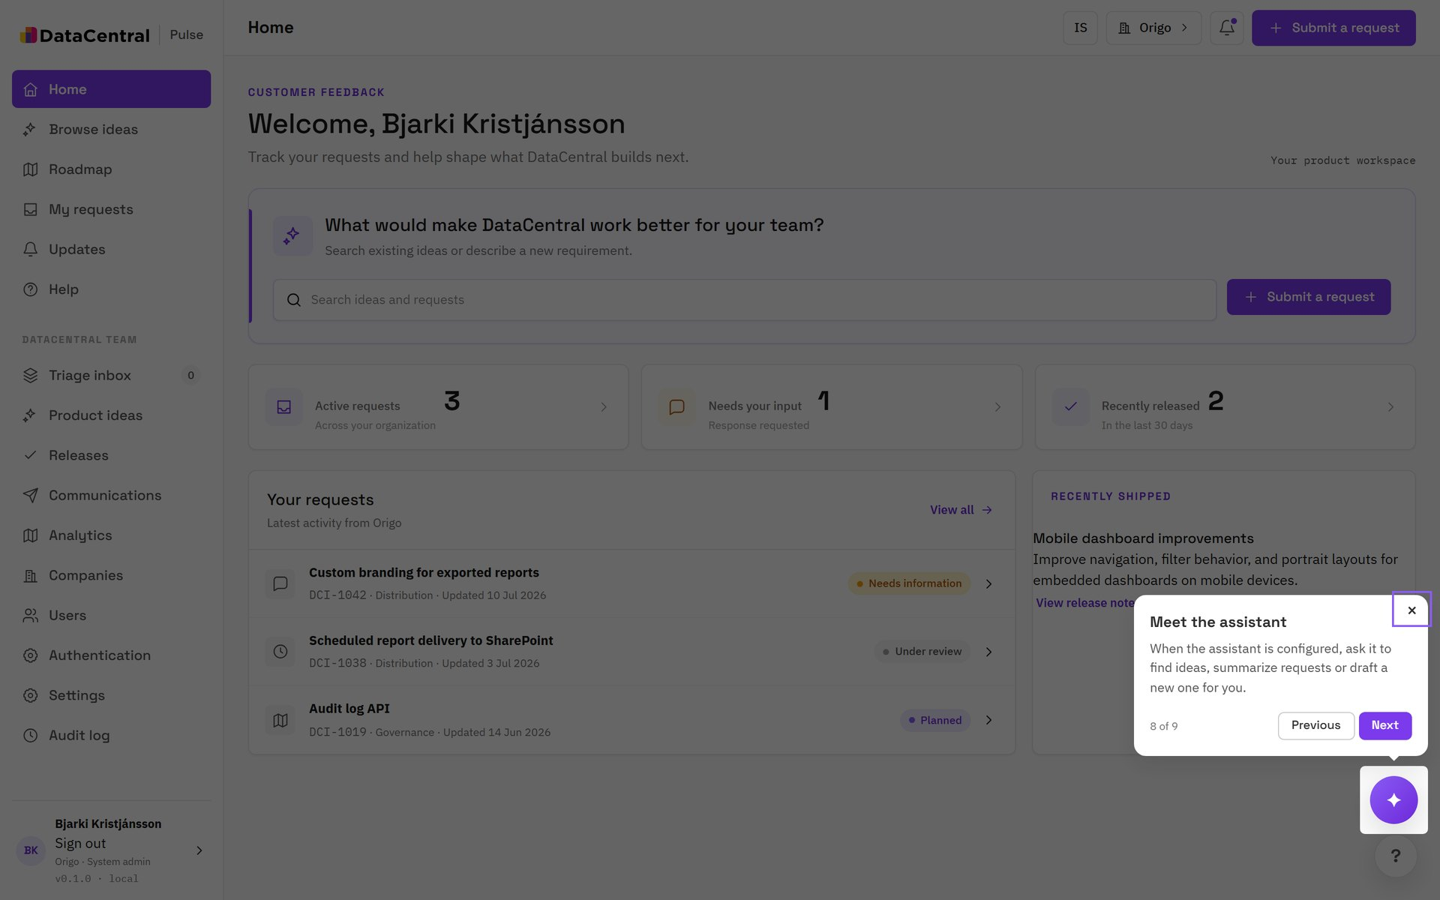
TOUR: WELCOME
The assistant
STEP 8 OF 9
Ask in plain language
When the assistant is enabled for you, ask it to find similar ideas, summarize your open requests or draft a new request. It can only see what you can see.

Slide 17
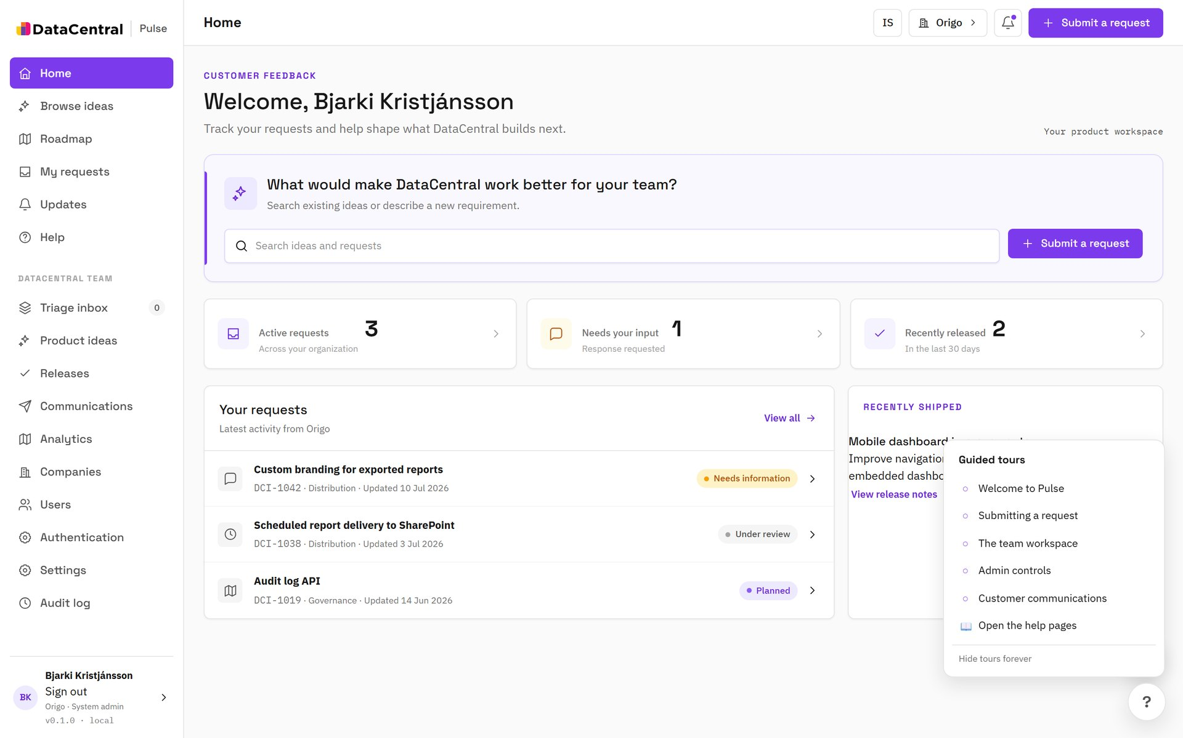
TOUR: WELCOME
Help and tours
ALWAYS AVAILABLE
The ? button
Replay any tour or open the full help pages from the ? button at the bottom right. Help is available in English and Icelandic.
TIP Use Hide tours forever if you prefer a clean screen. You can restore them later.

Slide 18
ROLES
What you can do depends on your role
Viewer
Requester
Company admin
Browse ideas and the roadmap, and read your organization's requests.
Everything a Viewer can do, plus submit requests and comment on them.
Everything a Requester can do, plus manage your company's people and contacts.
The same person can hold a different role at each company they belong to.

Slide 19
GOOD REQUESTS
Four habits that get requests moved faster
1
2
3
4
Search first
State the outcome
Give the impact
Attach evidence
Following an existing idea adds weight without adding noise.
Describe the goal and who it affects, not the feature you imagine.
Frequency, severity and the workaround you use today.
A screenshot or sample report removes a round of questions.

Slide 20
Your next request starts with a search.
Open Pulse from DataCentral, or use the ? button for the full help pages.
DataCentral Pulse · Customer guide

