Slide 1

MANAGER GUIDE
Run Pulse: triage, publish, release and communicate
A working guide for DataCentral product managers and system administrators, with the screens you will use every week.
DataCentral Pulse · Internal

Slide 2
OVERVIEW
Your weekly rhythm in Pulse
1
2
3
4
Triage
Shape ideas
Publish and release
Communicate
→
→
→
Work the inbox. Decide the next step for every new request.
Consolidate requests into canonical ideas and score them.
Publish in customer-safe language and bundle shipped ideas into releases.
Email affected customers, then read the analytics.

Slide 3
ACCESS
What each internal role can do
Internal contributor
Product manager
System admin
Read requests and ideas, comment internally and prepare triage notes.
Triage, consolidate, score, publish ideas, manage releases and send communications.
Everything above, plus users, companies, authentication policy, settings and the audit log.

Slide 4
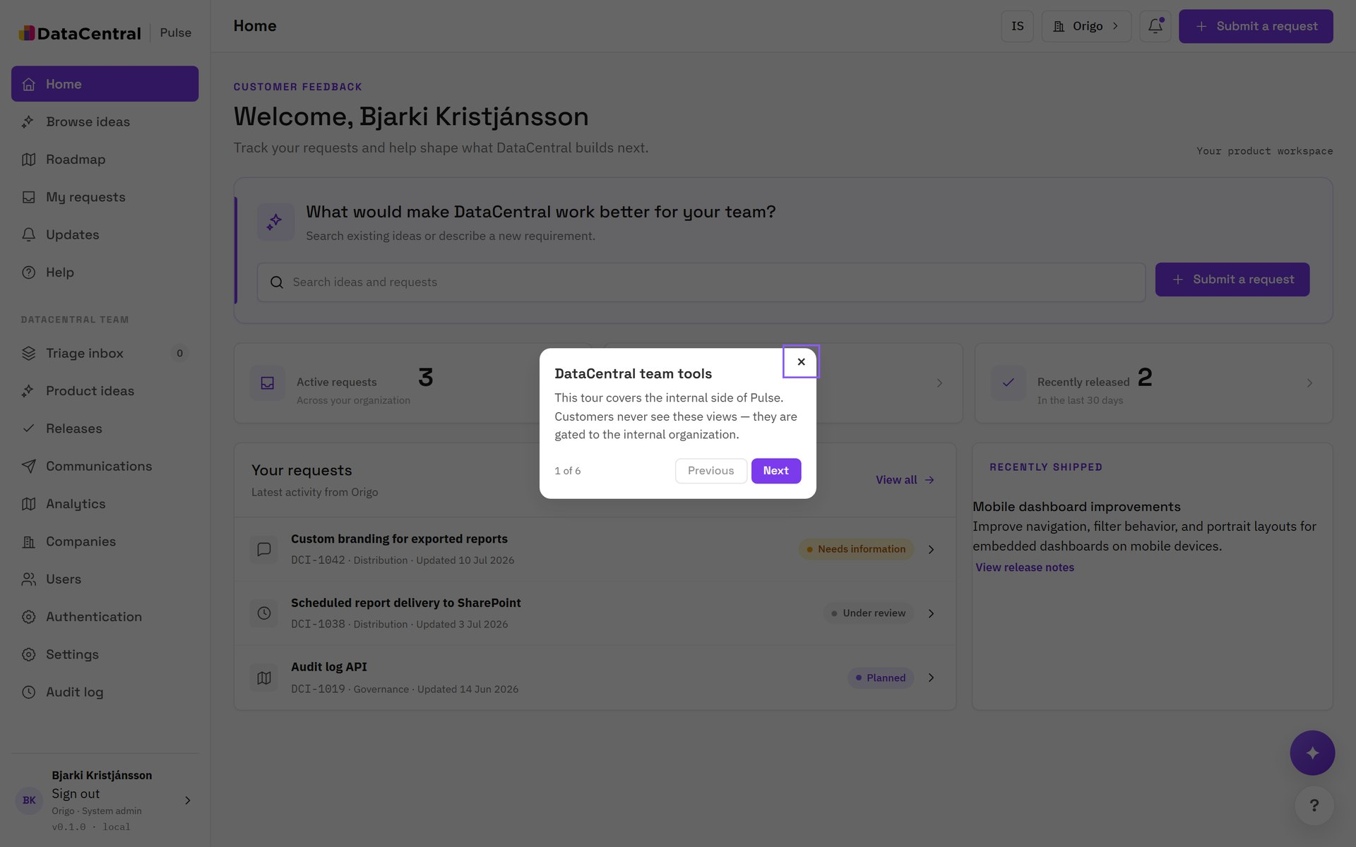
TOUR: TEAM WORKSPACE
The team workspace
STEP 1 OF 6
Internal views, hidden from customers
The DataCentral team section holds triage, product ideas, releases, communications and analytics. Customers never see it.

Slide 5
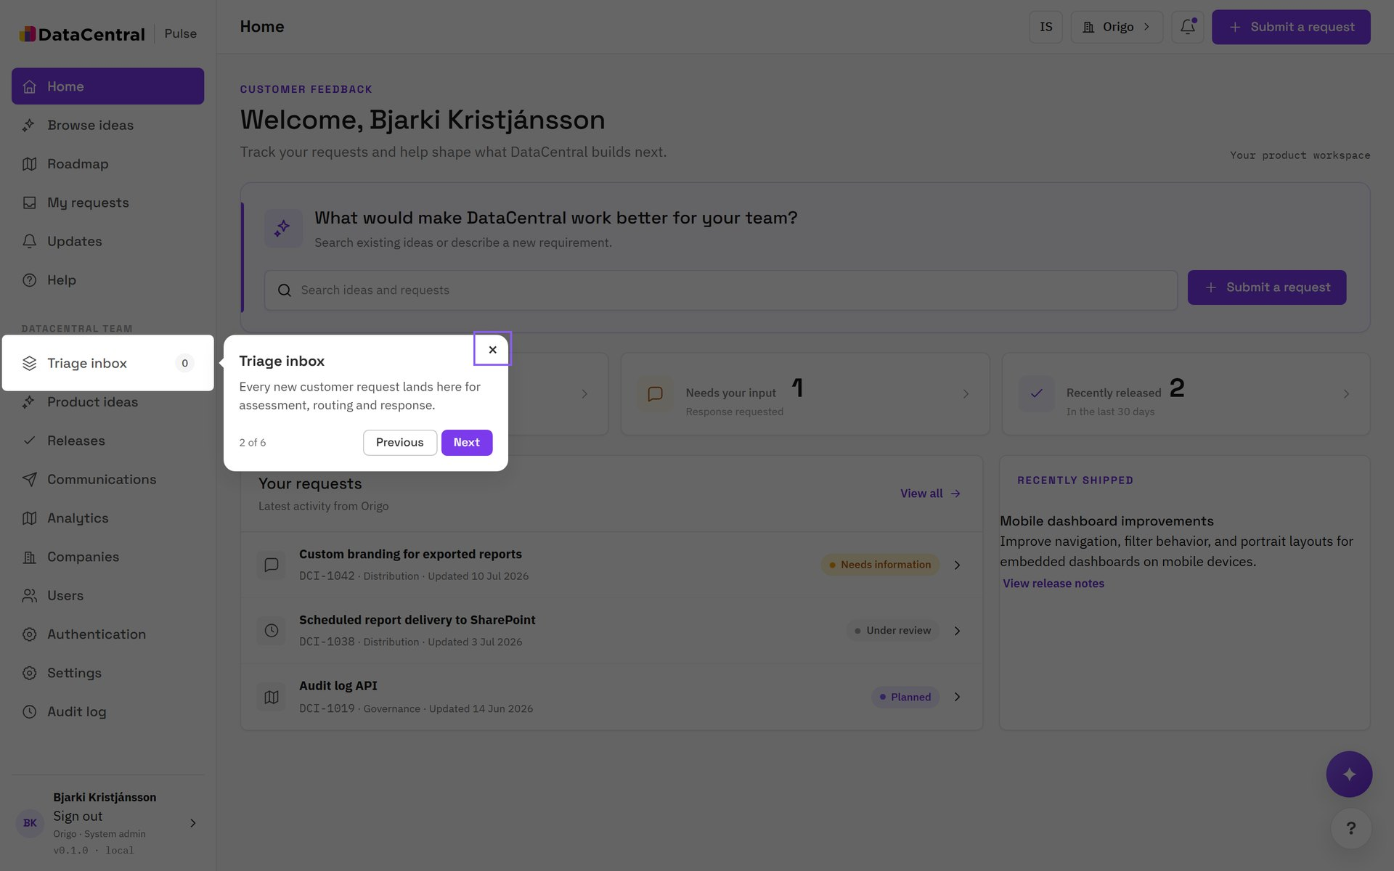
TOUR: TEAM WORKSPACE
Triage inbox
STEP 2 OF 6
Every new request lands here
Review the queue for assessment, tagging and response. The counter shows what has not been picked up.

Slide 6
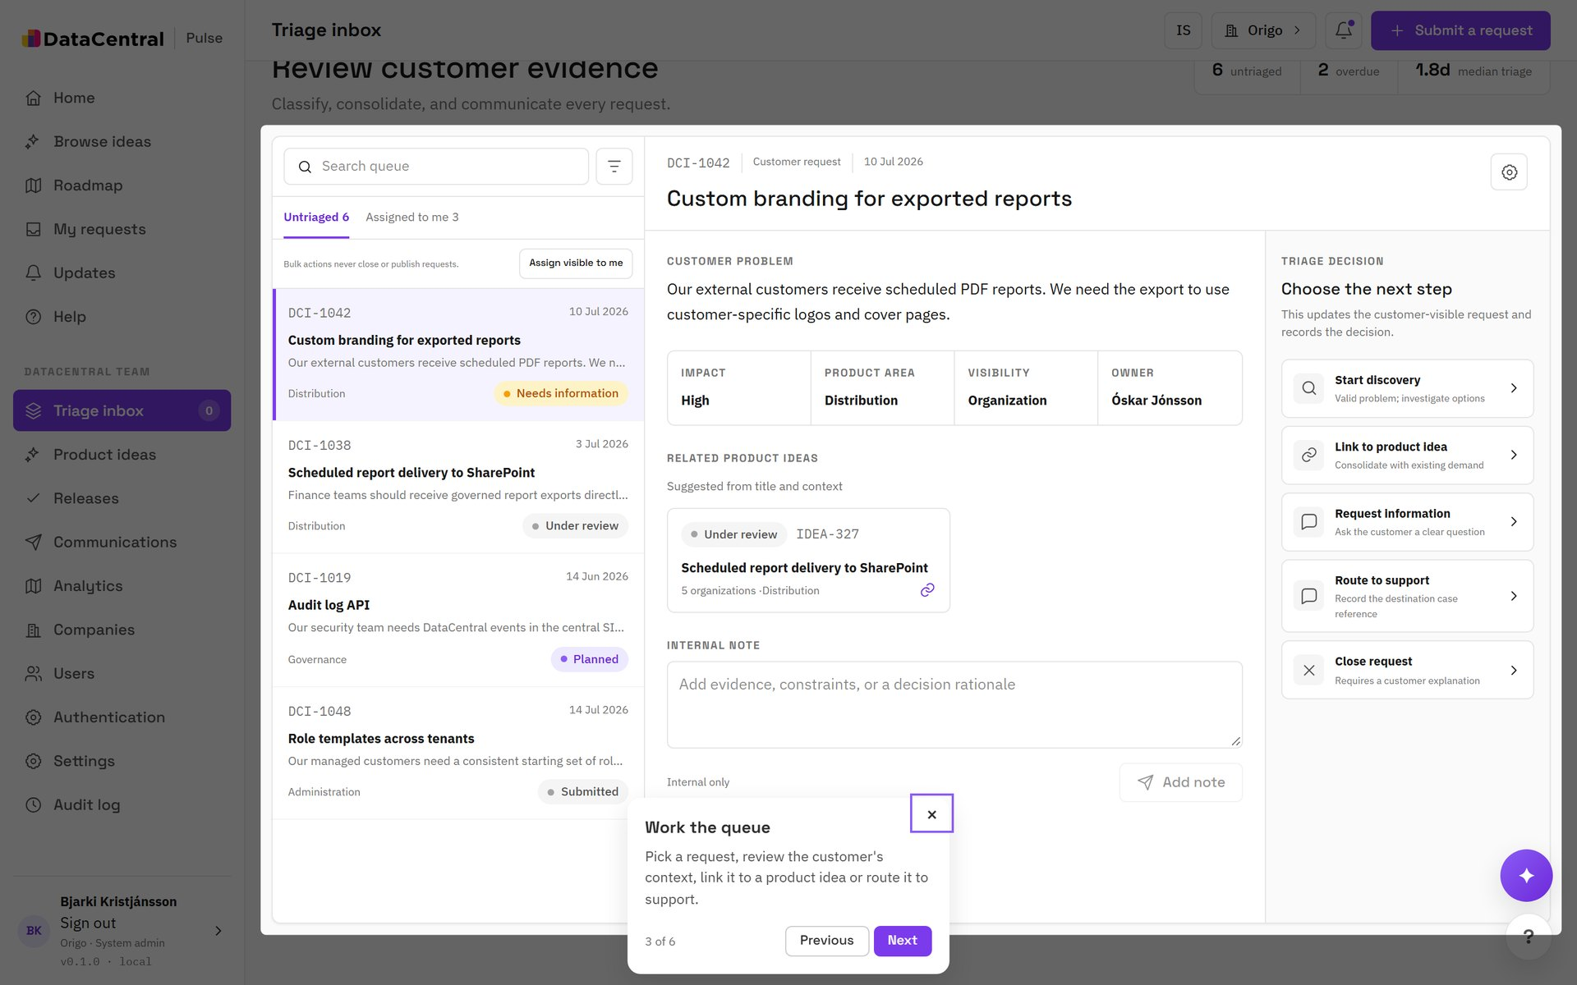
TOUR: TEAM WORKSPACE
Work the queue
STEP 3 OF 6
Pick the next step
Open a request, review the customer's context, then link it to a product idea, ask for information, or close it with a reason.
TIP Required fields change by status. A request cannot reach Released without notes and an availability date.

Slide 7
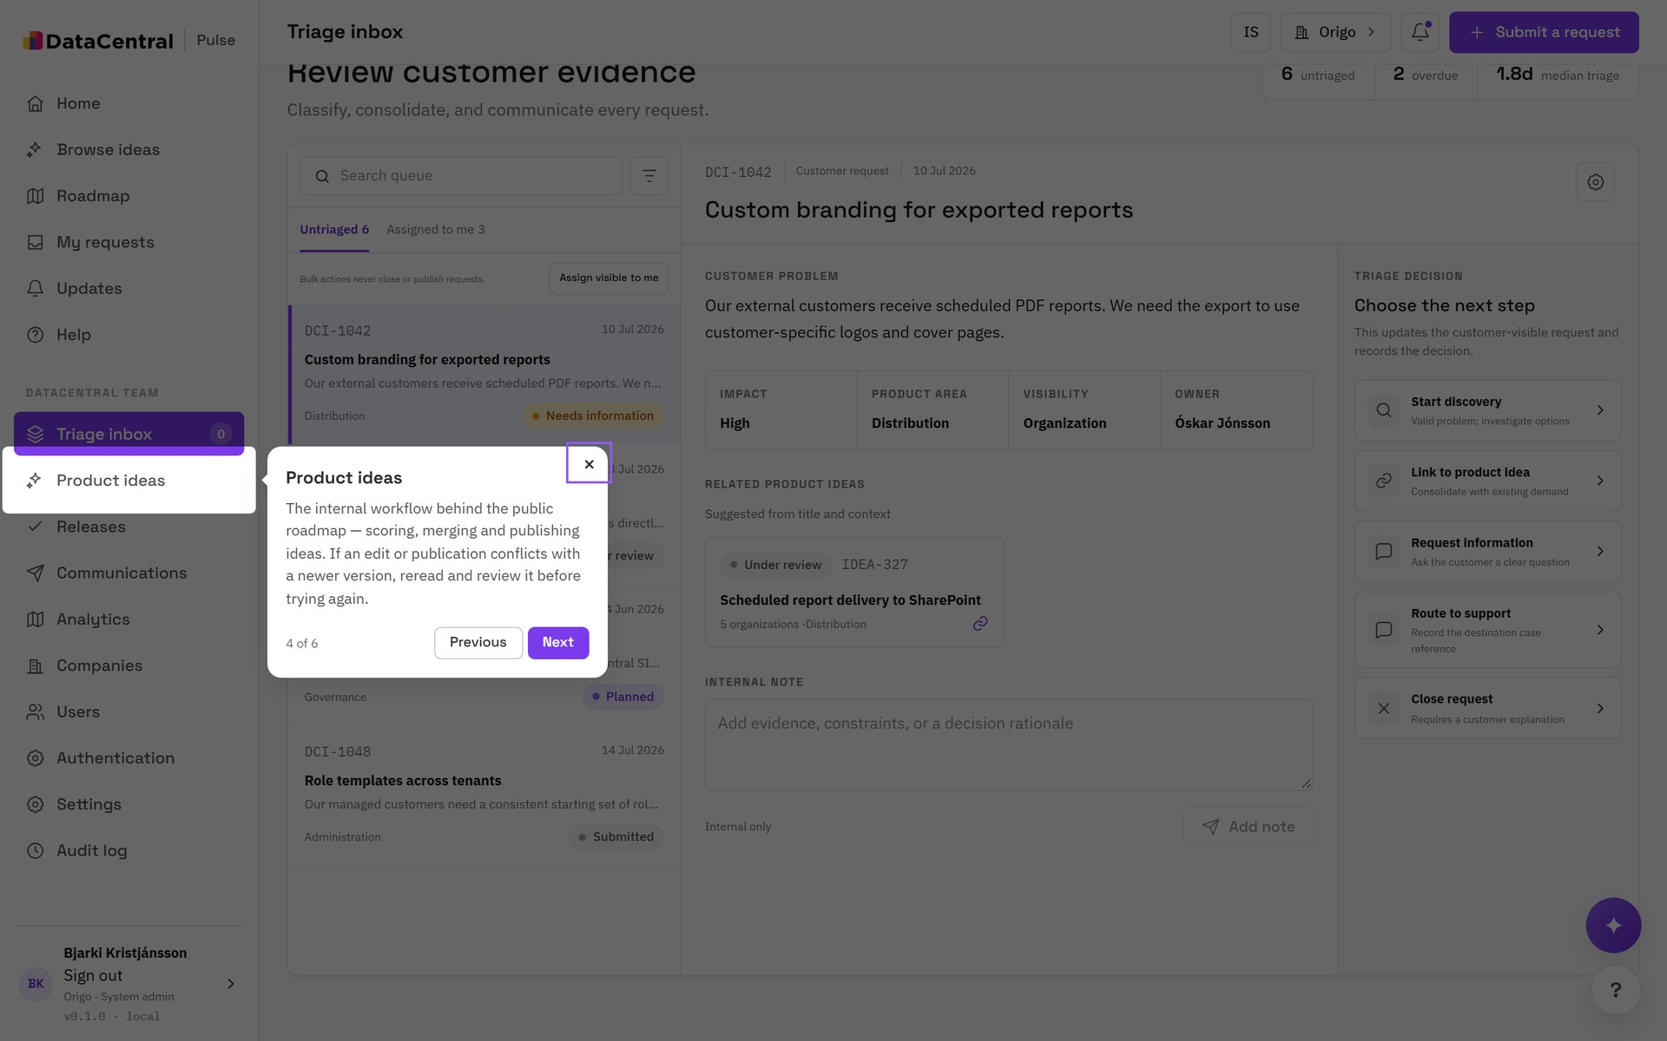
TOUR: TEAM WORKSPACE
Product ideas
STEP 4 OF 6
One idea, many requests
Consolidate duplicate requests behind one canonical idea. Score it, stage it on the roadmap, and publish it explicitly in customer-safe language.

Slide 8
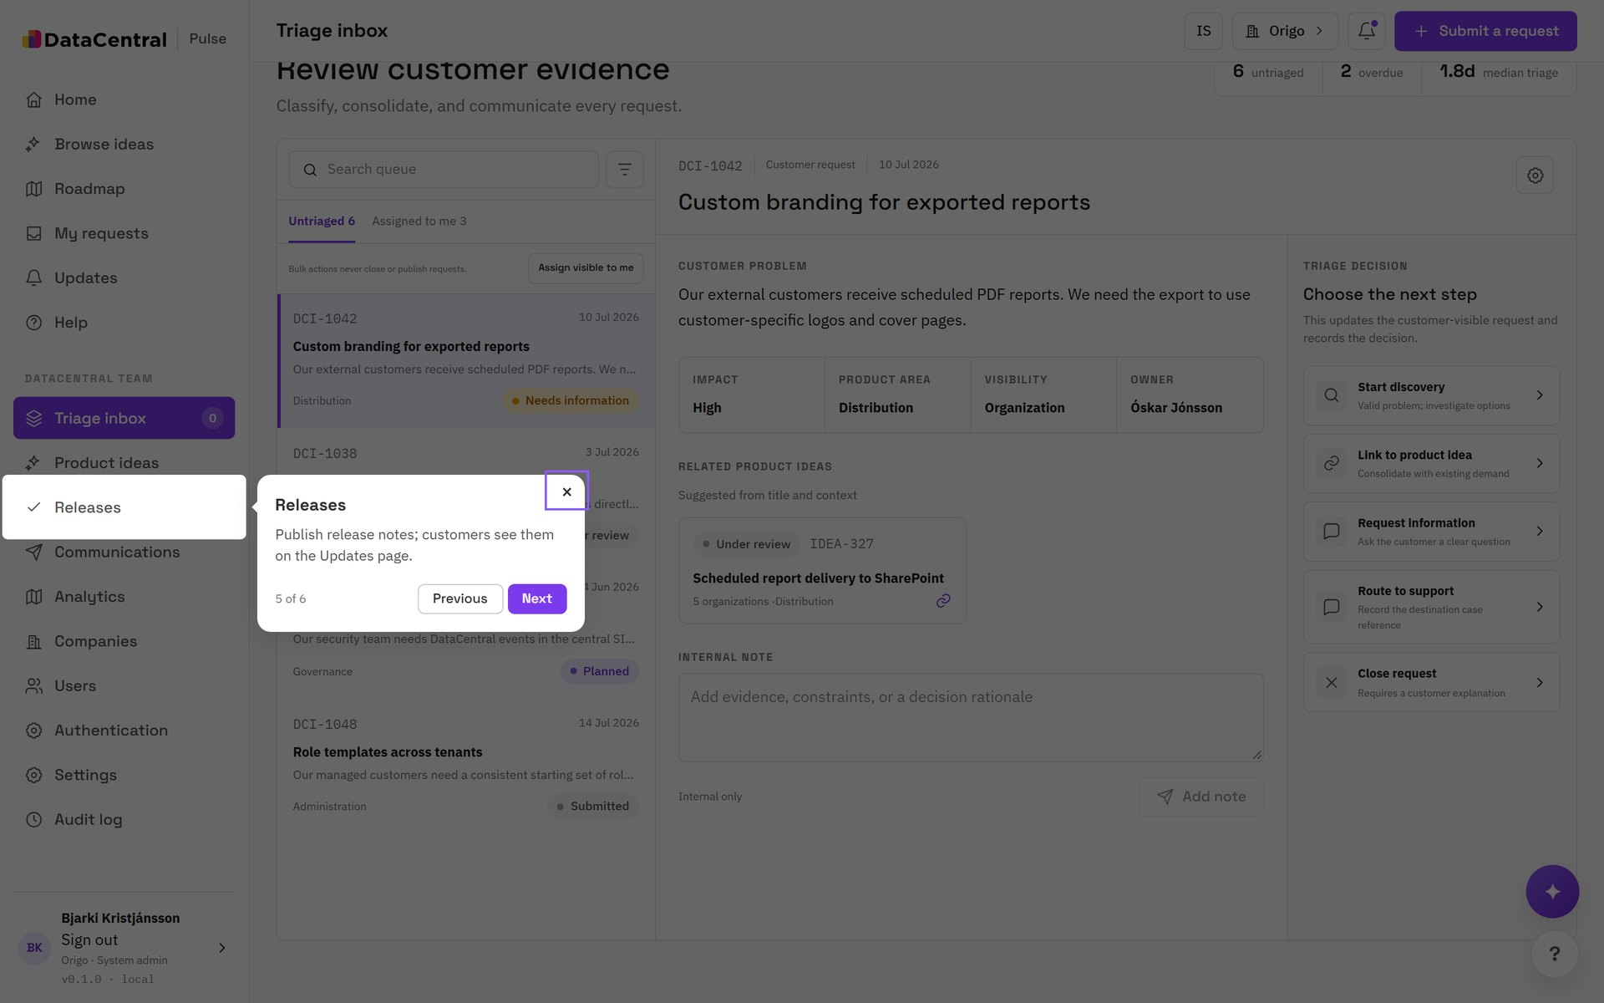
TOUR: TEAM WORKSPACE
Releases
STEP 5 OF 6
Bundle what shipped
Group ideas into a release with notes and an availability date. Publishing a release notifies the customers who asked.
TIP Use Draft customer email on a published release to start a communication.

Slide 9
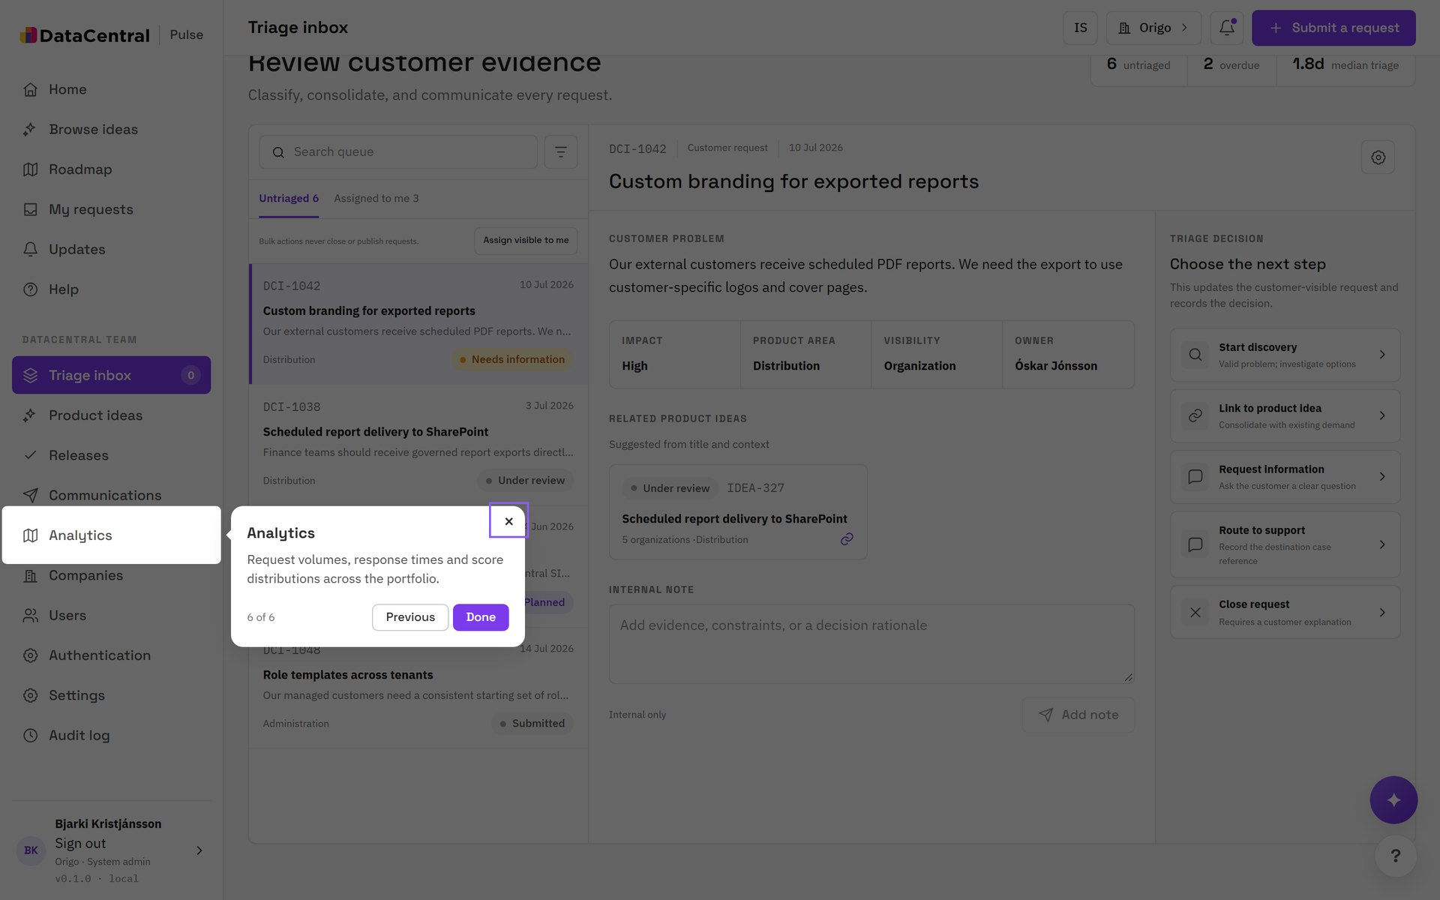
TOUR: TEAM WORKSPACE
Analytics
STEP 6 OF 6
See the shape of demand
Request volume, outcomes, response times and distribution across the portfolio, so prioritization rests on data.

Slide 10
01
Customer communications
Tell customers what shipped, in their language.

Slide 11
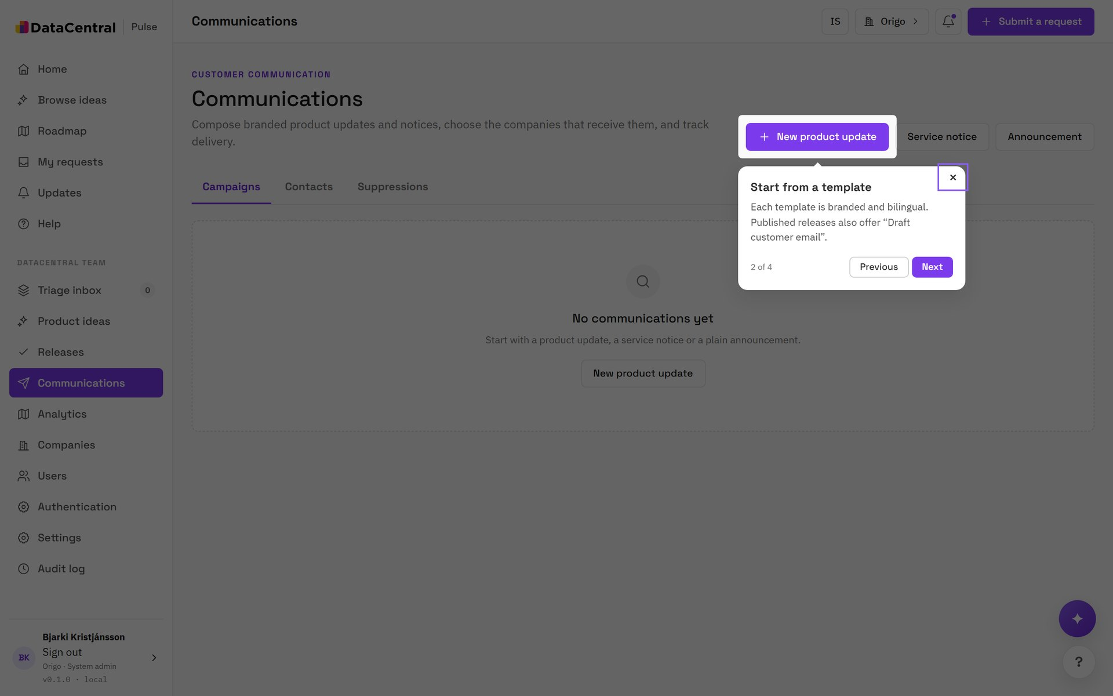
TOUR: CUSTOMER COMMUNICATIONS
Compose a communication
STEP 2 OF 4
Start from a template
Choose a product update, service notice or plain announcement. Each template is branded and bilingual. Published releases also offer Draft customer email.

Slide 12
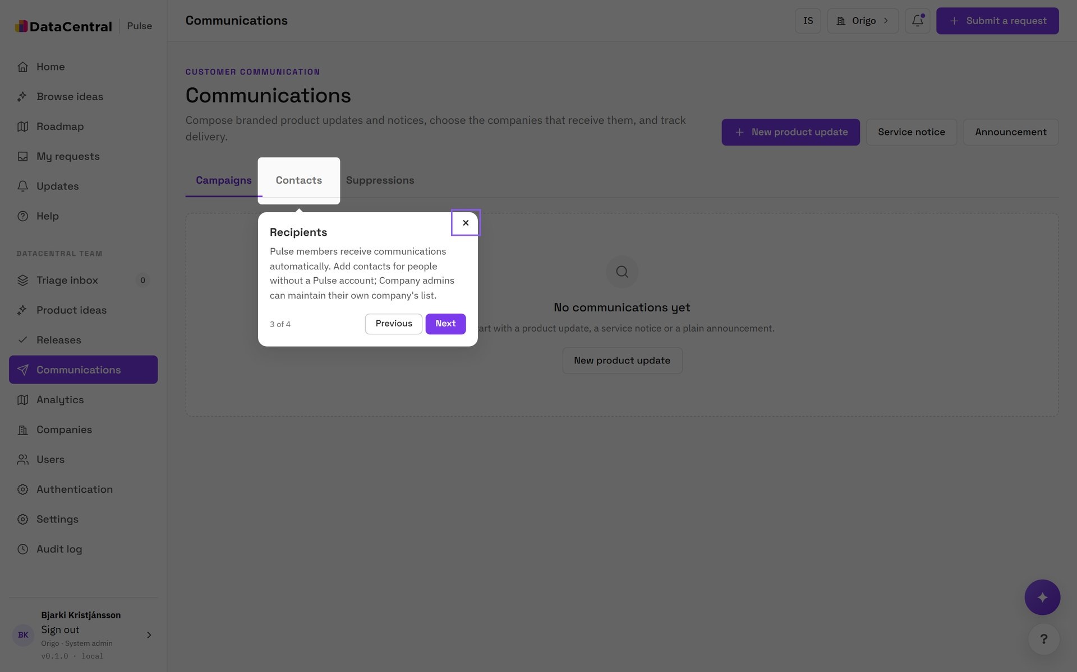
TOUR: CUSTOMER COMMUNICATIONS
Choose recipients
STEP 3 OF 4
Members and contacts
Pulse members receive communications automatically. Add contacts for people without a Pulse account. Company admins maintain their own company's list.
TIP Unsubscribes and bounces enter the suppression list and are honored on every future send.

Slide 13
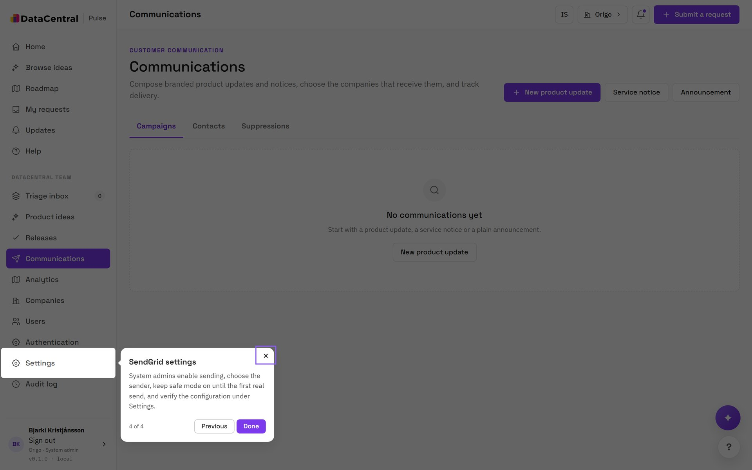
TOUR: CUSTOMER COMMUNICATIONS
SendGrid settings
STEP 4 OF 4
Sending is switched on deliberately
System admins enable sending, choose the sender, keep safe mode on until the first real send, and verify the configuration under Settings.

Slide 14
02
Administration
System admin only.

Slide 15
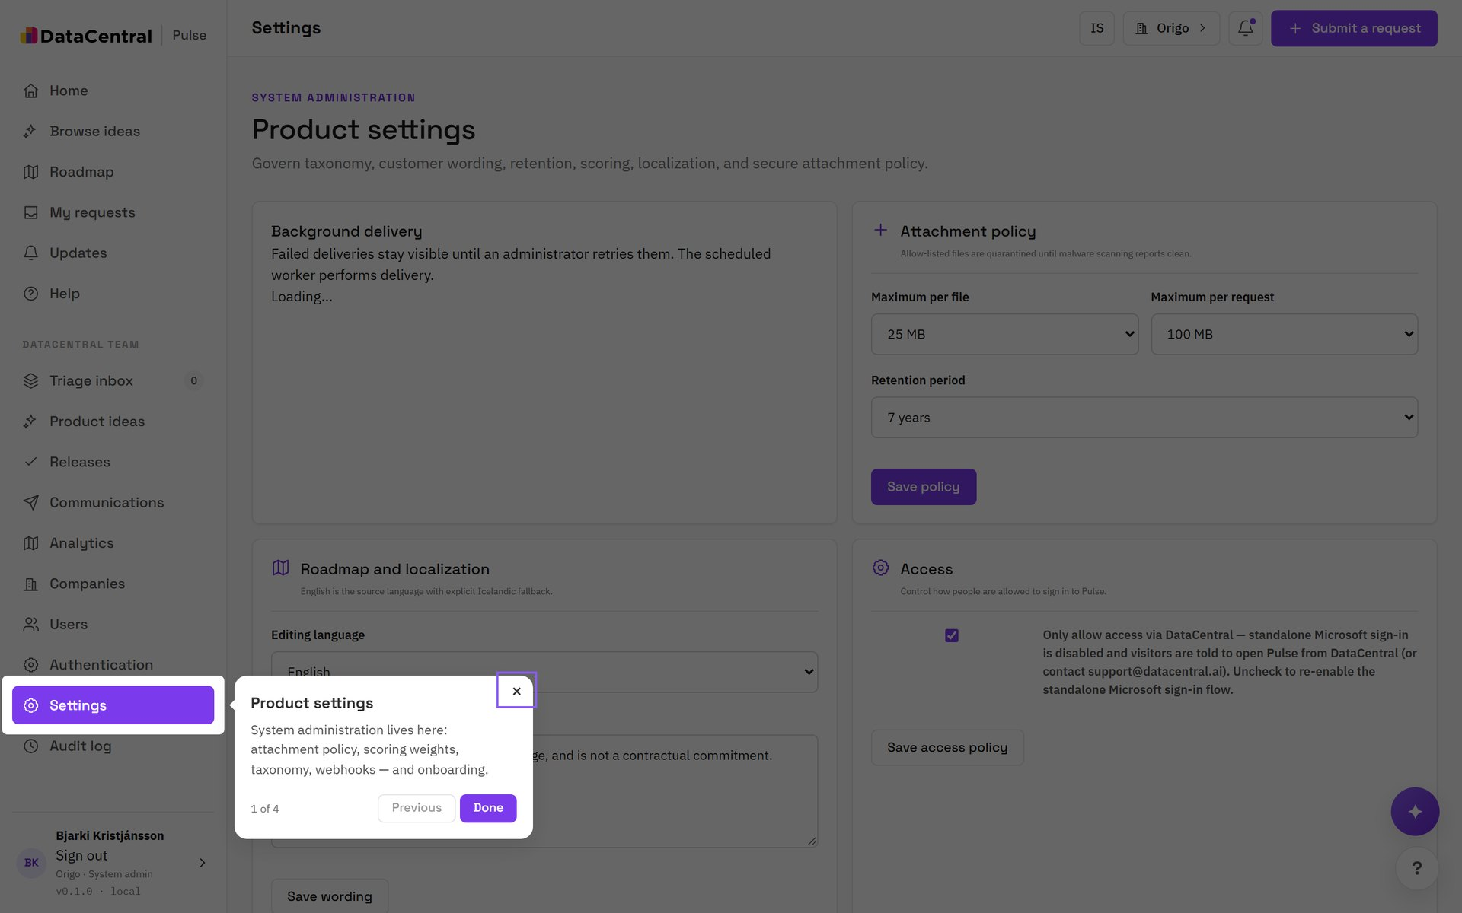
TOUR: ADMIN CONTROLS
Product settings
STEP 1 OF 4
Policy in one place
Attachment policy, scoring weights, taxonomy, webhooks and onboarding are configured under Settings.

Slide 16
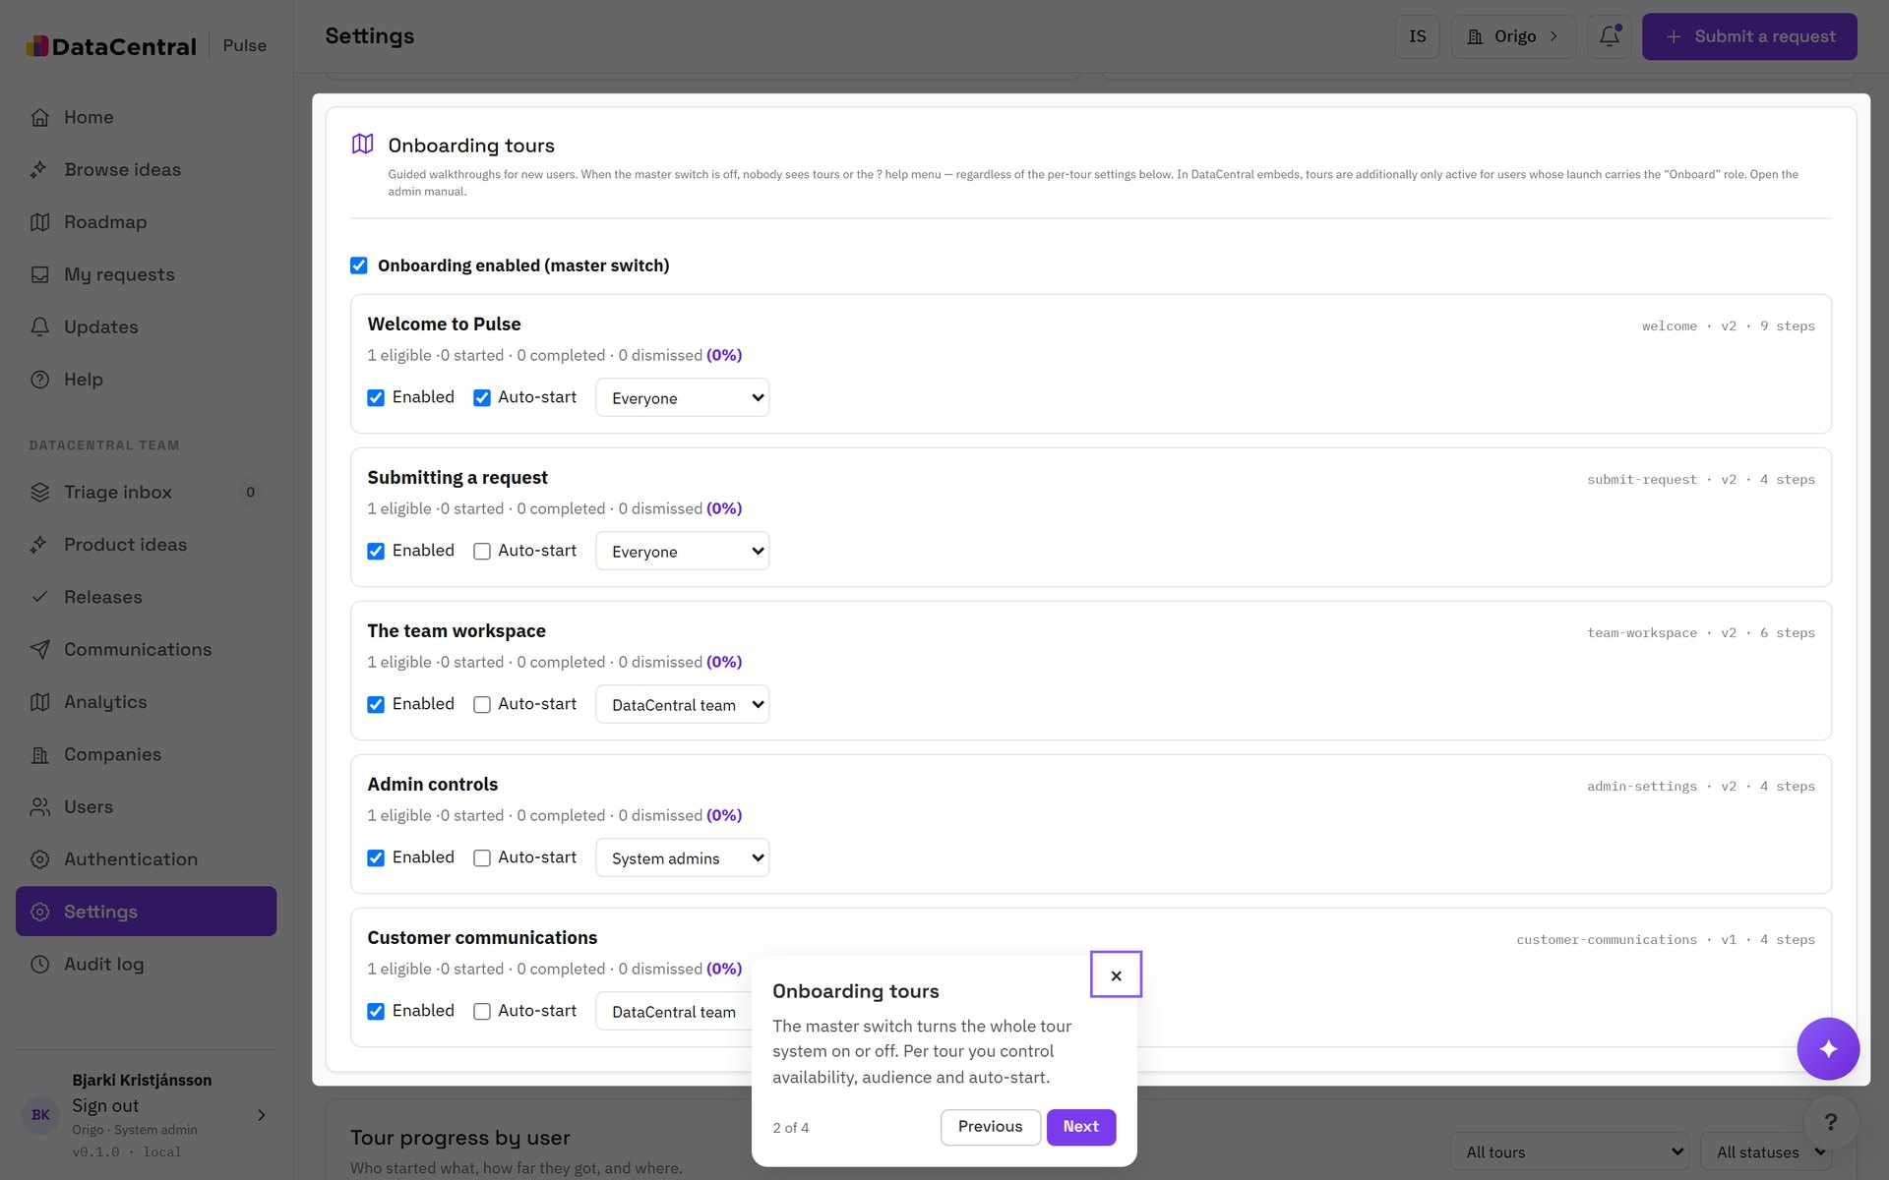
TOUR: ADMIN CONTROLS
Onboarding tours
STEP 2 OF 4
Control who sees which tour
The master switch turns the whole system on or off. Per tour you decide availability, audience and auto-start.

Slide 17
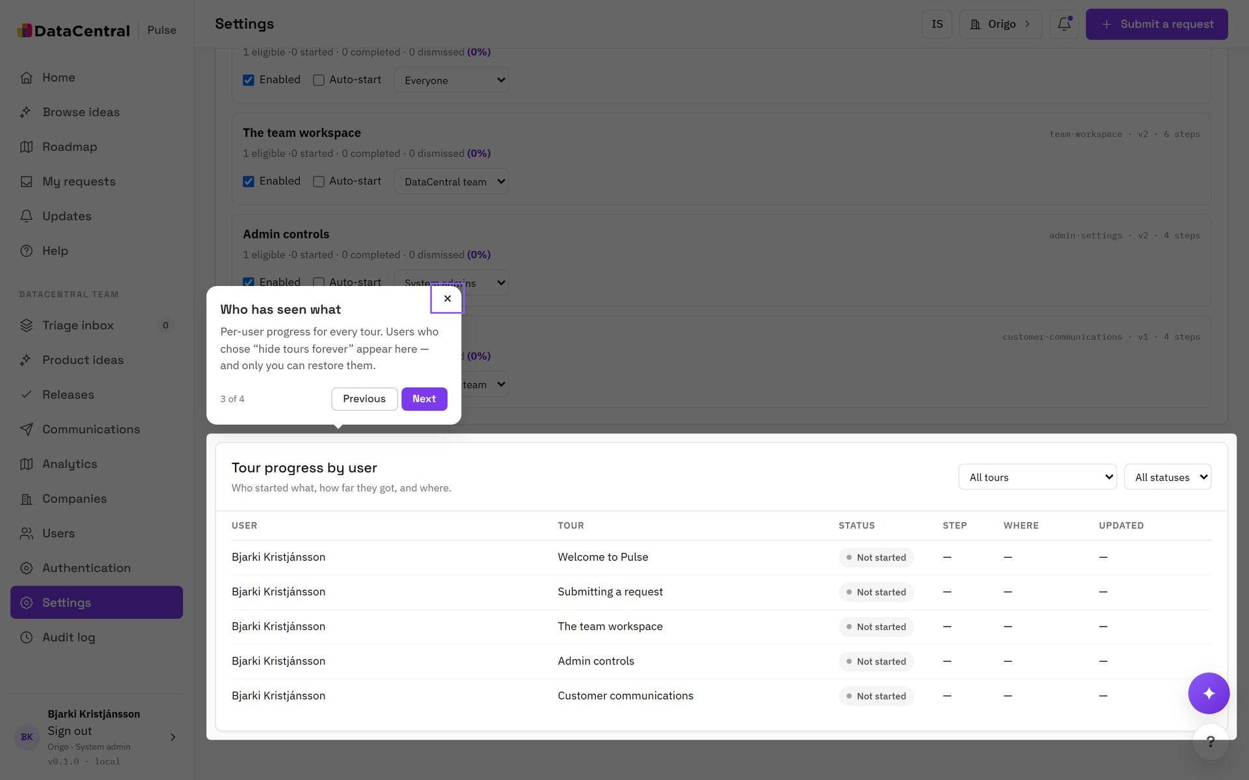
TOUR: ADMIN CONTROLS
Who has seen what
STEP 3 OF 4
Progress by person
See each user's status and last step per tour, and filter by tour or status. People can hide tours forever; only they can restore them.

Slide 18
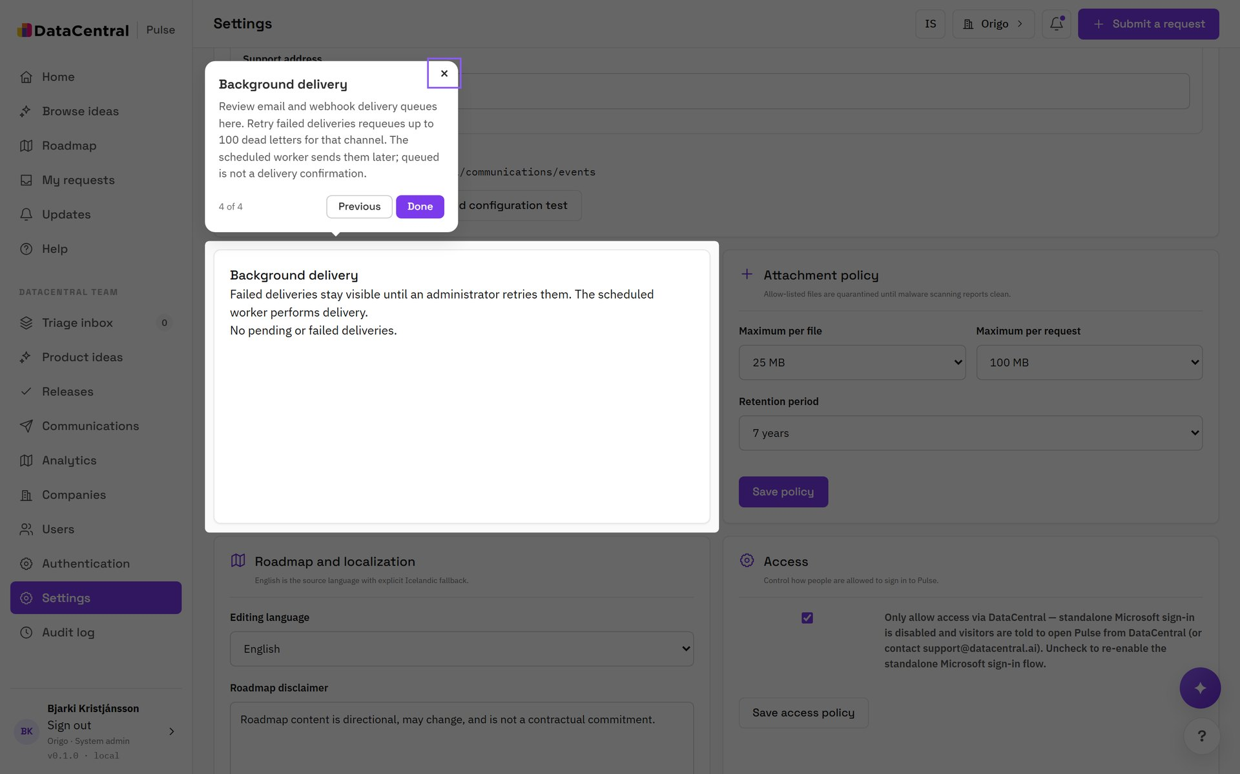
TOUR: ADMIN CONTROLS
Background delivery
STEP 4 OF 4
Watch the queues
Failed deliveries stay visible until an administrator retries them. The card covers notifications, webhooks and communications, including dead letters.

Slide 19
USERS AND SIGN-IN
Provision people, then choose how they sign in
1
2
3
Add the user
Pick the method
Verify access
Under Users, invite the person and set their organization membership and role.
Under Authentication, choose DataCentral launch, Microsoft Entra ID or email passcode per user.
Check the audit log. Authentication identifies the person; membership authorizes their access.

Slide 20
OPERATING PULSE
A short weekly checklist
Monday
Midweek
Friday
Clear the triage inbox. Every request has a next step and an owner.
Consolidate duplicates, rescore ideas and publish the ones ready for customers.
Release what shipped, send the customer email, and review delivery and dead letters.

Slide 21
Keep the loop closed: request, idea, release, email.
The ? button replays every tour. The help pages hold the full manual for administrators.
DataCentral Pulse · Manager guide

