Slide 1

PULSE · CUSTOMER COMMUNICATIONS
Sending release emails to customers
A step-by-step guide for Product managers and System admins: from a published release to delivered, measured email.
October 2026 · DataCentral team
Pulse · Customer communications
01

Slide 2

OVERVIEW
Six steps from a published release to a delivered email
1
2
3
4
5
6
Publish the release
Draft customer email
Write the content
Choose the audience
Review & send
Track delivery
Releases page
One click on the release
Editor · Content
Editor · Audience
Test, schedule or send
Communication detail
WHO DOES WHAT
Product managers and System admins
System admins
Company admins at the customer
Write, test and send communications. The rest of the DataCentral team reads the lists and the delivery results.
Own the Settings card: enable sending, choose the sender, keep safe mode on until the first real send, verify the configuration.
Keep their own recipient list on the Updates page. Every member switches each topic on or off for themselves.
Pulse · Customer communications
02

Slide 3
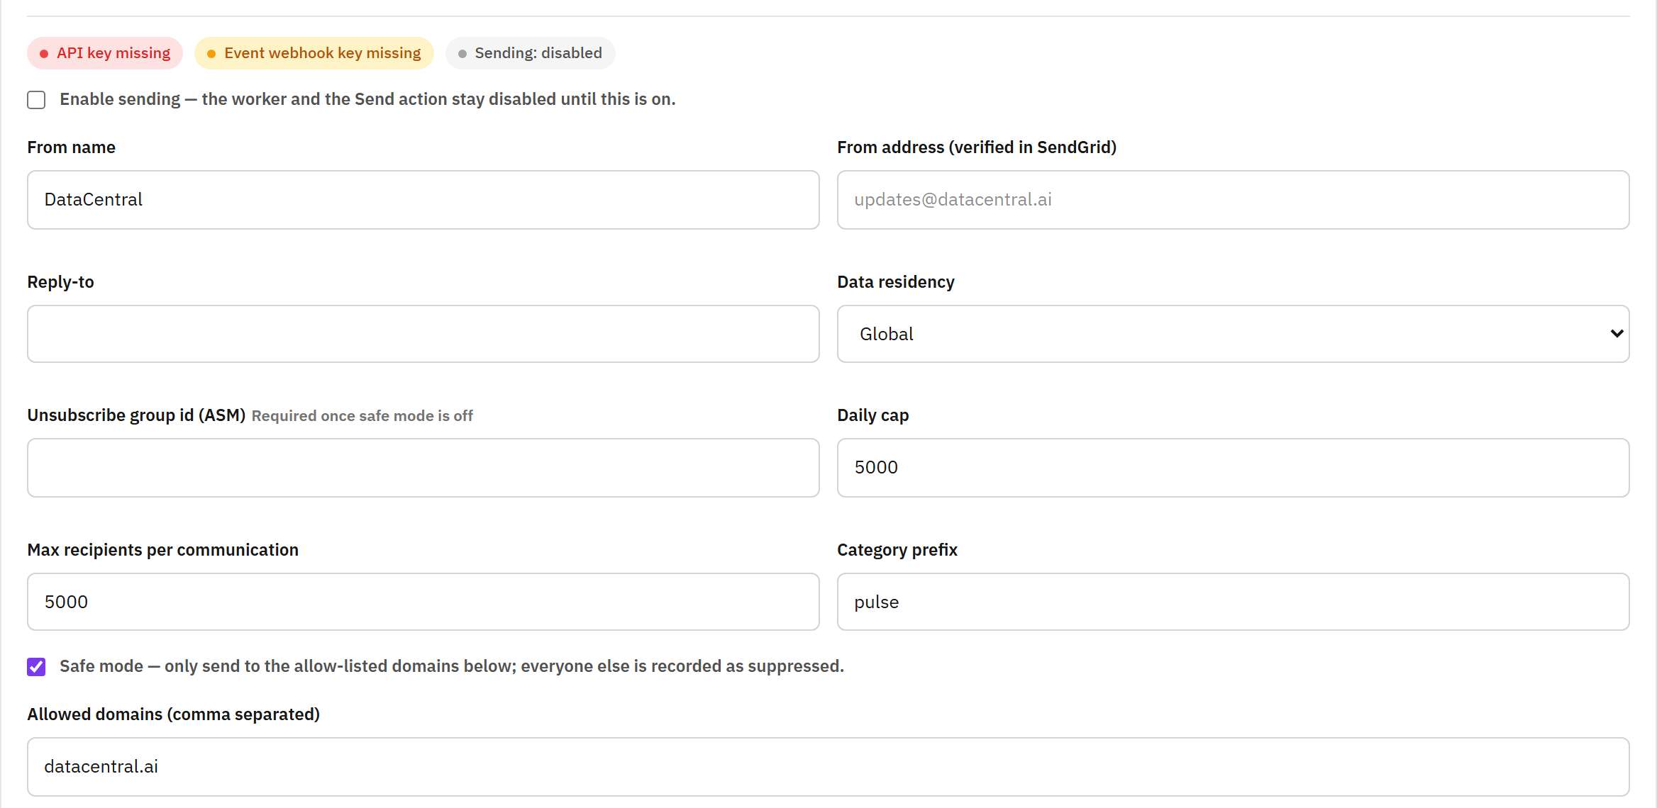
BEFORE YOU START
Before the first send: configure SendGrid once
Settings → “Customer communications (SendGrid)”. Only System admins see this card.
Turn on “Enable sending”. Until then the worker and the Send action stay disabled.
Set “From name” and a “From address (verified in SendGrid)”; add a “Reply-to” if replies should land elsewhere.
Enter the “Unsubscribe group id (ASM)”. It is required once safe mode is off, so every mail carries an unsubscribe link.
Keep “Safe mode” on until the first real send: only the allow-listed domains receive mail, everyone else is recorded as suppressed.
Press “Send configuration test” and check the mail that reaches your own address.
Keys never live on this page
The SendGrid API key and the event-webhook key come from Key Vault. The status pills at the top of the card tell you when one is missing.
Pulse · Customer communications
03

Slide 4
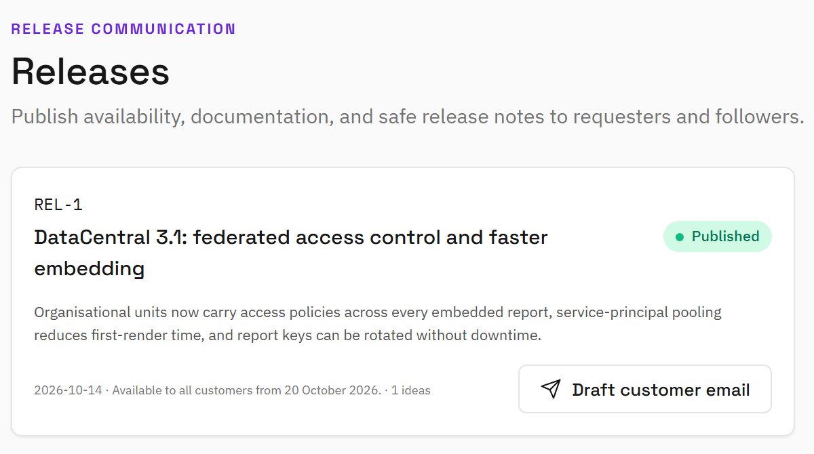
STEP 1 OF 6
1
Publish the release, then draft the email
Open Releases in the “DataCentral team” menu. Create the release as usual and publish it.
Published releases show “Draft customer email” on the card. Drafts do not.
One click creates a product update from the release: title, availability and summary are carried over.
The new draft opens in the Communications editor with its own id, for example COM-002, linked to the release.
Starting without a release
The Communications page also offers “New product update”, “Service notice” and “Announcement” for mail that is not tied to a release.
Pulse · Customer communications
04

Slide 5
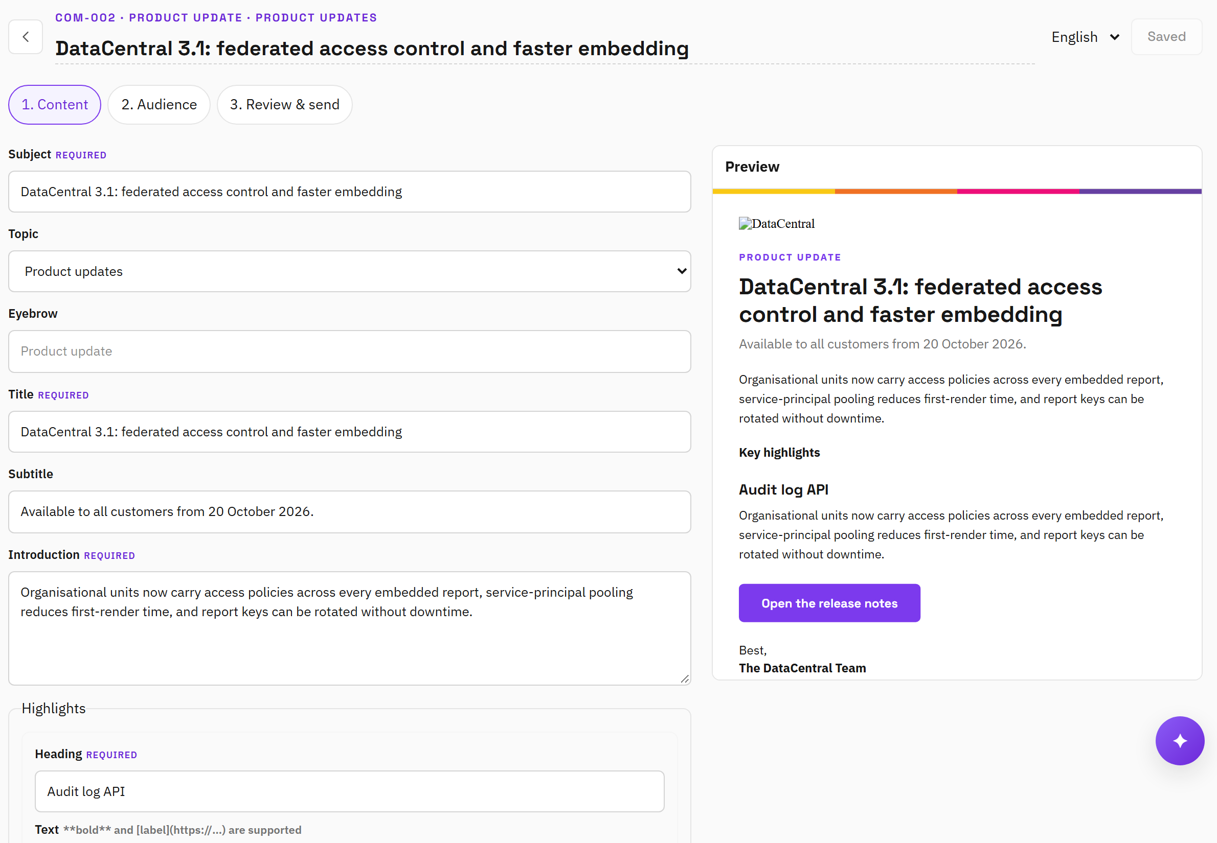
STEP 2 OF 6
2
Write the content
Subject and Title are required; Eyebrow, Subtitle and Introduction frame the message.
Add one highlight per change: a heading, a short text, an optional callout (note or action required) and an optional link.
Finish with a call to action, for example “Open the release notes”, and the sign-off from Settings.
Switch “Content language” to Icelandic to add the Icelandic text; “Copy from English” gives you a starting point. Missing Icelandic falls back to English.
The preview on the right shows the saved draft in the language you are editing. Save, then check it.
Writing for customers
Short sentences, active voice, numbers over adjectives. **bold** and [label](https://…) links are supported in highlight text.
Pulse · Customer communications
05

Slide 6
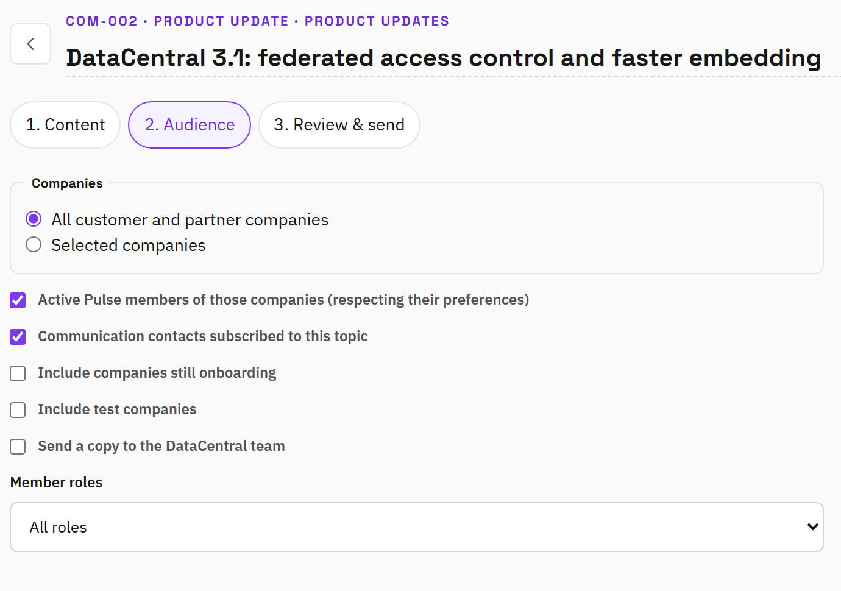
STEP 3 OF 6
3
Choose the audience
Pick “All customer and partner companies” or “Selected companies”.
Active Pulse members receive the mail according to their own topic preferences; contacts receive it when subscribed to the topic.
Companies still onboarding and test companies are left out unless you include them. “Send a copy to the DataCentral team” adds the staff copy.
Narrow by member role: all roles, Company admins and requesters, or Company admins only.
Addresses on the Suppressions tab and, in safe mode, domains outside the allow-list never receive mail. The counts show who is left out and why.
Pulse · Customer communications
06

Slide 7
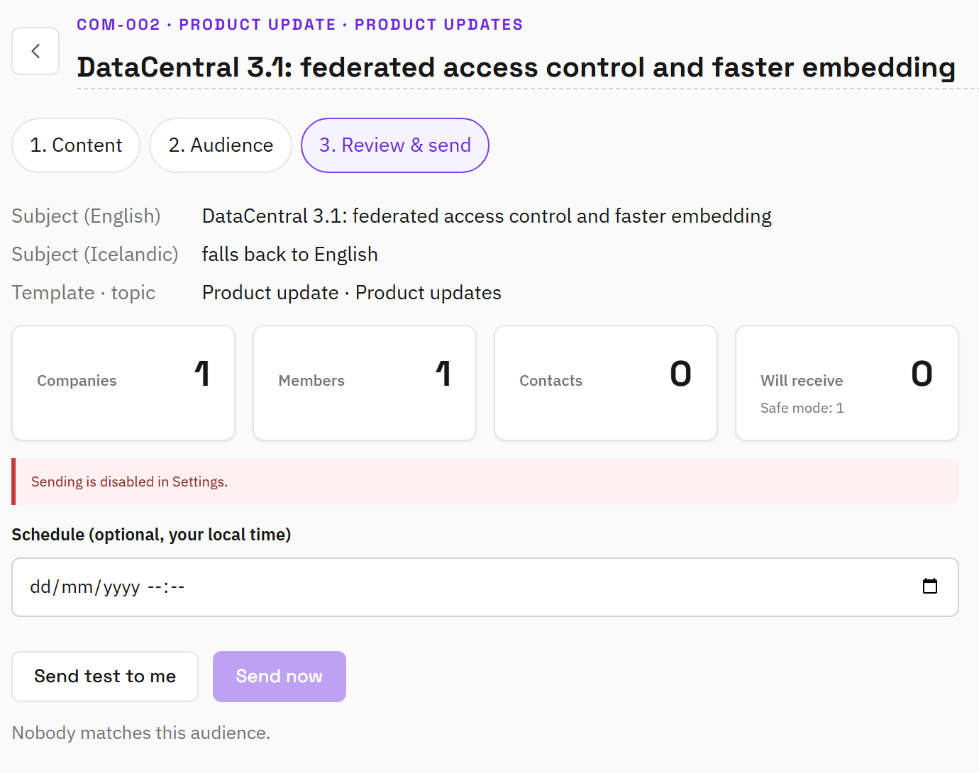
STEP 4 OF 6
4
Review & send: test, schedule or send now
The summary repeats subject, template and topic, with the counts: companies, members, contacts and “Will receive”.
A notice tells you when sending is disabled, in sandbox mode or in safe mode. Read it before you send.
Press “Send test to me”. The mail arrives at your own address marked [TEST] and never counts in the results.
Leave the schedule empty and press “Send now”, or pick a time in your local time and press “Schedule”. Both ask you to confirm.
Content and audience are frozen once sending starts. “Unschedule” returns a scheduled mail to a draft; “Cancel sending” stops what SendGrid has not received yet.
Pulse · Customer communications
07

Slide 8
STEP 5 OF 6
5
Track delivery and follow up
The Communications list shows every campaign with its status, recipients and send time; open one for the detail page.
Each recipient moves through these states on the communication detail page
Queued
Accepted
Delivered
Deferred
Bounced
Dropped
Dead letter
Suppressed
Cancelled
Queued, Accepted and Delivered are the normal path: Pulse hands the mail to SendGrid, which confirms delivery.
Opens and clicks are counted separately when tracking is on in Settings.
Deferred means the receiving server asked for more time; Pulse retries by itself.
Filter the recipients by company or state; the last event and its time are shown per row.
Dead letter means every attempt failed. “Retry dead letters” queues those recipients again.
“Cancel sending” stops what SendGrid has not received yet; mail already handed over is not recalled.
Suppressed recipients were left out before sending: unsubscribed, bounced, or outside safe mode.
“Duplicate” starts the next communication from a sent one with the same content and audience.
Pulse · Customer communications
08

Slide 9
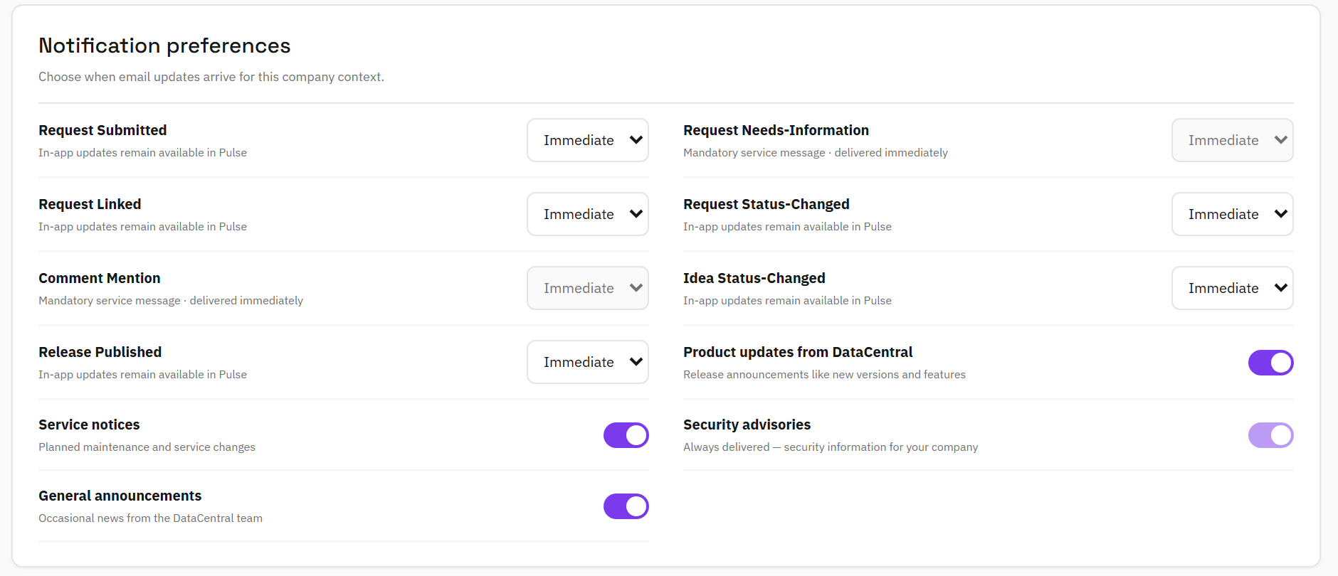
STEP 6 OF 6 · RECIPIENTS
6
Who receives it
Every Pulse member decides on the Updates page, under “Notification preferences”, whether to receive product updates, service notices and general announcements.
Security advisories are always delivered; the switch is locked on.
People without a Pulse account live on the Contacts tab of the Communications page: add them one by one or with “Paste list”, with a language and topics.
Company admins keep their own list under “Who receives DataCentral communications for your company” on their Updates page.
Bounces, spam reports and unsubscribes join the Suppressions tab by themselves. A suppressed address never receives mail again, whatever company it belongs to.
Pulse · Customer communications
09

Slide 10
BEFORE YOU PRESS SEND
A short checklist for every release email
✓
The release is published
✓
Both languages read well
The customer email links to release notes that already exist.
Icelandic text is in place, or the English fallback is acceptable for this mail.
✓
A test mail reached you
✓
The audience counts make sense
“Send test to me” from the Review step; open it on a phone as well.
“Will receive” matches your expectation; the suppressed count has a reason you understand.
✓
The notice is clear
✓
The timing is right
No “disabled”, “sandbox” or unexpected “safe mode” warning on the Review step.
Schedule for a working morning in Iceland; sending is frozen once it starts.
Learn more in Pulse
Open the ? menu and start the “Customer communications” tour, or read the “Customer communications” section of the help manual (Help → Admin manual).
Pulse · Customer communications
10

Slide 11
PULSE · CUSTOMER COMMUNICATIONS
Every release, announced to the right people, in their language, with delivery you can see.
Questions: the DataCentral team · support@datacentral.ai
Pulse · Customer communications
11

