Slide 1

Brandon Jarratt, Nathan Clark, Chris Bennett, David Nolan
Software Engineering Final Presentation
Section 502

Slide 2
Roles and Responsibilities
Nathan
Programmed Database
General Programming
Brandon
Web User Interface Design
General Programming
Chris
Web User Interface Design
General Programming
David
Project Management
General Programming

Slide 3
Three Low Level Use Cases
Manage Inventory
Add vehicle
Sell vehicle
View individual vehicles
Messaging
Send message
View messages
Mark Message as read
Use Cases

Slide 4
Core Requirements
provide a salesperson with various prices for the car
mark the car as Pending Sale and the manager could sign off on the price
manager would remove the car from inventory at the lot
manager needs to be able to enter new cars into the software
manager should be able to select common features such as the make, model, condition of car
Admin should be able to add new dealerships and new employees, as well as new makes and models

Slide 5
Core Requirements
When a dealership is removed, be able to list past employees in a "Limbo" list
have all dealerships using the same database system
Allow shipping and trading cars between dealership. Have a manager or admin initiate a trade and allow the receiving end to accept or decline
Allow other managers or admin to search other dealership's inventory
There should be an internal system of messaging other than email
Dealerships should be able to sell other types of vehicles such as boats, RV's, motorcycles, etc.
Allow employees to have multiple roles at more than one dealership

Slide 6
Underlying Structure
Database Schema
Architecture Diagram
Conceptual Model

Slide 7
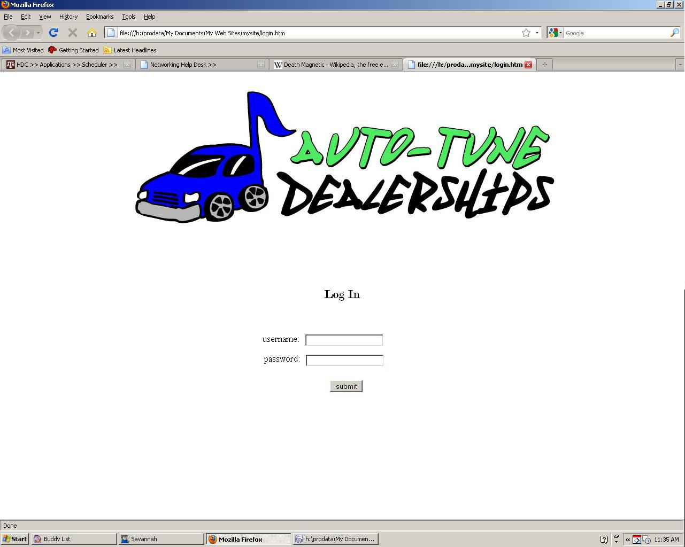
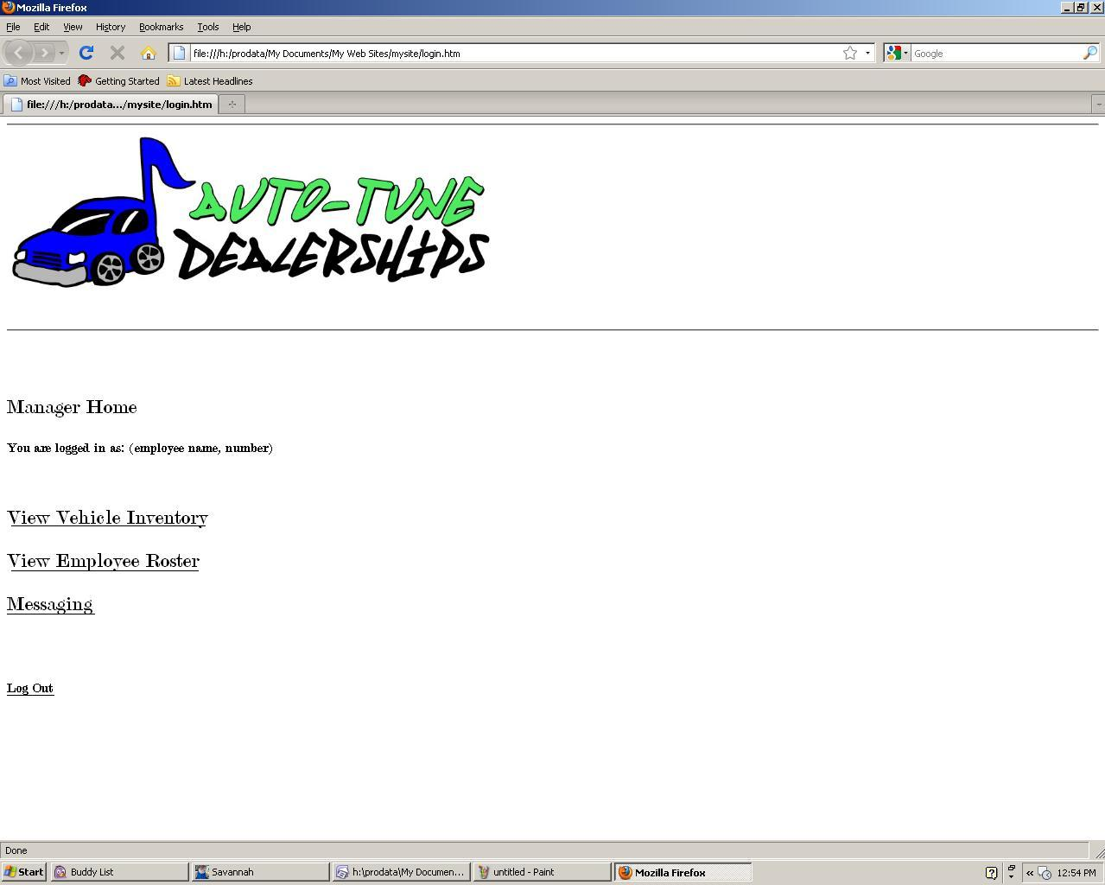
Initial Interface

Slide 8
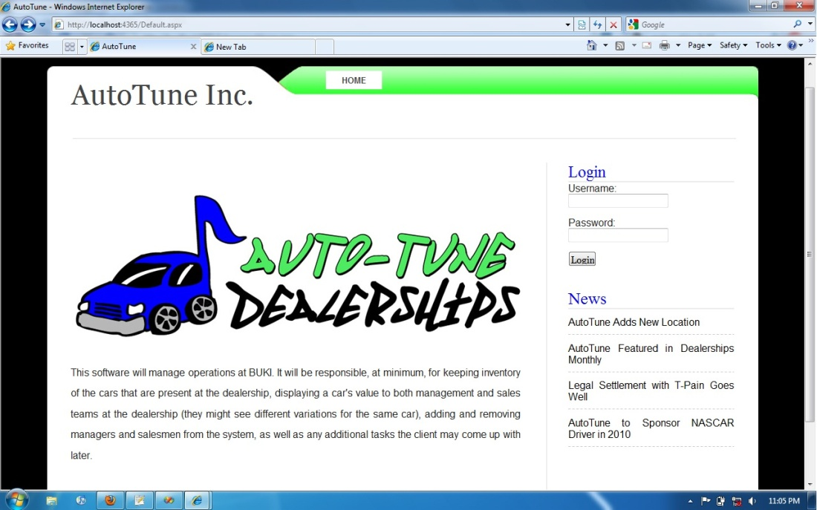
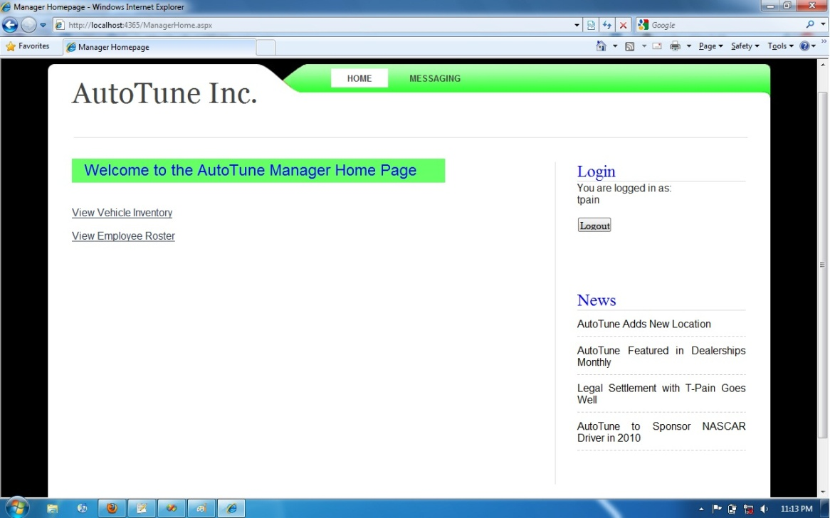
Final Interface

Slide 9
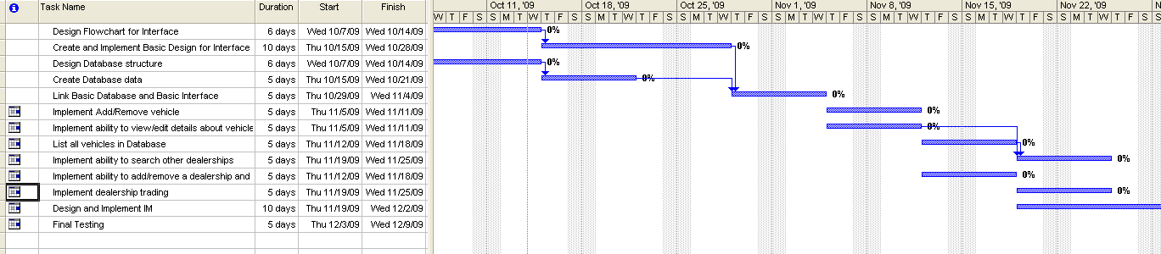
Schedule and Planning
Initial plan called for generalized database that could be implemented across a wide range of applications
Modular planning model utilized to maximize initial group member autonomy and productivity
Extensive testing period planned for final phase rather than per-unit testing as new portions were integrated
Spiral model allowed for risk assessment and adaptation to fit our needs

Slide 10
Management and Standards
Coding:
Stick with default convention for each language utilized (ASPX, HTML)
Keep uniform variable names format, tabbing and bracketing
Develop in the Visual Studio environment for consistency
Bugs:
Submitted through Google Code page using default format
Subversion:
Check for conflicts in the repository before committing large code changes
Notify group members when changes have been committed
Update the repository with most recent changes before beginning a work session
Management: Loose Structured

Slide 11
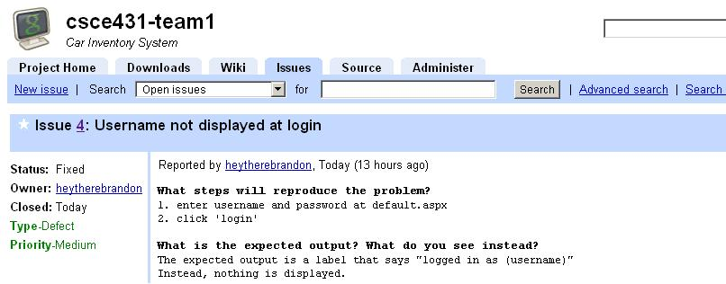
Bug Reports
Fixed by…
Rerouting the user to the default.aspx page if they are not logged in

Slide 12
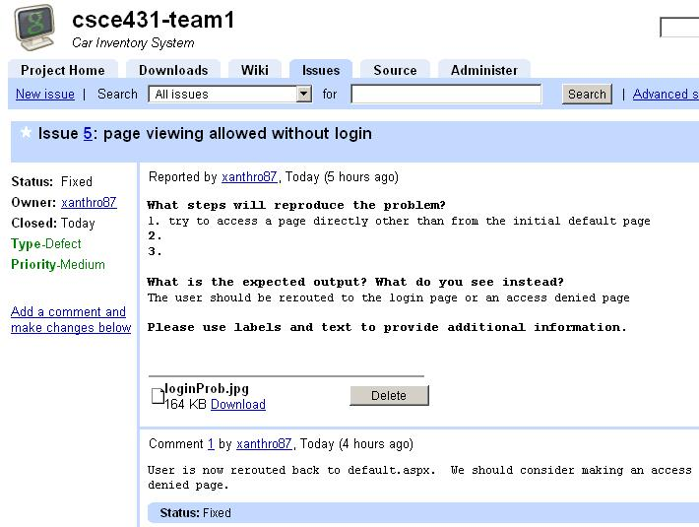
Bug Reports
Fixed by…
Adding a label to the ASP “LabelContentPlaceholder” field.

Slide 13
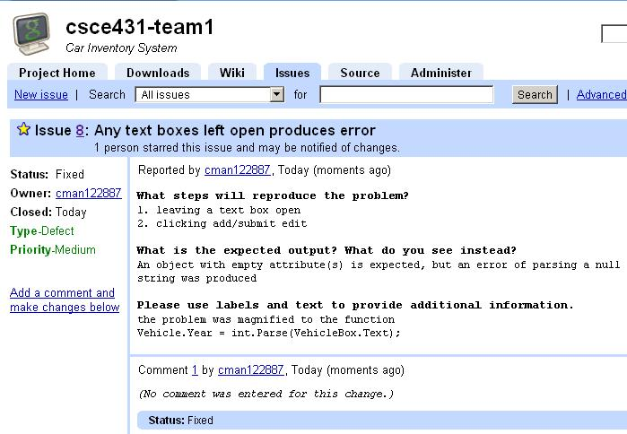
Bug Reports
Fixed by…
Changing the type of the messaging link to LinkButton and setting its class to “active”

Slide 14
Evaluation
What did we implement successfully?
Final Use Cases
What did we leave out?
Dropped Use Cases

