Slide 1

Brandon Jarratt, Nathan Clark, Chris Bennett, David Nolan
Software Engineering Final Presentation
Section 502

Slide 2
Roles and Responsibilities
Nathan
Programmed Database
General Programming
Brandon
Web User Interface Design
General Programming
Chris
Web User Interface Design
General Programming
David
Project Management

Slide 3
Three Low Level Use Cases
Manage Inventory
Add vehicle
Sell vehicle
View individual vehicles
Messaging
Send message
View messages
Mark Message as read
Use Cases

Slide 4
Core Requirements
provide a salesperson with various prices for the car
mark the car as Pending Sale and the manager could sign off on the price
manager would remove the car from inventory at the lot
manager needs to be able to enter new cars into the software
manager should be able to select common features such as the make, model, condition of car
Admin should be able to add new dealerships and new employees, as well as new makes and models

Slide 5
Core Requirements
When a dealership is removed, be able to list past employees in a "Limbo" list
have all dealerships using the same database system
Allow shipping and trading cars between dealership. Have a manager or admin initiate a trade and allow the receiving end to accept or decline
Allow other managers or admin to search other dealership's inventory
There should be an internal system of messaging other than email
Dealerships should be able to sell other types of vehicles such as boats, RV's, motorcycles, etc.
Allow employees to have multiple roles at more than one dealership

Slide 6
Underlying Structure
Database Schema
Architecture Diagram
Conceptual Model

Slide 7
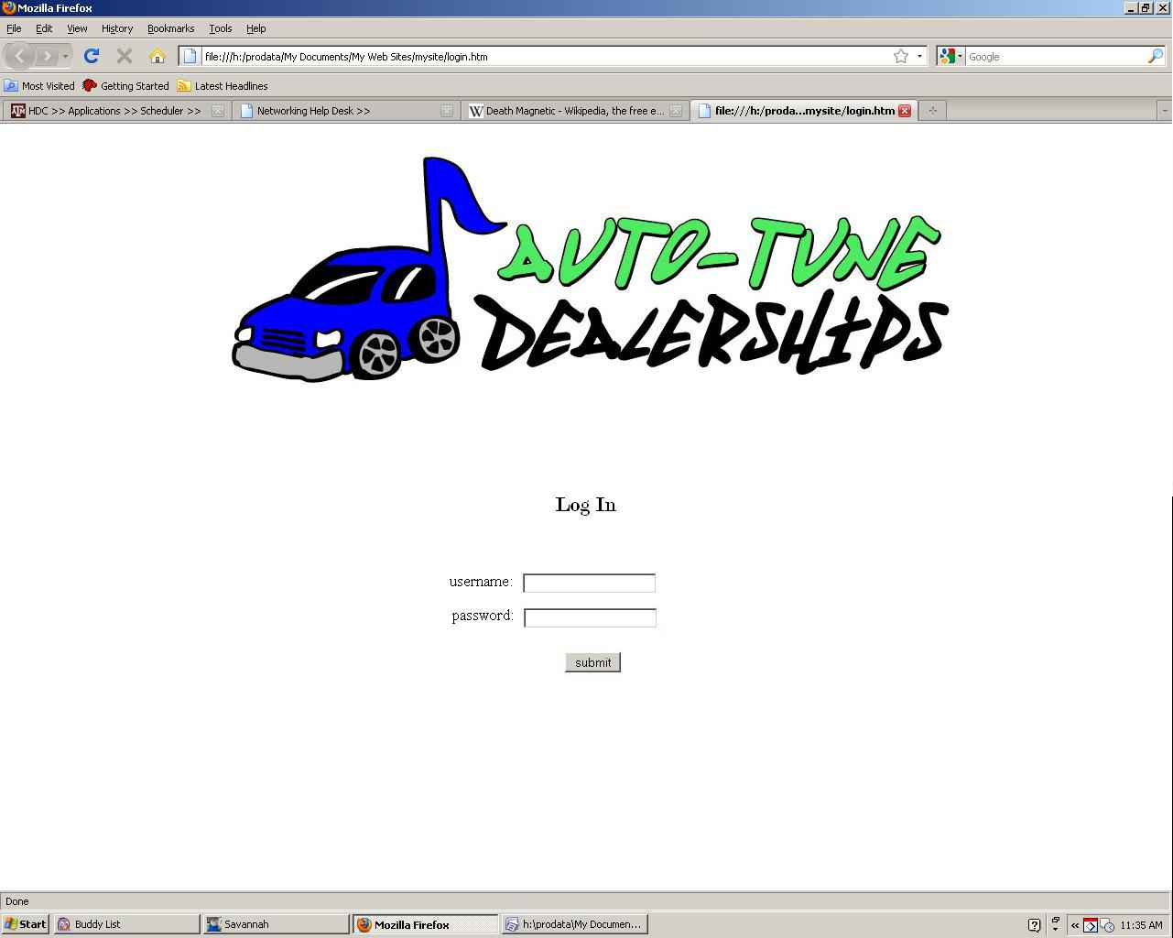
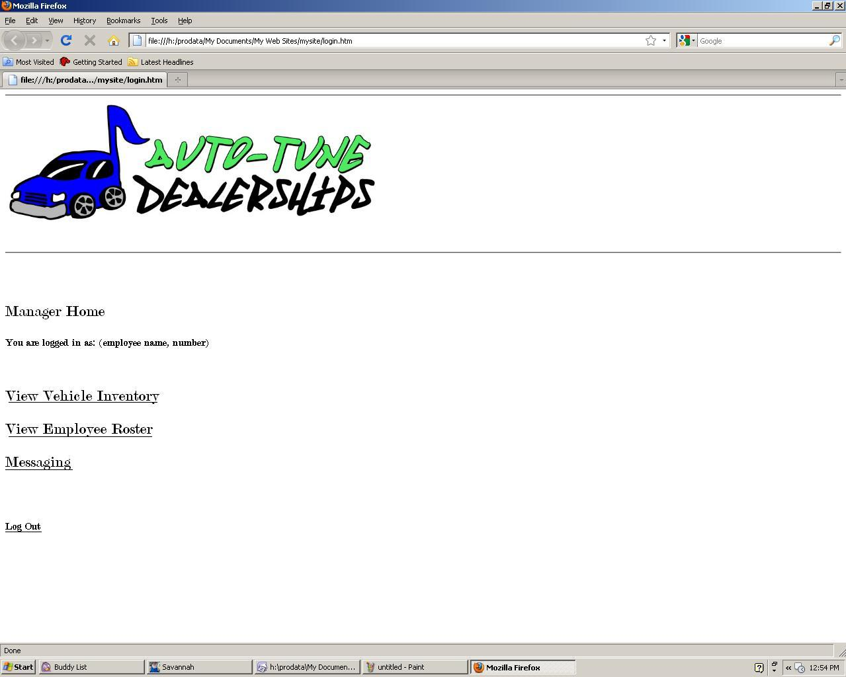
Initial Interface

Slide 8
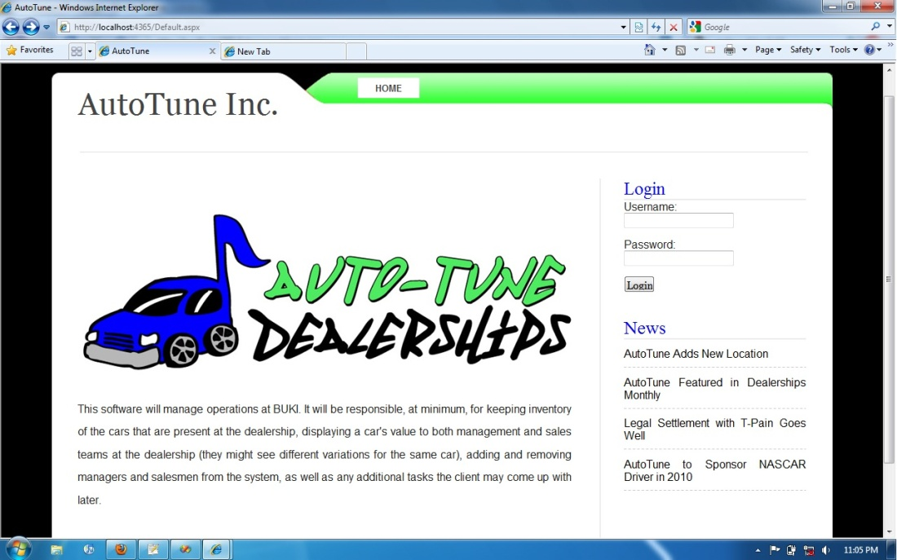
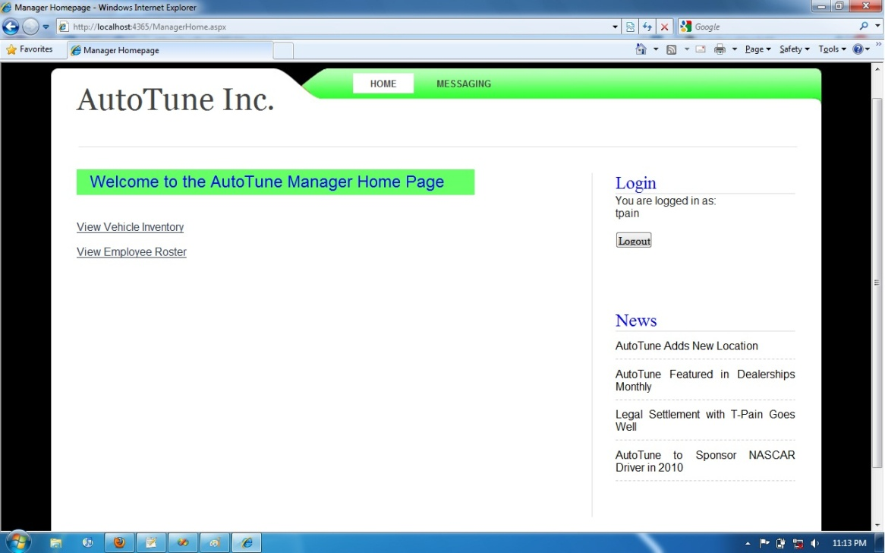
Final Interface

Slide 9
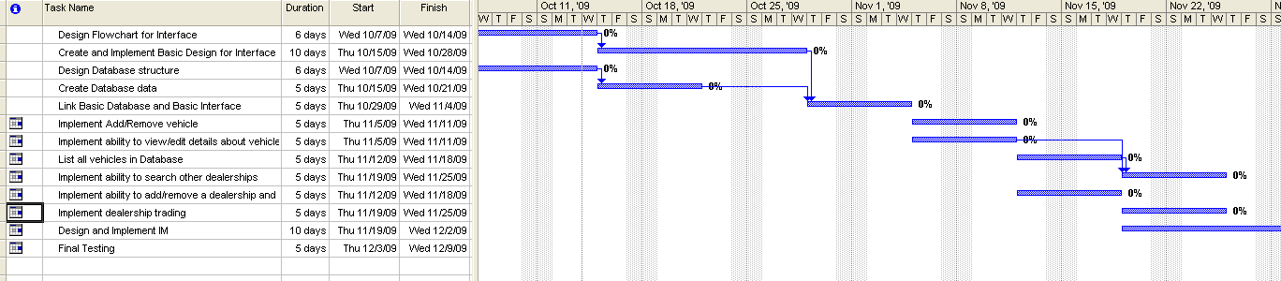
Schedule and Planning
Initial plan called for generalized database that could be implemented across a wide range of applications
Modular planning model utilized to maximize initial group member autonomy and productivity
Extensive testing period planned for final phase rather than per-unit testing as new portions were integrated
Spiral model allowed for risk assessment and adaptation to fit our needs

Slide 10
Management and Standards
Coding:
Stick with default convention for each language utilized (ASPX, HTML)
Keep uniform variable names format, tabbing and bracketing
Develop in the Visual Studio environment for consistency
Bugs:
Submitted through Google Code page using default format
Subversion:
Check for conflicts in the repository before committing large code changes
Notify group members when changes have been committed
Update the repository with most recent changes before beginning a work session
Management: Loose Structured

Slide 11
Bug Reports
Some sample issues:
PAGE VIEWING ALLOWED WITHOUT LOGGING IN
What steps will reproduce the problem?
try to access a page directly other than from the initial default page
What is the expected output? What do you see instead?
The user should be rerouted to the login page or an access denied page
Fixed by…
Rerouting the user to the default.aspx page if they are not logged in

Slide 12
Bug Reports
Some sample issues:
USERNAME NOT DISPLAYED AT LOGIN
What steps will reproduce the problem?
enter username and password at default.aspx
click 'login'
What is the expected output? What do you see instead?
The expected output is a label that says "logged in as (username)."
Instead, nothing is displayed.
Fixed by…
Adding a label to the ASP “LabelContentPlaceholder” field.

Slide 13
Bug Reports
Some sample issues:
MESSAGING PAGE LINK NOT DISPLAYED AS A BUTTON
What steps will reproduce the problem?
log in with username and password
click on the "Messaging" link at the top of the page
What is the expected output? What do you see instead?
The message link should be displayed as a white rectangle labeled with the word
"Messaging." Instead it's just displayed as text.
Fixed by…
Changing the type of the messaging link to LinkButton and setting its class to “active”

Slide 14
Process for
Requirements
Specifications
Design
Programming
testing and integration

