Slide 1

Brandon Jarratt, Nathan Clark, Chris Bennett, David Nolan
Software Engineering Final Presentation
Section 502

Slide 2
Roles and Responsibilities
Nathan
Programmed Database
General Programming
Brandon
Web User Interface Design
General Programming
Chris
Web User Interface Design
General Programming
David
Project Management

Slide 3
Three Low Level Use Cases
Manage Inventory
Add vehicle
Sell vehicle
View individual vehicles
Messaging
Send message
View messages
Mark Message as read

Slide 4
Core Requirements
provide a salesperson with various prices for the car
mark the car as Pending Sale and the manager could sign off on the price
manager would remove the car from inventory at the lot
manager needs to be able to enter new cars into the software
manager should be able to select common features such as the make, model, condition of car
Admin should be able to add new dealerships and new employees, as well as new makes and models

Slide 5
Core Requirements
When a dealership is removed, be able to list past employees in a "Limbo" list
have all dealerships using the same database system
Allow shipping and trading cars between dealership. Have a manager or admin initiate a trade and allow the receiving end to accept or decline
Allow other managers or admin to search other dealership's inventory
There should be an internal system of messaging other than email
Dealerships should be able to sell other types of vehicles such as boats, RV's, motorcycles, etc.
Allow employees to have multiple roles at more than one dealership

Slide 6
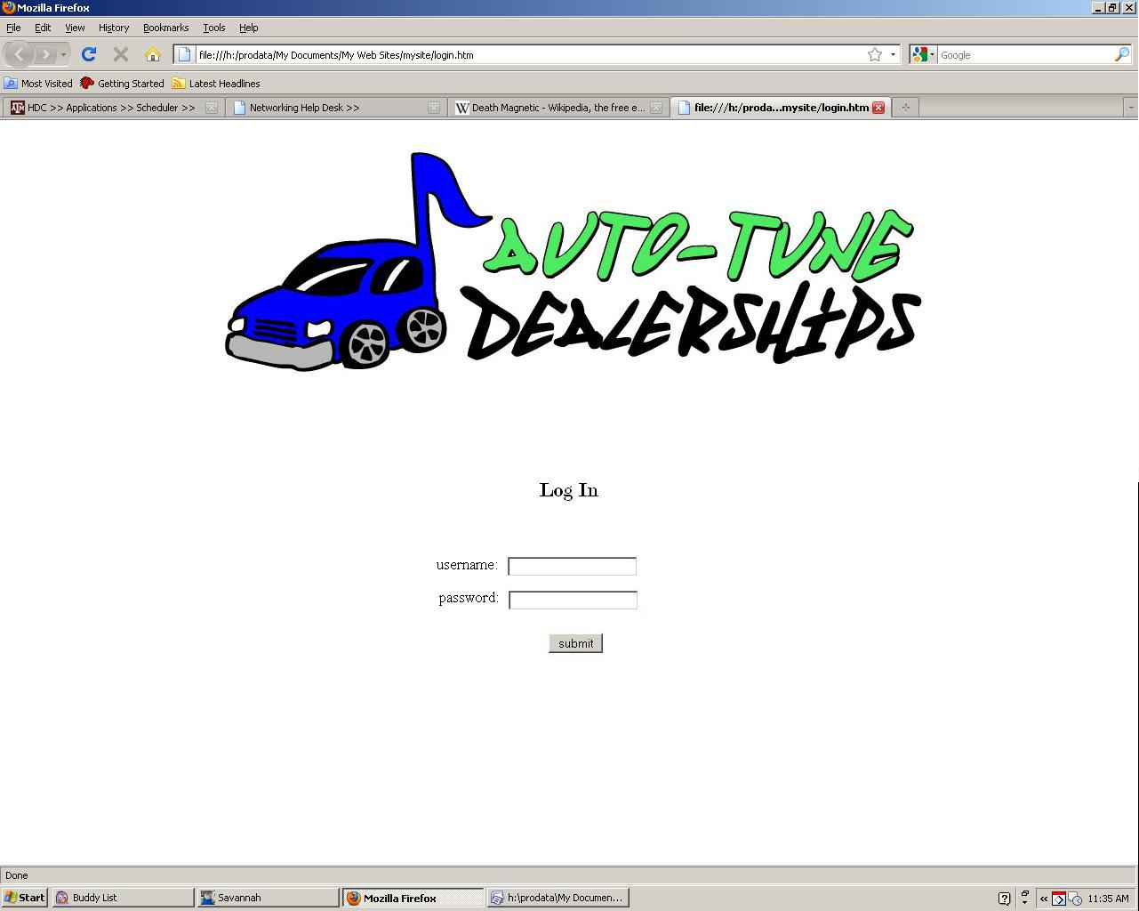
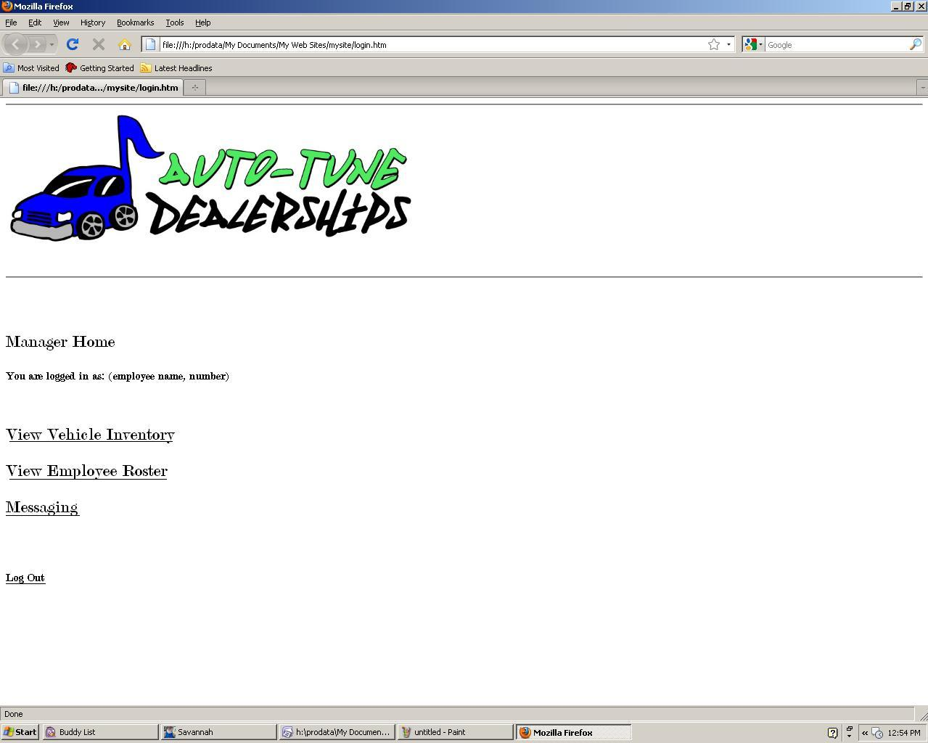
Interface Diagram(Before)

Slide 7
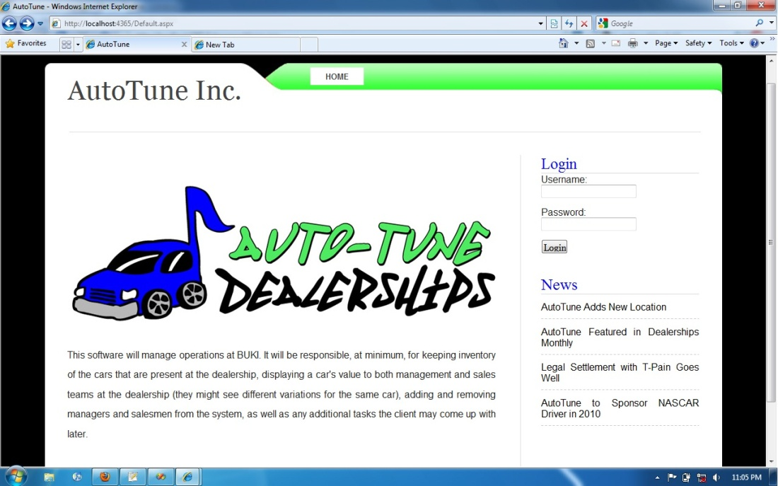
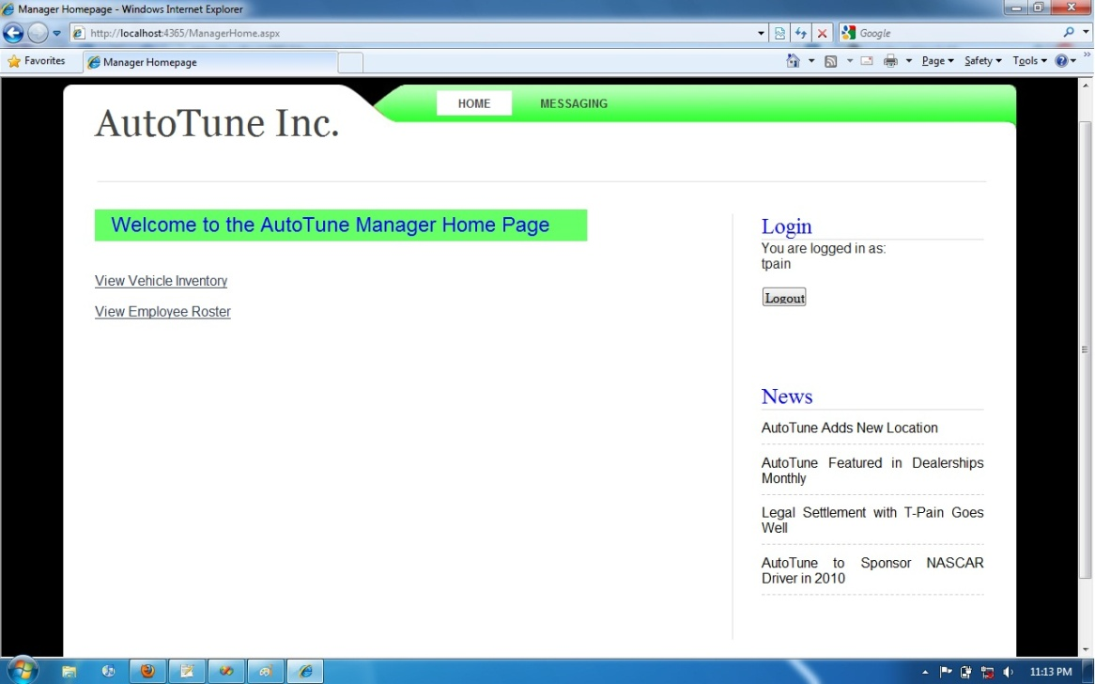
Interface Diagram(After)

Slide 8
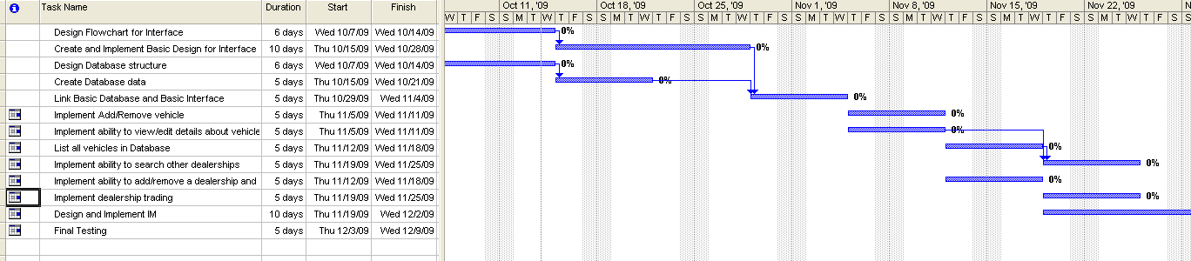
Schedule
initial messaging system involved RSS feed, scrapped in favor storing messages on the database
linking db and interface were not implemented until much later, as was the data to be entered
general database structure should have been iterative instead, making simple functionality available early in the dev process

Slide 9
Standards

Slide 10
Bug Reports

Slide 11
Process for
Requirements
Specifications
Design
Programming
testing and integration

