Slide 1

Coevolution of Medical Malpractice Claims and Mortality Due to Complications of Medical Care
Bryce Bartlett, PhD Candidate (Sociology)
Conference on Empirical Legal Studies
November 19, 2016
National Institute of Aging grant (NIA 5T32 AG000139-27)

Slide 2
An Endogenous System Model
  [picture]

Slide 3
Overview
Hypotheses
  Cross-influence of mortality and malpractice
Combined Administrative Data
  CDC Mortality and NPDB
  3. Models and Results
  Hybrid Poisson
  4. Discussion & Next Steps

Slide 4
Error, Mortality, and Patient Safety
  Goals of the Malpractice Tort System:
  1. Remuneration.
  2. Efficient delivery of medical care.

Slide 5
Error, Mortality, and Patient Safety
  Rational Choice Theory
  Treatment decisions are a function of costs and benefits across the severity of a condition.
  Recent studies measure patient safety directly, with patient safety indexes.

Slide 6
Error, Mortality, and Patient Safety
  Public Health and Mortality
  No medical procedure is riskless.
  Hospital epidemiology shows iatrogenic death is closely related to medical error.
  I measure patient safety indirectly as changes in the number of deaths due to iatrogenic harm.
Notes:
Focus on pp. 8 and 9 – mention those studies
Suggest that the basic assumption is that the DEATHS are a result of an error (less severe harm may be simply part-and-parcel of the procedure)
This is a common approach in health and mortality. Reference my earlier work, and say that I am actually a critic of it.
Identify the possibility of a robustness check for RELATIVE rate of deaths.

Slide 7
Hypothesis 1
Changes in iatrogenic mortality are associated with subsequent changes in paid malpractice claims in the same direction.

Slide 8
Defensive Medicine
Rational Choice Theory
Ex Ante changes in malpractice law adjust cost/benefit curves and motivate rational physician decision-making on the cost/benefit of a given procedure.
Example Findings

Slide 9
Defensive Medicine
Defensive medicine as suboptimal care.
Defensive medicine as a social psychological phenomenon.

Slide 10
Defensive Medicine
Suboptimal Care
By definition, “defensive medicine” are inefficient treatment decisions: either over-treatment or under-treatment.
Either inefficiency results in increased patient risk.

Slide 11
Defensive Medicine
Field Theory/Medical Cultural
Medicalization is the process whereby conditions are moved under medical jurisdiction.
Once under medical jurisdiction, they are the subject to the interventionist power of physicians.
The response is always more treatment.

Slide 12
Hypothesis 2
Changes in paid malpractice claims are associated with subsequent changes in iatrogenic mortality in the same direction.

Slide 13
Hypothesis 3
Spikes in paid claims are associated with subsequent increases in iatrogenic mortality.
Tort reform changes are associated with subsequent increases in iatrogenic mortality.

Slide 14
Data (2003-2008)
Multiple Cause Mortality File (CDC Wonder)
Iatrogenic mortality by state, year, gender.
2. National Practitioner Data Bank
Paid malpractice claims (resulting in death) by state, year, gender.
I also include a dummy indicator for damage caps in state (as tort reform measure).

Slide 15

Multiple Cause Mortality
Cause(s) of Death
The ICD is a fixed list of all acceptable causes.
Medical Doctors identify diagnoses.
Nosologists assign ICD codes using pre-defined algorithms.
U.S. Centers for Disease Control, “Nosologists: What They Do and Why Is It Important?” available at http://www.cdc.gov/nchs/features/nosologists.htm (last visited 2/12/2014)

Slide 16
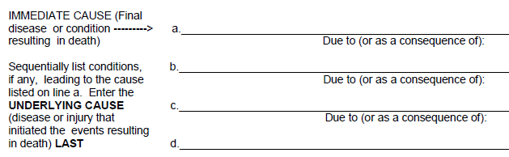
Example
The Death Certificate.
Counted if any include iatrogenic causes, based on NCHS 113 causes of death.
Acute Myocardial Infarction
Foreign object left during heart catheterization
Atherosclerotic Heart Disease
Modified from WHO. 2011. ICD-10: International Statistical Classification of Diseases and Related Health Problems. Geneva: World Health Organization.

Slide 17
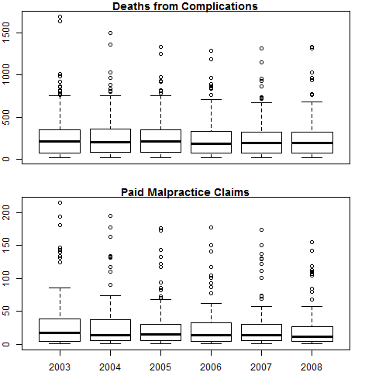
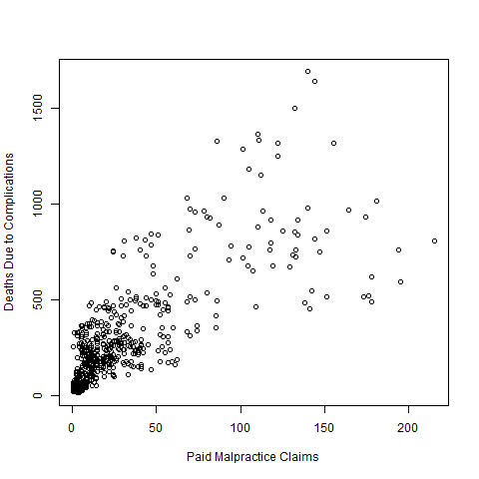
Distributions

Slide 18
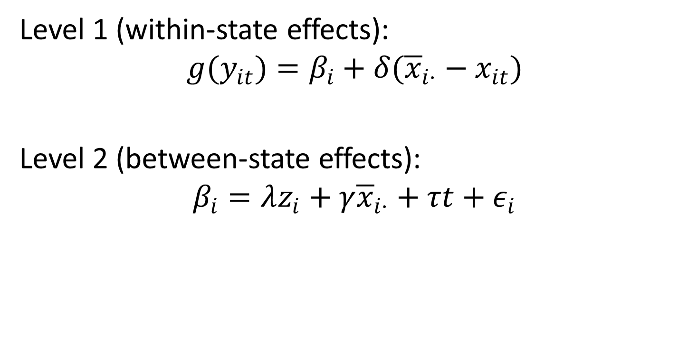
Model
Level 1 (within-state effects):
$$g(y_{it})=β_{i}+δ({\overline{x}}_{i⋅}−x_{it})$$
Level 2 (between-state effects):
$$β_{i}=λz_{i}+γ{\overline{x}}_{i⋅}+τt+ε_{i}$$
Notes:
ID:
i indexes state/gender combination; t indexes year
Z is fixed (female)
I include year fixed effects (tau)
x includes lagged “other”
Why this model:
Dependent variables is a count variable, and the fully conditional “fixed effects” models are biased, i.e. unlike an OLS, they are not truly fixed.
The hybrid model is more efficient.
ID robustness from text: method of moments (fgls); poisson; ols fixed
A more fundamental issue, before fixing this, is addressing the lag.

Slide 19
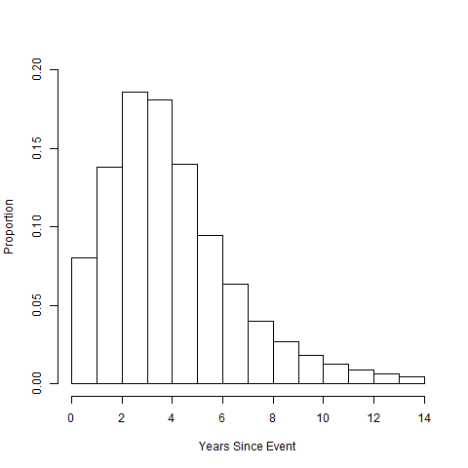
Lag in Claims

Slide 20
Results

Slide 21
The Problem in Observing Medicalization
Changes in Field Effects
Particular Cause of Death
Social Position
Changes in Biological Pathways

