Slide 1
Interpreting Data for use in Charts and Graphs.
Guilford County SciVis
V105.03

Slide 2
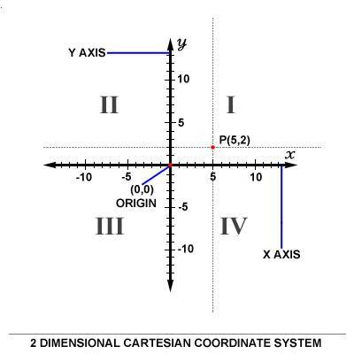
The Cartesian Coordinate System
2D system
X and Y coordinates
X is horizontal and Y is vertical
Identify the number of each quadrant
Positive Right and above and negative values are left and below
Plotting points in 2D space
What quadrant are
these plotted in:
(-3,2)
(-4,-4)
(5,-2)
(3,1)

Slide 3
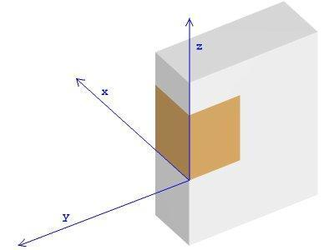
The Cartesian Coordinate System
The 3D coordinate system
X, Y, and Z coordinate
Positive and negative values
Origin
Plotting points in 3D space

Slide 4
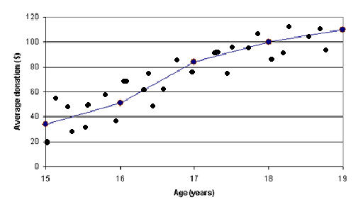
Dealing with Data
Understand direct or positive relationships.
Values of related variables move in the same direction.
If the points cluster around a line that runs from the lower left to upper right of the graph area, then the relationship between the two variables is positive or direct.
An increase in the value of x is more likely associated with an increase in the value of y. The closer points are to the line, the stronger the relationship.

Slide 5
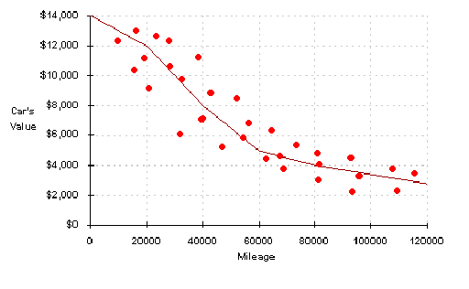
Dealing with Data
Understand Inverse or negative relationships.
Negative Values move in opposite directions.
If the points tend to cluster around a line that runs from the upper left to lower right of the graph, then the relationship between the two variables is negative or inverse.

Slide 6
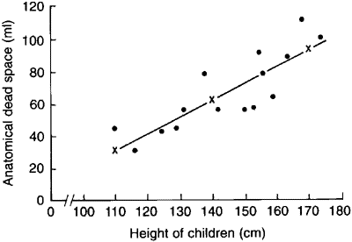
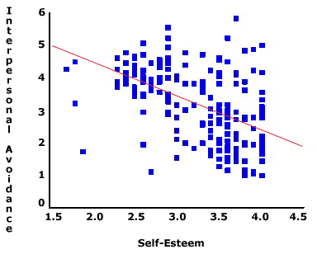
Regression Line
A Regression line is a line drawn through a graph of two variables. The line is chosen so that it comes as close to the points as possible. This line can show the data trend.
The line is a best fit line and does not connect the points.
The closer the points are to the line the better the relationship between the points.
Which plot shows a better relationship between the points? Why?

Slide 7
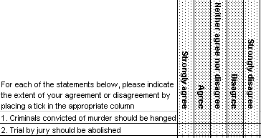
Dealing with Data
Ordinal data is categorized into a logical order like 1st, 2nd, and 3rd.
A good example is the Likert scale used on many surveys:
1=Strongly disagree;
2=Disagree;
3=Neutral;
4=Agree;
5=Strongly agree

Slide 8

Dealing with Data
Nominal data are categorical data where the order of the categories is arbitrary.
A good example is race/ethnicity values:
1=White
2=Hispanic
3=American Indian
4=Black
5=Other

Slide 9
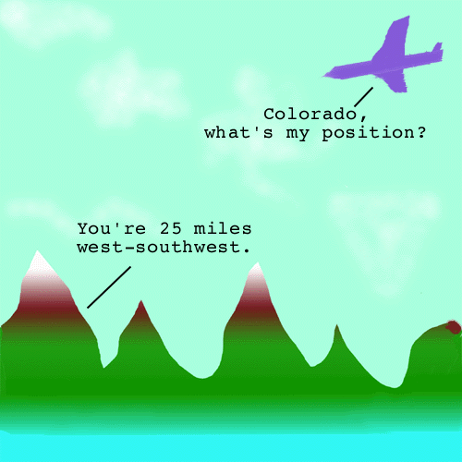
Dealing with Data
Scalar quantities – have magnitude but not a direction and should thus be distinguished from vectors (i.e. distance, power, speed). Just because you know the speed a car is traveling does not mean you know the direction the car is traveling in.
What’s my speed?
25 mph

Slide 10
Dealing with Data
Vector quantity – A mathematical concept represented as a line with a starting point, a length and direction. Vectors can be described with mathematical equations.
Vectors have both magnitude and direction.
Most 2D and 3D computer graphic software packages create shapes using vectors.
25 mph

Slide 11


Dealing with Data
Qualitative data – includes information that can be obtained that is not numerical in nature.
Such a interviews, direct observation, and written documents like newspapers, magazines, books, and websites.

Slide 12
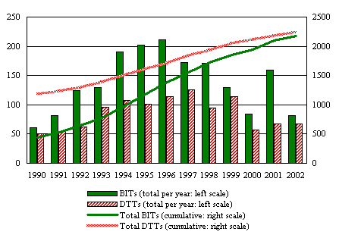
Dealing with Data
Quantitative data – includes information that can be obtained that is numerical in nature.
Examples include the temperature at 12 pm in Charlotte on 4/30/04, the size of a leaf, and the number of students who passed the VOCATS test.

Slide 13
Dealing with Data
Mean – Arithmetic Average. To calculate the mean, add all the given numbers, and then divide by the total count.
Median – Middle. It is defined as the middle value of several readings, where all the readings are placed in an increasing or decreasing order.
Mode – Most Common. It is defined as the most common value found in a group consisting of several readings.
11
12
12
12
13
15
17
18
25
26
52
+
19.36

Slide 14

Dealing with Data
Independent variable – is the variable that you believe might influence your outcome measure. It is the variable that you control.
It might represent a demographic factor like age or gender. It is graphed on the x-axis.
The different colors of light

Slide 15
Dealing with Data
Dependent variable – is the variable that is influenced or modified by some treatment or exposure (the independent variable).
It may also represent the variable you are trying to predict or the variable that you measure. It is graphed on the y-axis.
Growth of plants.

Slide 16
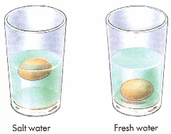
Dealing with Data
Control – In an experimental design refers to keeping outside influences the same for all groups.
The goal in experimental design is to group units in such a way that most unwanted errors would be removed.
A controlled experiment usually results in the most powerful comparisons and the clearest conclusions.

Slide 17


Dealing with Data
Empirically derived data – Data you can physically measure like length, width, or height that does not require a mathematical formula to find.
Computationally derived data – Data that requires you to see a formula and perform a calculation to get a measurement such as area, volume, circumference.

Slide 18
That’s all Folks Time to graph

Slide 19
Now lets do some Work:
1. Open Corel Draw. Place a grid on the page.
2. Import a simple drawing or draw something simple in the middle of the grid. List all points of the drawing.

