Slide 1
Charts and Graphs
Guilford County SciVis
V105.01

Slide 2
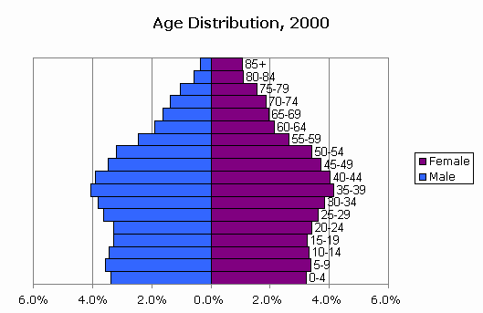
Types of Charts and Their Uses
Why create charts?
Present data in a visual method
Prevent distorting data
Present many numbers in a single unit.
Make large data sets easy to understand
Encourage the eye to compare different pieces of data
Reveal the data at several levels of detail, from a broad overview to the fine structure
Greensboro Age Distribution 2000

Slide 3
5 types of Graphs
Bar
Column
Line
Pie
Scatter
Histogram

Slide 4
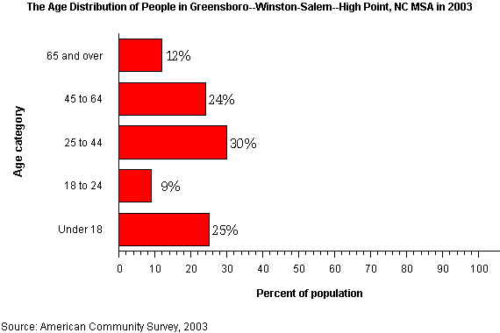
Bar Chart
Used for comparing items that are not related to each other-also comparisons between unrelated variables.
Other names: bar chart, column graph, histogram, horizontal bar chart, stacked bar chart
Bar graphs are a family of charts that display quantitative information

Slide 5
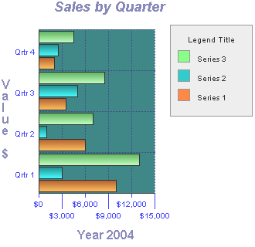
Bar Chart
4 Bar Charts are frequently used to compare multiple variables or to show how one or more variables vary over time.
5. Each bar or column represents a data element, and a complete set of columns makes up a data set.
6. Bar graphs generally have one linear scale on the vertical axis, and a category or sequence scale (such as a time scale) along the horizontal axis. These charts are useful when trying to compare a number of discrete sets or categories against each other.

Slide 6

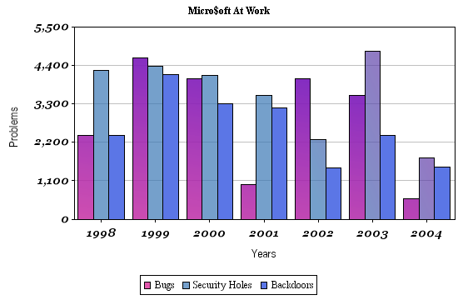
Bar Chart
7. A bar chart is a column chart on its side; this is usually employed when there are fewer categories and when the differences between categories are larger.
8. For a column chart, the x-axis lists the different categories, and the height of each category's column (with respect to the y-axis) shows the value.

Slide 7
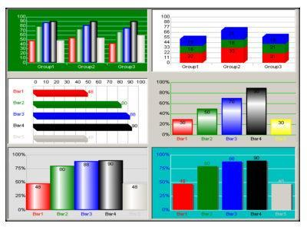
Bar Chart
Column
Chart
Bar Chart

Slide 8
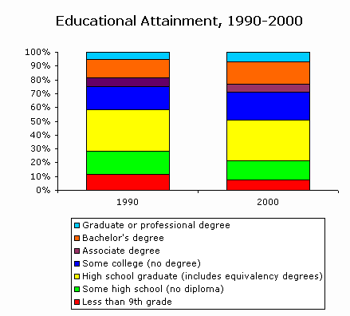
Stacked Column Chart
9. A type of bar chart, the stacked column chart, shows several sets of related data adding up to a whole with their columns stacked on top of each other.
a. The net result of
this stacking should
demonstrate some
total value.
Greensboro

Slide 9
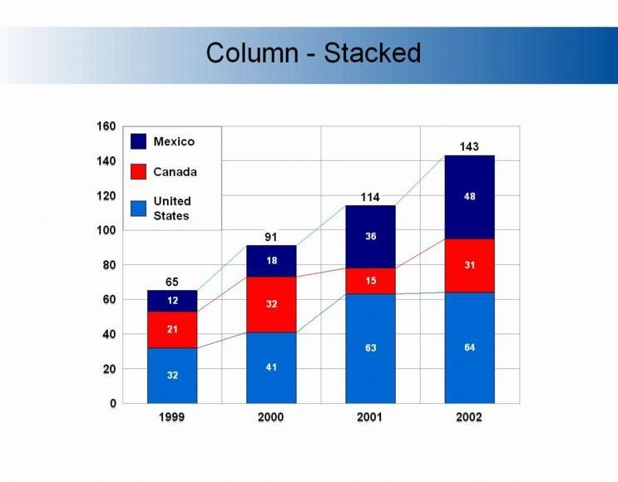
Stacked Column Chart
b. Stacking and grouping
bars can also serve
to show relationships
between data sets,
helping the user to:
Compare multiple items at various points in time;
Show how relationships between multiple items change with time;
Look for correlations or meaningful relationships between multiple data sets.

Slide 10
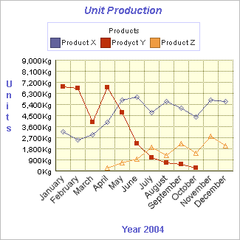
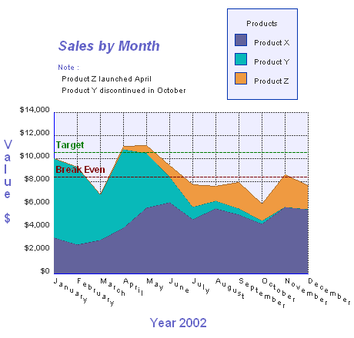
Line (X-Y) Graph
Used for related variables and relationships over time.
Line charts are good for showing trends of continuous data, usually involving time.
An area chart is a line chart with the area between the line and the x-axis is shaded.

Slide 11
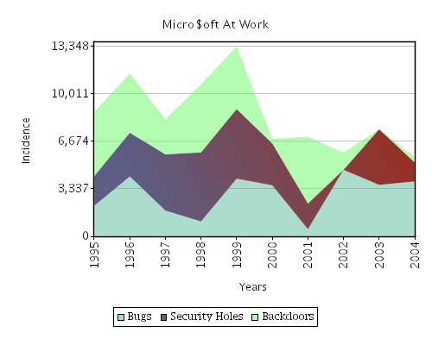
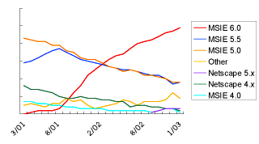
Line (X-Y) Graph
Line Graph
Area Chart

Slide 12
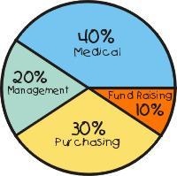
Pie Chart
Used for showing parts of a whole or percentages.
Pie graphs compare the components of a set to each other and to the whole.
Pie graphs are a member of an entire family of proportional graphs.

Slide 13
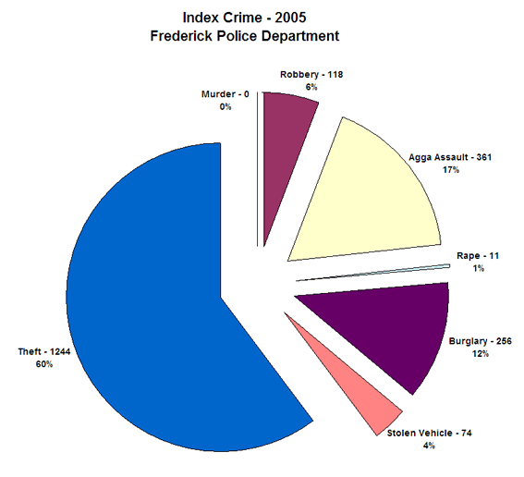
Pie Chart
3. The angle of the area of each slice (sometimes called a segment or wedge) is the same percent of the total circle as the data it represents.
4. Pie graph data may be contiguous or simultaneous in time and may be linked more by meaning than by physical proximity or sequence.

Slide 14
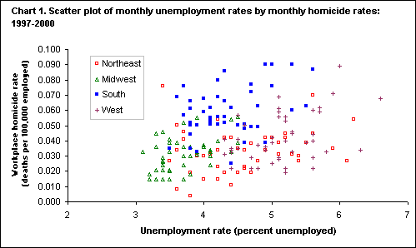
Scatter Plot Graph
Used to get a visual representation of the relationship or correlation between two variables using the x-y graph method of plotting.
Usually the lines connecting the data points are not connected.

Slide 15
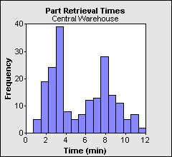
Histograms
Histograms are bar charts that display frequencies or relative frequencies in the form of contiguous (touching) bars.
Histograms can be used to see the shape of the distribution and to determine whether the data are distributed symmetrically.

Slide 16
Histograms or Bar Charts
Histograms are "sorting boxes." There is one variable and data is sorted by this variable by placing them into "boxes.”
The number of pieces of data in each box is counted. The height of the rectangle drawn on top of each box is proportional to the number of pieces in that box.
A bar graph has several measurements of different items that are compared.
The main question a histogram answers is: "How many measurements are there in each of the classes of measurements?"
The main question a bar graph answers is: "What is the measurement for each item?" Here are some examples:

Slide 17
Histogram or Bar Graph
Situation
Bar Graph or Histogram?
We want to compare total income of five different people.
Bar graph. Key question: What is the revenue for each person?
We have measured revenues of several people. We want to compare numbers of people that make from 0 to 10,000; from 10,000 to 20,000; from 20,000 to 30,000 and so on.
Histogram. Key question: How many people are in each class of revenues?
We want to compare heights of ten basketball players on a team.
Bar graph. Key question: What is the height of each player?
We have measured several players. We want to compare numbers of players that are from 5-5.5 feet high; from 5.5-6; from 6-6.5 and so on.
Histogram. Key question: How many players are there in each class of heights?

Slide 18
Parts of a Chart
Axis -- The reference lines in a coordinate system. The X-axis is the horizontal reference, and the Y-axis is the vertical reference.
Title -- Describes the data the chart is symbolizing.
Legend -- An explanatory list of symbols on a chart (needed when you graph multiple data sets).
Labels -- Are needed for linking the chart to the information being displayed. If charted data has labels in the spreadsheet, the labels should be carried over to the chart.

Slide 19
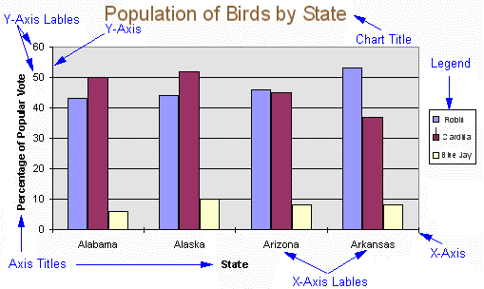
Parts of a Chart

Slide 20
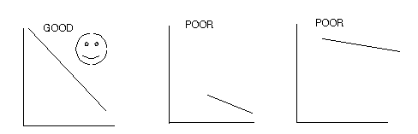
Basic Rules for Creating a Chart
Use graph paper, a spreadsheet program, or graphing program such as Excel.
Decide on the correct type of chart or graph.
Determine the largest value number to be plotted on each axis and make sure the scale is large enough to use at least half of the paper in both directions.

Slide 21
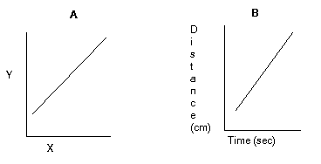
Basic Rules for Creating a Chart
4. Plot the independent or control variable on the x-axis. The dependent variable is plotted on the y-axis.
5. Label the axes and give units to those labels.
6. All graphs should have a title. A good title that always works is "y" as a function of "x."

Slide 22
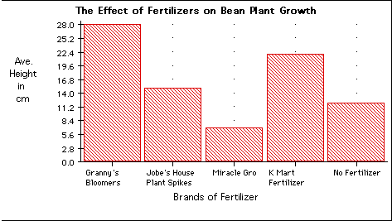
Basic Rules for Creating a Chart
7. Most graphs should start at the origin (x = 0, y = 0). There are exceptions like graphing temperature. If the lowest temperature is 37o C start at 35 o C. This is because 0 o C is not the lowest temperature.
8. Number the x- and y-axis with a regular numerical sequence or pattern starting with 0 to space out your data so it fills the entire graph. Use a ruler for straight lines.
origin

Slide 23
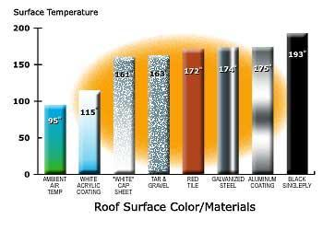
Basic Rules for Creating a Chart
10. If 2 or more lines are plotted on a graph, a key or legend is necessary. A different hue or symbol should be used for each line.
11. The color of the background of the graph, and the lines on the graph should be clearly distinguishable from each other.
12. The color of lines on a multi-line graph should be distinguishable from each other.
How many color rules are broken in the graph?

Slide 24
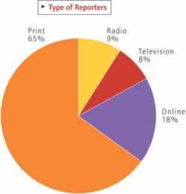
General Advice for Creating a Chart
a. Keep graphs simple -- make the data do the talking. Don’t "liven" up you chart with extra colors, 3D, or pictures. Interesting data captures an audience’s attention more than any graphic or special printing effects could.
b. Use meaningful titles and labels - let the audience think about what the data means, not what the data is or could be.
c. Be truthful with the axes -- Do not exchange
scales or perspectives to gain a falsely perceived
advantage.

Slide 25
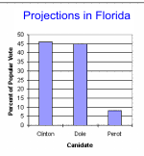
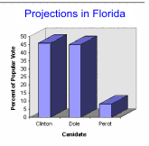
Basic Rules for 3D
3D may not be a good idea because the data may appear distorted, can be misinterpreted, or may be misleading.
A demonstration of problematic 3D perspective: the chart on the left clearly shows that Clinton edged out Dole in Florida.
When Excel shows this data in 3D format, it is impossible to clearly tell if anyone won or if it was a tie.

Slide 26
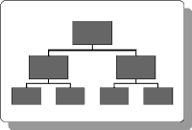
Flow/Process Charts
Picture description of a
procedure followed to solve a
problem
shows relationships between people and processes rather than numbers
Common use -computer programs
To perform the process start at the top and move from box to box.

Slide 27
input
input
output

Slide 28
How to Make a Flowchart
Determine the beginning and end of a process.
Brainstorm all major inputs, outputs, and processes
Use “post it” notes to sequence events and arrange them for all to see
Walk through. Check for smoothness. Make changes. Apply.

Slide 29
Flowchart symbols
Oval - Input / Output (Start, end)
Box - Activity a single step ("add two cups "), or and entire sub-process ("make bread") within a larger process.
Diamond - Yes / NO-Lines representing different decisions emerge from different points of the diamond.
Circle - Break Indicates that the flow continues on another page, where a matching symbol (containing the same letter) has been placed.
Arrow - Flow-sequence of steps and the direction of flow

Slide 30
Enter a number
Enter a number
no
Is it even?
yes
Add 42
Mult by 12
Is it less than
300?
yes
Is = or >
300?
Mult by 7
Divide by 6
Divide by 4
Mult by3
yes
no
no
output

Slide 31
Flowchart Layout
Keep your type as large as possible, but don't crowd the edges of your boxes.
Abbreviate wherever possible. Use only first initials for names in organization charts.
Keep connecting lines short ­ use the space for boxes and text.
Always supply printed handouts when using complex charts.

Slide 32
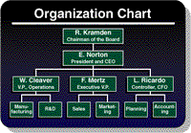
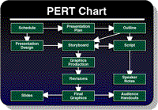
Examples of flowcharts
Organization Charts-the relationships between people in a business or other group
-
PERT Charts-a product is made, or a task completed

Slide 33
Venn Diagrams
Made up of two or more overlapping circles.
Used to show relationships between sets.
Used to show similarities and differences in characters, stories, poems, etc.

