Slide 1




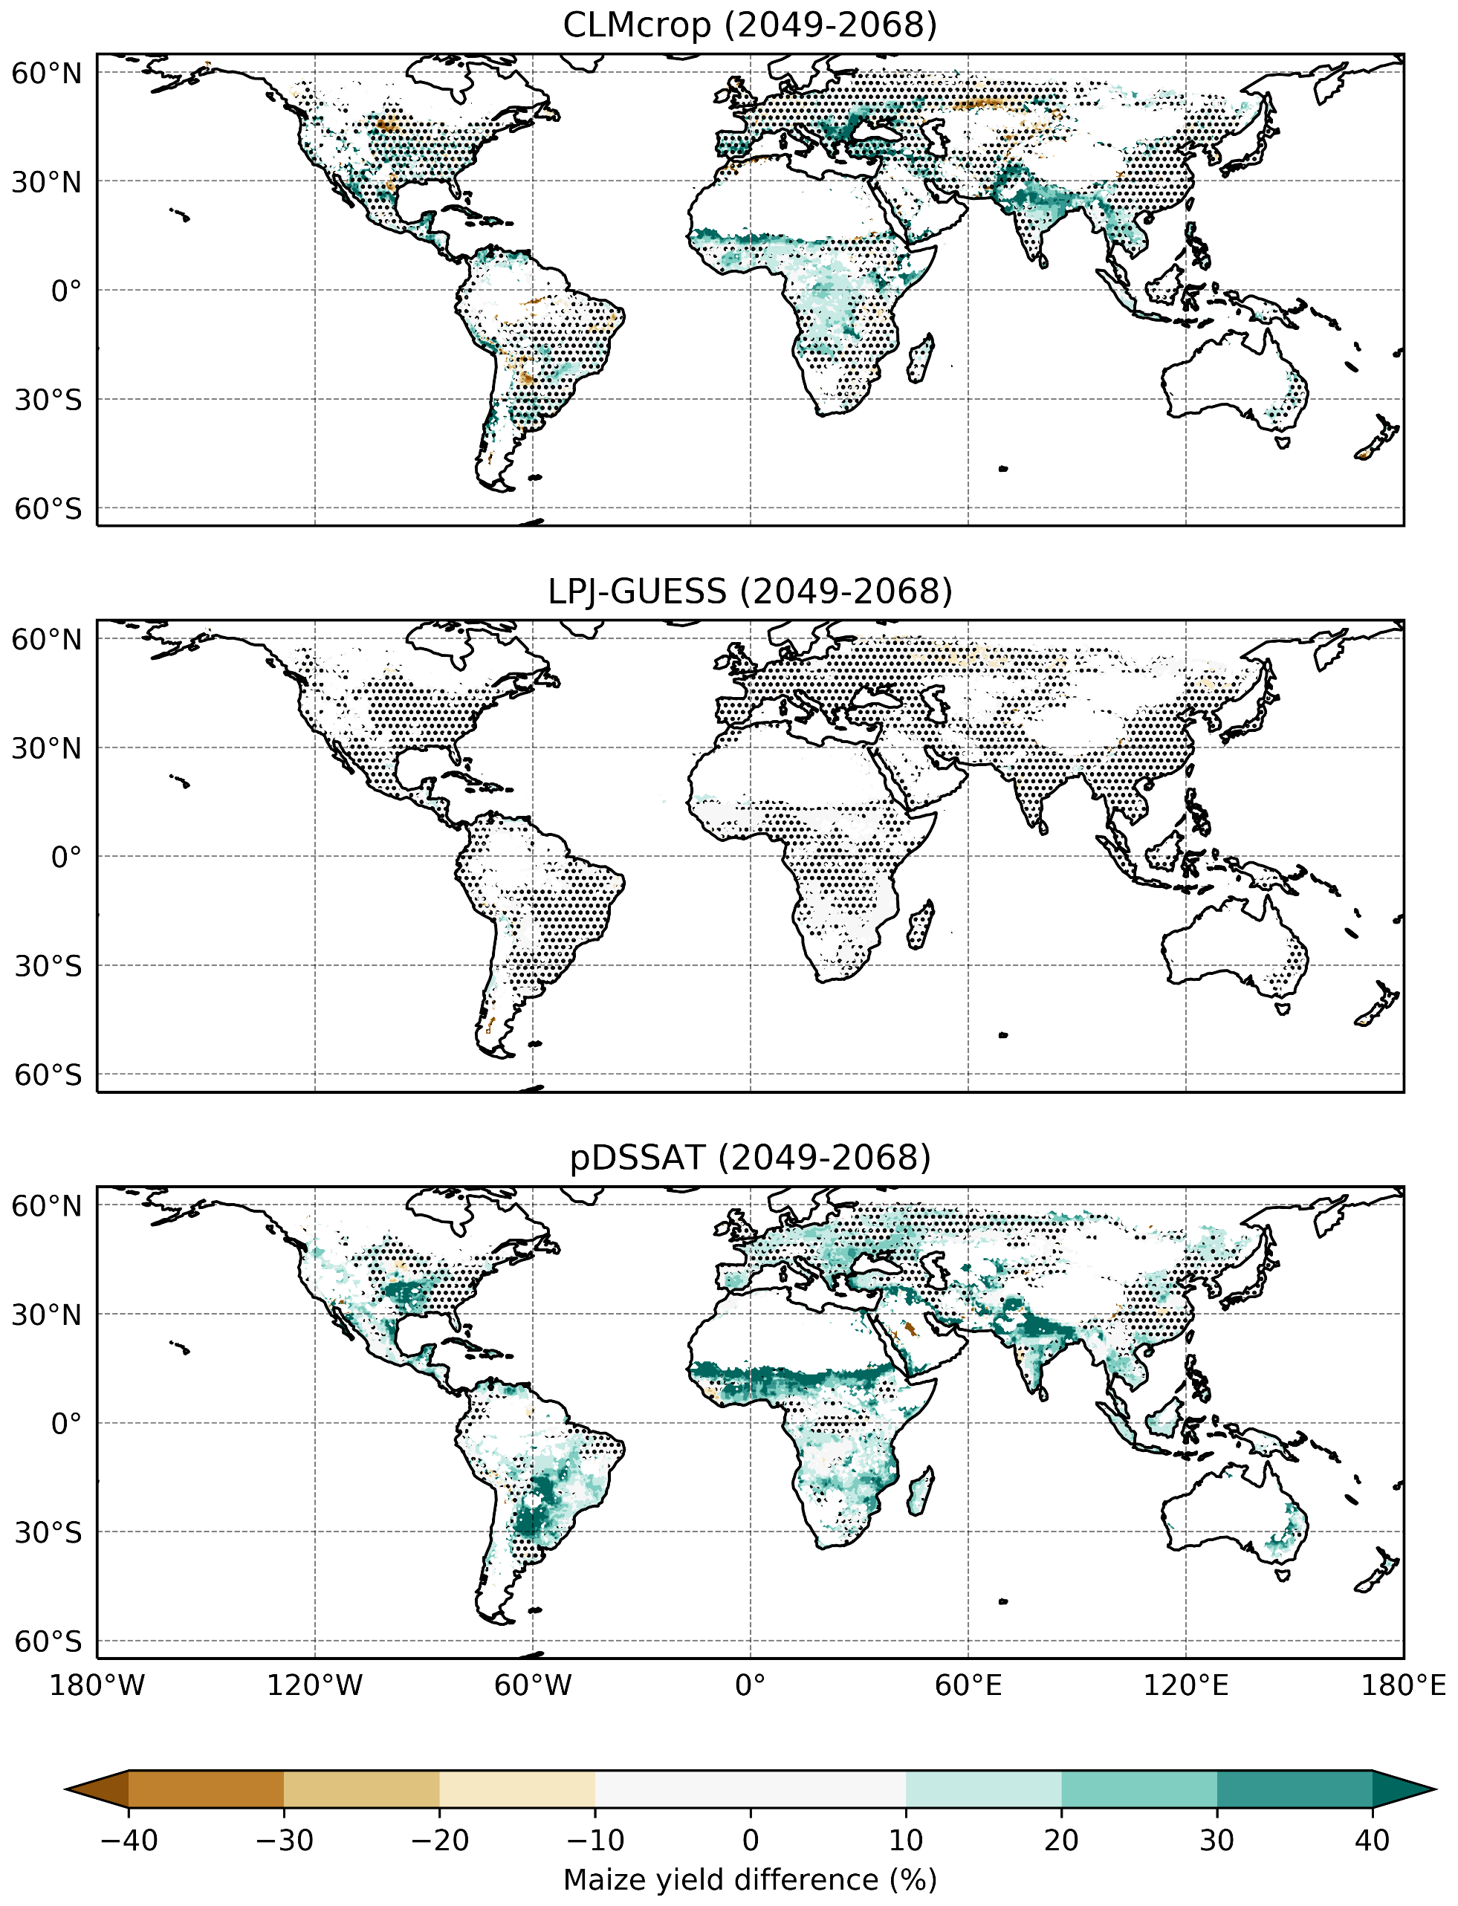
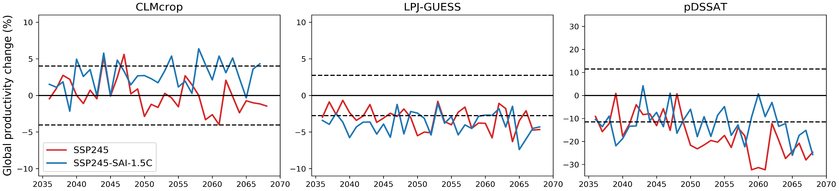
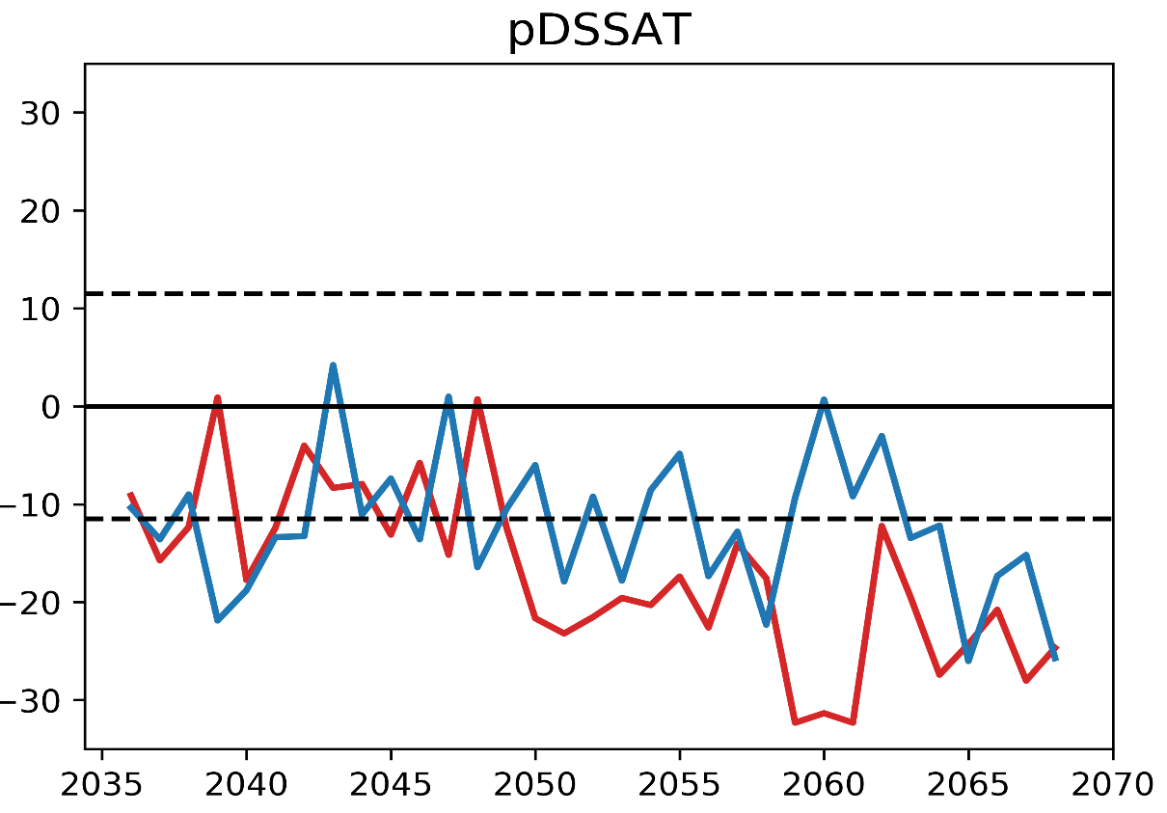
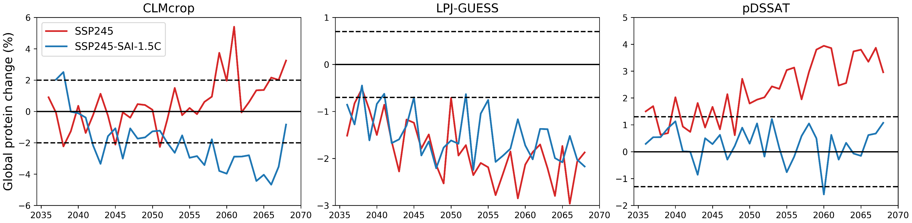
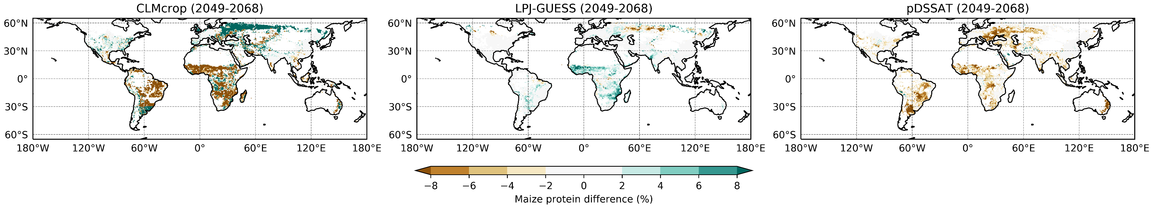
Sulfate Aerosol Climate Intervention Impacts on Maize Yield and Protein in Three Global Gridded Crop Models
Brendan Clark^{1,✉}, Alan Robock¹, Lili Xia¹, Sam S. Rabin², Jonas Jaegermeyr^{3,4}, and Jose Guarin⁴
¹Department of Environmental Sciences, Rutgers University, New Brunswick, NJ, USA. ²Climate and Global Dynamics Laboratory, National Center for Atmospheric Research, Boulder, CO, USA. ³Center for Climate Systems Research, Columbia University, New York, NY, USA. ⁴NASA Goddard Institute for Space Studies, New York, NY, USA
✉email: bjc204@envsci.rutgers.edu
Abstract
Results
Discussion and Conclusions
Sulfate aerosol intervention (SAI) is being researched as a potential method for minimizing the effects of anthropogenic climate change by reducing a small portion of incoming solar radiation. How global crop production would be affected by such an intervention strategy is still uncertain, and large uncertainty remains from single crop model studies of SAI impacts on global agriculture production. Here we utilize three global gridded process-based crop models to better understand the potential impacts of one SAI scenario on global maize production and nutritional quality. Two of the crop models show benefits to maize production under SAI, while the third crop model shows almost no difference between SAI and climate change. Models that show benefits to maize production also show decreases to maize protein, which could partially offset benefits under SAI. This model disagreement highlights the urgent need for multi-crop model assessments using multi-climate model forcings under different SAI scenarios.
d)
The response of global maize to SAI varies between models. Two of the crop models show an increase to maize production under SAI, while the third crop models shows almost no difference between climate change and SAI (Figure 1). Even though pDSSAT shows a benefit to global maize production under SAI relative to climate change, it is still a decrease of about 15% relative to the reference period. While maize production increases under SAI in CLMcrop and pDSSAT, this is accompanied by deceases to maize protein (Figure 2). However, LPJ-GUESS shows small differences to maize production and protein between SAI and climate change.
This study is limited by using just one ensemble member from one climate model that simulated one SAI scenario. Global gridded crop models show very large uncertainty of production impacts under future climate change, and crop model uncertainty is much larger than uncertainty stemming from climate models (Jägermeyr et al., 2021). This study serves as a pilot study for a more robust analysis in the future, and the uncertainty in global crop responses to future SAI highlighted here shows the urgent need for a multi-model and multi-scenario impact assessment of SAI. Incorporating other impact models, such as fisheries models, and updating models to include impacts of surface ozone and ultraviolet radiation is vital to understand the full story of how SAI might impact global food production.
a)
Global production change (%)
b)
e)
Global production change (%)
Introduction
c)
Climate change projections and associated impacts have driven research on climate intervention (also called geoengineering or solar radiation modification) strategies. The strategy that has had the most attention in the literature is sulfate aerosol intervention (SAI). SAI would temporarily increase Earth’s albedo by placing reflective sulfate aerosols in the stratosphere, reducing surface temperatures, the same mechanism that reduces surface temperatures after large volcanic eruptions (NASEM, 2021). This would affect the entire Earth system, such as global temperature, precipitation, humidity, and direct and diffuse radiation, which drive changes in agriculture.
This study uses three global gridded process-based crop models to study maize yield and protein changes under the future climate warming scenario SSP2-4.5 and the Assessing Responses and Impacts of Solar climate intervention on the Earth system with stratospheric aerosol injection scenario (ARISE-SAI; Richter et al., 2022). Here we aim to understand whether different crop models respond differently to a specific SAI implementation and highlight the importance of multi-crop model and multi-climate model assessment before drawing conclusions of SAI impacts on agriculture.
f)
Global production change (%)
Acknowledgments
Figure 1. Relative maize yield difference between SSP2-4.5-SAI-1.5C minus SSP2-4.5 averaged over the years 2049-2068 (a, b, c). Hatched areas indicate grid cells where the difference is not statistically significant at the 95% confidence level based on a two-tailed Student’s t-test. Time series of the percent change to the sum of global maize production under SSP2-4.5 and SSP2-4.5-SAI-1.5C relative to the reference period of 2016-2025 for each of the three crop models (d, e, f). Horizontal dashed lines indicate the standard deviation of production variability over the reference period for each model.
This work was supported by NSF grant AGS-2017113 and Silver Lining. CESM2, CLM-crop, and LPJ-GUESS calculations were done on the National Center for Atmospheric Research computer system, which is supported by NSF. pDSSAT calculations were done on the University of Chicago computer system.
References
Danabasoglu, G., Lamarque, J.-F., Bacmeister, J., Bailey, D. A., DuVivier, A. K., Edwards, J., et al. The Community Earth System Model Version 2 (CESM2). Journal of Advances in Modeling Earth Systems, 12, e2019MS001916. https://doi.org/10.1029/2019MS001916 (2020).
Jägermeyr, J. et al. Climate impacts on global agriculture emerge earlier in new generation of climate and crop models. Nat. Food, 2, 873–885. https://doi.org/10.1038/s43016-021-00400-y (2021).
Jones, J. et al. The DSSAT cropping system model. European Journal of Agronomy, 18, 235–265, doi.org/10.1016/S1161-0301(02)00107-7 (2003).
Lawrence, D. M., et al. The Community Land Model version 5: Description of new features, benchmarking, and impact of forcing uncertainty. Journal of Advances in Modeling Earth Systems, 11, 4245– 4287, doi:10.1029/2018MS001583 (2019).
National Academies of Sciences, Engineering, and Medicine. Reflecting Sunlight: Recommendations for Solar Geoengineering Research and Research Governance. National Academies Press.. 10.17226/25762 (2021).
Richter, J. et al. Assessing responses and impacts of solar climate intervention on the Earth system with stratospheric aerosol injection (ARISE-SAI): protocol and initial results from the first simulations. Geosci. Model Dev. 15, 8221–8243 (2022).
Smith, B. et al. Implications of incorporating N cycling and N limitations on primary production in an individual based dynamic vegetation model, Biogeosciences, 11, 2027–2054. doi.org/10.5194/bg-11-2027-2014 (2014).
Methods
a)
b)
c)
This analysis uses atmospheric forcing output from the community Earth system model, whole atmosphere community climate model (CESM2-WACCM6; Danabasoglu et al., 2020) to force three global gridded crop models: The Community Land Model version 5 crop model (CLMcrop; Lawrence et al., 2019), the Decision Support System for Agrotechnology Transfer global crop model (pDSSAT; Jones et al., 2003), and the Lund-Potsdam-Jena General Ecosystem Simulator crop model (LPJ-GUESS; Smith et al., 2014). Climate change scenario SSP2-4.5 was followed with SAI used to maintain 1.5 °C above preindustrial levels (SSP245-SAI-1.5C) (Richter et al., 2022). Crop model simulations were run offline at half degree resolution with crop area, planting dates, and fertilizer application constant at 2015 values, so impacts on maize are due to climate changes alone.
d)
e)
f)
Figure 2. Time series of the percent change to maize protein under SSP2-4.5 and SSP2-4.5-SAI-1.5C relative to the reference period of 2016-2025 for each of the three crop models (a, b, c). Horizontal dashed lines indicate the standard deviation of production variability over the reference period for each model. Relative maize protein difference between SSP2-4.5-SAI-1.5C minus SSP2-4.5 averaged over the years 2049-2068 (d, e, f).

