Slide 1
Coursera IBM Data science capstone
Selecting a franchise location
Presented by: Braulio J. Cabral
6/14/2019

Slide 2
Introduction
Problem Statement
A critical factor when opening a franchise is to determine if the location is suited for such venue. Other factors, such as distance from other franchises of the same corporation or competitor franchises are also important, as well as the need for people traffic through the location .
The business problem discussed here relates to the need of a franchisee to validate a proposed location to open a new franchise.
The proposed solution to investigate the potential of the location, is to collect a dataset of all businesses in the area, conduct an exploratory data analysis to determine, competitors, distances from the proposed location, and non-competitor businesses that could bring potential customers.

Slide 3
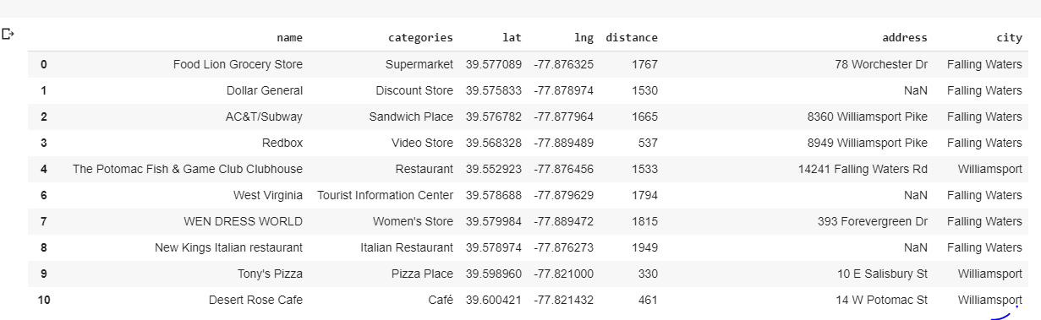
THE DATASET
The proposed location is located at coordinates 39.56375, -77.887494 in the town of Falling Waters, WV.
Using Foursquare, I collected data of all businesses, competitors and non-competitors in a 10-miles radius, creating a dataset as shown here.

Slide 4
Dataset
The dataset describes each business, 368 in total. The feature of interest are:
Business name
Category, 112 unique categories
Coordinates (latitude and longitude)
Distance from the proposed location
Address
City

Slide 5
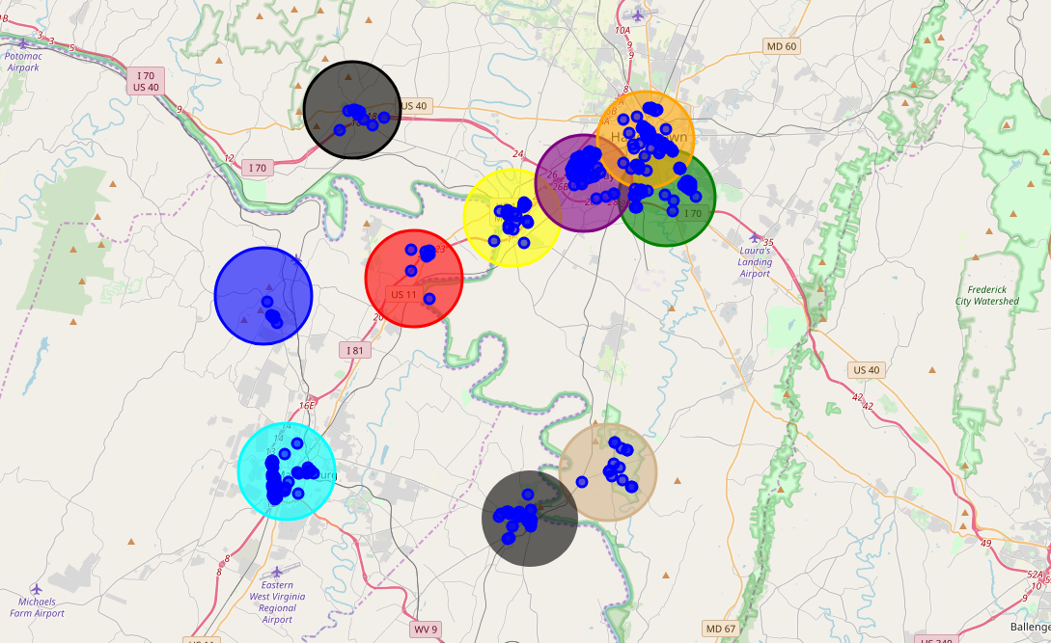
Methodology
The approach to the data exploratory analysis was as follows:
Produce a visual depiction of where the businesses are located in relation to proposed location
Using folium, library based on Python, create a map overlay each town as a colored circle, and super imposed the businesses as small blue circle.

Slide 6
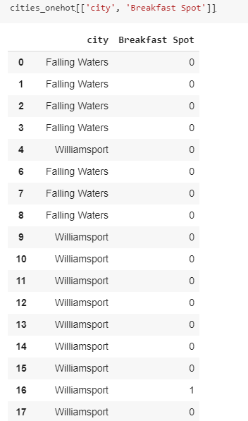
Methodology
Second approach was the use of one-hot-encoding to represent the categorical features in a more clear manner.
One-hot-encoding helped visualize businesses considered competitors and those that could bring potential customers.
For example, the first identified competitor business is shown in the town of Williamsport. The one-hot encoding helped mapped all such businesses.

Slide 7
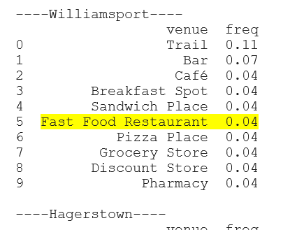
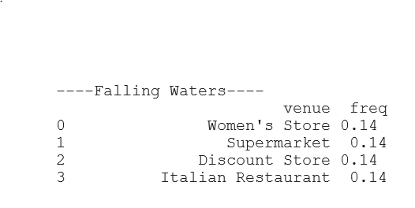
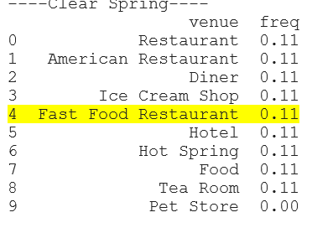
Methodology (cont)
Another technique used in the analysis of the data was the distribution of the 10 most common venues based on their frequency. In the example below you can appreciate the competitors and their frequency. Also, it shows that in Falling Waters, home of the proposed location, there are no direct competitors.

Slide 8
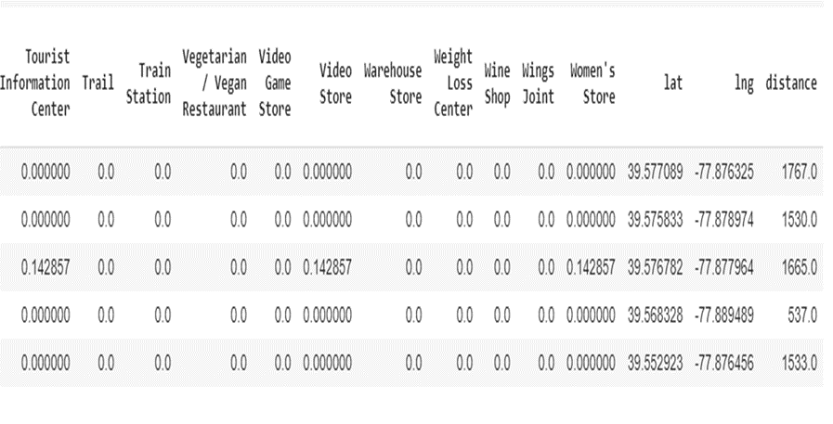
Methodology (cont)
Later, Kmeans Clustering was used to cluster businesses based on their similarities. Kmeans is an unsupervised learning algorithm. The data was standardized using Standard Scaler to manage disparate numbers such as distance.

Slide 9
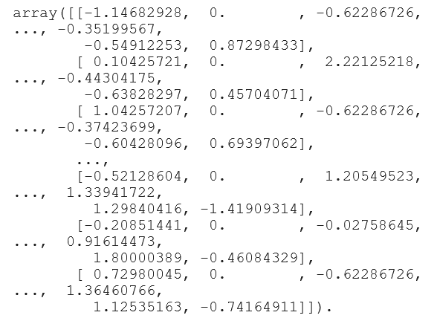
Methodology (cont)
Array of standardized (normalized) data

Slide 10
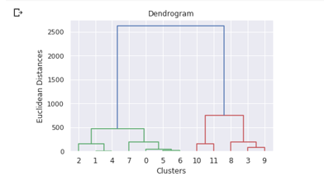
Methodology (cont)
Since Kmeans requires a predetermine number of clusters (K), you can guess a number, but it is more efficient to use agglomerative cluster technique to generate a dendrogram and select the number of end points for number of clusters in K.

Slide 11
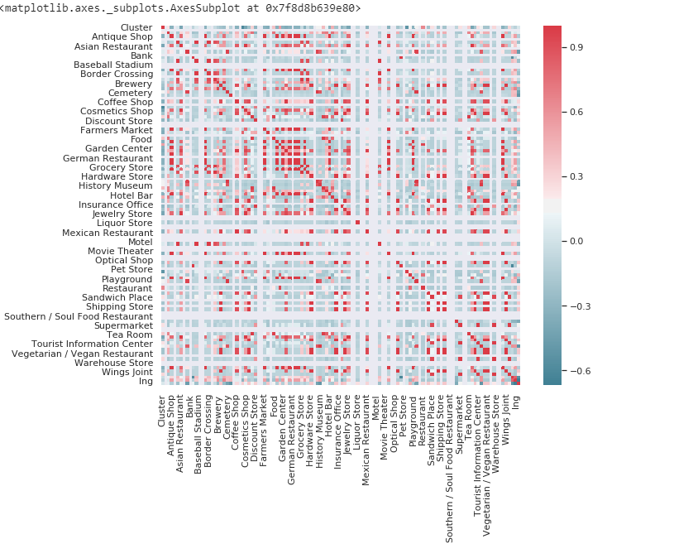
Methodology (cont)
Next, a features correlation heat map was created. This technique helps easy visualization of the relationship between the different features.

Slide 12
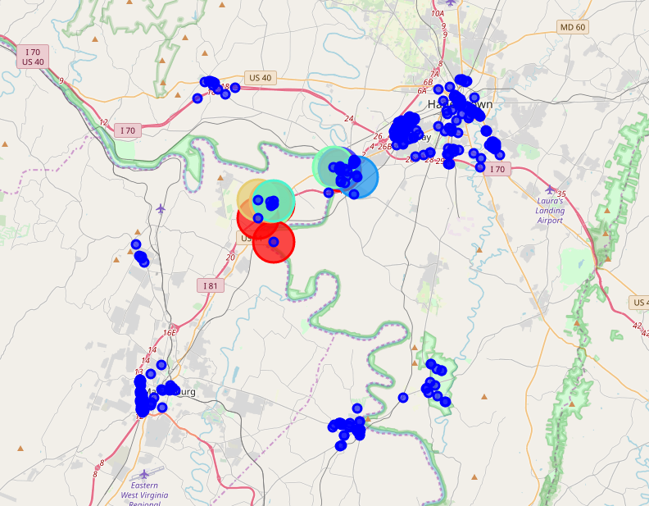
Methodology (cont)
Finally, I plotted the resulting clusters from the Kmean algorithm and super imposed the businesses. As can be appreciated in the picture below, the accuracy of the algorithm was not ideal. Many of the businesses did not align with the cluster centroids. This could be for different reasons delineated in the report.

Slide 13
Results
The resulting outcome of this exploratory data analysis is that even when the clustering may not give a definitive answer to verifying if the proposed location is ideal, the exercise provides evidence that the location has certain features that makes it suitable for the type of franchise being opened. For example, we analyzed 116 different business categories, through the analysis, it can be seen that the proposed location does not have any direct competitor and that the existing competitors are at a distance far enough as to minimize the threat. The location is surrounded by other type of businesses that will bring an inflow of people to the area creating potential customers.

Slide 14
Discussion
Some observations include:
Kmeans algorithms are not so suitable for prediction.
The labels are pretty much arbitrary and it is difficult to determine the type of businesses that are member of a particular cluster.
This exercise was more geared toward data exploration, I think it can be enhanced by identifying more relevant features such as menu of competitive businesses, organize the competitors by a certain weigh based on distance, menu similarity, and even pricing. I learned a lot with this exercise, and look forward to more practice.
One interesting thing I noticed is that looking for help with Python and Python libraries, becomes more difficult when you are dealing with relatively big datasets due to the fact that most examples are based on very simple Numpy generated synthetic data or data that does not necessary relate to the problem at hand.

Slide 15
Conclusion
I would say that the outcome of the data exploration can help the interested audience make a decision based on more information about the surrounding area. The data exploration in itself, provides a good understanding of the type of businesses and the level of competition the new franchise should expect. Enhancing the analysis to include prediction of other possible locations would be of great interest for anyone looking to open any type of business.

