Slide 1
BRAIN-A-LYTICS
SMART BASKET
CAN YOU PREDICT CUSTOMER ENGAGEMENT WITH AN ADVERTISEMENT?
Team Name: BitsNBytes Institute: IIM Calcutta
Participant’s names: Piyush Raj Gupta
Bhushan Jayant Chaudhari

Slide 2
Exploratory data analysis
Click Flag vs LTE Flag
Total On click vs non click data
From the graph above, it can be seen that the data is highly imbalanced.
We observed that there is a correlation between LTE flag and os_version with customer engagement.
Can we use this correlation as predictive power of the data? Lets see..
OS version vs Click Flag

Slide 3
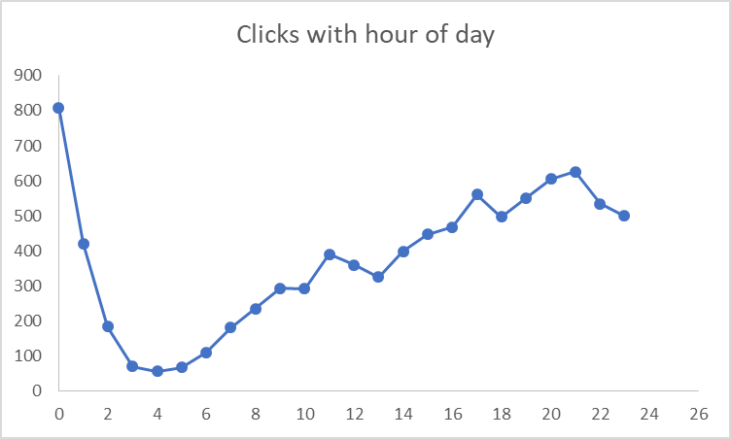
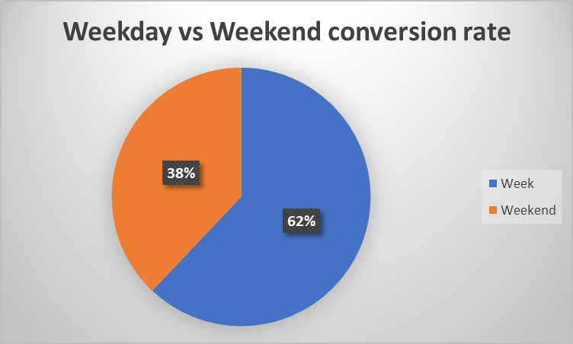
Exploratory data analysis
Engagement is dependent on the time when the ad has been by the customer.
It is evident from pie chart that conversion rate is more in week days than on weekends.
Feature engineering can be done basis these observations and their predictive power can be enhanced/judged by combining other relevant features.

Slide 4
Feature Engineering
Train
View_log
Item_data
Assimilation of 3 different data files into single train data was done by joining them at customer level. This was achieved by using cust_id and item_id.
Impression time and Server time were split into day , month, hour, min in order to train timely dependence of click rate to model.
Aggregation of impression time in order to find activeness of customer on the site was done.
Day has been further categorized into week day and weekends.
Monthly data is further categorized into 1st, 2nd, 3rd, 4th week of the month and corresponding flags were made.
Frequency of items browsed, website visits and other dependent features were fabricated for each customer.
New_Train_data

Slide 5
Analysis and Approach
Models Trained – 1) LightGBM
2) Random Forest
3) XGBoost
4) Ensemble of Random Forest and LightGBM
After trying above combinations of models we chose 4th option as its F1 score as well as accuracy was high.
LGBM
(.65)
Random Forest
(.35)
Predixion Model
Ensemble Split –

Slide 6
Training Parameters
Model Used – Ensembling of LightGBM and Random Forest
Parameters Used (LightGBM)–
n_estimators=1000
random_state=1994
learning_rate=0.08
colsample_bytree=0.2
objective='binary‘
scale_pos_weight=1
eval_metric='f1‘
early_stopping_rounds=200
verbose=200
Parameters Used (Random Forest) –
bootstrap=True
criterion='gini‘
max_features='auto‘
min_samples_split =2
n_estimators=350
random_state=7000
Note: Above parameters were found using GridSearch tuning to ensure no overfitting has been done on training data.

Slide 7

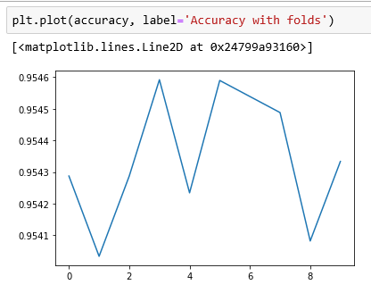
Validation methodology
Methodology Used: StratifiedKfold with 10 folds
Result Instances:
Displayed graph is for variation of model accuracy with multiple iteration of data split. Inference: Since there is no big jump in accuracy, hence model is not over fitting the data.

Slide 8
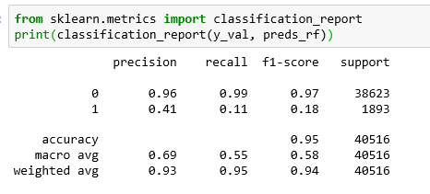
Results from Modelling
Classification report for our model on validation data set

Slide 9
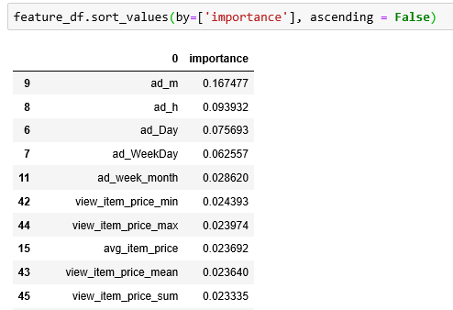
Insights & Summary
Despite having high accuracy, we can’t trust the model as the data is highly imbalanced (4:96 approx).
Emphasis should be given to F1 score as correct prediction of 1’s are more important from business perspective.
After doing analysis we found that following features are important in prediction:
We can see that timing of add displayed played an important role in prediction. Hence our final conclusion is to improve the on click rate timing of add should be chosen appropriately.

