Slide 1
A Tour of C++: The Basics
Lesson 1

Slide 2
Contents
Introduction
The Basics
Hello, World!; Types, Variables, and Arithmetic; Constants; Tests and Loops; Pointers, Arrays, and Loops
User-Deﬁned Types
Structures; Classes; Enumerations
Modularity
Separate Compilation; Namespaces; Error Handling
Postscript
Advice

Slide 3
Introduction
The aim of this lesson is to give you an idea of what C++ is, without going into a lot of details.
This lesson informally presents the notation of C++, C++’s model of memory and computation, and the basic mechanisms for organizing code into a program.
These are the language facilities supporting the styles most often seen in C and sometimes called procedural programming.
The assumption is that you have programmed before.

Slide 4
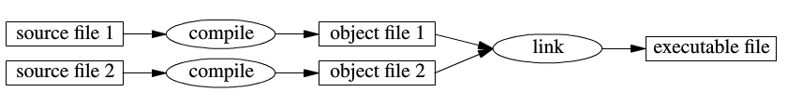
The Basics
C++ is a compiled language. For a program to run, its source text has to be processed by a compiler, producing object ﬁles, which are combined by a linker yielding an executable program.
A C++ program typically consists of many source code ﬁles (usually simply called source ﬁles).

Slide 5
Two kind of entities
The ISO C++ standard deﬁnes two kinds of entities:
Core language features, such as built-in types (e.g.,char and int) and loops (e.g.,for statements and while statements).
Standard-library components, such as containers (e.g., vector and map)and I/O operations (e.g., << and getline(.))

Slide 6
C++ is a statically typed language
C++ is a statically typed language. That is, the type of every entity (e.g., object, value, name, and expression) must be known to the compiler at its point of use.
The type of an object determines the set of operations applicable to it.
In C++, as in most programming languages, the type of an object determines what operations can be performed on it.
Whether a particular expression is legal depends on the type of the objects in that expression.
Some languages, such as Smalltalk and Python, check types at run time. In contrast, C++ is a statically typed language; type checking is done at compile time.
As a consequence, the compiler must know the type of every name used in the program.

Slide 7
Hello World
The minimal C++ program is
int main() { } //the minimal C++ program
This deﬁnes a function called main, which takes no arguments and does nothing.
Curly braces, { }, express grouping in C++. Here, they indicate the start and end of the function body.
The double slash, //, begins a comment that extends to the end of the line.
A comment is for the human reader; the compiler ignores comments.
Every C++ program must have exactly one global function named main(). The program starts by executing that function.
The int value returned by main(),if any, is the program’s return value to ‘‘the system.’’
If no value is returned, the system will receive a value indicating successful completion.
A non zero value from main() indicates failure.
Not every operating system and execution environment make use of that return value: Linux/Unix-based environments often do, but Windows-based environments rarely do.

Slide 8
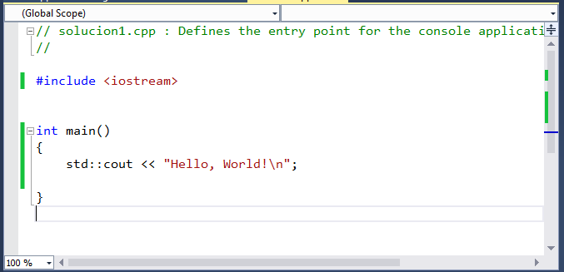
A program that writes Hello, World!:
The line #include <iostream> instructs the compiler to include the declarations of the standard stream I/O facilities as found in iostream.
The operator << (‘‘put to’’) writes its second argument onto its ﬁrst. In this case, the string literal "Hello, World!\n“ is written onto the standard output stream std::cout.

Slide 9
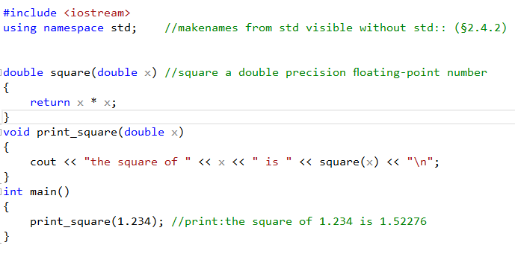
All executable code is placed in functions and called directly or indirectly from main()
All of the C++ standard library now lives in namespace std.

Slide 10
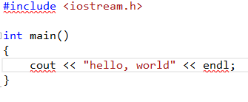
Name spaces
Although C++ changed greatly during standardization, few of the changes the committee made are likely to break existing code.
There is one change, however, that will cause nearly all earlier C++ code to fail to compile, to wit: the addition of namespaces, specifically the fact that all of the C++ standard library now lives in namespace std.
Code that used to work, but not any more:

Slide 11
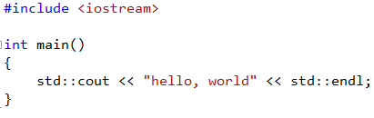
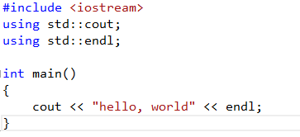
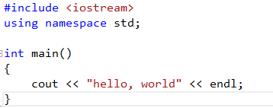
Now you must specifically say which names are in std:
Or write "using declarations" to bring the necessary std names into scope:
Or write a "using directive" to simply drag all the std names into scope wholesale:

Slide 12
Namespace Rule #1: Avoid using directives entirely, especially in header files.
The reason for Rule #1 is that using directives cause wanton namespace pollution by bringing in potentially huge numbers of names, many (usually the vast majority) of which are unnecessary. The presence of the unnecessary names greatly increases the possibility of unintended name conflicts--not just in the header itself, but in every module that #includes the header.

Slide 13
Namespace Rule #2: Never write namespace using declarations in header files.
Note that Rule #2 goes much further than most popular advice. Most authors recommend that using declarations never appear at file scope in shared header files. That's good advice, as far as it goes, because at file scope a using declaration causes the same kind of namespace pollution as a using directive, only less of it.

Slide 14
Namespace Rule #3: Use C headers with the new style "#include <cheader>“ instead of the old style "#include <header.h>".
For backward compatibility with C, C++ still supports all of the standard C header names (e.g., stdio.h), and when you #include those original versions the associated C library functions are visible in the global namespace as before--but in the same breath C++ also says that the old header names are deprecated, which puts the world on notice that they may be removed in a future version of the C++ standard. Thus Standard C++ strongly encourages programmers to prefer using the new versions of the C headers that start with "c" and drop the ".h" extension (e.g., cstdio); when you #include the C headers using the new names, you get the same C library functions, but now they live in namespace std.

Slide 15
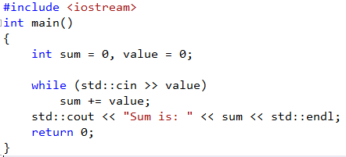
Exercise: What does this program do?

Slide 16
Disecting the program
The first line inside main defines two int variables, named sum and value, which we initialize to 0. We’ll use value to hold each number as we read it from the input.
We read the data inside the condition of the while:
while (std::cin >> value)
Evaluating the while condition executes the expression
std::cin >> value
That expression reads the next number from the standard input and stores that number in value. The input operator returns its left operand, which in this case is std::cin. This condition, therefore, tests std::cin.
When we use an istream as a condition, the effect is to test the state of the stream. If the stream is valid—that is, if the stream hasn’t encountered an error—then the test succeeds. An istream becomes invalid when we hit end-of-file or encounter an invalid input, such as reading a value that is not an integer. An istream that is in an invalid state will cause the condition to yield false.
Thus, our while executes until we encounter end-of-file (or an input error). The while body uses the compound assignment operator to add the current value to the evolving sum. Once the condition fails, the while ends. We fall through and execute the next statement, which prints the sum followed by endl.

Slide 17
Entering an End-of-File from the Keyboard
When we enter input to a program from the keyboard, different operating systems use different conventions to allow us to indicate end-of-file.
On Windows systems we enter an end-of-file by typing a control- z followed by hitting either the Enter or Return key.
On UNIX systems, including on Mac OS X machines, end-of-file is usually control-d.

Slide 18
Types, Variables, and Arithmetic
Every name and every expression has a type that determines the operations that may be performed on it. For example, the declaration
int inch; // speciﬁes that inch is of type int;
A declaration is a statement that introduces a name into the program. It speciﬁes a type for the named entity:
A type deﬁnes a set of possible values and a set of operations (for an object).
An object is some memory that holds a value of some type.
A value is a set of bits interpreted according to a type.
A variable is a named object.

Slide 19
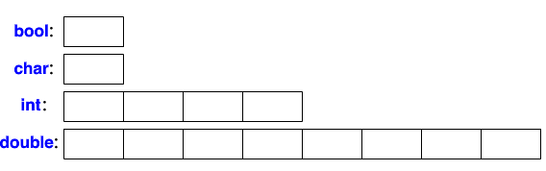
C++ offers a variety of fundamental types.
bool //Boolean, possible values are true and false
char //character, for example, 'a', ' z', and '9'
int //integer, for example, 1, 42, and 1066
double //double-precision ﬂoating-point number, for example,3.14 and 299793.0
Each fundamental type corresponds directly to hardware facilities and has a ﬁxed size that determines the range of values that can be stored in it:
A char variable is of the natural size to hold a character on a given machine (typically an 8-bit byte), and the sizes of other types are quoted in multiples of the size of a char. The size of a type is implementation-deﬁned (i.e., it can vary among different machines) and can be obtained by the sizeof operator; for example, sizeof(char) equals 1 and sizeof(int) is often 4.

Slide 20
Primitive Built-in Types
C++ defines a set of primitive types that include the arithmetic types and a special type named void. The arithmetic types represent characters, integers, boolean values, and floating-point numbers. The void type has no associated values and can be used in only a few circumstances, most commonly as the return type for functions that do not return a value.
Arithmetic Types
The arithmetic types are divided into two categories: integral types (which include character and boolean types) and floating-point types.
The size of—that is, the number of bits in—the arithmetic types varies across machines.

Slide 21
Machine-Level Representation of the Built-in Types
Computers store data as a sequence of bits, each holding a 0 or 1, such as 00011011011100010110010000111011 ...
Most computers deal with memory as chunks of bits of sizes that are powers of 2. The smallest chunk of addressable memory is referred to as a “byte.”
The basic unit of storage, usually a small number of bytes, is referred to as a “word.” In C++ a byte has at least as many bits as are needed to hold a character in the machine’s basic character set. On most machines a byte contains 8 bits and a word is either 32 or 64 bits, that is, 4 or 8 bytes.

Slide 22
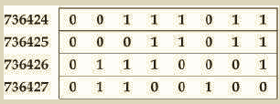
Most computers associate a number (called an “address”) with each byte in memory. On a machine with 8-bit bytes and 32-bit words, we might view a word of memory as follows
Here, the byte’s address is on the left, with the 8 bits of the byte following the address. We can use an address to refer to any of several variously sized collections of bits starting at that address. It is possible to speak of the word at address 736424 or the byte at address 736427. To give meaning to memory at a given address, we must know the type of the value stored there. The type determines how many bits are used and how to interpret those bits.
If the object at location 736424 has type float and if floats on this machine are stored in 32 bits, then we know that the object at that address spans the entire word. The value of that float depends on the details of how the machine stores floating-point numbers. Alternatively, if the object at location 736424 is an unsigned char on a machine using the ISO-Latin-1 character set, then the byte at that address represents a semicolon.

Slide 23
Integral types may be signed or unsigned.
Except for bool and the extended character types, the integral types may be signed or unsigned.
The types int, short, long, and long long are all signed.
We obtain the corresponding unsigned type by adding unsigned to the type, such as unsigned long.
The type unsigned int may be abbreviated as unsigned.
There are three distinct basic character types: char, signed char, and unsigned char. In particular, char is not the same type as signed char. Although there are three character types, there are only two representations: signed and unsigned. The (plain) char type uses one of these representations. Which of the other two character representations is equivalent to char depends on the compiler.
In an unsigned type, all the bits represent the value. For example, an 8-bit unsigned char can hold the values from 0 through 255 inclusive.
The standard does not define how signed types are represented, but does specify that the range should be evenly divided between positive and negative values. Hence, an 8-bit signed char is guaranteed to be able to hold values from –127 through 127; most modern machines use representations that allow values from –128 through 127.

Slide 24
Advice: Deciding which Type to Use
Use an unsigned type when you know that the values cannot be negative.
Use int for integer arithmetic. short is usually too small and, in practice, long often has the same size as int. If your data values are larger than the minimum guaranteed size of an int, then use long long.
Do not use plain char or bool in arithmetic expressions. Use them only to hold characters or truth values. Computations using char are especially problematic because char is signed on some machines and unsigned on others. If you need a tiny integer, explicitly specify either signed char or unsigned char.
Use double for floating-point computations; float usually does not have enough precision, and the cost of double-precision calculations versus single-precision is negligible. In fact, on some machines, double-precision operations are faster than single. The precision offered by long double usually is unnecessary and often entails considerable run-time cost.

Slide 25
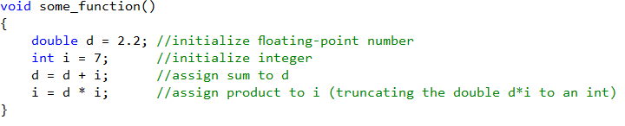
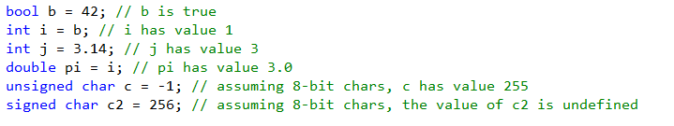
In assignments and in arithmetic operations, C++ performs all meaningful conversions.

Slide 26
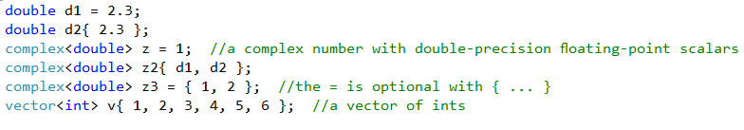
C++ offers a variety of notations for expressing initialization

Slide 27
Rules for implicit conversions
When we assign one of the nonbool arithmetic types to a bool object, the result is false if the value is 0 and true otherwise.
When we assign a bool to one of the other arithmetic types, the resulting value is 1 if the bool is true and 0 if the bool is false.
When we assign a floating-point value to an object of integral type, the value is truncated.
When we assign an integral value to an object of floating-point type, the fractional part is zero. Precision may be lost if the integer has more bits than the floating-point object can accommodate.
If we assign an out-of-range value to an object of unsigned type, the result is the remainder of the value modulo the number of values the target type can hold. For example, an 8-bit unsigned char can hold values from 0 through 255, inclusive. If we assign a value outside this range, the compiler assigns the remainder of that value modulo 256. Therefore, assigning –1 to an 8-bit unsigned char gives that object the value 255.
If we assign an out-of-range value to an object of signed type, the result is undefined. The program might appear to work, it might crash, or it might produce garbage values.

Slide 28
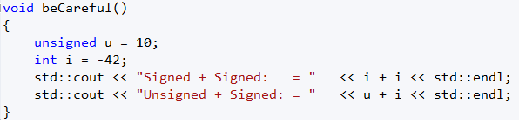
Expressions Involving Unsigned Types
What would be the result when calling beCareful()?

Slide 29

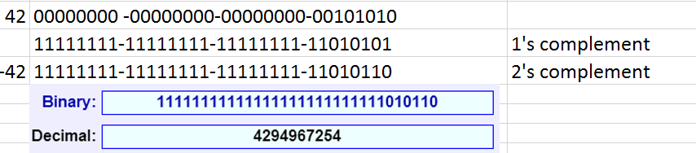
Expressions Involving Unsigned Types
If we use both unsigned and int values in an arithmetic expression, the int value ordinarily is converted to unsigned. Converting an int to unsigned executes the
same way as if we assigned the int to an unsigned

Slide 30


Expressions Involving Unsigned Types
Try to run this loop:
And now run this:

Slide 31
Caution: Don’t Mix Signed and Unsigned Types
Expressions that mix signed and unsigned values can yield surprising results when the signed value is negative. It is essential to remember that signed values are automatically converted to unsigned. For example, in an expression like a * b, if a is -1 and b is 1, then if both a and b are ints, the value is, as expected -1. However, if a is int and b is an unsigned, then the value of this expression depends on how many bits an int has on the particular machine. On our machine, this expression yields 4294967295.

Slide 32
Literals
A value, such as 42, is known as a literal because its value self-evident. Every literal has a type. The form and value of a literal determine its type.
Integer literals
We can write an integer literal using decimal, octal, or hexadecimal notation. Integer literals that begin with 0 (zero) are interpreted as octal. Those that begin with either 0x or 0X are interpreted as hexadecimal.
Decimal | Octal | Hexadecimal
20 | 024 | 0X14

Slide 33
Type of an integer literal
The type of an integer literal depends on its value and notation.
By default, decimal literals are signed whereas octal and hexadecimal literals can be either signed or unsigned types.
A decimal literal has the smallest type of int, long, or long long (i.e., the first type in this list) in which the literal’s value fits.
Octal and hexadecimal literals have the smallest type of int, unsigned int, long, unsigned long, long long, or unsigned long long in which the literal’s value fits.
It is an error to use a literal that is too large to fit in the largest related type.
There are no literals of type short.

Slide 34
Floating point literals
Floating-point literals include either a decimal point or an exponent specified using scientific notation. Using scientific notation, the exponent is indicated by either E or e:
3.14159 3.14159E0 0. 0e0 .001

Slide 35
Character and Character String Literals
A character enclosed within single quotes is a literal of type char. Zero or more characters enclosed in double quotation marks is a string literal:
'a' // character literal
"Hello World!" // string literal
The type of a string literal is array of constant chars
The compiler appends a null character (’\0’) to every string literal. Thus, the actual size of a string literal is one more than its apparent size. For example, the literal 'A' represents the single character A, whereas the string literal "A" represents an array of two characters, the letter A and the null character.
Two string literals that appear adjacent to one another and that are separated only by spaces, tabs, or newlines are concatenated into a single literal. We use this form of literal when we need to write a literal that would otherwise be too large to fit comfortably on a single line:
std::cout << "a really, really long string literal "
"that spans two lines" << std::endl;

Slide 36
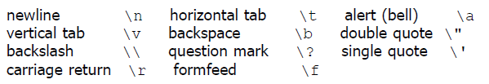
Escape Sequences
Some characters, such as backspace or control characters, have no visible image. Such characters are nonprintable. Other characters (single and double quotation marks, question mark, and backslash) have special meaning in the language.
Our programs cannot use any of these characters directly. Instead, we use an escape sequence to represent such characters. An escape sequence begins with a backslash. The language defines several escape sequences:

Slide 37
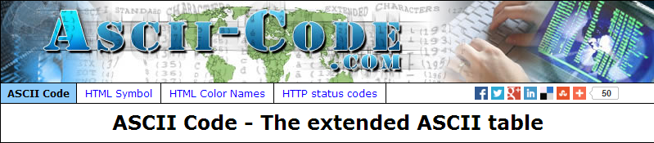
ASCII Code - The extended ASCII table

Slide 38
Boolean and Pointer Literals
The words true and false are literals of type bool:
bool test = false;
The word nullptr is a pointer literal.

Slide 39
Specifying the Type of a Literal
Character and Character String Literals
Prefix | Meaning | Type
u | Unicode 16 character | char16_t
U | Unicode 32 character | char32_t
L | Wide character | wchar_t
u8 | Utf8 (string literals only) | char
Integer Literals
Suffix | Minimum type
u or U | unsigned
l or L | long
ll or LL | long long
Floating Point Literals
Suffix | Type
f or F | float
l or L | long double

Slide 40
It is tricky: The value of a decimal literal is never a negative number
Although integer literals may be stored in signed types, technically speaking, the value of a decimal literal is never a negative number.
If we write what appears to be a negative decimal literal, for example, -42, the minus sign is not part of the literal.
The minus sign is an operator that negates the value of its (literal) operand.

Slide 41
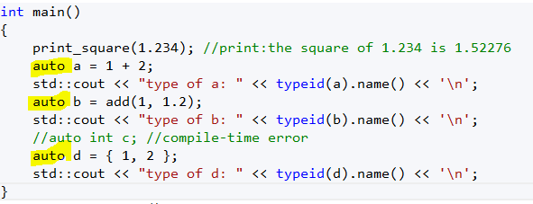
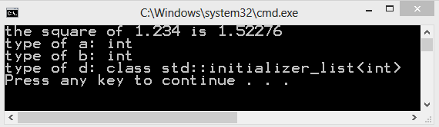
Type inference When deﬁning a variable, you don’t actually need to state its type explicitly when it can be deduced from the initializer
When declaring variables in block scope, in namespace scope, in init statements of for loops, etc, the type of the variable may be omitted and the keyword auto may be used instead.
Once the type of the initializer has been determined, the compiler determines the type that will replace the keyword auto.

Slide 42
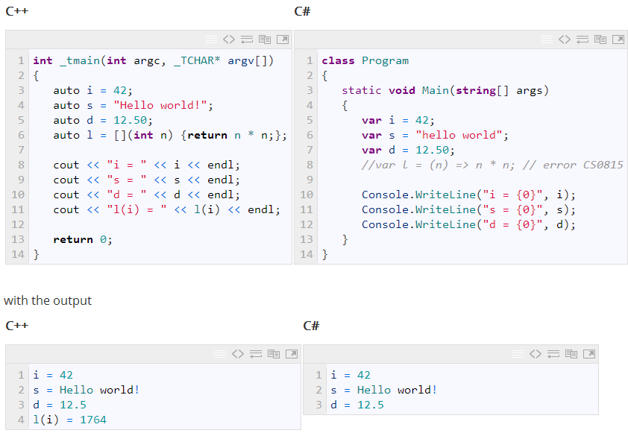
Here is a comparison between auto in C++ and var in C#

Slide 43
Constants
C++ supports two notions of immutability:
const: meaning roughly ‘‘I promise not to change this value’’. This is used primarily to specify interfaces, so that data can be passed to functions without fear of it being modiﬁed. The compiler enforces the promise made by const.
constexpr: meaning roughly ‘‘to be evaluated at compile time’’. This is used primarily to specify constants, to allow placement of data in memory where it is unlikely to be corrupted, and for performance.

Slide 44
Examples. Support For C++11 Features in VS 2013
const int dmv = 17; //dmv is a named constant
int var = 17; //var is not a constant
constexpr double max1 = 1.4 * square(dmv); //OK if square(17) is a constant expression
constexpr double max2 = 1.4 * square(var); //error :var is not a constant expression
const double max3 = 1.4 * square(var); //OK, may be evaluated at run time
double sum(const vector<double>&); //sum will not modify its argument
vector<double> v{ 1.2, 3.4, 4.5 }; //v is not a constant
const double s1 = sum(v); //OK: evaluated at run time
constexpr double s2 = sum(v); //error :sum(v) not constant expression

Slide 45
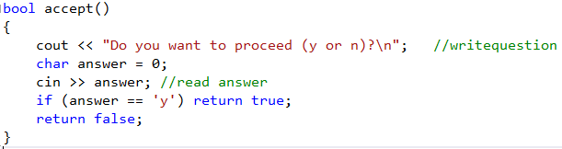
Tests and Loops
C++ provides a conventional set of statements for expressing selection and looping.
A simple function that prompts the user and returns a Boolean indicating the response:

Slide 46
.. cout The standard ouput stream
<< The output operator (put to)
…-----------…………The standard input stream
……………. >> The input operator (get from)

Slide 47
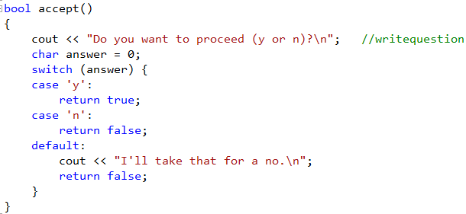
The switch-statement

Slide 48
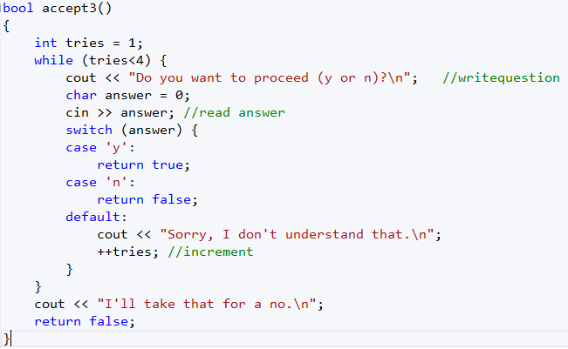
The while-statement

Slide 49
Pointers, Arrays, and Loops
An array of elements of type char can be declared like this:
char v[6]; //array of 6 characters
Similarly, a pointer can be declared like this:
char∗ p; //pointer to character
The size of an array must be a constant expression.
A pointer variable can hold the address of an object of the appropriate type:
char∗ p=&v[3]; //p points to v’s fourth element
char x = ∗p; //*p is the object that p points to

Slide 50
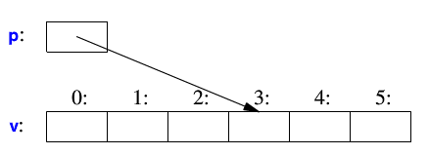
Prefix unary * and prefix unary &
In an expression, preﬁx unary ∗ means ‘‘contents of’’ and preﬁx unary & means ‘‘address of.’’ Graphically:

Slide 51
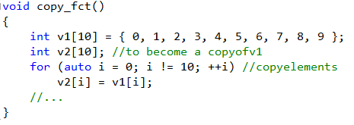
The for-statement

Slide 52
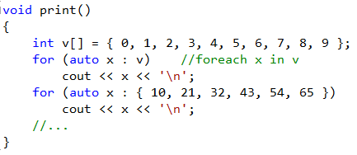
The range for-statement
The range-for-statement can be used for any sequence of elements

Slide 53
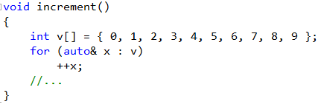
The unary sufﬁx &
In a declaration, the unary sufﬁx & means ‘‘reference to.’’ A reference is similar to a pointer, except that you don’t need to use a preﬁx ∗ to access the value referred to by the reference. Also, a reference cannot be made to refer to a different object after its initialization.

Slide 54
& and [] are declarator operators
Ta[n]; // T[n]: array of n T’s
T* p; // T*: pointer to T
T& r; // T&: reference to T
T f(A); // T(A): function taking an argument of type A returning a // result of type T

Slide 55
The value nullptr (More C++ Idioms/nullptr)
We try to ensure that a pointer always points to an object, so that dereferencing it is valid. When we don’t have an object to point to or if we need to represent the notion of ‘‘no object available’’ (e.g., for an end of a list), we give the pointer the value nullptr(‘‘the null pointer’’). There is only one nullptr shared by all pointer types:
double* pd = nullptr;
Link<Record>* lst = nullptr; //pointer to a Link to a Record
int x = nullptr; //error :nullptr is a pointer not an integer
In older code,0 or NULL is typically used instead of nullptr. However, using nullptr eliminates potential confusion between integers (such as 0 or NULL) and pointers (such as nullptr).

Slide 56
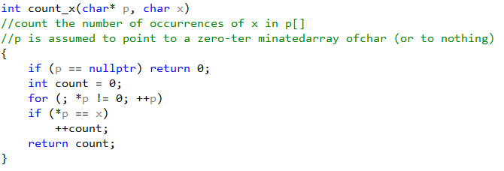
Check that a pointer argument that is supposed to point, actually points to something

Slide 57
More on nullptr
In C and C++, it's always been important to express the idea of a NULL pointer--one that has no value. Oddly, in C++, the expression used, 0 (or NULL, always #defined to zero) was not even a pointer type. Although this worked most of the time, it could lead to strange and unexpected problems in what are, admittedly, rather edge cases.
An example follows

Slide 58
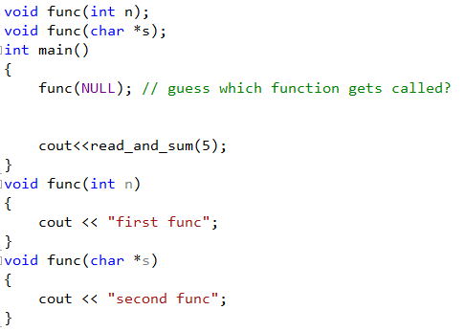
More on nullptr
Imagine you have the following two function declarations.
Although it looks like the second function will be called--you are, after all, passing in what seems to be a pointer--it's really the first function that will be called!
The trouble is that because NULL is 0, and 0 is an integer, the first version of func will be called instead.
A language feature that looks like a compiler bug is, well, not something you want.

Slide 59
Enter nullptr
In C++11, nullptr is a new keyword that can (and should!) be used to represent NULL pointers; in other words, wherever you were writing NULL before, you should use nullptr instead.
It's no more clear to you, the programmer, (everyone knows what NULL means), but it's more explicit to the compiler, which will no longer see 0s everywhere being used to have special meaning when used as a pointer.

Slide 60
std::nullptr_t
nullptr, by the way, is not only declared to be a pointer and convert implicitly to all pointer types (and bool), but it is its own special, distinct type:
decltype( nullptr )
While we can use decltype to extract its type, there is also a more convenient notation:
std::nullptr_t
Since nullptr is its own unique type, you can use it as a constructor or function argument when you want to be sure that you only ever take an empty pointer for a value. For example:
void func( std::nullptr_t );
declares a function that takes only nullptr (or a value cast to std::nullptr_t) and nothing else, a rather neat trick.
Regardless of all this--the rule of thumb for C++11 is simply to start using nullptr whenever you would have otherwise used NULL in the past.

Slide 61
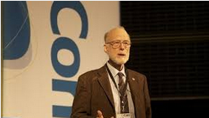
Null References: The Billion Dollar Mistake
Sir Charles Antony Richard Hoare (Tony Hoare or C.A.R. Hoare, born January 11, 1934) is a British computer scientist, probably best known for the development in 1960 of Quicksort (or Hoaresort), one of the world's most widely used sorting algorithms.
He also developed Hoare logic for verifying program correctness, and the formal language Communicating Sequential Processes (CSP) used to specify the interactions of concurrent processes (including the Dining philosophers problem) and the inspiration for the Occam programming language.
Historically bad ideas
I call it my billion-dollar mistake. It was the invention of the null reference in 1965. At that time, I was designing the first comprehensive type system for references in an object oriented language (ALGOL W). My goal was to ensure that all use of references should be absolutely safe, with checking performed automatically by the compiler. But I couldn't resist the temptation to put in a null reference, simply because it was so easy to implement. This has led to innumerable errors, vulnerabilities, and system crashes, which have probably caused a billion dollars of pain and damage in the last forty years. In recent years, a number of program analysers like PREfix and PREfast in Microsoft have been used to check references, and give warnings if there is a risk they may be non-null. More recent programming languages like Spec# have introduced declarations for non-null references. This is the solution, which I rejected in 1965.

Slide 62
User-Deﬁned Types
Built-in types
Types that can be built from the fundamental types, the const modiﬁer, and the declarator are built-in types.
They don’t provide the programmer with high-level facilities to conveniently write advanced applications. Instead, C++ augments the built-in types and operations with a sophisticated set of abstraction mechanisms out of which programmers can build such high level facilities.
User-defined types
The C++ abstraction mechanisms are primarily designed to let programmers design and implement their own types, with suitable representations and operations, and for programmers to simply and elegantly use such types. Types built out of the built-in types using C++’s abstraction mechanisms are called user-deﬁned types .They are referred to as classes and enumerations.

Slide 63

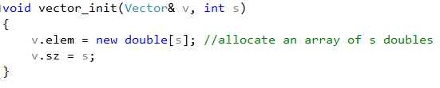
Structures
The ﬁrst step in building a new type is often to organize the elements it needs into a data structure, a struct:
Constructing a vector:

Slide 64
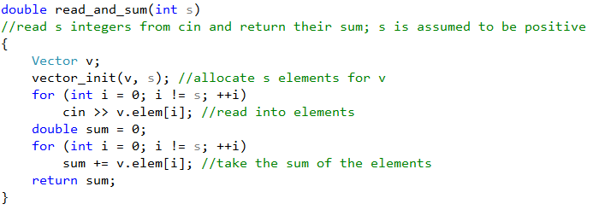
The new operator
The new operator allocates memory from an area called the free store (also known as dynamic memory and heap).
A simple use of Vector:

Slide 65
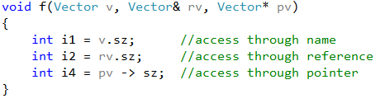
Accesing the struct members
We use . (dot) to access struct members through a name (and through a reference) and −> to access struct members through a pointer.

Slide 66
Classes
Having the data speciﬁed separately from the operations on it has advantages, such as the ability to use the data in arbitrary ways. However, a tighter connection between the representation and the operations is needed for a user-deﬁned type to have all the properties expected of a ‘‘real type.’’
In particular, we often want to keep the representation inaccessible to users, so as to ease use, guarantee consistent use of the data, and allow us to later improve the representation. To do that we have to distinguish between the interface to a type (to be used by all) and its implementation (which has access to the otherwise inaccessible data).
The language mechanism for that is called a class.

Slide 67
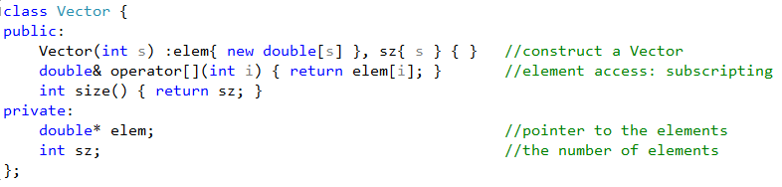
Defining a class
A class is deﬁned to have a set of members, which can be data, function, or type members. The interface is deﬁned by the public members of a class, and private members are accessible only through that interface. For example:

Slide 68
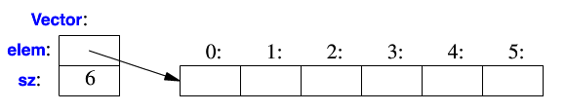
Now, create a Vector
Vector(6);
Basically, the Vector object is a ‘‘handle’’ containing a pointer to the elements (elem) plus the number of elements (sz). The number of elements (6 in the example) can vary from Vector object to Vector object, and a Vector object can have a different number of elements at different times.
However, the Vector object itself is always the same size. This is the basic technique for handling varying amounts of information in C++: a ﬁxed-size handle referring to a variable amount of data ‘‘elsewhere’’(e.g., on the free store allocated by new).

Slide 69
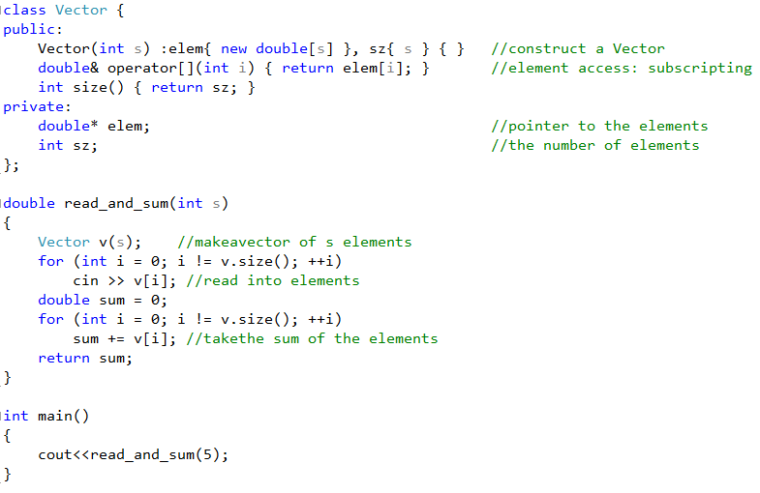
Using the Vector class

Slide 70
The Constructor
A ‘‘function’’ with the same name as its class is called a constructor, that is, a function used to construct objects of a class.
Unlike an ordinary function, a constructor is guaranteed to be used to initialize objects of its class.
Vector(int) deﬁnes how objects of type Vector are constructed. In particular, it states that it needs an integer to do that. That integer is used as the number of elements. The constructor initializes the Vector members using a member initializer list:

Slide 71

Operator overloading: Subscript Function
Access to elements is provided by a subscript function, called operator[]. It returns a reference to the appropriate element (a double&).

Slide 72
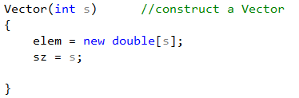
Providing a mechanism to ‘‘give back’’ the array of doubles acquired by new
How to free the memory reserved for the array of doubles?
We will use a destructor to elegantly do that.

Slide 73

Enumerations
In addition to classes, C++ supports a simple form of user-deﬁned type for which we can enumerate the values:
Note that enumerators (e.g., red) are in the scope of their enum class, so that they can be used repeatedly in different enum classes without confusion. For example, Color::red is Color’s red which is different from Trafﬁc_light::red.
Enumerations are used to represent small sets of integer values. They are used to make code more readable and less error-prone than it would have been had the symbolic (and mnemonic) enumerator names not been used.

Slide 74
enum versus enum class
Old-style C++ enums are essentially integers; they could be compared with integers or with other enums of different types.
The thing is, you normally don't want to do that since enums are supposed to be some fixed list of enumerated values.
Why would you want to compare to some other enum type (or an integer)? It's like saying, "please compare this kind of nail with this kind of toothbrush." It makes no sense, and you probably don't mean to do it. But old-style C++ enums will happily tell you, "why yes, this nail isn't like this toothbrush" or, worse, they might compare equal because they happen to share the same underlying integer value ("ah yes, this nail IS a Panasonic electronic toothbrush").
Now, with strongly typed enums, the compiler will tell you that you're doing it. If you really mean it, you can always use a typecast.

Slide 75
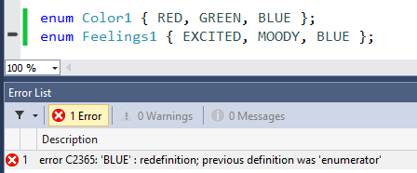
enum values are unscoped
Another limitation is that enum values were unscoped--in other words, you couldn't have two enumerations that shared the same name:

Slide 76

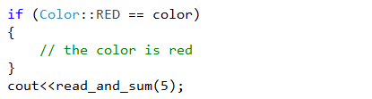
Strongly typed enums - enum classes
Strongly typed enums are a new kind of enum, declared like so:
The use of the word class is meant to indicate that each enum type really is different and not comparable to other enum types. Strongly typed enums, enum classes, also have better scoping. Each enum value is scoped within the name of the enum class. In other words, to access the enum values, you must write:

Slide 77
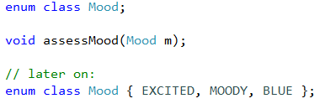
Forward declaration to a strongly typed enum
Enum classes have another advantages over old-style enums. You can have a forward declaration to a strongly typed enum, meaning that you can write code like:
Using a forward declaration allows you to declare an enum type in the header file while putting specific values into the cpp file. This lets you change the list of possible enum values quite frequently without forcing all dependent files to recompile.

Slide 78
Well-defined enum sizes
A final advantage of enum classes is that you can set the size of your enum--you can use any signed or unsigned integer type. It defaults to int, but you can also use char, unsigned long, etc. This will ensure some measure of compatibility across compilers.
But in C++11, we can do even better, specifying exact sizes for enums, using cstdint.

Slide 79
Cstdint: <cstdint> vs <stdint.h>
One problem that C++ has suffered from is a lack of standard types that provide fixed, well-defined sizes.
For example, sometimes you want to have a 32-bit integer, not just an int that might have different sizes on different architectures.
In C++11, the C99 header file stdint.h has been included as cstdint. The cstdint header includes types such as std::int8_t, std::int16_t, std::int32_t, and std::int64_t (as well as unsigned versions that begin with u: std::uint8_t).
Here's an example that combines these new types with enum classes to get completely known sizes for your enum across compilers and architectures:

Slide 81
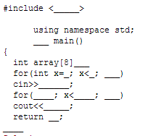
Exercises
Fill in the missing parts of the code to create a working program that will accomplish the stated task.
Array Challenge

Slide 82
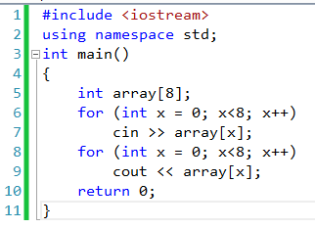
Solution

Slide 83
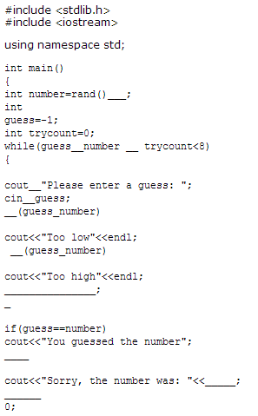
Guessing Game Solution
The following program will act as a guessing game in which the user has eight tries to guess a randomly generated number. The program will tell the user each time whether he guessed high or low

Slide 84
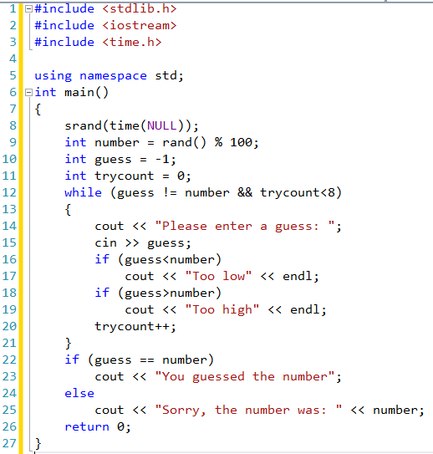

Slide 85
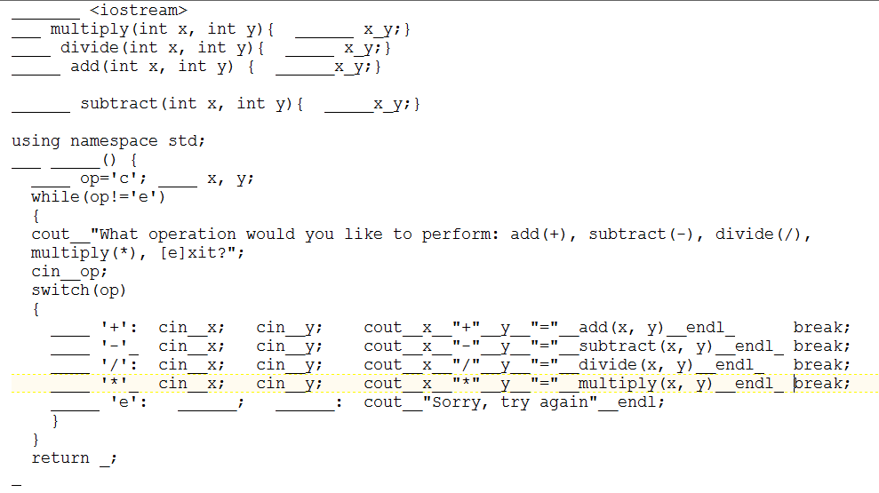
Calculator
The following program should function as a basic calculator; it should ask the user to input what type of arithmetic operation he would like, and then ask for the numbers on which the operation should be performed. The calculator should then give the output of the operation.

Slide 86
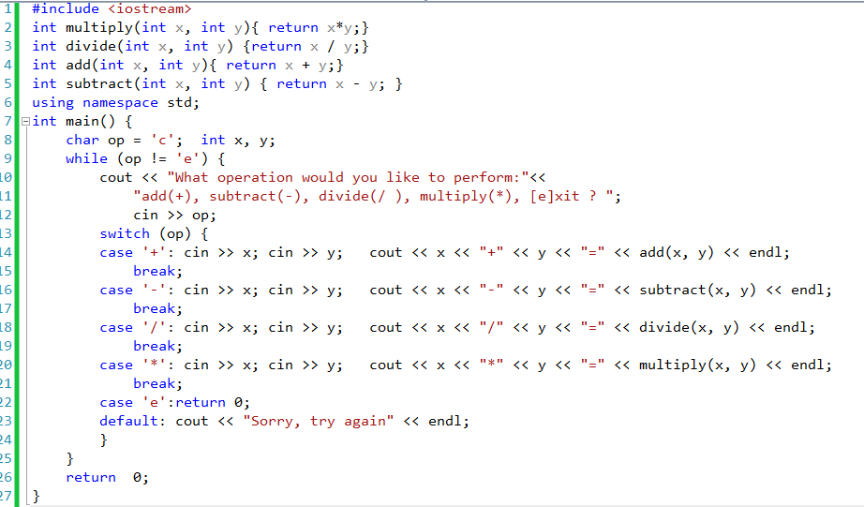
Solution

Slide 87
Temperature Converter
In this challenge:
Write a program that takes in three arguments, a start temperature (in Celsius), an end temperature (in Celsius) and a step size.
Print out a table that goes from the start temperature to the end temperature, in steps of the step size; you do not actually need to print the final end temperature if the step size does not exactly match.
You should perform input validation: do not accept start temperatures less than a lower limit (which your code should specify as a constant) or higher than an upper limit (which your code should also specify).
You should not allow a step size greater than the difference in temperatures

Slide 88
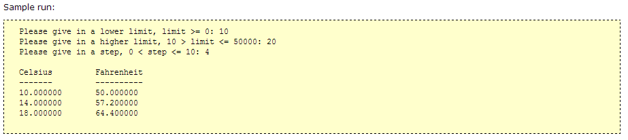
Temperature Converter

Slide 89
Temperature Converter
Solution

Slide 90
Line Count program
count filename.txt
Here's a simple help free challenge to get you started: write a program that takes a file as an argument and counts the total number of lines. Lines are defined as ending with a newline character. Program usage should be
count filename.txt
and the output should be the line count.

Slide 91
Line Count program
Solution

