Slide 1

Predicting Closest NBA Games
Data Science Capstone Project
Brett Gordon
2/25/2023

Slide 2
Agenda
Problem Statement
Basketball Statistics Overview
Data Discovery
Modeling
Resolution

Slide 3
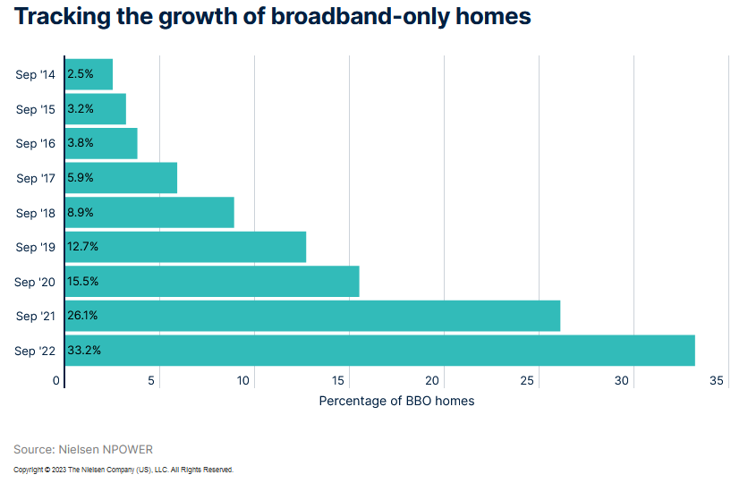
Problem Statement
Streaming sporting events has grown massively over the past 15 years
Basketball is one of the most watched sports in the US and growing rapidly internationally
Time to capitalize on this growth with a unique opportunity

Slide 4

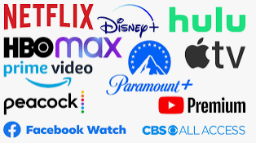
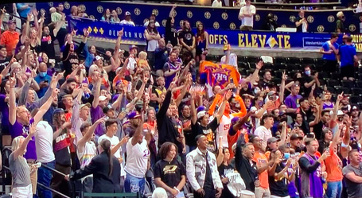
Goal
Create a unique premium service for basketball viewers
Utilize information about both teams
Predict closest NBA games on a nightly basis
Stakeholders:

Slide 5
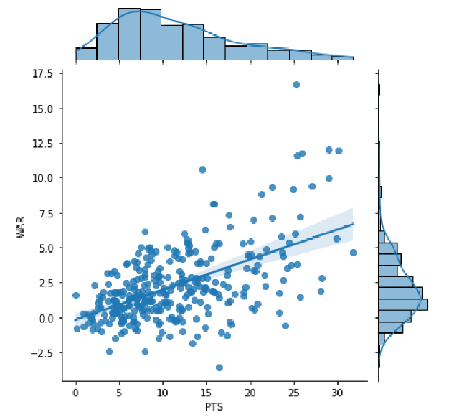
Basketball Statistics
Team Statistics
Points
Win Percentage
Point Differential
Player Statistics
Points
Rebounds
Assists
WAR/RAPTOR

Slide 6
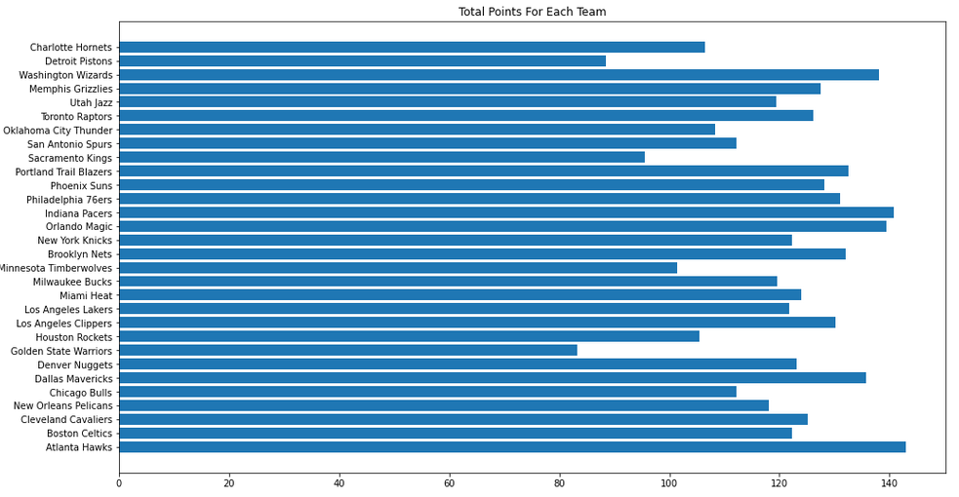
Team Scoring (2020 Season)

Slide 7
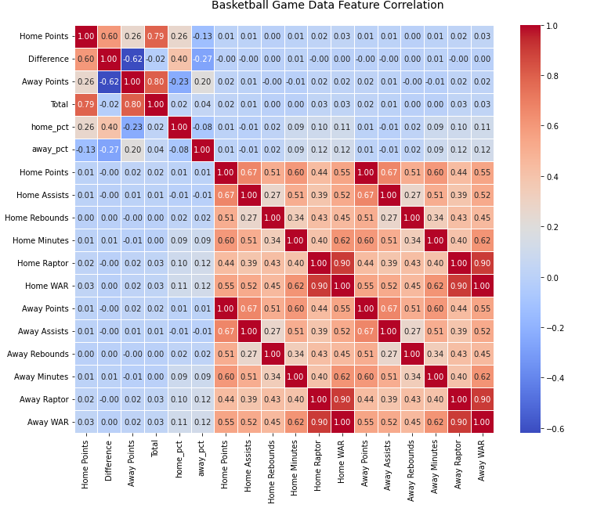
Data Discovery
Team Stats have higher correlations to Team Stats
Player Stats have STRONG correlation to Player Stats
Given data shows individual players don’t have strong influence on team results

Slide 8
Regression Models Trained/Tested
Linear Regression
K-Nearest Neighbors
Epsilon-Support Vector Regression
Linear Support Vector Regression
Random Forest
Gradient Boosting
Baseline Model
Best Models for the data given

Slide 9
Regression Models Trained/Tested
Model | R-Squared Training Score | R-Squared Test Score
Linear Regression | 0.206 | 0.213
K-Nearest Neighbor | 0.212 | 0.158
Epsilon-Support Vector Regression | 0.205 | 0.213
Linear Support Vector Regression | 0.205 | 0.212
Random Forest (Squared-Error Criterion) | 0.989 | 0.903
Random Forest (Mean Absolute-Error Criterion) | 0.987 | 0.886
Gradient Boosting (Squared-Error Criterion) | 0.993 | 0.873
Gradient Boosting (Mean Absolute-Error Criterion) | 0.683 | 0.639

Slide 10
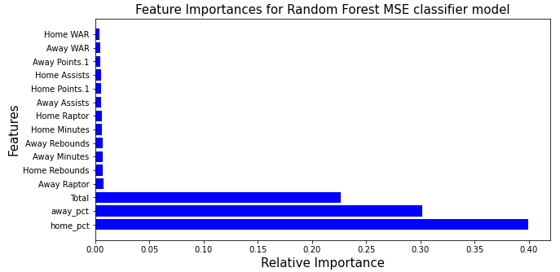
Model Feature Importance

Slide 11
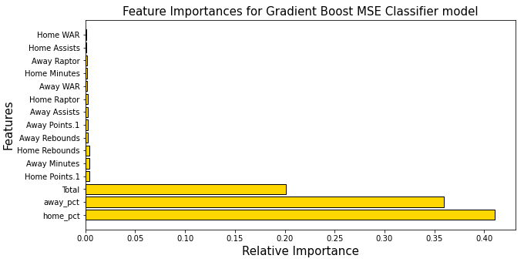
Model Feature Importance

Slide 12
What We Learned
Point Differential correlates to teams, not players
Primary features:
Home Team winning percentage
Away Team winning percentage
Total points scored

Slide 13
What Next?
A large portion of marketing and streamer for basketball is focused on major players
E.g. LeBron James vs Steph Curry
Streaming services should focus on quality of teams instead
These games will have higher likelihood of exciting finishes and scores
Future works:
Create models on different variables
Weigh dependent variables against one another
Expand beyond 2020 NBA season

