Slide 1
Advanced Artificial Intelligence Fall 2017

Slide 2
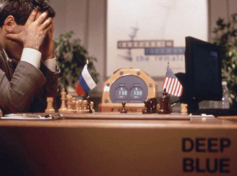
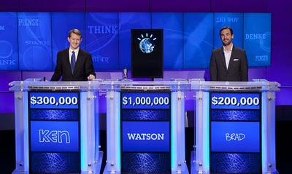
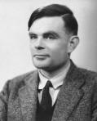
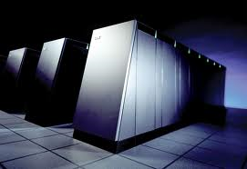
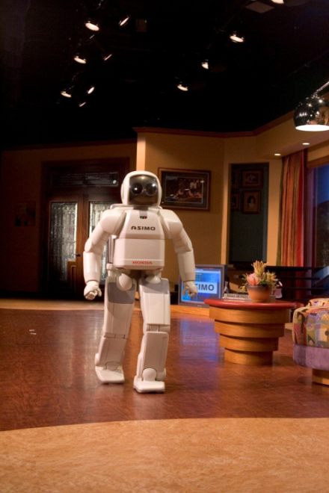
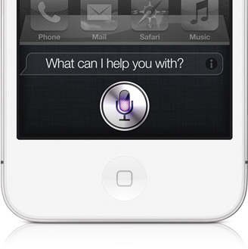
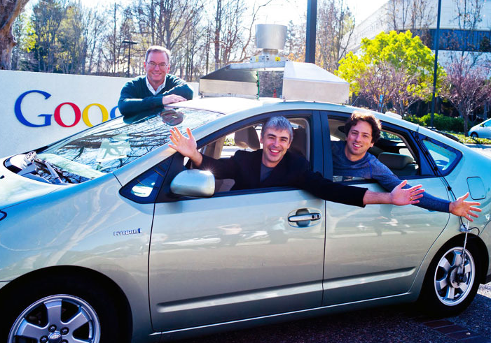
Artificial Intelligence

Slide 3
What is AI?
Some possible definitions from the textbook:
Thinking humanly
Acting humanly
Thinking rationally
Acting rationally

Slide 4
Thinking humanly
Cognitive science: the brain as an information processing machine
Requires scientific theories of how the brain works
How to understand cognition as a computational process?
Introspection: try to think about how we think
Predict and test behavior of human subjects
Image the brain, record neurons
The latter two methodologies are the domains of cognitive science and cognitive neuroscience

Slide 5
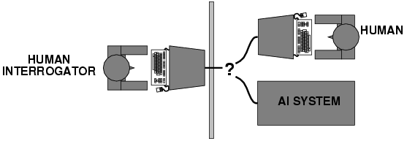
Acting humanly
Turing (1950) "Computing machinery and intelligence"
The Turing Test
What capabilities would a computer need to have to pass the Turing Test?
Natural language processing
Knowledge representation
Automated reasoning
Machine learning
Turing predicted that by the year 2000, machines would be able to fool 30% of human judges for five minutes

Slide 6
Turing Test: Criticism
What are some potential problems with the Turing Test?
Some human behavior is not intelligent
Some intelligent behavior may not be human
Human observers may be easy to fool
A lot depends on expectations
Anthropomorphic fallacy
Chatbots, e.g., ELIZA
Chinese room argument: one may simulate intelligence without having true intelligence (more of a philosophical objection)
Is passing the Turing test a good scientific/engineering goal?

Slide 7
Thinking rationally
Idealized or “right” way of thinking
Logic: patterns of argument that always yield correct conclusions when supplied with correct premises
“Socrates is a man; all men are mortal; therefore Socrates is mortal.”
Beginning with Aristotle, philosophers and mathematicians have attempted to formalize the rules of logical thought
Logicist approach to AI: describe problem in formal logical notation and apply general deduction procedures to solve it
Problems with the logicist approach
Computational complexity of finding the solution
Describing real-world problems and knowledge in logical notation
Dealing with uncertainty
A lot of intelligent or “rational” behavior has nothing to do with logic

Slide 8
Acting rationally: Rational agent
A rational agent is one that acts to achieve the best expected outcome
Goals are application-dependent and are expressed in terms of the utility of outcomes
Being rational means maximizing your expected utility
In practice, utility optimization is subject to the agent’s computational constraints (bounded rationality or bounded optimality)
This definition of rationality only concerns the decisions/actions that are made, not the cognitive process behind them

Slide 9
Acting rationally: Rational agent
Advantages of the “utility maximization” formulation
Generality: goes beyond explicit reasoning, and even human cognition altogether
Practicality: can be adapted to many real-world problems
Amenable to good scientific and engineering methodology
Avoids philosophy and psychology
Any disadvantages?

Slide 10
AI Connections
Philosophy logic, methods of reasoning, mind vs. matter, foundations of learning and knowledge
Mathematics logic, probability, optimization
Economics utility, decision theory
Neuroscience biological basis of intelligence
Cognitive science computational models of human intelligence
Linguistics rules of language, language acquisition
Machine learning design of systems that use experience to improve performance
Control theory design of dynamical systems that use a controller to achieve desired behavior
Computer engineering, mechanical engineering, robotics, …

Slide 11
What are some successes of AI today?

Slide 12
IBM Watson
http://www-03.ibm.com/innovation/us/watson/
NY Times article
Trivia demo
IBM Watson wins on Jeopardy (February 2011)

Slide 13
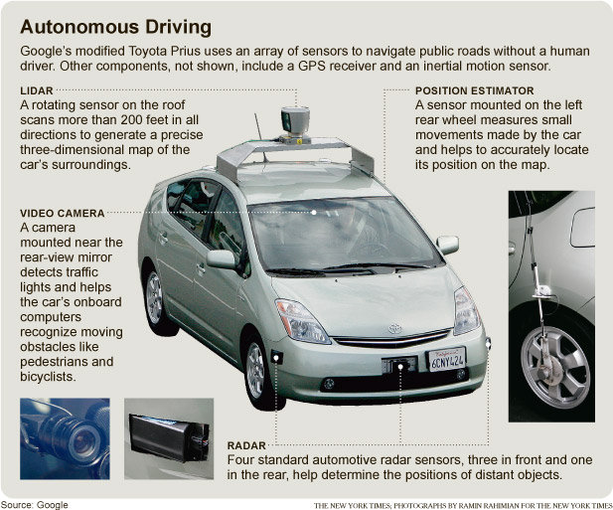
Google self-driving cars
Google’s self-driving car passes 300,000 miles (Forbes, 8/15/2012)

Slide 14
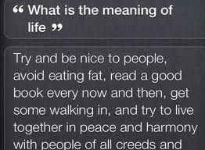
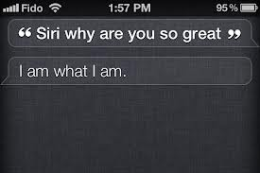
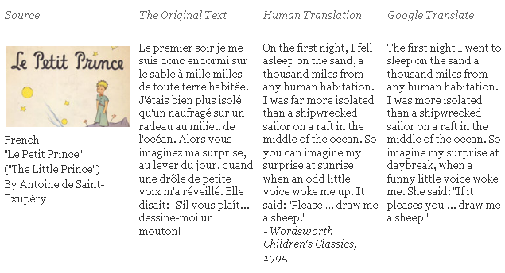
Natural Language
Speech technologies
Google voice search
Apple Siri
Machine translation
translate.google.com
Comparison of several translation systems

Slide 15
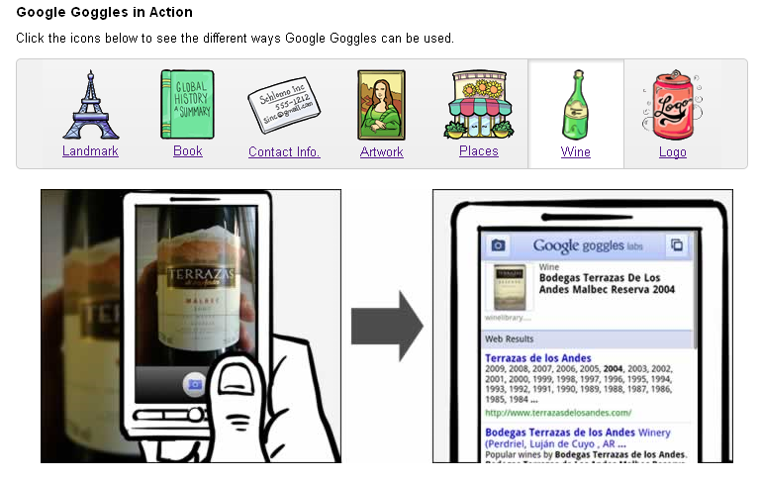
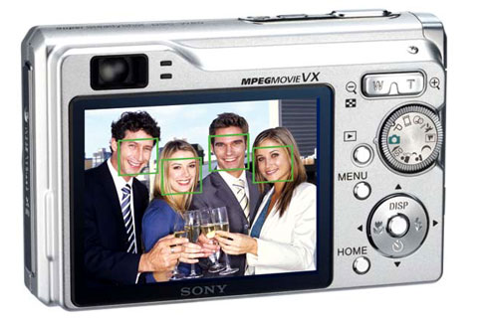
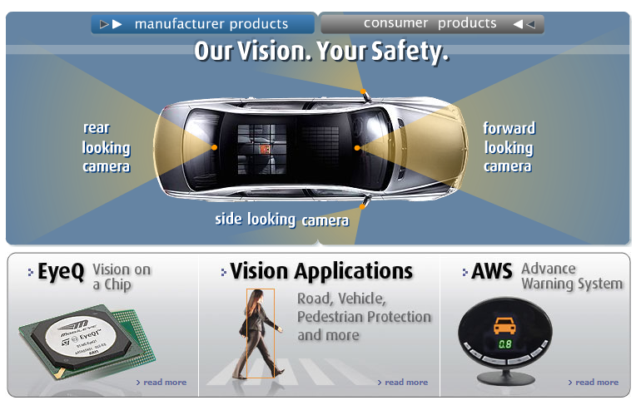

Vision
OCR, handwriting recognition
Face detection/recognition: many consumer cameras, Apple iPhoto
Visual search: Google Goggles
Vehicle safety systems: Mobileye

Slide 16
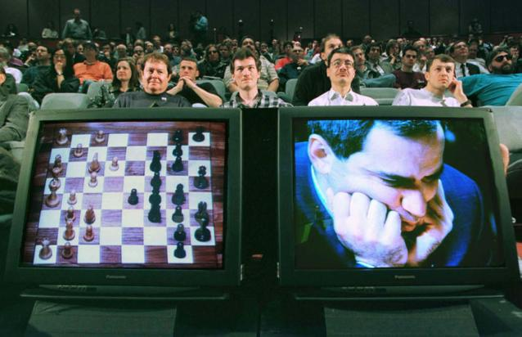
Math, games
In 1996, a computer program written by researchers at Argonne National Laboratory proved a mathematical conjecture unsolved for decades
NY Times story: “[The proof] would have been called creative if a human had thought of it”
IBM’s Deep Blue defeated the reigning world chess champion Garry Kasparov in 1997
1996: Kasparov Beats Deep Blue “I could feel – I could smell – a new kind of intelligence across the table.”
1997: Deep Blue Beats Kasparov “Deep Blue hasn't proven anything.”
In 2007, checkers was “solved”
Science article

Slide 17
Logistics, scheduling, planning
During the 1991 Gulf War, US forces deployed an AI logistics planning and scheduling program that involved up to 50,000 vehicles, cargo, and people
NASA’s Remote Agent software operated the Deep Space 1 spacecraft during two experiments in May 1999
In 2004, NASA introduced the MAPGEN system to plan the daily operations for the Mars Exploration Rovers

Slide 18
Information agents
Search engines
Recommendation systems
Spam filtering
Automated helpdesks
Fraud detection
Automated trading
Medical diagnosis

Slide 19
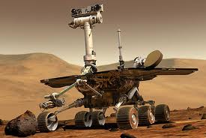
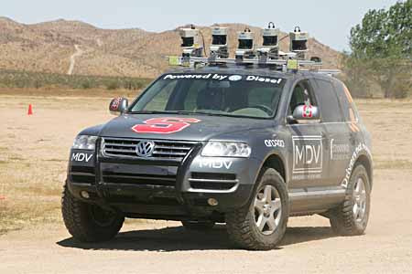

Robotics
Mars rovers
Autonomous vehicles
DARPA Grand Challenge
Google self-driving cars
Autonomous helicopters
Robot soccer
RoboCup
Personal robotics
Humanoid robots
Robotic pets
Personal assistants?

Slide 20
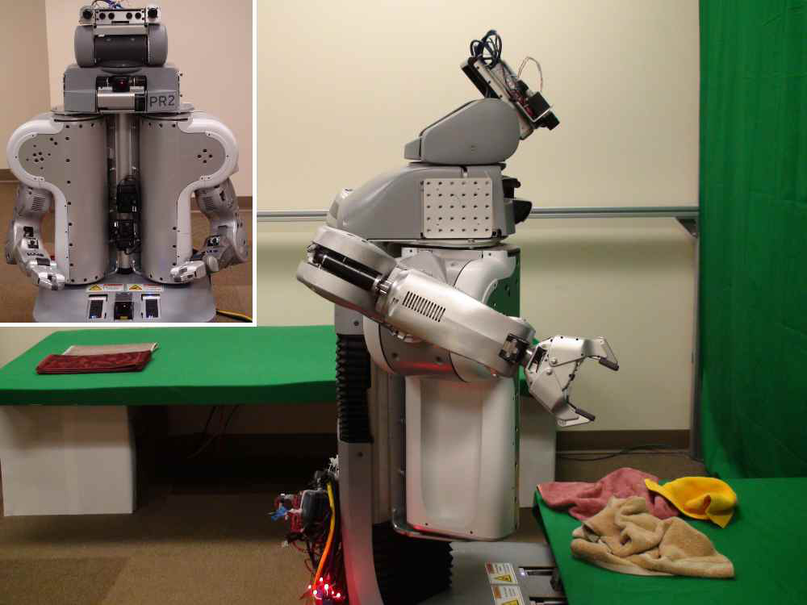
Towel-folding robot
YouTube Video
J. Maitin-Shepard, M. Cusumano-Towner, J. Lei and P. Abbeel, “Cloth Grasp Point Detection based on Multiple-View Geometric Cues with Application to Robotic Towel Folding,” ICRA 2010

