Slide 1
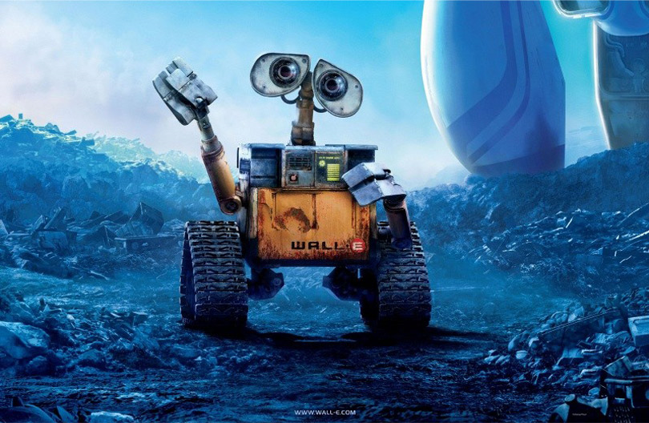
Intelligent Agents
CHAPTER 2

Slide 2
Outline
Agents and environments
Rationality
PEAS (Performance measure, Environment, Actuators, Sensors)
Environment types
Agent types
Artificial Intelligence a modern approach

Slide 3
Agents
An agent is anything that can be viewed as perceiving its environment through sensors and acting upon that environment through actuators
Human agent:
  eyes, ears, and other organs for sensors;
  hands, legs, mouth, and other body parts for actuators
Robotic agent:
  cameras and infrared range finders for sensors
  various motors for actuators
Artificial Intelligence a modern approach

Slide 4

Agents and environments
The agent function maps from percept histories to actions:
[f: P* → A]
The agent program runs on the physical architecture to produce f
agent = architecture + program
Artificial Intelligence a modern approach

Slide 5

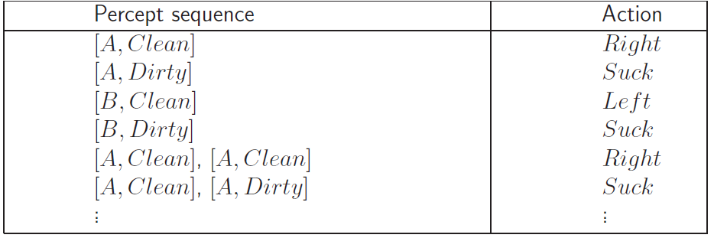
Vacuum-cleaner world
Demo: http://aima-java.googlecode.com/svn/trunk/aima-all/release/aima3ejavademos.html
Percepts: location and contents, e.g., [A,Dirty]
Actions: Left, Right, Suck, NoOp
Agent’s function → look-up table
  For many agents this is a very large table
Artificial Intelligence a modern approach
Notes:
Only 2 locations

Slide 6
Rational agents
Rationality
  Performance measuring success
  Agents prior knowledge of environment
  Actions that agent can perform
  Agent’s percept sequence to date
Rational Agent: For each possible percept sequence, a rational agent should select an action that is expected to maximize its performance measure, given the evidence provided by the percept sequence and whatever built-in knowledge the agent has.
Artificial Intelligence a modern approach

Slide 7
Vacuum-cleaner
Performance measure: Awarding one point for each clean square at each time.
Priori: the geography of the environment.
Actions: Left, Right, Suck
Artificial Intelligence a modern approach

Slide 8
Rationality
Rational is different from omniscience
  Percepts may not supply all relevant information
  E.g., in card game, don’t know cards of others.
Rational is different from being perfect
  Rationality maximizes expected outcome while perfection maximizes actual outcome.
Artificial Intelligence a modern approach

Slide 9
Autonomy in Agents
The autonomy of an agent is the extent to which its
behaviour is determined by its own experience,
rather than knowledge of designer.
Extremes
  No autonomy – ignores environment/data
  Complete autonomy – must act randomly/no program
Example: baby learning to crawl
Ideal: design agents to have some autonomy
  Possibly become more autonomous with experience

Slide 10
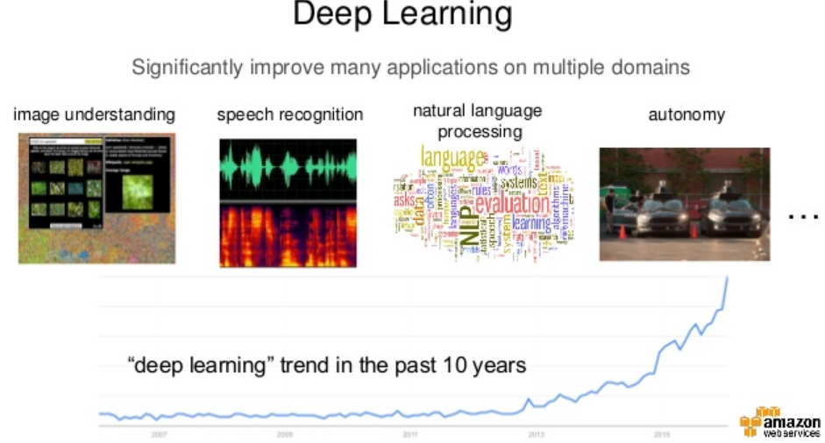

Slide 11
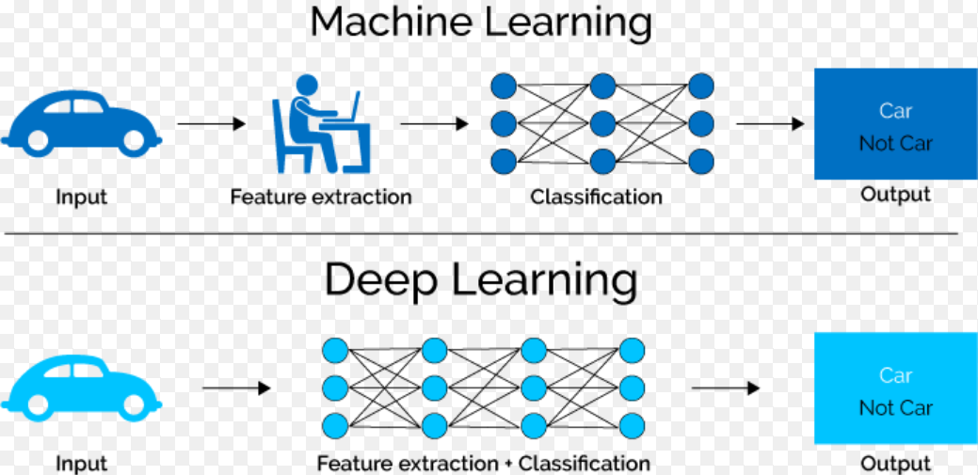
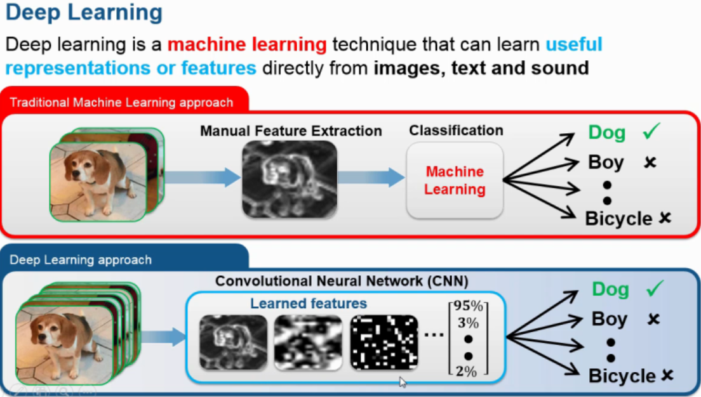

Slide 12
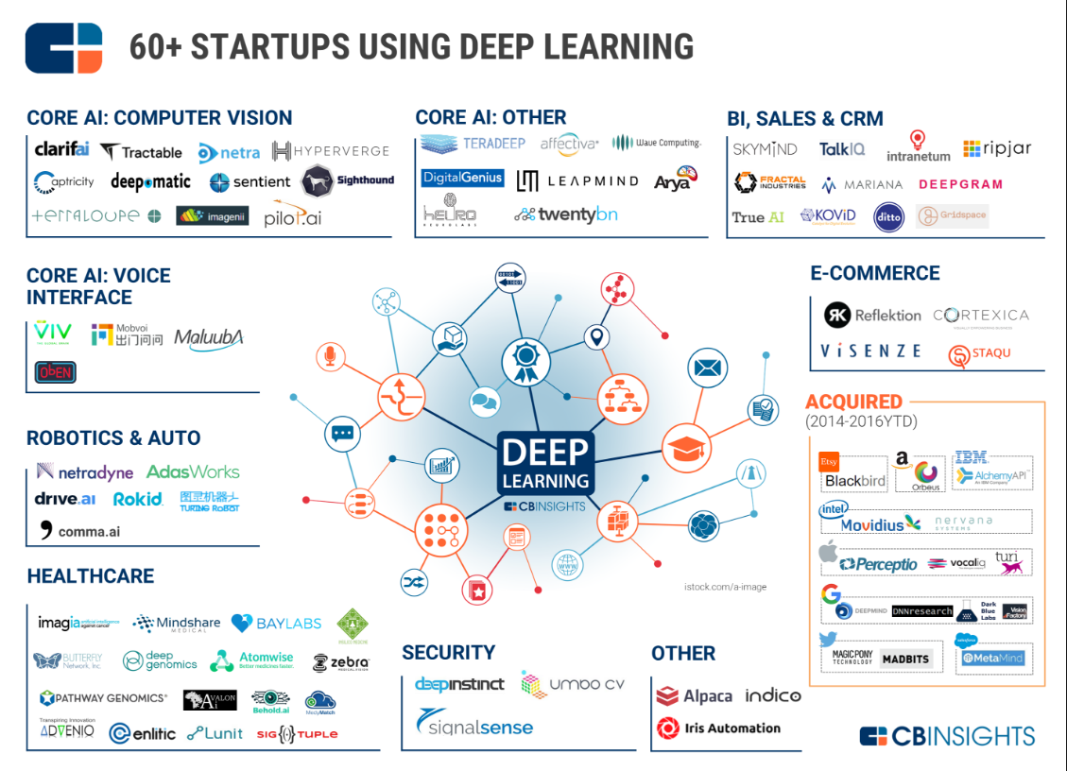

Slide 13
PEAS
PEAS: Performance measure, Environment, Actuators, Sensors
Must first specify the setting for intelligent agent design
Consider, e.g., the task of designing an automated taxi driver:
  Performance measure: Safe, fast, legal, comfortable trip, maximize profits
  Environment: Roads, other traffic, pedestrians, customers
  Actuators: Steering wheel, accelerator, brake, signal, horn
  Sensors: Cameras, sonar, speedometer, GPS, odometer, engine sensors, keyboard
Artificial Intelligence a modern approach

Slide 14
PEAS
Agent: Part-picking robot
Performance measure: Percentage of parts in correct bins
Environment: Conveyor belt with parts, bins
Actuators: Jointed arm and hand
Sensors: Camera, joint angle sensors
Artificial Intelligence a modern approach

Slide 15
PEAS
Agent: Interactive English tutor
Performance measure: Maximize student's score on test
Environment: Set of students
Actuators: Screen display (exercises, suggestions, corrections)
Sensors: Keyboard
Artificial Intelligence a modern approach

Slide 16
Environment types
Fully observable (vs. partially observable)
Deterministic (vs. stochastic)
Episodic (vs. sequential)
Static (vs. dynamic)
Discrete (vs. continuous)
Single agent (vs. multiagent):
Artificial Intelligence a modern approach

Slide 17
Fully observable (vs. partially observable)
Is everything an agent requires to choose its actions available to it via its sensors? Perfect or Full information.
  If so, the environment is fully accessible
If not, parts of the environment are inaccessible
  Agent must make informed guesses about world.
In decision theory: perfect information vs. imperfect information.
Cross Word
Poker
Backgammon
Taxi driver
Fully
Partially
Partially
Partially
Artificial Intelligence a modern approach
Notes:
Satellite image analysis. Some categories depend on definition of task.

Slide 18
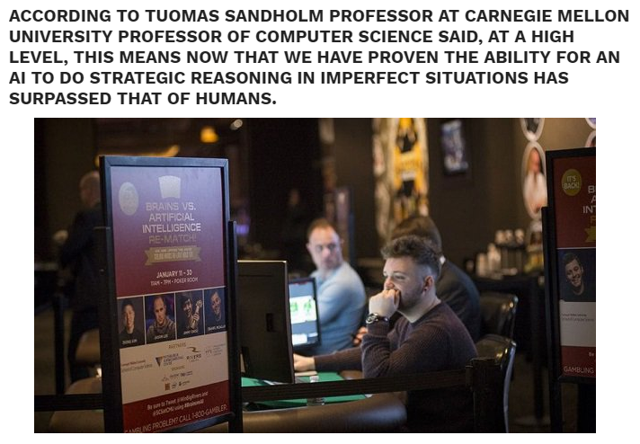
Notes:
http://news.163.com/17/0131/22/CC51S056000187VE.html

Slide 19
Deterministic (vs. stochastic)
Does the change in world state
  Depend only on current state and agent’s action?
Non-deterministic environments
  Have aspects beyond the control of the agent
  Utility functions have to guess at changes in world
Cross Word
Cross Word
Poker
Poker
Backgammon
Backgammon
Taxi driver
Taxi driver
Deterministic
Stochastic
Stochastic
Stochastic
Artificial Intelligence a modern approach

Slide 20
Episodic (vs. sequential):
Is the choice of current action
  Dependent on previous actions?
  If not, then the environment is episodic
In non-episodic environments:
  Agent has to plan ahead:
    Current choice will affect future actions
Cross Word
Poker
Backgammon
Taxi driver
Sequential
Sequential
Sequential
Sequential
Artificial Intelligence a modern approach

Slide 21
Static (vs. dynamic):
Static environments don’t change
  While the agent is deliberating over what to do
Dynamic environments do change
  So agent should/could consult the world when choosing actions
  Alternatively: anticipate the change during deliberation OR make decision very fast
Semidynamic: If the environment itself does not change with the passage of time but the agent's performance score does.
Cross Word
Poker
Backgammon
Taxi driver
Static
Static
Static
Dynamic
Another example: off-line route planning vs. on-board navigation system
Artificial Intelligence a modern approach
Notes:
Chess, when played with a clock, is semidynamic

Slide 22
Discrete (vs. continuous)
A limited number of distinct, clearly defined percepts and actions vs. a range of values (continuous)
Cross Word
Poker
Backgammon
Taxi driver
Discrete
Discrete
Discrete
Conti
Artificial Intelligence a modern approach

Slide 23
Single agent (vs. multiagent):
An agent operating by itself in an environment or there are many agents working together
Cross Word
Poker
Backgammon
Taxi driver
Single
Multi
Multi
Multi
Artificial Intelligence a modern approach

Slide 24
Summary.
Observable
Deterministic
Episodic
Static
Discrete
Agents
Cross Word
Fully
Deterministic
Sequential
Static
Discrete
Single
Poker
Fully
Stochastic
Sequential
Static
Discrete
Multi
Backgammon
Partially
Stochastic
Sequential
Static
Discrete
Multi
Taxi driver
Partially
Multi
Stochastic
Sequential
Dynamic
Conti
Part picking robot
Partially
Stochastic
Episodic
Dynamic
Conti
Single
Image analysis
Fully
Deterministic
Episodic
Semi
Conti
Single
Artificial Intelligence a modern approach

Slide 25
Choice under (Un)certainty
Fully Observable
yes
no
Deterministic
no
yes
Certainty: Search
Uncertainty
Artificial Intelligence a modern approach
Notes:
Comparison to game theory

Slide 26
Agent types
Four basic types in order of increasing generality:
  Simple reflex agents
  Reflex agents with state/model
  Goal-based agents
  Utility-based agents
  All these can be turned into learning agents
Artificial Intelligence a modern approach

Slide 27

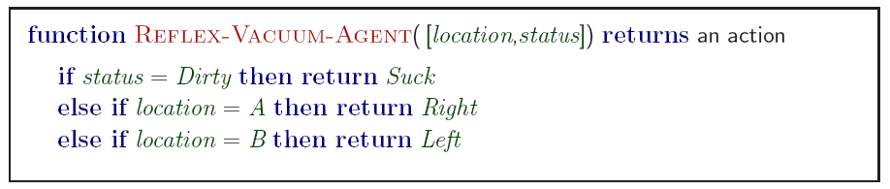
1. Simple reflex agents
Artificial Intelligence a modern approach
Notes:
Based on sensors

Slide 28
Simple reflex agents
With perception
see
action
Agent
Environment
Artificial Intelligence a modern approach

Slide 29
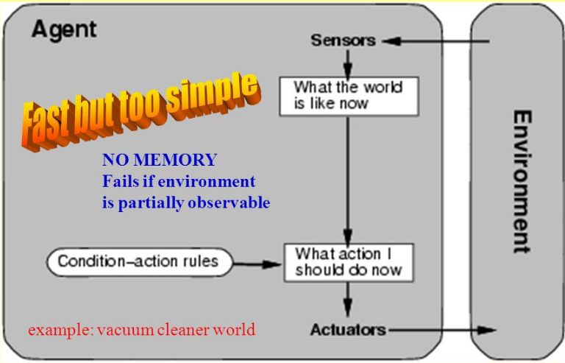
Simple reflex agents
Act only on the basis of the current percept. The agent function is based on the
condition-action rule: condition ⇒ action
Limited functionality; work well only when
  The environment is fully observable, and
  The condition-action rules have predicted all necessary actions
Artificial Intelligence a modern approach
Notes:
Limited Intelligence: For example if a mars lander found a rock in a specific place it needed to collect then it would collect it, if it was a simple reflex agent then if it found the same rock in a different place it would still pick it up as it doesn't take into account that it already picked it up.
if hand is in fire then pull away hand

Slide 30

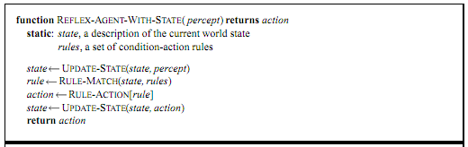
2. Model-based reflex agents
Know how world evolves
  Overtaking car gets closer from behind
How agents actions affect the world
  Wheel turned clockwise takes you right
Model base agents update their state
Artificial Intelligence a modern approach

Slide 31
Model-based reflex agents
Have information about how the world behaves – Model of the World.
They can work out information about the part of the world which they have not seen.
Handle partially observable environments.
Model of the World allows them to
Use information about how the world evolves to keep track of the parts of the world they cannot see
  Example: If the agent has seen an object in a place and has since not seen any agent moving towards that object then the object is still at that place.
Know the effects of their own actions on the world
  Example: if the agent has moved northwards for 5 minutes then it is 5 minutes north of where it was.
Artificial Intelligence a modern approach

Slide 32
Model-based reflex agents
With internal states
Agent
see
action
Predict
state
Environment
Artificial Intelligence a modern approach

Slide 33

Model-based reflex agents
Given a Percept
Integrate Percept in State ➔ State
Evaluate the condition-action rules in State and choose Action
Execute Action
Update State with Action ➔ State
Artificial Intelligence a modern approach

Slide 34

3. Goal-based agents
Reflex agent breaks when it sees brake lights. Goal based agent reasons
  Brake light -> car in front is stopping -> I should stop -> I should use brake
Artificial Intelligence a modern approach

Slide 35
Goal-based agents
Agent
see
Goals
Decision
action
Predict
state
Environment
Artificial Intelligence a modern approach

Slide 36
Goal-based agents
knowing state and environment? Enough?
  Taxi can go left, right, straight
Have a goal
  A destination to get to
Uses knowledge about a goal to guide its actions
  E.g., Search, planning
Artificial Intelligence a modern approach

Slide 37
Goal-based agents
World Model (as model-based agents) + Goals
Goals are situations that are desirable
The goals allow the agent a way to choose among multiple possibilities, selecting the one which reaches a goal state.
Artificial Intelligence a modern approach

Slide 38

Goal-based agents
Differences from Reflexive Agents:
  Goals are explicit
  The future is taken into account
  Reasoning about the future is necessary
    Planning
    Search
Artificial Intelligence a modern approach

Slide 39

4. Utility-based agents
Artificial Intelligence a modern approach

Slide 40
Utility-based agents
Goals are not always enough
  Many action sequences get taxi to destination
  Consider other things. How fast, how safe…..
A utility function maps a state onto a real number which describes the associated degree of “happiness”, “goodness”, “success”.
Where does the utility measure come from?
  Economics: money.
  Biology: number of offspring.
  Your life?
Artificial Intelligence a modern approach
Notes:
Example: why is it important to get a good grade in this course?

Slide 41

Utility-based agents
Utility functions map states to a measure of the utility of the states, often real numbers.
They are used to:
Select between conflicting goals
Select between alternative ways of achieving a goal
Deal with cases of multiple goals, none of which can be achieved with certainty – weighing up likelihood of success against importance of goal.

Slide 42
Multi-Agent Systems
Agent
Agent
ENVIRONMENT
Agent
ENVIRONMENT
Agent
ENVIRONMENT
Agent
Agent

Slide 43
Multiagent Systems Features
Interaction
  Communication languages
  Protocols
  Policies
Co-ordination
Co-operation
Collaboration : Shared goals
Negotiation

