Slide 1
Solving Problems By Searching
CHAPTER 3

Slide 2
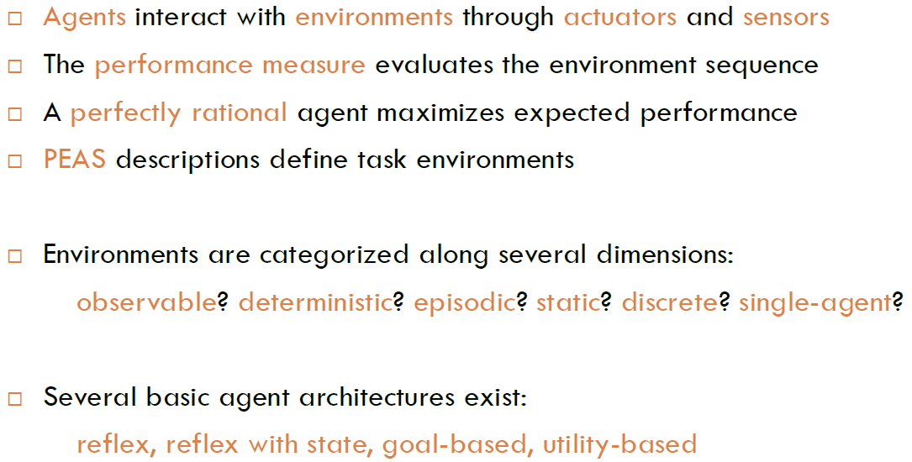
Last chapter…
Notes:
Reflex agent
:
an agent whose action depends only on the current percept.
•
Model-based agent
:
an agent whose action is derived directly from an internal model of the
current world state that is updated over time.
•
Goal-based
agent
:
an
agent
that
selects
actions
that
it
believes
will
achieve
explicitly
represented goals.
•
Utility-based agent
:
an agent that selects actions that it believes will maximize the expected
utility of the outcome state.

Slide 3
Outline
Problem – solving agents
  Goal-based agents
Problem formulation
Example problems
Basic search algorithms

Slide 4
Example: Romania
On holiday in Romania; currently in Arad.
Flight leaves tomorrow from Bucharest
Formulate goal:
  be in Bucharest
Formulate problem:
  states: various cities
  actions: drive between cities
Find solution:
  sequence of cities, e.g., Arad, Sibiu, Fagaras, Bucharest
Notes:
Problem formulation is the process of deciding what actions and states to consider, given a goal

Slide 5

Example: Romania
Abstraction: The process of removing details from a representation
Is the map a good representation of the problem? What is a good replacement?
Notes:
这里面的环境假定是理想环境，当面临很多选择时，选择对将来最有益的
An agent with several immediate options of unknown value can decide what to do by first examining future actions that lead to states of known value

Slide 6
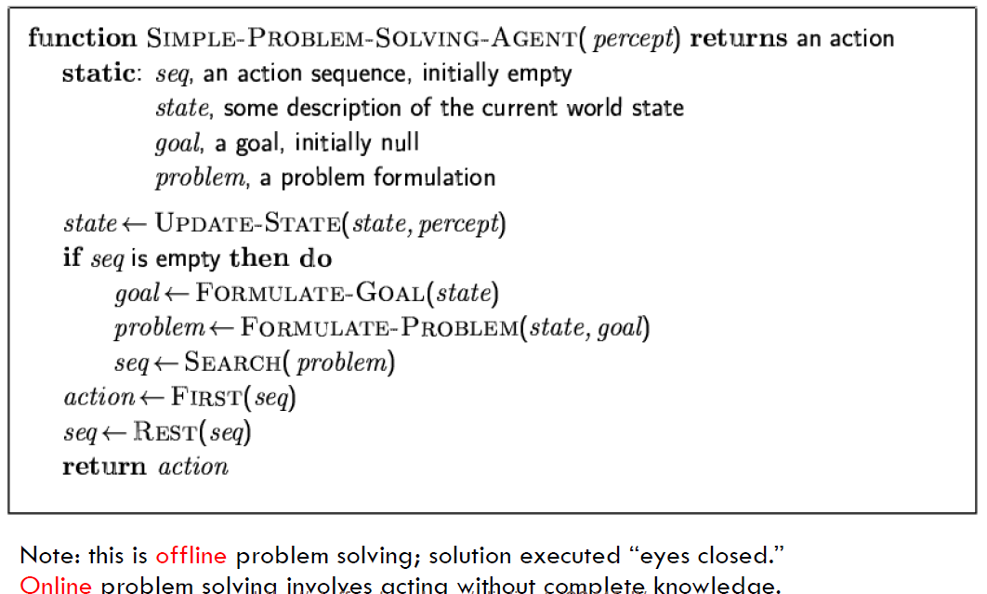
Problem-solving agents

Slide 7
Single-state problem formulation
A problem is defined by four items:
initial state e.g., "at Arad“
actions or successor function S(x) = set of action–state pairs
  e.g., S(Arad) = {<Arad → Zerind, Zerind>, … }
goal test, can be
  explicit, e.g., x = "at Bucharest"
  implicit, e.g., Checkmate(x)
path cost (additive)
  e.g., sum of distances, number of actions executed, etc.
  c(x,a,y) is the step cost, assumed to be ≥ 0
A solution is
  a sequence of actions leading from the initial state to a goal state

Slide 8
Selecting a state space
Real world is complex
  → state space must be abstracted for problem solving
(Abstract) state = set of real states
(Abstract) action = complex combination of real actions
  e.g., "Arad → Zerind" represents a complex set of possible routes, detours, rest stops, etc.
(Abstract) solution =
  set of real paths that are solutions in the real world
Each abstract action should be "easier" than the original problem
Notes:
Abstraction: the process of removing details from a representation is called abstraction

Slide 9

Vacuum world state space graph
states?
actions?
goal test?
path cost?

Slide 10
Vacuum world state space graph
states? integer dirt and robot location
actions? Left, Right, Suck
goal test? no dirt at all locations
path cost? 1 per action

Slide 11

Example: The 8-puzzle
states?
actions?
goal test?
path cost?
Notes:
8-puzzle has 181,440 reachalble stats.
15-puzzle has around 1.3 trillion states

Slide 12
Example: The 8-puzzle
states? locations of tiles
actions? move blank left, right, up, down
goal test? = goal state (given)
path cost? 1 per move
[Note: optimal solution of n-Puzzle family is NP-hard]

Slide 13

Example: robotic assembly
states?:
  real-valued coordinates of robot joint angles parts of the object to be assembled
actions?:
  continuous motions of robot joints
goal test?:
  complete assembly
path cost?:
  time to execute

Slide 14

Tree search algorithms
Basic idea:
  offline, simulated exploration of state space by generating successors of already-explored states (a.k.a.~expanding states)

Slide 15

Tree search example

Slide 16

Tree search example

Slide 17

Tree search example

Slide 18
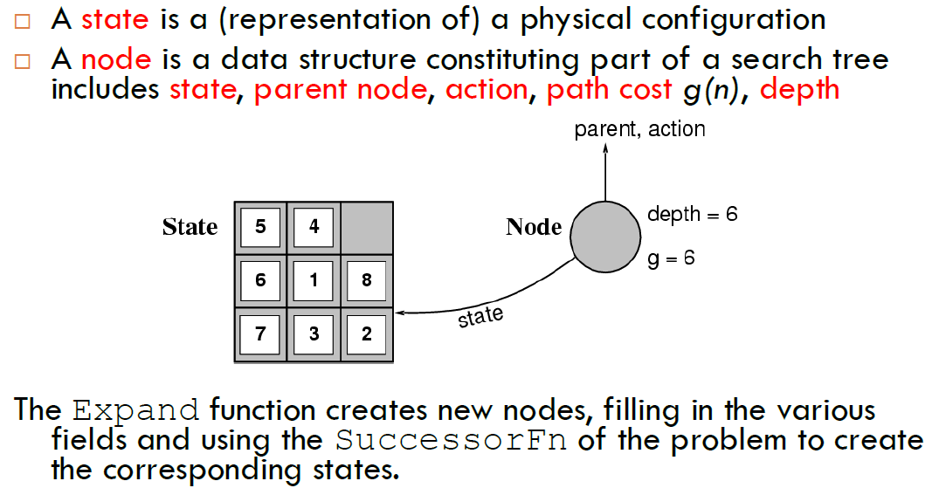
Implementation: states vs. nodes

Slide 19
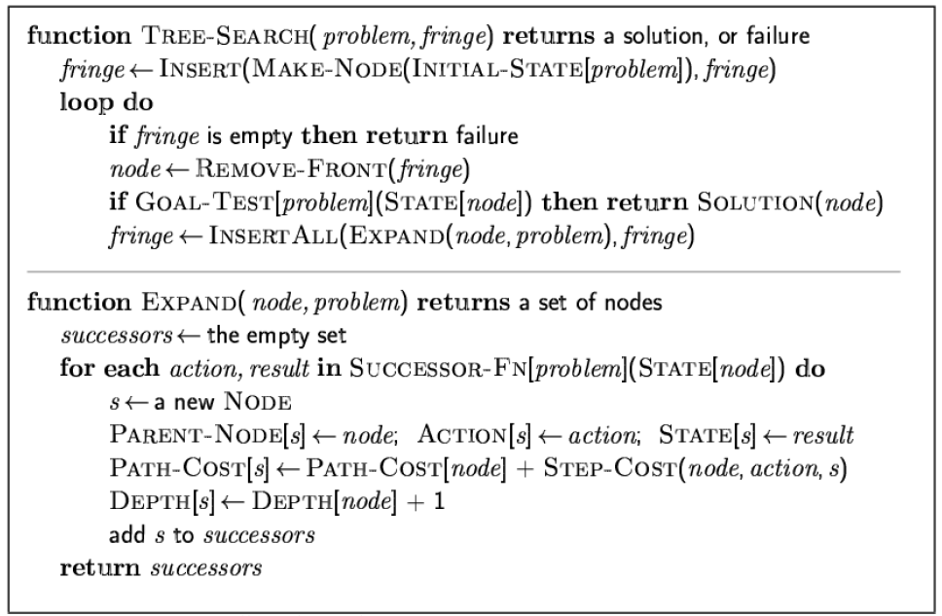
Implementation: general tree search
Notes:
Leaf node: a node with no children in the tree
The set of all leaf nodes available for expansion at any given point is called the frontier (many authors call it the open list)

Slide 20
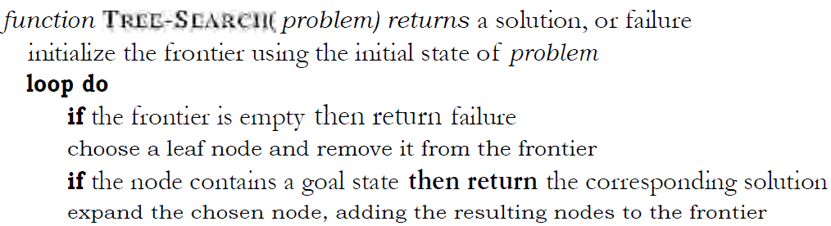
Implementation: general tree search

Slide 21
Search strategies
A search strategy is defined by picking the order of node expansion
Strategies are evaluated along the following dimensions:
  completeness: does it always find a solution if one exists?
  time complexity: number of nodes generated
  space complexity: maximum number of nodes in memory
  optimality: does it always find a least-cost solution?
Time and space complexity are measured in terms of
  b: maximum branching factor of the search tree
  d: depth of the least-cost solution
  m: maximum depth of the state space (may be ∞)
Notes:
Very popular, basically graph theory
m: the maximum length of any path in the state space

Slide 22
Uninformed search strategies
Uninformed search strategies use only the information available in the problem definition
Breadth-first search
Depth-first search
Depth-limited search
Iterative deepening search
Notes:
Also called blind search

Slide 23

Breadth-first search
Expand shallowest unexpanded node
Implementation:
  Frontier or fringe is a FIFO queue, i.e., new successors go at end

Slide 24

Breadth-first search
Expand shallowest unexpanded node
Implementation:
  frontier is a FIFO queue, i.e., new successors go at end

Slide 25

Breadth-first search
Expand shallowest unexpanded node
Implementation:
  frontier is a FIFO queue, i.e., new successors go at end

Slide 26

Breadth-first search
Expand shallowest unexpanded nodehttp://aispace.org/search/
Implementation:
  frontier is a FIFO queue, i.e., new successors go at end

Slide 27
Properties of breadth-first search
Complete? Time? Space?Optimal?
Complete? Yes (if b is finite)
Time? 1+b+b²+b³+… +b^{d} + b(b^{d}-1) = O(b^{d+1})
Space? O(b^{d+1}) (keeps every node in memory)
Optimal? Yes (if cost = 1 per step)
Space is the bigger problem (more than time), can easily generate nodes at 100MB/sec, so 24hrs = 8640GB
Notes:
We skip for now, come back later.
Think about, why it is optimal?
Since it never generates a node in the tree until all the nodes at shallower levels have been generated, breadth-first searchalways finds a shortest path to a goal

Slide 28
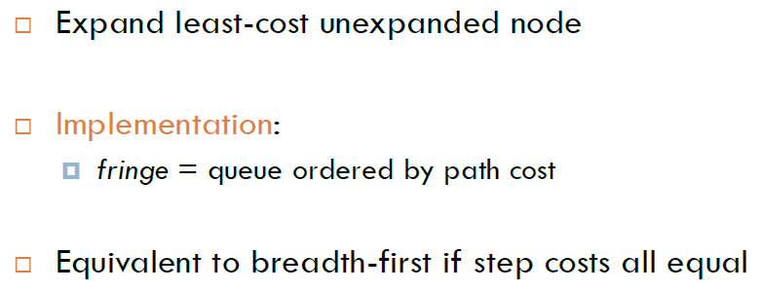
Uniform-cost search
Uniform-cost search is guided by path costs rather than depths, so its complexity is not easily characterized
Notes:
Differences with breath-first search
Ordering of the queue by path cost
Goal test is applied to a node when it is selected for expansion (in BFS, goal test is applied when it is first generated)
The second difference is that a test is added in case a better path is found to a node currently on the frontier.

Slide 29
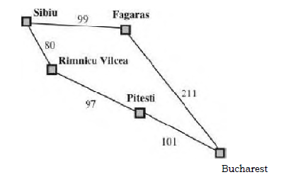
Uniform-cost search
What’s the solution?
Notes:
S->R->P->B

Slide 30

Depth-first search
Expand deepest unexpanded node
Implementation:
  frontier = LIFO queue, i.e., put successors at front

Slide 31

Depth-first search
Expand deepest unexpanded node
Implementation:
  frontier = LIFO queue, i.e., put successors at front

Slide 32

Depth-first search
Expand deepest unexpanded node
Implementation:
  frontier = LIFO queue, i.e., put successors at front

Slide 33

Depth-first search
Expand deepest unexpanded node
Implementation:
  frontier = LIFO queue, i.e., put successors at front

Slide 34

Depth-first search
Expand deepest unexpanded node
Implementation:
  frontier = LIFO queue, i.e., put successors at front

Slide 35

Depth-first search
Expand deepest unexpanded node
Implementation:
  frontier = LIFO queue, i.e., put successors at front

Slide 36

Depth-first search
Expand deepest unexpanded node
Implementation:
  frontier = LIFO queue, i.e., put successors at front

Slide 37

Depth-first search
Expand deepest unexpanded node
Implementation:
  frontier = LIFO queue, i.e., put successors at front

Slide 38

Depth-first search
Expand deepest unexpanded node
Implementation:
  frontier = LIFO queue, i.e., put successors at front
Notes:
Beautifil connection to queue concepts

Slide 39

Depth-first search
Expand deepest unexpanded node
Implementation:
  frontier = LIFO queue, i.e., put successors at front

Slide 40

Depth-first search
Expand deepest unexpanded node
Implementation:
  frontier = LIFO queue, i.e., put successors at front

Slide 41

Depth-first search
Expand deepest unexpanded nodehttp://aispace.org/search/
Implementation:
  frontier = LIFO queue, i.e., put successors at front

Slide 42
Properties of depth-first search
Complete? Time? Space?Optimal?
Complete? No: fails in infinite-depth spaces, spaces with loops
  Modify to avoid repeated states along path (graph search)
    → complete in finite spaces
Time? O(b^{m}): terrible if maximum depth m is much larger than solution depth d
  but if solutions are dense, may be much faster than breadth-first
Space? O(bm), i.e., linear space! Store single path with unexpanded siblings.
  Seems to be common in animals and humans.
Optimal? No.
Important for exploration (on-line search).

Slide 43
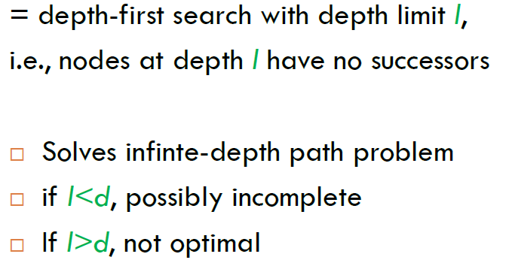
Depth-limited search

Slide 44

Iterative deepening search

Slide 45

Iterative deepening search l =0

Slide 46

Iterative deepening search l =1

Slide 47

Iterative deepening search l =2

Slide 48

Iterative deepening search l =3
Notes:
http://www.ai.sri.com/~oreilly/aima3ejava/aima3ejavademos.html
Is seriously buggy

Slide 49
Properties of iterative deepening search
Complete? Yes
Time? (d+1)b⁰ + d b¹ + (d-1)b² + … + b^{d} = O(b^{d})
Space? O(bd)
Optimal? Yes, if step cost = 1

Slide 50

Summary of algorithms

Slide 51
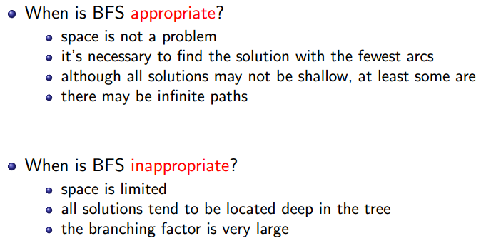
Using Breath-First Search

Slide 52
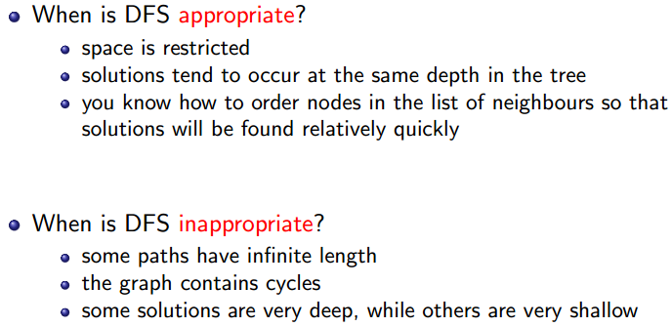
Using Depth-First Search

Slide 53

Repeated states
Failure to detect repeated states can turn a linear problem into an exponential one!

Slide 54

Graph search
Simple solution: just keep track of which states you have visited.
Usually easy to implement in modern computers.

Slide 55
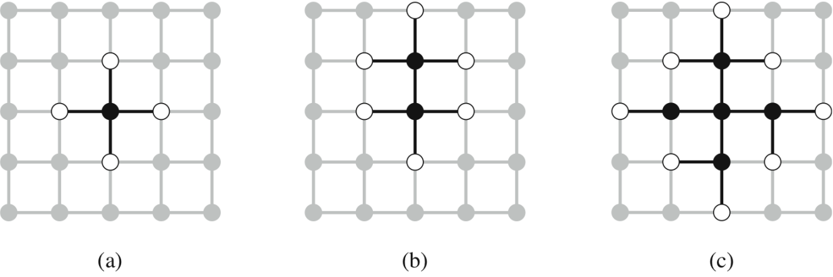
The Separation Property of Graph Search
Black: expanded nodes.
White: frontier nodes.
Grey: unexplored nodes.

Slide 56
Summary
Problem formulation usually requires abstracting away real-world details to define a state space that can feasibly be explored
Variety of uninformed search strategies
Iterative deepening search uses only linear space and not much more time than other uninformed algorithms
Graph search can be exponentially more efficient than tree search

