Slide 1
Informed search algorithms
Advanced Artificial Intelligence
Fall 2017

Slide 2
Warm-up exercise
A Water Jug Problem:
You are given two jugs, a 4-gallon one and a 3-gallon
one, a pump which has unlimited water which you can
use to fill the jug, and the ground on which water may
be poured. Neither jug has any measuring markings on
it. How can you get exactly 2 gallons of water in the 4
gallon jug?
Notes:
Informed消息灵通的，uninformed消息不灵通的

Slide 3
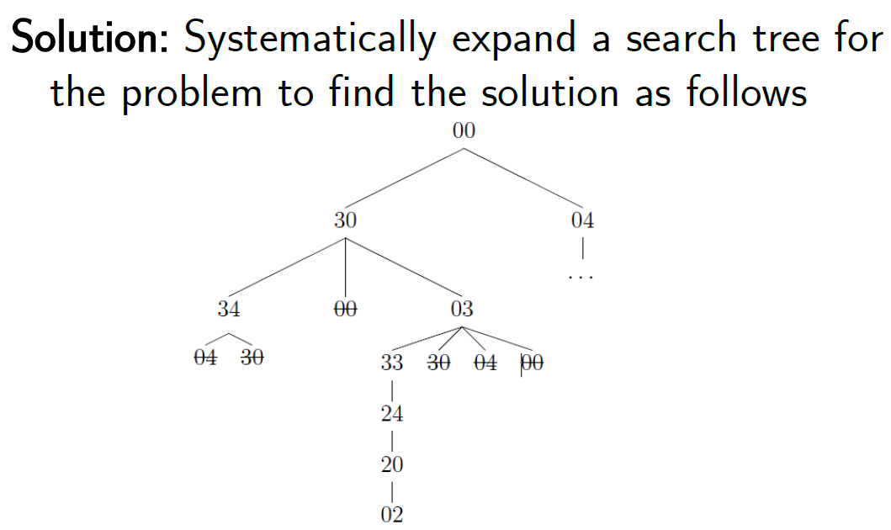
Warm-up exercise

Slide 4
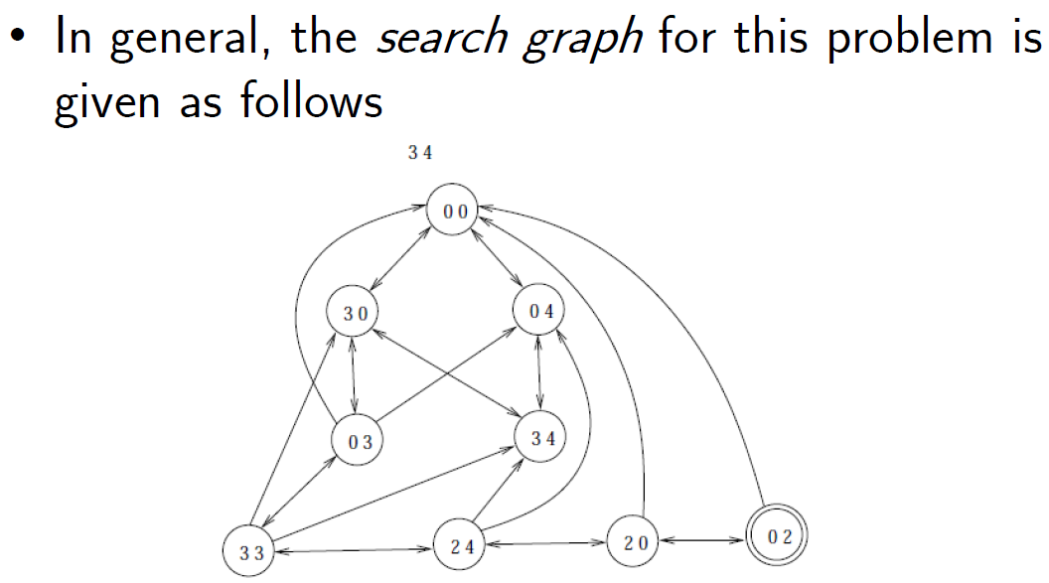
Warm-up exercise

Slide 5
Production rules
The operators to be used to solve the problem can be described as follows:
Sl No | Current state | Next State | Descritpion
1 | (x,y) if x < 4 | (4,y) | Fill the 4 gallon jug
2 | (x,y) if y <3 | (x,3) | Fill the 3 gallon jug
3 | (x,y) if x > 0 | (x-d, y) | Pour some water out of the 4 gallon jug
4 | (x,y) if y > 0 | (x, y-d) | Pour some water out of the 3-gallon jug
5 | (x,y) if x>0 | (0, y) | Empty the 4 gallon jug
6 | (x,y) if y >0 | (x,0) | Empty the 3 gallon jug on the ground
7 | (x,y) if x+y >= 4 and y >0 | (4, y-(4-x)) | Pour water from the 3 –gallon jug into the 4 –gallon jug until the 4-gallon jug is full

Slide 6
Production rules
8 | (x, y) if x+y >= 3 and x>0 | (x-(3-y), 3) | Pour water from the 4-gallon jug into the 3-gallon jug until the 3-gallon jug is full
9 | (x, y) if x+y <=4 and y>0 | (x+y, 0) | Pour all the water from the 3-gallon jug into the 4-gallon jug
10 | (x, y) if x+y <= 3 and x>0 | (0, x+y) | Pour all the water from the 4-gallon jug into the 3-gallon jug
11 | (0,2) | (2,0) | Pour the 2 gallons from 3-gallon jug into the 4-gallon jug
12 | (2,y) | (0,y) | Empty the 2 gallons in the 4-gallon jug on the ground

Slide 7
To solve the water jug problem
One solution to the water jug problem
Shortest such sequence will have a impact on the choice of appropriate mechanism to guide the search for solution.
Gallons in the 4-gallon jug | Gallons in the 3-gallon jug | Rule applied
0 | 0 | 2
0 | 3 | 9
3 | 0 | 2
3 | 3 | 7
4 | 2 | 5 or 12
0 | 2 | 9 0r 11
2 | 0

Slide 8
Outline
Best-first search
  Greedy best-first search
  A* search
Heuristics
Local search algorithms
  Hill-climbing search
  Simulated annealing search
  Local beam search

Slide 9
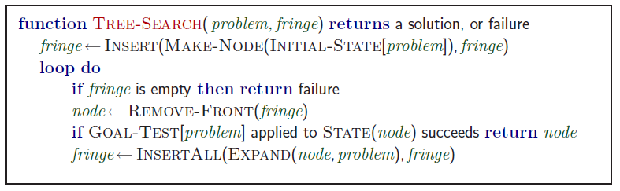
Review: Tree search
A search strategy is defined by picking the order of node expansion
Which nodes to check first?

Slide 10
Knowledge and Heuristics
Simon and Newell, Human Problem Solving, 1972.
Thinking out loud: experts have strong opinions like “this looks promising”, “no way this is going to work”.
S&N: intelligence comes from heuristics that help find promising states fast.
Notes:
图灵的朋友，simon后来也获得诺贝尔奖

Slide 11
Best-first search
Idea: use an evaluation function f(n) for each node
  estimate of "desirability"
  Expand most desirable unexpanded node
Implementation:
Order the nodes in frontier in decreasing order of desirability
Special cases:
  greedy best-first search
  A* search

Slide 12

Romania with step costs in km

Slide 13
Greedy best-first search
Evaluation function
  f(n) = h(n) (heuristic)
  = estimate of cost from n to goal
e.g., h_{SLD}(n) = straight-line distance from n to Bucharest
Greedy best-first search expands the node that appears to be closest to goal

Slide 14

Greedy best-first search example

Slide 15

Greedy best-first search example

Slide 16

Greedy best-first search example

Slide 17

Greedy best-first search example
http://aispace.org/search/

Slide 18
Properties of greedy best-first search
Complete?
Time?
Space?
Optimal?

Slide 19
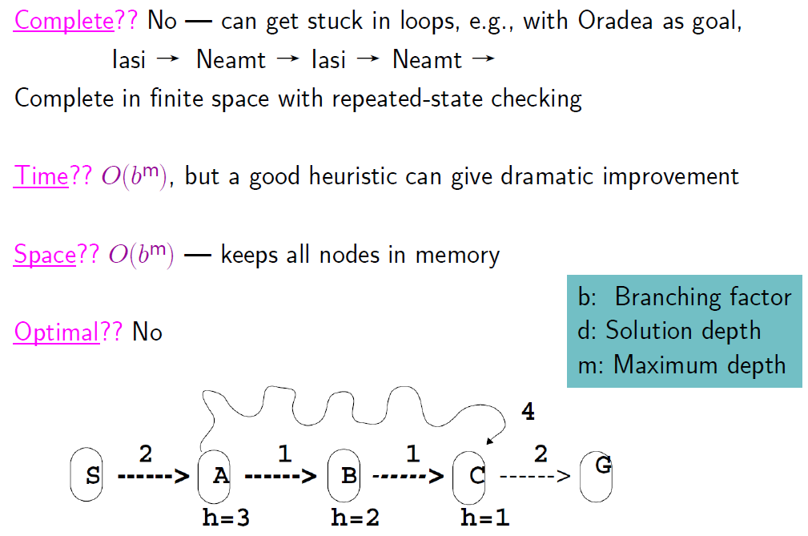
Properties of greedy best-first search

Slide 20
A* search
Idea: avoid expanding paths that are already expensive.
Very important!
Evaluation function f(n) = g(n) + h(n)
h(n) = estimated cost from n to goal
f(n) = estimated total cost of path through n to goal
g(n) = cost so far to reach n

Slide 21

A* search example

Slide 22

A* search example

Slide 23

A* search example

Slide 24

A* search example

Slide 25

A* search example

Slide 26

A* search example
http://aispace.org/search/
We stop when the node with the lowest f-value is a goal state.
Is this guaranteed to find the shortest path?

Slide 27
Admissible heuristics
A heuristic h(n) is admissible if for every node n,
h(n) ≤ h*(n), where h*(n) is the true cost to reach the goal state from n.
An admissible heuristic never overestimates the cost to reach the goal, i.e., it is optimistic.
Example: h_{SLD}(n) (never overestimates the actual road distance)
Theorem: If h(n) is admissible, A* using TREE-SEARCH is optimal

Slide 28

Optimality of A* (proof)
Suppose some suboptimal goal path G₂ has been generated and is in the frontier. Let n be an unexpanded node in the frontier such that n is on a shortest path to an optimal goal G.
f(G₂) = g(G₂) since h(G₂) = 0 because h is admissible
g(G₂) > g(G) since G₂ is suboptimal, cost of reaching G is less.
f(G) = g(G) since h(G) = 0
f(G₂) > f(G) from above

Slide 29
Optimality of A* (proof)
Suppose some suboptimal goal path G₂ has been generated and is in the frontier. Let n be an unexpanded node in the frontier such that n is on a shortest path to an optimal goal G.
f(G₂) > f(G) from above
h(n) ≤ h*(n) since h is admissible, h* is minimal distance.
g(n) + h(n) ≤ g(n) + h*(n)
f(n) ≤ f(G)
Hence f(G₂) > f(n), and A* will never select G₂ for expansion

Slide 30

Consistent heuristics
A heuristic is consistent if for every node n, every successor n' of n generated by any action a,
h(n) ≤ c(n,a,n') + h(n')
Intuition: can’t do worse than going through n’.
If h is consistent, we have
f(n') = g(n') + h(n') = g(n) + c(n,a,n') + h(n')
≥ g(n) + h(n) = f(n)
i.e., f(n) is non-decreasing along any path.
Theorem: If h(n) is consistent, A* using GRAPH-SEARCH is optimal

Slide 31
Properties of A*
Complete? Yes (unless there are infinitely many nodes with f ≤ f(G) )
Time? Exponential
Space? Keeps all nodes in memory
Optimal? Yes
Notes:
Also optimally efficient: any search based on h must expand as many nodes as A*. Reason: think of f(n) as saying: this path could lead to the goal as quickly as f(n). So must try it.

Slide 32

Admissible heuristics
E.g., for the 8-puzzle:
h₁(n) = number of misplaced tiles
h₂(n) = total Manhattan distance
(i.e., no. of squares from desired location of each tile)
h₁(S) = ?
h₂(S) = ?

Slide 33
Admissible heuristics
E.g., for the 8-puzzle:
h₁(n) = number of misplaced tiles
h₂(n) = total Manhattan distance
(i.e., no. of squares from desired location of each tile)
h₁(S) = ? 8
h₂(S) = ? 3+1+2+2+2+3+3+2 = 18

Slide 34
Dominance
If h₂(n) ≥ h₁(n) for all n (both admissible) then h₂ dominates h₁ .
h₂ is better for search
Typical search costs (average number of nodes expanded):
d=12 IDS = 3,644,035 nodes
A*(h₁) = 227 nodes
A*(h₂) = 73 nodes
d=24 IDS = too many nodes
A*(h₁) = 39,135 nodes
A*(h₂) = 1,641 nodes

Slide 35


8-Puzzle Search (A*)
f(n)=g(n)+h(n)
h(n): the # of misplaced tiles
g(n): the depth of node

Slide 36
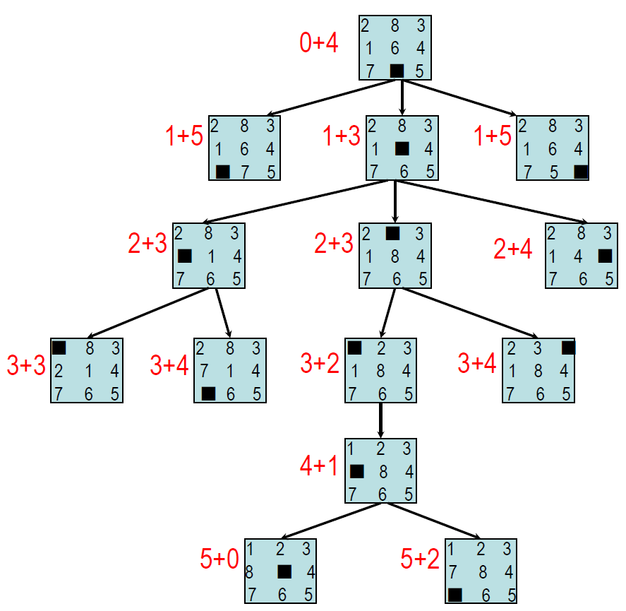
8-Puzzle Search (A*)

Slide 37
Relaxed problems
A problem with fewer restrictions on the actions is called a relaxed problem
The cost of an optimal solution to a relaxed problem is an admissible heuristic for the original problem
If the rules of the 8-puzzle are relaxed so that a tile can move anywhere, then h₁(n) gives the shortest solution
If the rules are relaxed so that a tile can move to any adjacent square, then h₂(n) gives the shortest solution

Slide 38


Relaxed problems
Constructing relaxed problems
  Original problem: a tile can move from square A to B, if A and B are horizontally or vertically adjacent and B is empty
  Relax 1: : a tile can move from square A to B, if A and B are horizontally or vertically adjacent
  Relax 2: : a tile can move from square A to B, if B is empty
  Relax 3: : a tile can move from square A to B
If a set of admissible heuristics is available

Slide 39
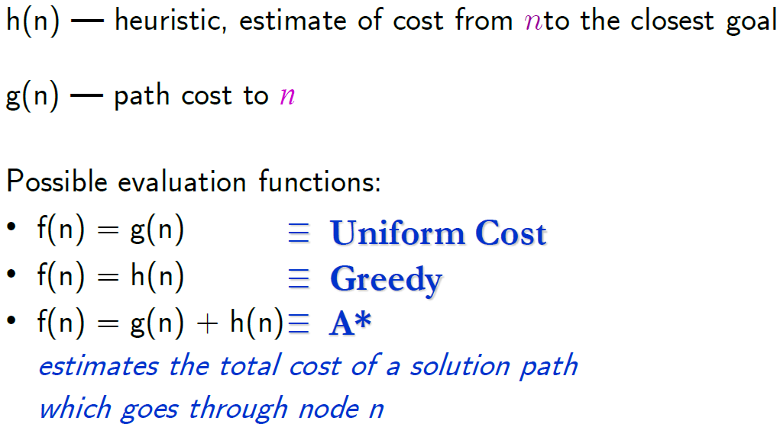
Evaluation Function f(n)

Slide 40
Summary
Heuristic functions estimate costs of shortest paths
Good heuristics can dramatically reduce search cost
Greedy best-first search expands lowest h
  incomplete and not always optimal
A∗ search expands lowest g + h
  complete and optimal
  also optimally efficient
Admissible heuristics can be derived from exact solution of relaxed problems

