Slide 1
Local Search and Optimization
Fall 2017
Instructor: Donghai Guan

Slide 2
Outline
Local search techniques and optimization
  Hill-climbing
  Gradient methods
  Simulated annealing
  Genetic algorithms
  Issues with local search

Slide 3
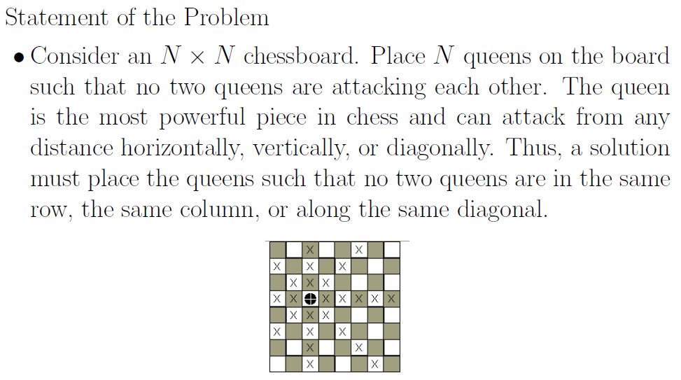
N-Queens Problem

Slide 4
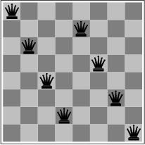
Local search and optimization
Previously: systematic exploration of search space.
  Path to goal is solution to problem
YET, for some problems path is irrelevant.
  E.g 8-queens
Different algorithms can be used
  Local search
Notes:
Network optimization, vehicle routing. All the matters is the solution state, not the path cost to reach it!

Slide 5
Local search and optimization
Local search
  Keep track of single current state
  Move only to neighboring states
  Ignore paths
Advantages:
  Use very little memory
  Can often find reasonable solutions in large or infinite (continuous) state spaces.
“Pure optimization” problems
  All states have an objective function
  Goal is to find state with max (or min) objective value
  Does not quite fit into path-cost/goal-state formulation
  Local search can do quite well on these problems.

Slide 6
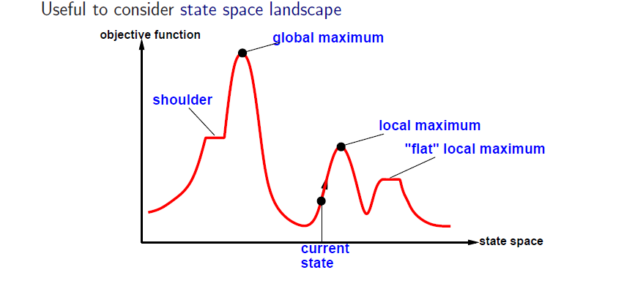
“Landscape” of search
Simple Video

Slide 7
Hill-climbing search
function HILL-CLIMBING( problem) return a state that is a local maximum
input: problem, a problem
local variables: current, a node.
neighbor, a node.
current ← MAKE-NODE(INITIAL-STATE[problem])
loop do
neighbor ← a highest valued successor of current
if VALUE [neighbor] ≤ VALUE[current] then return STATE[current]
current ← neighbor

Slide 8
Simple Example
Random Starting Point
function
value
x

Slide 9
Simple Example
Three random steps
function
value
x

Slide 10
Simple Example
Choose Best One for new position
function
value
x

Slide 11
Simple Example
Repeat
function
value
x

Slide 12
Simple Example
Repeat
function
value
x

Slide 13
Simple Example
Repeat
function
value
x

Slide 14
Simple Example
Repeat
function
value
x

Slide 15
Simple Example
No Improvement, so stop.
function
value
x

Slide 16
Hill-climbing search
“a loop that continuously moves in the direction of increasing value”
  terminates when a peak is reached
  Aka greedy local search
Value can be either
  Objective function value
  Heuristic function value (minimized)
Hill climbing does not look ahead of the immediate neighbors of the current state.
Can randomly choose among the set of best successors, if multiple have the best value
Characterized as “trying to find the top of Mount Everest while in a thick fog”

Slide 17


Hill-climbing search
What we think hill-climbing
looks like
What we learn hill-climbing is
Usually like

Slide 18

Hill climbing and local maxima
When local maxima exist, hill climbing is suboptimal
Simple (often effective) solution
  Multiple random restarts

Slide 19
Hill-climbing example
8-queens problem, complete-state formulation
  All 8 queens on the board in some configuration
Successor function:
  move a single queen to another square in the same column.
Example of a heuristic function h(n):
  the number of pairs of queens that are attacking each other (directly or indirectly)
  (so we want to minimize this)

Slide 20
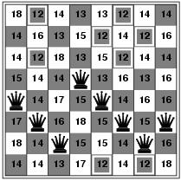
Hill-climbing example
Current state: h=17
Shown is the h-value for each possible successor in each column

Slide 21

A local minimum for 8-queens
A local minimum in the 8-queens state space (h=1)

Slide 22
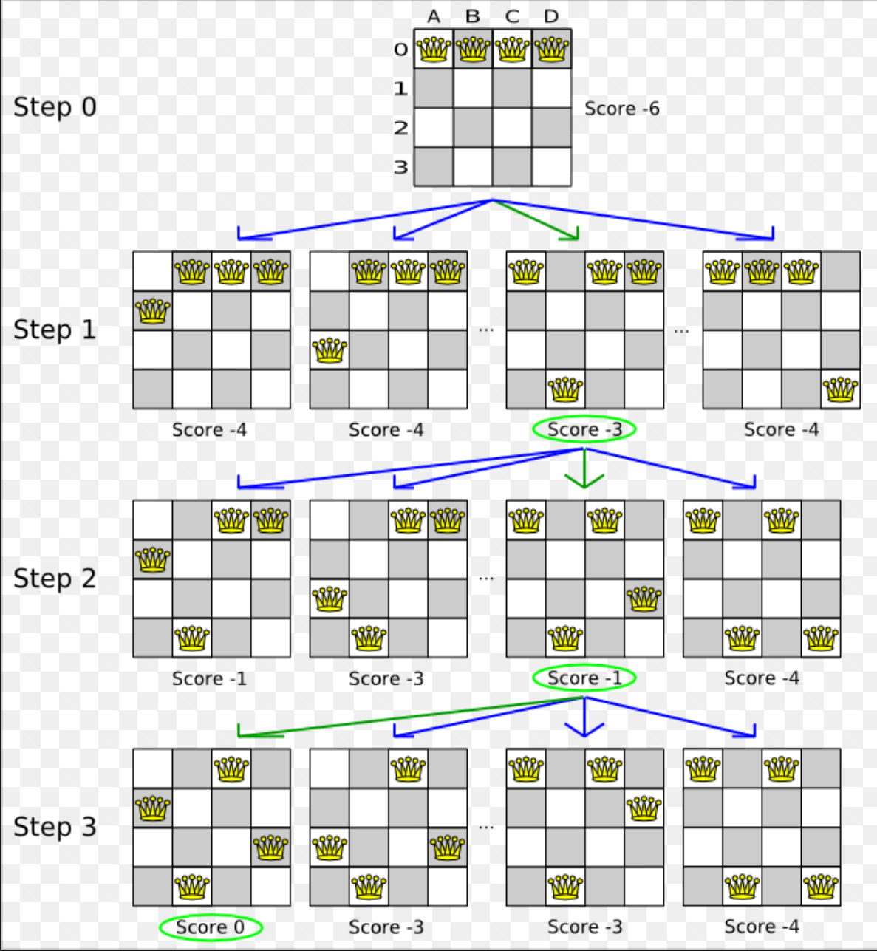

Slide 23
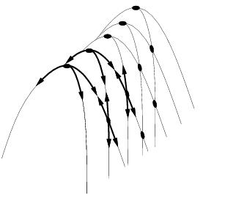
Other drawbacks
Ridge = sequence of local maxima difficult for greedy algorithms to navigate
Plateau = an area of the state space where the evaluation function is flat.

Slide 24
Performance of hill-climbing on 8-queens
Randomly generated 8-queens starting states…
14% the time it solves the problem
86% of the time it get stuck at a local minimum
However…
  Takes only 4 steps on average when it succeeds
  And 3 on average when it gets stuck
  (for a state space with ~17 million states)

Slide 25
Possible solution…sideways moves
If no downhill (uphill) moves, allow sideways moves in hope that algorithm can escape
  Need to place a limit on the possible number of sideways moves to avoid infinite loops
For 8-queens
  Now allow sideways moves with a limit of 100
  Raises percentage of problem instances solved from 14 to 94%
  However….
    21 steps for every successful solution
    64 for each failure

Slide 26
Hill-climbing variations
Stochastic hill-climbing
  Random selection among the uphill moves.
  The selection probability can vary with the steepness of the uphill move.
First-choice hill-climbing
  stochastic hill climbing by generating successors randomly until a better one is found
  Useful when there are a very large number of successors
Random-restart hill-climbing
  Tries to avoid getting stuck in local maxima.

Slide 27
Hill-climbing with random restarts
Different variations
  For each restart: run until termination v. run for a fixed time
  Run a fixed number of restarts or run indefinitely
Analysis
  Say each search has probability p of success
    E.g., for 8-queens, p = 0.14 with no sideways moves
  Expected number of restarts?
Notes:
Expected number of restart: 1/p

Slide 28
Local beam search
Keep track of k states instead of one
  Initially: k randomly selected states
  Next: determine all successors of k states
  If any of successors is goal → finished
  Else select k best from successors and repeat.
Major difference with random-restart search
  Information is shared among k search threads.
Can suffer from lack of diversity.
  Stochastic beam search
    choose k successors proportional to state quality.

Slide 29

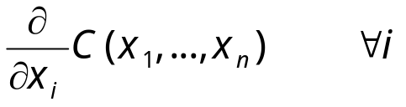
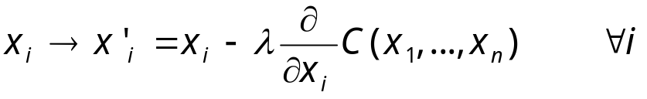
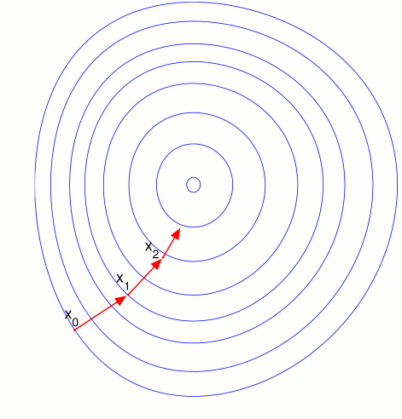
Gradient Descent
Assume we have some cost-function:
and we want minimize over continuous variables X1,X2,..,Xn
1. Compute the gradient :
2. Take a small step downhill in the direction of the gradient:
3. Check if
4. If true then accept move, if not reject.
5. Repeat.

Slide 30
Gradient Ascent
Random Starting Point
function
value
x

Slide 31
Gradient Ascent
Take step in direction of largest increase
(obvious in 1D, must be computed in higher dimensions)
function
value
x

Slide 32
Gradient Ascent
Repeat
function
value
x

Slide 33
Gradient Ascent
Next step is actually lower, so stop
function
value
x

Slide 34
Gradient Ascent
Could reduce step size to “hone in”
function
value
x

Slide 35
Gradient Ascent
Converge to (local) maximum
function
value
x

Slide 36
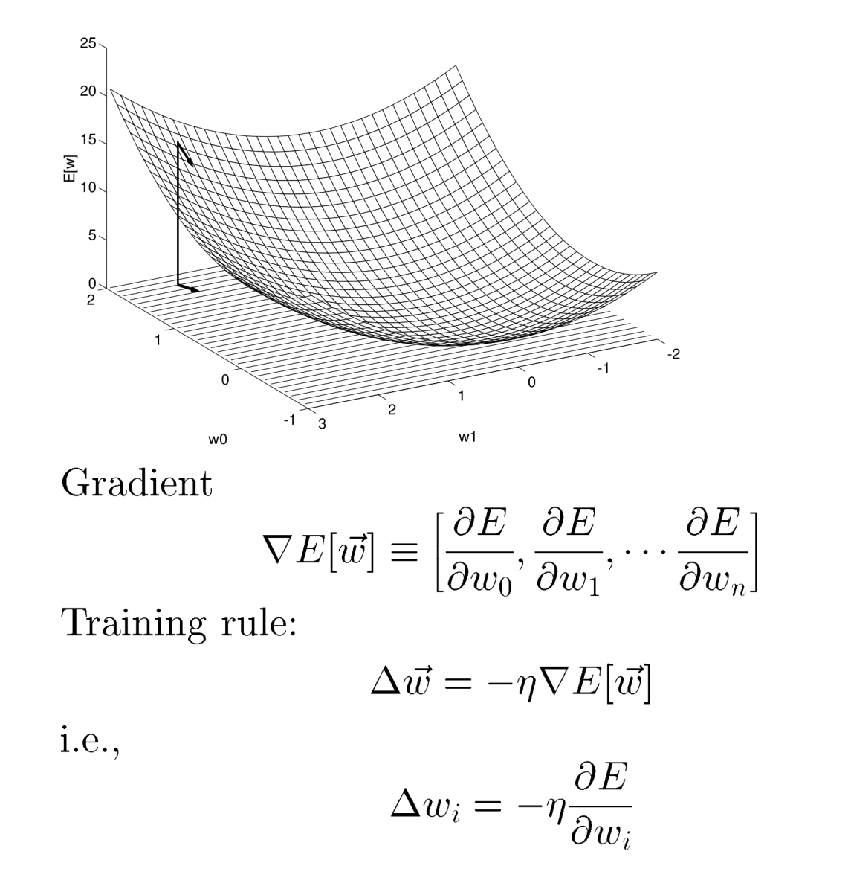
Gradient Descent In Multiple Dimensions

Slide 37
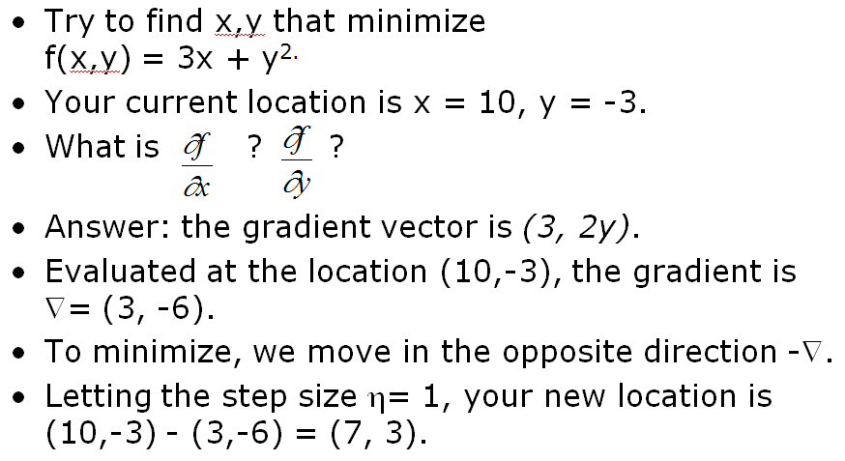
Gradient Descent: Example.

Slide 38
Learning as optimization
Many machine learning problems can be cast as optimization
Example:
  Training data D = {(x₁,c₁),………(x_{n}, c_{n})}
  where x_{i} = feature or attribute vector
  and c_{i} = class label (say binary-valued)
  We have a model (a function or classifier) that maps from x to c
  e.g., sign( w. x’ ) = {-1, +1}
  We can measure the error E(w) for any settig of the weights w, and given a training data set D
  Optimization problem: find the weight vector that minimizes E(w)
  (general idea is “empirical error minimization”)

Slide 39
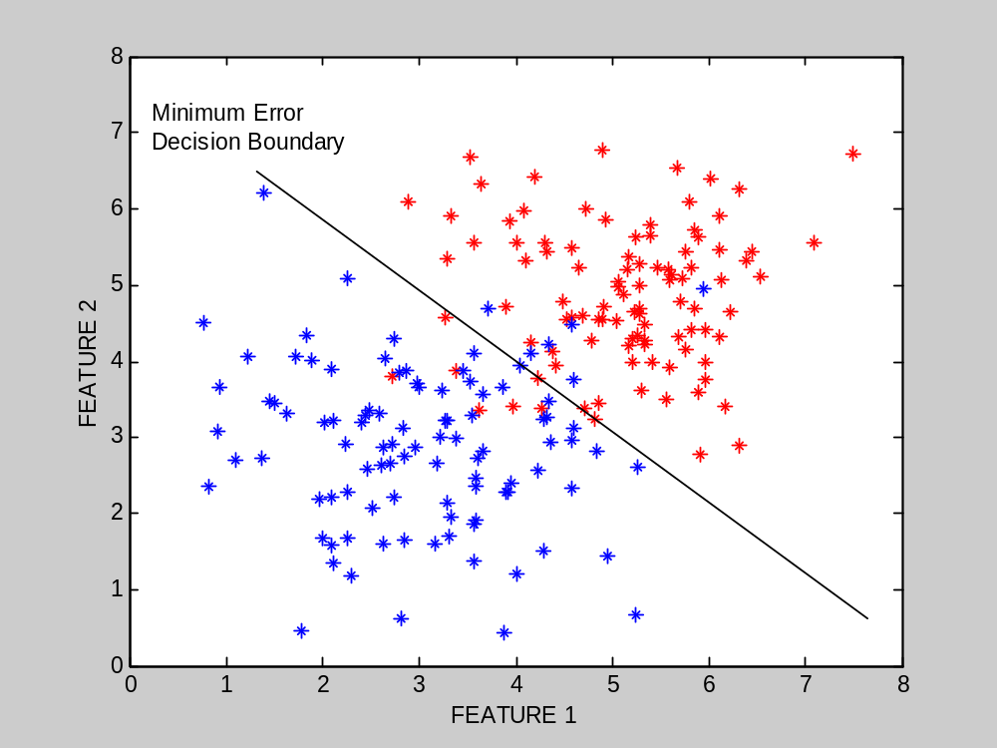
Learning a minimum error decision boundary

Slide 40
Search using Simulated Annealing
Simulated Annealing = hill-climbing with non-deterministic search
Basic ideas:
  like hill-climbing identify the quality of the local improvements
  instead of picking the best move, pick one randomly
  say the change in objective function is δ
  if δ is positive, then move to that state
  otherwise:
    move to this state with probability proportional to δ
    thus: worse moves (very large negative δ) are executed less often
  however, there is always a chance of escaping from local maxima
  over time, make it less likely to accept locally bad moves
  (Can also make the size of the move random as well, i.e., allow “large” steps in state space)

Slide 41
Physical Interpretation of Simulated Annealing
A Physical Analogy:
    imagine letting a ball roll downhill on the function surface
      this is like hill-climbing (for minimization)
    now imagine shaking the surface, while the ball rolls, gradually reducing the amount of shaking
      this is like simulated annealing
Annealing = physical process of cooling a liquid or metal until particles achieve a certain frozen crystal state
    simulated annealing:
      free variables are like particles
      seek “low energy” (high quality) configuration
      get this by slowly reducing temperature T, which particles move around randomly

Slide 42
Simulated annealing
function SIMULATED-ANNEALING( problem, schedule) return a solution state
input: problem, a problem
schedule, a mapping from time to temperature
local variables: current, a node.
next, a node.
T, a “temperature” controlling the probability of downward steps
current ← MAKE-NODE(INITIAL-STATE[problem])
for t ← 1 to ∞ do
T ← schedule[t]
if T = 0 then return current
next ← a randomly selected successor of current
∆E ← VALUE[next] - VALUE[current]
if ∆E > 0 then current ← next
else current ← next only with probability e^{∆E /T}

Slide 43
More Details on Simulated Annealing
  Lets say there are 3 moves available, with changes in the objective function of d1 = -0.1, d2 = 0.5, d3 = -5. (Let T = 1).
  pick a move randomly:
    if d2 is picked, move there.
    if d1 or d3 are picked, probability of move = exp(d/T)
    move 1: prob1 = exp(-0.1) = 0.9,
      i.e., 90% of the time we will accept this move
    move 3: prob3 = exp(-5) = 0.05
      i.e., 5% of the time we will accept this move
  T = “temperature” parameter
    high T => probability of “locally bad” move is higher
    low T => probability of “locally bad” move is lower
    typically, T is decreased as the algorithm runs longer
      i.e., there is a “temperature schedule”

Slide 44
Simulated Annealing in Practice
  method proposed in 1983 by IBM researchers for solving VLSI layout problems (Kirkpatrick et al, Science, 220:671-680, 1983).
    theoretically will always find the global optimum (the best solution)
  useful for some problems, but can be very slow
      slowness comes about because T must be decreased very gradually to retain optimality
    In practice how do we decide the rate at which to decrease T? (this is a practical problem with this method)

Slide 45
Simulated Annealing
T = Very
High
Random Starting Point
function
value
x

Slide 46
Simulated Annealing
T = Very
High
Random Step
function
value
x

Slide 47
Simulated Annealing
T = Very
High
Even though E is lower, accept
function
value
x

Slide 48
Simulated Annealing
T = Very
High
Next Step; accept since higher E
function
value
x

Slide 49
Simulated Annealing
T = Very
High
Next Step; accept since higher E
function
value
x

Slide 50
Simulated Annealing
T = High
Next Step; accept even though lower
function
value
x

Slide 51
Simulated Annealing
T = High
Next Step; accept even though lower
function
value
x

Slide 52
Simulated Annealing
T = Medium
Next Step; accept since higher
function
value
x

Slide 53
Simulated Annealing
T = Medium
Next Step; lower, but reject (T is falling)
function
value
x

Slide 54
Simulated Annealing
T = Medium
Next Step; Accept since E is higher
function
value
x

Slide 55
Simulated Annealing
T = Low
Next Step; Accept since E change small
function
value
x

Slide 56
Simulated Annealing
T = Low
Next Step; Accept since E larger
function
value
x

Slide 57
Simulated Annealing
T = Low
Next Step; Reject since E lower and T low
function
value
x

Slide 58
Simulated Annealing
T = Low
Eventually converge to Maximum
function
value
x

Slide 59
Questions
What is the difference between Hill Climbing and Best First Search?

Slide 60
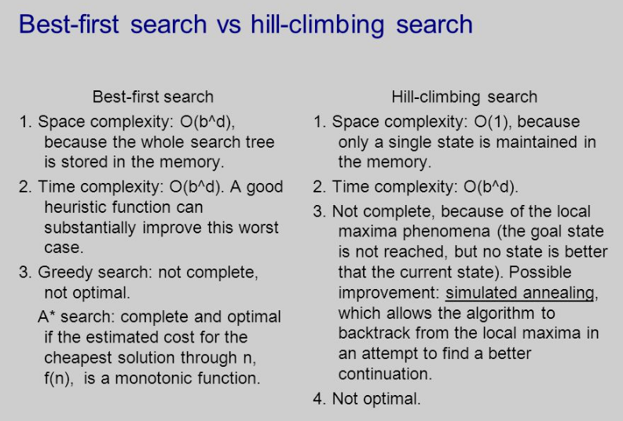
Questions
What is the difference between Hill Climbing and Best First Search?

Slide 61
Genetic algorithms
Different approach to other search algorithms
  A successor state is generated by combining two parent states
A state is represented as a string over a finite alphabet (e.g. binary)
  8-queens
    State = position of 8 queens each in a column
    => 8 x log(8) bits = 24 bits (for binary representation)
Start with k randomly generated states (population)
Evaluation function (fitness function).
  Higher values for better states.
  Opposite to heuristic function, e.g., # non-attacking pairs in 8-queens
Produce the next generation of states by “simulated evolution”
  Random selection
  Crossover
  Random mutation

Slide 62

Genetic algorithms
Fitness function: number of non-attacking pairs of queens (min = 0, max = 8 × 7/2 = 28)
24/(24+23+20+11) = 31%
23/(24+23+20+11) = 29% etc
4 states for
8-queens
problem
2 pairs of 2 states randomly
selected based on fitness.
Random crossover points
selected
New states
after crossover
Random
mutation
applied

Slide 63

Genetic algorithms
Has the effect of “jumping” to a completely different new
part of the search space (quite non-local)

Slide 64
Genetic algorithm pseudocode
function GENETIC_ALGORITHM( population, FITNESS-FN) return an individual
input: population, a set of individuals
FITNESS-FN, a function which determines the quality of the individual
repeat
new_population ← empty set
loop for i from 1 to SIZE(population) do
x ← RANDOM_SELECTION(population, FITNESS_FN) y ← RANDOM_SELECTION(population, FITNESS_FN)
child ← REPRODUCE(x,y)
if (small random probability) then child ← MUTATE(child )
add child to new_population
population ← new_population
until some individual is fit enough or enough time has elapsed
return the best individual

Slide 65
Comments on genetic algorithms
Positive points
  Random exploration can find solutions that local search can’t
    (via crossover primarily)
  Appealing connection to human evolution
    E.g., see related area of genetic programming
Negative points
  Large number of “tunable” parameters
    Difficult to replicate performance from one problem to another
  Lack of good empirical studies comparing to simpler methods
  Useful on some (small?) set of problems but no convincing evidence that GAs are better than hill-climbing w/random restarts in general

Slide 66
Summary
Local search techniques and optimization
  Hill-climbing
  Gradient methods
  Simulated annealing
  Genetic algorithms
  Issues with local search

