Slide 1
Constraint Satisfaction Problems
Fall 2017
Instructor: Donghai Guan

Slide 2
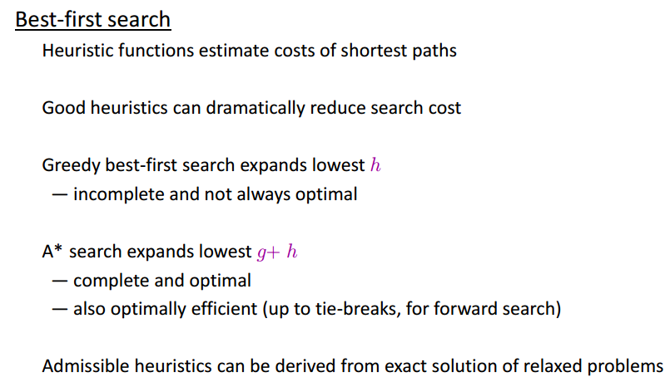
Review

Slide 3
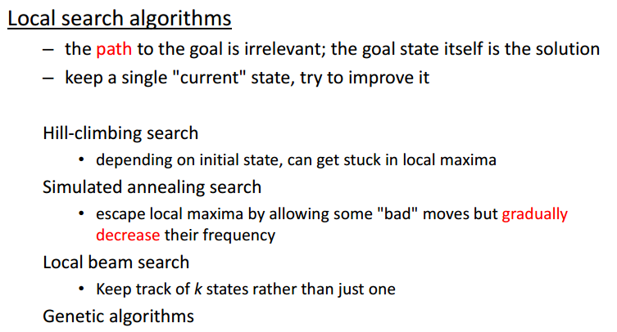
Review

Slide 4
Outline
What is a CSP
Backtracking for CSP
Local search for CSPs
Problem structure and decomposition

Slide 5
Constraint Satisfaction Problems
What is a CSP?
  Finite set of variables V₁, V₂, …, V_{n}
    Nonempty domain of possible values for each variable
    D_{V1}, D_{V2}, … D_{Vn}
  Finite set of constraints C₁, C₂, …, C_{m}
    Each constraint C_{i} limits the values that variables can take,
      e.g., V₁ ≠ V₂
A state is defined as an assignment of values to some or all variables.
Consistent assignment
  assignment does not violate the constraints
CSP benefits
  Standard representation pattern
  Generic goal and successor functions
  Generic heuristics (no domain specific expertise).

Slide 6
CSPs (continued)
An assignment is complete when every variable is mentioned.
A solution to a CSP is a complete assignment that satisfies all constraints.
Some CSPs require a solution that maximizes an objective function.
Examples of Applications:
  Scheduling the time of observations on the Hubble Space Telescope
  Airline schedules
  Cryptography
  Computer vision -> image interpretation
  Scheduling your MS or PhD thesis exam ☺

Slide 7
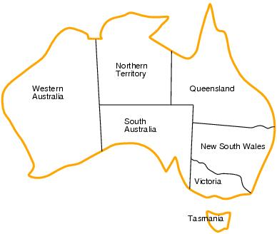
CSP example: map coloring
Variables: WA, NT, Q, NSW, V, SA, T
Domains: D_{i}={red,green,blue}
Constraints:adjacent regions must have different colors.
    E.g. WA ≠ NT

Slide 8
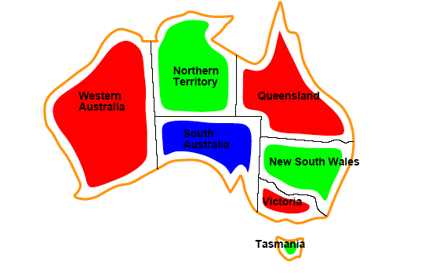
CSP example: map coloring
Solutions are assignments satisfying all constraints, e.g.
{WA=red,NT=green,Q=red,NSW=green,V=red,SA=blue,T=green}

Slide 9
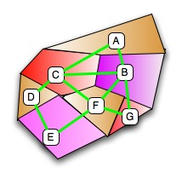
Graph coloring
More general problem than map coloring
Planar graph = graph in the 2d-plane with no edge crossings
Guthrie’s conjecture (1852)
  Every planar graph can be colored with 4 colors or less
  Proved (using a computer) in 1977 (Appel and Haken)
Notes:
planar graph : it can be drawn in such a way that no edges cross each other

Slide 10
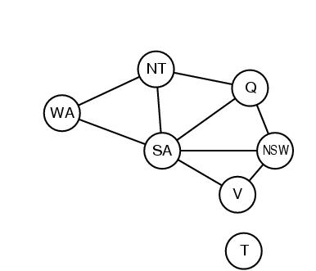
Constraint graphs
Constraint graph:
  nodes are variables
  arcs are binary constraints
Graph can be used to simplify search
e.g. Tasmania is an independent subproblem
(will return to graph structure later)

Slide 11
Varieties of CSPs
Discrete variables
  Finite domains; size d ⇒O(d^{n}) complete assignments.
    E.g. Boolean CSPs: Boolean satisfiability (NP-complete).
  Infinite domains (integers, strings, etc.)
    E.g. job scheduling, variables are start/end days for each job
    Need a constraint language e.g StartJob₁ +5 ≤ StartJob₃.
    Infinitely many solutions
    Linear constraints: solvable
    Nonlinear: no general algorithm
Continuous variables
  e.g. building an airline schedule or class schedule.
  Linear constraints solvable in polynomial time by LP methods.

Slide 12
Varieties of constraints
Unary constraints involve a single variable.
  e.g. SA ≠ green
Binary constraints involve pairs of variables.
  e.g. SA ≠ WA
Higher-order constraints involve 3 or more variables.
  Professors A, B,and C cannot be on a committee together
  Can always be represented by multiple binary constraints
Preference (soft constraints)
  e.g. red is better than green often can be represented by a cost for each variable assignment
  combination of optimization with CSPs

Slide 13
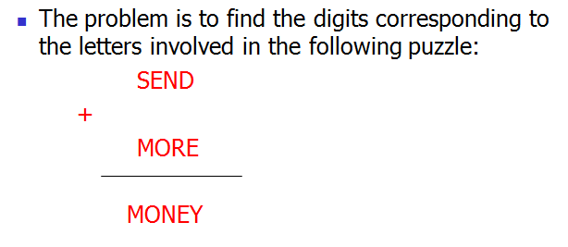
CSP Example: Cryptharithmetic puzzle

Slide 14
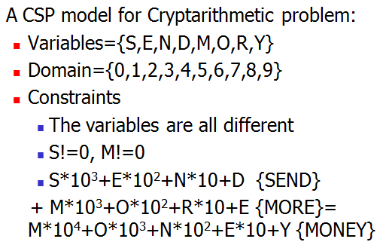
CSP Example: Cryptharithmetic puzzle

Slide 15
CSP as a standard search problem
A CSP can easily be expressed as a standard search problem.
Incremental formulation
  Initial State: the empty assignment {}
  Successor function: Assign a value to any unassigned variable provided that it does not violate a constraint
  Goal test: the current assignment is complete
    (by construction its consistent)
  Path cost: constant cost for every step (not really relevant)
Can also use complete-state formulation
  Local search techniques tend to work well
Notes:
Complete-state formulation: iterative improvement

Slide 16
CSP as a standard search problem
Solution is found at depth n (if there are n variables).
Consider using BFS
  Branching factor b at the top level is nd
  At next level is (n-1)d
  ….
end up with n!d^{n} leaves even though there are only d^{n} complete assignments!

Slide 17
Commutativity
CSPs are commutative.
  The order of any given set of actions has no effect on the outcome.
  Example: choose colors for Australian territories one at a time
    [WA=red then NT=green] same as [NT=green then WA=red]
All CSP search algorithms can generate successors by considering assignments for only a single variable at each node in the search tree
  ⇒ there are d^{n} leaves
  (will need to figure out later which variable to assign a value to at each node)

Slide 18
Backtracking search
Similar to Depth-first search
Chooses values for one variable at a time and backtracks when a variable has no legal values left to assign.
Uninformed algorithm
  No good general performance

Slide 19
Backtracking search
function BACKTRACKING-SEARCH(csp) return a solution or failure
return RECURSIVE-BACKTRACKING({} , csp)
function RECURSIVE-BACKTRACKING(assignment, csp) return a solution or failure
if assignment is complete then return assignment
var ← SELECT-UNASSIGNED-VARIABLE(VARIABLES[csp],assignment,csp)
for each value in ORDER-DOMAIN-VALUES(var, assignment, csp) do
if value is consistent with assignment according to CONSTRAINTS[csp] then
add {var=value} to assignment
result ← RRECURSIVE-BACTRACKING(assignment, csp)
if result ≠ failure then return result
remove {var=value} from assignment
return failure

Slide 20
Backtracking example

Slide 21
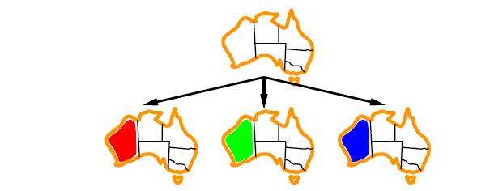
Backtracking example

Slide 22
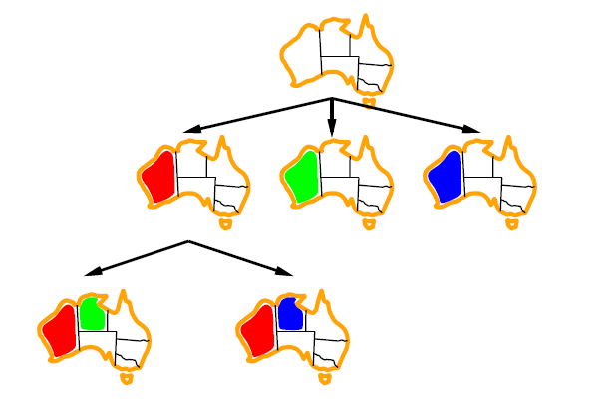
Backtracking example

Slide 23
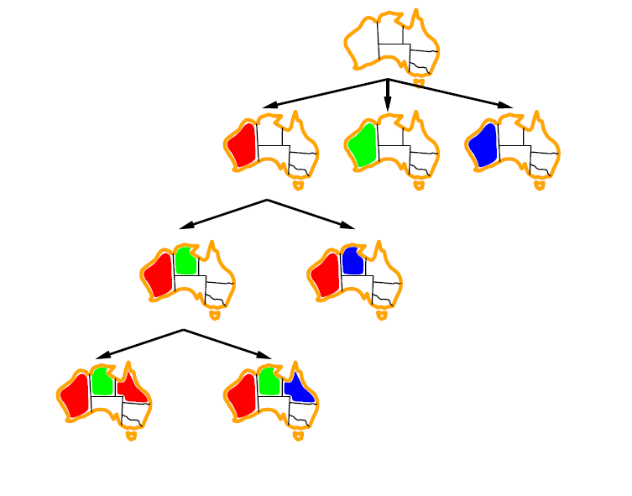
Backtracking example

Slide 24
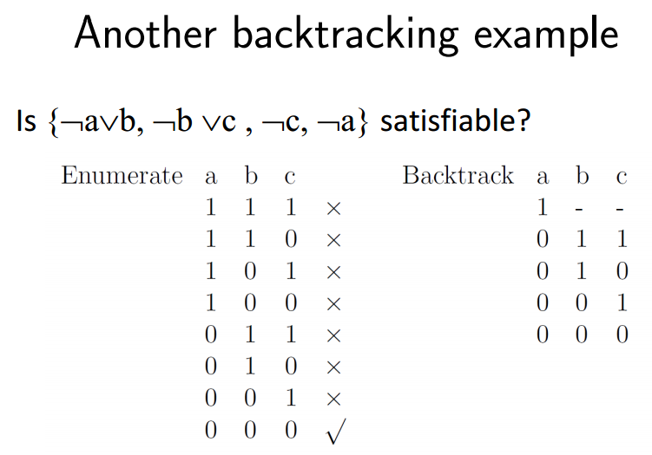

Slide 25
Improving CSP efficiency
Previous improvements on uninformed search
  → introduce heuristics
For CSPS, general-purpose methods can give large gains in speed, e.g.,
  Which variable should be assigned next?
  In what order should its values be tried?
  Can we detect inevitable failure early?
  Can we take advantage of problem structure?

Slide 26
Backtracking search
function BACKTRACKING-SEARCH(csp) return a solution or failure
return RECURSIVE-BACKTRACKING({} , csp)
function RECURSIVE-BACKTRACKING(assignment, csp) return a solution or failure
if assignment is complete then return assignment
var ← SELECT-UNASSIGNED-VARIABLE(VARIABLES[csp],assignment,csp)
for each value in ORDER-DOMAIN-VALUES(var, assignment, csp) do
if value is consistent with assignment according to CONSTRAINTS[csp] then
add {var=value} to assignment
result ← RRECURSIVE-BACTRACKING(assignment, csp)
if result ≠ failure then return result
remove {var=value} from assignment
return failure

Slide 27
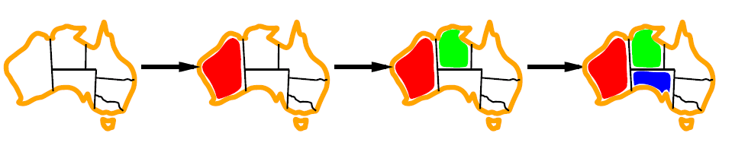
Minimum remaining values (MRV)
var ← SELECT-UNASSIGNED-VARIABLE(VARIABLES[csp],assignment,csp)
A.k.a. most constrained variable heuristic
Heuristic Rule: choose variable with the fewest legal moves
  e.g., will immediately detect failure if X has no legal values

Slide 28

Degree heuristic for the initial variable
Heuristic Rule: select variable that is involved in the largest number of constraints on other unassigned variables.
Degree heuristic can be useful as a tie breaker.
In what order should a variable’s values be tried?

Slide 29
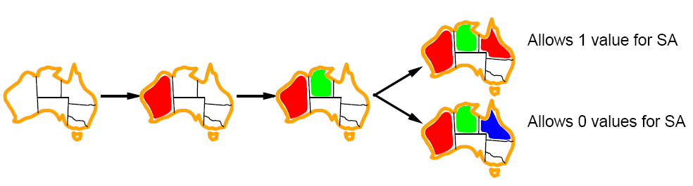
Least constraining value for value-ordering
Least constraining value heuristic
Heuristic Rule: given a variable choose the least constraining value
  leaves the maximum flexibility for subsequent variable assignments

Slide 30
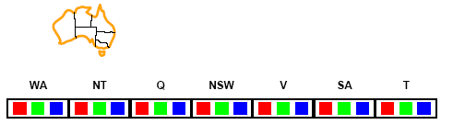
Forward checking
Can we detect inevitable failure early?
  And avoid it later?
Forward checking idea: keep track of remaining legal values for unassigned variables.
Terminate search when any variable has no legal values.

Slide 31
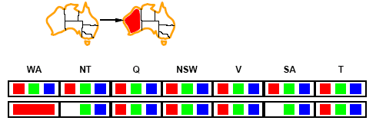
Forward checking
Assign {WA=red}
Effects on other variables connected by constraints to WA
  NT can no longer be red
  SA can no longer be red

Slide 32
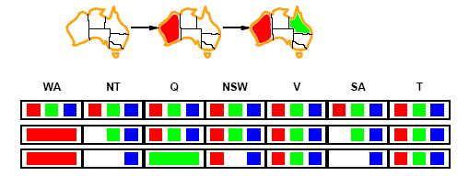
Forward checking
Assign {Q=green}
Effects on other variables connected by constraints with WA
  NT can no longer be green
  NSW can no longer be green
  SA can no longer be green
MRV heuristic would automatically select NT or SA next

Slide 33
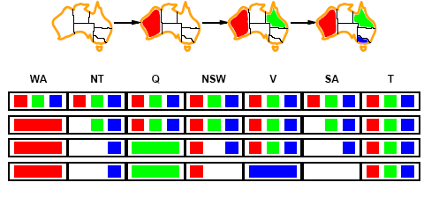
Forward checking
If V is assigned blue
Effects on other variables connected by constraints with WA
  NSW can no longer be blue
  SA is empty
FC has detected that partial assignment is inconsistent with the constraints and backtracking can occur.

Slide 34
Example: 4-Queens Problem
X1
{1,2,3,4}
X2
{1,2,3,4}
1
2
3
4
1
2
3
4
X3
{1,2,3,4}
X4
{1,2,3,4}

Slide 35
Example: 4-Queens Problem
X1
{1,2,3,4}
X2
{1,2,3,4}
1
2
3
4
1
2
3
4
X3
{1,2,3,4}
X4
{1,2,3,4}

Slide 36
Example: 4-Queens Problem
X1
{1,2,3,4}
X2
{ , ,3,4}
1
2
3
4
1
2
3
4
X3
{ ,2, ,4}
X4
{ ,2,3, }

Slide 37
Example: 4-Queens Problem
X1
{1,2,3,4}
X2
{ , ,3,4}
1
2
3
4
1
2
3
4
X3
{ ,2, ,4}
X4
{ ,2,3, }

Slide 38
Example: 4-Queens Problem
X1
{1,2,3,4}
X2
{ , ,3,4}
1
2
3
4
1
2
3
4
X3
{ , , , }
X4
{ , ,3, }

Slide 39
Example: 4-Queens Problem
X1
{1,2,3,4}
X2
{ , , ,4}
1
2
3
4
1
2
3
4
X3
{ ,2, ,4}
X4
{ ,2,3, }

Slide 40
Example: 4-Queens Problem
X1
{1,2,3,4}
X2
{ , , ,4}
1
2
3
4
1
2
3
4
X3
{ ,2, ,4}
X4
{ ,2,3, }

Slide 41
Example: 4-Queens Problem
X1
{1,2,3,4}
X2
{ , , ,4}
1
2
3
4
1
2
3
4
X3
{ ,2, , }
X4
{ , ,3, }

Slide 42
Example: 4-Queens Problem
X1
{1,2,3,4}
X2
{ , , ,4}
1
2
3
4
1
2
3
4
X3
{ ,2, , }
X4
{ , ,3, }

Slide 43
Example: 4-Queens Problem
X1
{1,2,3,4}
X2
{ , ,3,4}
1
2
3
4
1
2
3
4
X3
{ ,2, , }
X4
{ , , , }

Slide 44
Problem
Consider the constraint graph on the right.
The domain for every variable is [1,2,3,4].
There are 2 unary constraints:
- variable “a” cannot take values 3 and 4.
variable “b” cannot take value 4.
There are 8 binary constraints stating that variables
connected by an edge cannot have the same value.
Find a solution for this CSP by using the following
heuristics: minimum value heuristic, degree heuristic,
forward checking.
b
a
c
e
d

Slide 45
Problem
Consider the constraint graph on the right.
The domain for every variable is [1,2,3,4].
There are 2 unary constraints:
- variable “a” cannot take values 3 and 4.
variable “b” cannot take value 4.
There are 8 binary constraints stating that variables
connected by an edge cannot have the same value.
Find a solution for this CSP by using the following
heuristics: minimum value heuristic, degree heuristic,
forward checking.
MVH→ a=1 (for example)
FC+MVH→ b=2
FC+MVH+DH→ c=3
FC+MVH→ d=4
FC→ e=1
b
a
c
e
d
Notes:
Q: why should variable selection be fail-first, but value selection be fail-last?
For many example, selecting fair-first node helps minimize the number of nodes in the search tree by pruning larger parts of the tree earlier
For value ordering, the trick is that we only need one solution. If enumerate all solutions, the value ording would be irrelevant.

Slide 46
Constraint propagation
Solving CSPs with combination of heuristics plus forward checking is more efficient than either approach alone
FC checking does not detect all failures.
  E.g., NT and SA cannot be blue
  Look ahead. But not far!
Notes:
FC does not look far enough ahead.

Slide 47
Constraint propagation
Techniques like CP and FC are in effect eliminating parts of the search space
  Somewhat complementary to search
Constraint propagation goes further than FC by repeatedly enforcing constraints locally
  Needs to be faster than actually searching to be effective
Arc-consistency (AC) is a systematic procedure for constraint propagation

Slide 48
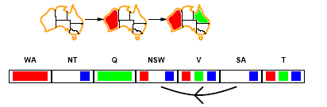
Arc consistency
An Arc X → Y is consistent if
for every value x of X there is some value y consistent with x
(note that this is a directed property)
Consider state of search after WA and Q are assigned:
SA → NSW is consistent if
SA=blue and NSW=red
Notes:
Arc refers to directed arc in the constraint graph.

Slide 49
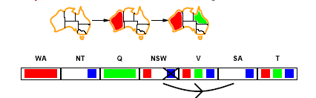
Arc consistency
X → Y is consistent if
for every value x of X there is some value y consistent with x
NSW → SA is consistent if
NSW=red and SA=blue
NSW=blue and SA=???
Notes:
The arc can be made consistent by deleting the value blue from the domain of NSW

Slide 50
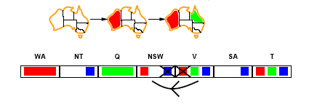
Arc consistency
Can enforce arc-consistency:
Arc can be made consistent by removing blue from NSW
Continue to propagate constraints….
  Check V → NSW
  Not consistent for V = red
  Remove red from V

Slide 51
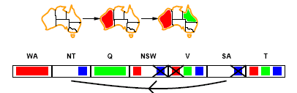
Arc consistency
Continue to propagate constraints….
SA → NT is not consistent
  and cannot be made consistent
Arc consistency detects failure earlier than FC

Slide 52
Arc consistency checking
Can be run as a preprocessor or after each assignment
  Or as preprocessing before search starts
AC must be run repeatedly until no inconsistency remains
Trade-off
  Requires some overhead to do, but generally more effective than direct search
  In effect it can eliminate large (inconsistent) parts of the state space more effectively than search can
Need a systematic method for arc-checking
  If X loses a value, neighbors of X need to be rechecked:
i.e. incoming arcs can become inconsistent again
(outgoing arcs will stay consistent).

Slide 53
Arc consistency algorithm (AC-3)
function AC-3(csp) return the CSP, possibly with reduced domains
inputs: csp, a binary csp with variables {X₁, X₂, …, X_{n}}
local variables: queue, a queue of arcs initially the arcs in csp
while queue is not empty do
(X_{i}, X_{j}) ← REMOVE-FIRST(queue)
if REMOVE-INCONSISTENT-VALUES(X_{i}, X_{j}) then
for each X_{k} in NEIGHBORS[X_{i} ] do
add (X_{k}, X_{j}) to queue
function REMOVE-INCONSISTENT-VALUES(X_{i}, X_{j}) return true iff we remove a value
removed ← false
for each x in DOMAIN[X_{i}] do
if no value y in DOMAIN[X_{i}] allows (x,y) to satisfy the constraints between X_{i} and X_{j}
then delete x from DOMAIN[X_{i}]; removed ← true
return removed
(from Mackworth, 1977)

Slide 54
Complexity of AC-3
A binary CSP has at most n² arcs
Each arc can be inserted in the queue d times (worst case)
  (X, Y): only d values of X to delete
Consistency of an arc can be checked in O(d²) time
Complexity is O(n² d³)
Notes:
The
complexity of arc consistency checking can be analyzed as follows: a binary CSP has at most
O(n2) arcs; each arc (Xk;Xi) can be inserted on the agenda only d times, because Xi has
at most d values to delete; checking consistency of an arc can be done in O(d2) time; so the
total worst-case time is O(n2d3). Although this is substantially more expensive than forward
checking, the extra cost is usually worthwhile.1

Slide 55
Arc-consistency as message-passing
This is a propagation algorithm. It’s like sending messages to neighbors on the graph. How do we schedule these messages?
Every time a domain changes, all incoming messages need to be re-sent. Repeat until convergence → no message will change any domains.
Since we only remove values from domains when they can never be part of a solution, an empty domain means no solution possible at all → back out of that branch.
Forward checking is simply sending messages into a variable that just got its value assigned. First step of arc-consistency.

Slide 56
K-consistency
Arc consistency does not detect all inconsistencies:
  Partial assignment {WA=red, NSW=red} is inconsistent.
Stronger forms of propagation can be defined using the notion of k-consistency.
A CSP is k-consistent if for any set of k-1 variables and for any consistent assignment to those variables, a consistent value can always be assigned to any kth variable.
  E.g. 1-consistency = node-consistency
  E.g. 2-consistency = arc-consistency
  E.g. 3-consistency = path-consistency
Strongly k-consistent:
  k-consistent for all values {k, k-1, …2, 1}
  Suppose we have a CSP problem with n nodes and make it strongly n-consistent. We can then solve the problem without no backtracking.
Notes:
3-consistency: any pair of adjacent variables can always be extended to a third neighboring variable

Slide 57
Trade-offs
Running stronger consistency checks…
  Takes more time
  But will reduce branching factor and detect more inconsistent partial assignments
  No “free lunch”
    In worst case n-consistency takes exponential time
Notes:
In practice, determining
the appropriate level of consistency checking is mostly an empirical science.

Slide 58
Further improvements
Checking special constraints
  Checking Alldif(…) constraint
    E.g. {WA=red, NSW=red}
  Checking Atmost(…) constraint
    Bounds propagation for larger value domains
Notes:
For example, let’s suppose there are two
flights, 271 and 272, for which the planes have capacities 165 and 385, respectively. The
initial domains for the numbers of passengers on each flight are then
Flight271 2 [0; 165] and Flight272 2 [0; 385] :
Now suppose we have the additional constraint that the two flights together must carry 420
people: Flight271 + Flight272 2 [420; 420]. Propagating bounds constraints, we reduce the
domains to
Flight271 2 [35; 165] and Flight272 2 [255; 385] :

Slide 59
Intelligent backtracking
  Standard form is chronological backtracking i.e. try different value for preceding variable.
  More intelligent, backtrack to conflict set.
    Set of variables that caused the failure or set of previously assigned variables that are connected to X by constraints.
    Backjumping moves back to most recent element of the conflict set.
    Forward checking can be used to determine conflict set.
Sequence: Q, NSW, V , T, SA, WA, NT
SA=?
Go to T
Go to the variable which cause the failure

Slide 60
Local search for CSPs
Use complete-state representation
  Initial state = all variables assigned values
  Successor states = change 1 (or more) values
For CSPs
  allow states with unsatisfied constraints (unlike backtracking)
  operators reassign variable values
  hill-climbing with n-queens is an example
Variable selection: randomly select any conflicted variable
Value selection: min-conflicts heuristic
  Select new value that results in a minimum number of conflicts with the other variables

Slide 61
Local search for CSP
function MIN-CONFLICTS(csp, max_steps) return solution or failure
inputs: csp, a constraint satisfaction problem
max_steps, the number of steps allowed before giving up
current ← an initial complete assignment for csp
for i = 1 to max_steps do
if current is a solution for csp then return current
var ← a randomly chosen, conflicted variable from VARIABLES[csp]
value ← the value v for var that minimize CONFLICTS(var,v,current,csp)
set var = value in current
return failure

Slide 62
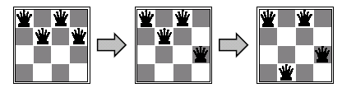
Min-conflicts example 1
h=5
h=3
h=1
Use of min-conflicts heuristic in hill-climbing.

Slide 63
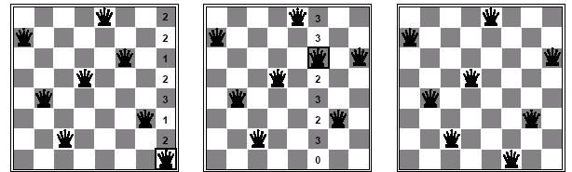
Min-conflicts example 2
A two-step solution for an 8-queens problem using min-conflicts heuristic
At each stage a queen is chosen for reassignment in its column
The algorithm moves the queen to the min-conflict square breaking ties randomly.
Notes:
Amazingly, on the n-queens problem, if you don’t count the initial placement of queens, the runtime of minconflicts
is roughly independent of problem size. It solves even the million-queens problem in an average of 50 steps (after the initial assignment).

Slide 64
Advantages of local search
Local search can be particularly useful in an online setting
  Airline schedule example
    E.g., mechanical problems require than 1 plane is taken out of service
    Can locally search for another “close” solution in state-space
    Much better (and faster) in practice than finding an entirely new schedule
The runtime of min-conflicts is roughly independent of problem size.
  Can solve the millions-queen problem in roughly 50 steps.
  Why?
    n-queens is easy for local search because of the relatively high density of solutions in state-space

Slide 65
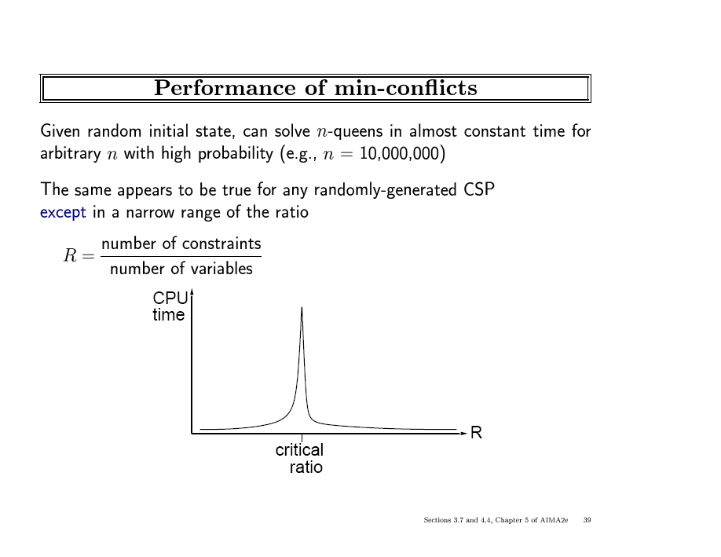

Slide 66
Graph structure and problem complexity
Solving disconnected subproblems
  Suppose each subproblem has c variables out of a total of n.
  Worst case solution cost is O(n/c d^{c}), i.e. linear in n
    Instead of O(d ^{n}), exponential in n
E.g. n= 80, c= 20, d=2
  2⁸⁰ = 4 billion years at 1 million nodes/sec.
  4 * 2²⁰= .4 second at 1 million nodes/sec

Slide 67
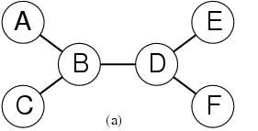
Tree-structured CSPs
Theorem:
  if a constraint graph has no loops then the CSP can be solved in O(nd ²) time
  linear in the number of variables!
Compare difference with general CSP, where worst case is O(d ^{n})
Notes:
We will show that any tree-structured CSP can be solved in time linear in the
number of variables.

Slide 68
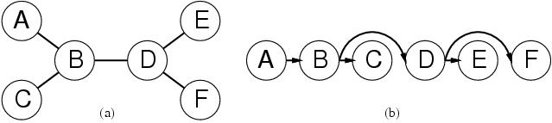
Algorithm for Solving Tree-structured CSPs
  Choose some variable as root, order variables from root to leaves such that
  every node’s parent precedes it in the ordering.
    Label variables from X₁ to X_{n})
    Every variable now has 1 parent
  Backward Pass
    For j from n down to 2, apply arc consistency to arc [Parent(X_{j}), X_{j}) ]
    Remove values from Parent(X_{j}) if needed
  Forward Pass
    For j from 1 to n assign X_{j} consistently with Parent(X_{j} )

Slide 69
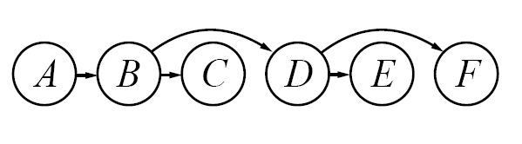
Tree CSP Example
G
B

Slide 70
Tree CSP Example
Backward Pass
(constraint
propagation)
B
R
G
B
R
G
B
G
R
G
B

Slide 71
Tree CSP Example
Backward Pass
(constraint
propagation)
B
R
G
B
R
G
B
G
R
G
B
Forward Pass
(assignment)
B
G
R
R
G
B

Slide 72
Tree CSP complexity
Backward pass
  n arc checks
  Each has complexity d² at worst
Forward pass
  n variable assignments, O(nd)
  Overall complexity is O(nd ²)
Algorithm works because if the backward pass succeeds, then every variable by definition has a legal assignment in the forward pass

Slide 73
What about non-tree CSPs?
General idea is to convert the graph to a tree
2 general approaches
Assign values to specific variables (Cycle Cutset method)
Construct a tree-decomposition of the graph
  - Connected subproblems (subgraphs) form a tree structure

Slide 74
Cycle-cutset conditioning
Choose a subset S of variables from the graph so that graph without S is a tree
  S = “cycle cutset”
For each possible consistent assignment for S
  Remove any inconsistent values from remaining variables that are inconsistent with S
  Use tree-structured CSP to solve the remaining tree-structure
    If it has a solution, return it along with S
    If not, continue to try other assignments for S

Slide 75
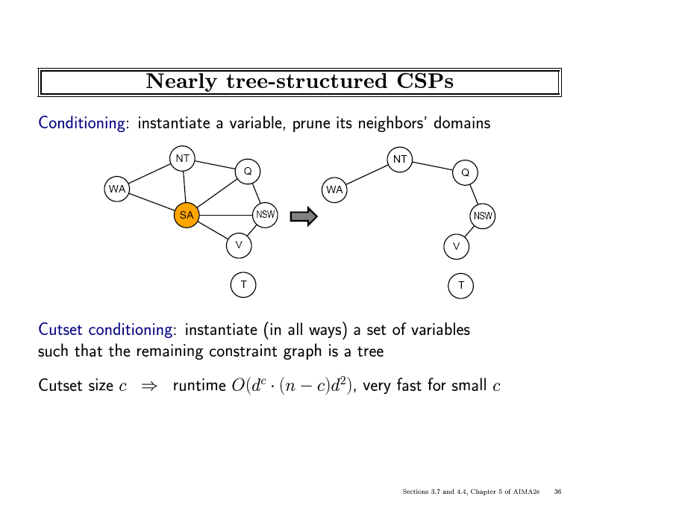

Slide 76
Finding the optimal cutset
If c is small, this technique works very well
However, finding smallest cycle cutset is NP-hard
  But there are good approximation algorithms

Slide 77

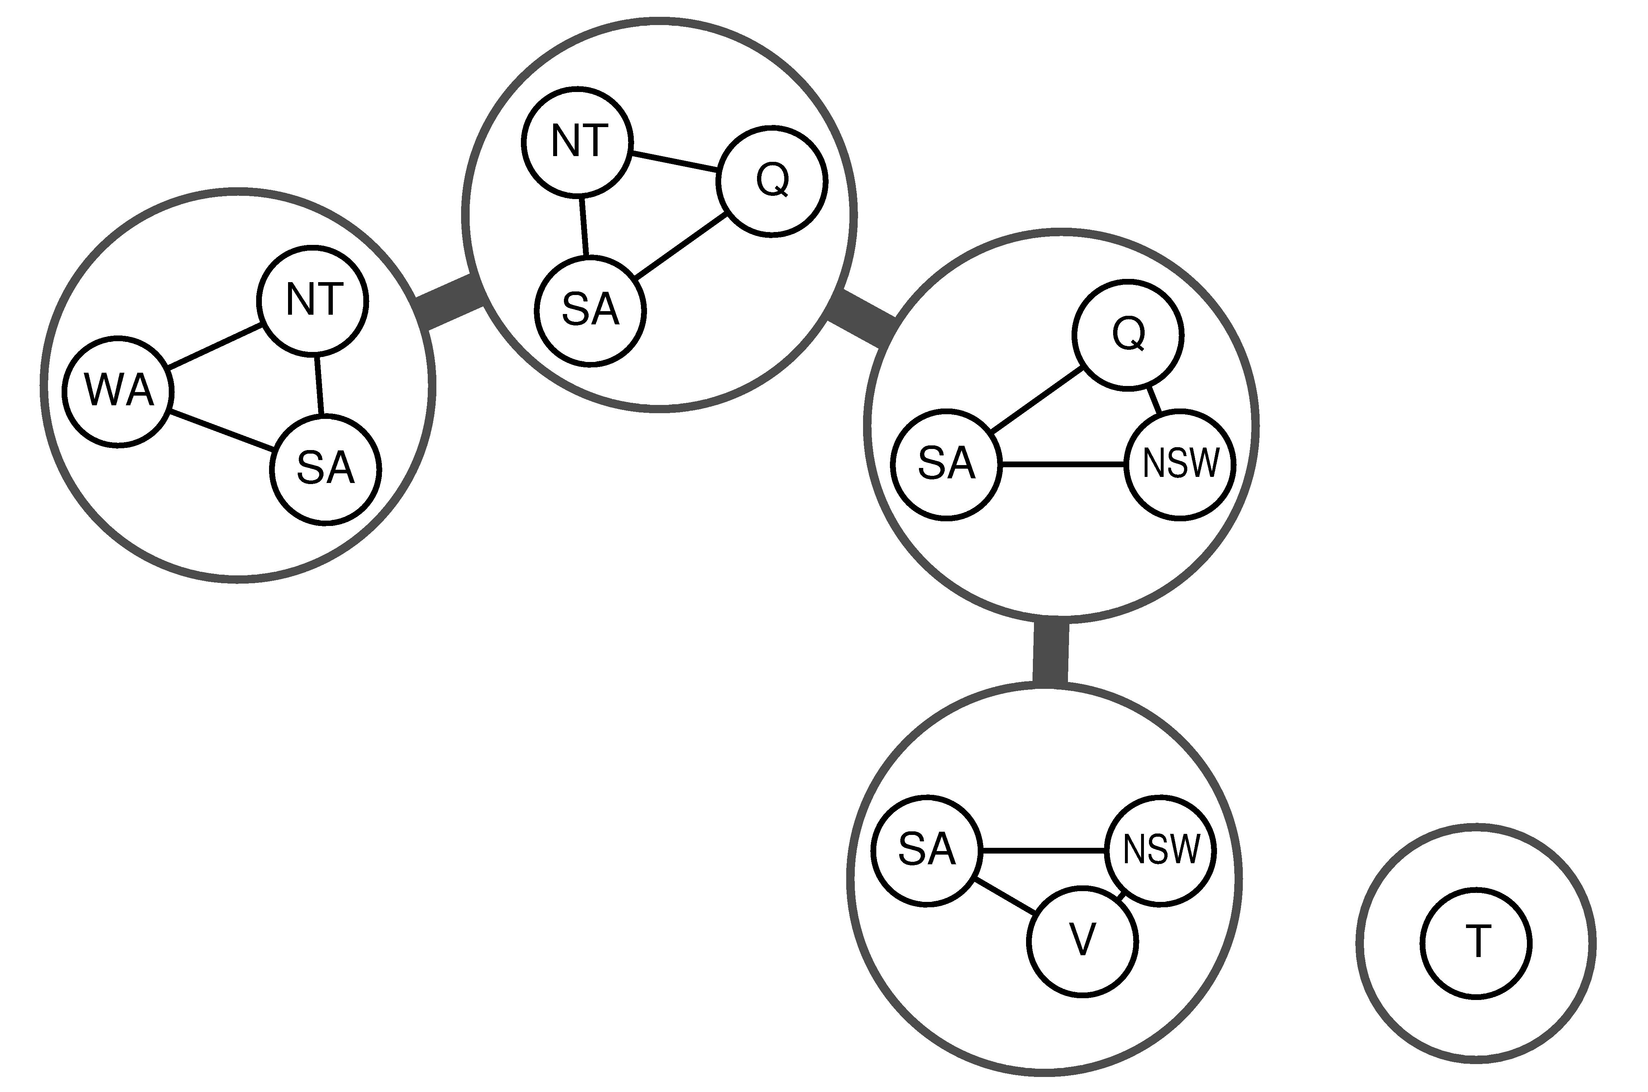
Tree Decompositions

Slide 78
Rules for a Tree Decomposition
Every variable appears in at least one of the subproblems
If two variables are connected in the original problem, they must appear together (with the constraint) in at least one subproblem
If a variable appears in two subproblems, it must appear in each node on the path.
Notes:
The first two conditions ensure that all the variables and constraints are represented in the
decomposition. The third condition seems rather technical, but simply reflects the constraint
that any given variable must have the same value in every subproblem in which it appears;
the links joining subproblems in the tree enforce this constraint.

Slide 79
Tree Decomposition Algorithm
View each subproblem as a “super-variable”
  Domain = set of solutions for the subproblem
  Obtained by running a CSP on each subproblem
  E.g., 6 solutions for 3 fully connected variables in map problem
Now use the tree CSP algorithm to solve the constraints connecting the subproblems
  Declare a subproblem a root node, create tree
  Backward and forward passes
Example of “divide and conquer” strategy

Slide 80
Complexity of Tree Decomposition
Many possible tree decompositions for a graph
Tree-width of a tree decomposition = 1 less than the size of the largest subproblem
Tree-width of a graph = minimum tree width
If a graph has tree width w, then solving the CSP can be
done in O(n d^{w+1}) time (why?)
  CSPs of bounded tree-width are solvable in polynomial time
Finding the optimal tree-width of a graph is NP-hard, but good heuristics exist.

Slide 81
Summary
CSPs
  special kind of problem: states defined by values of a fixed set of variables, goal test defined by constraints on variable values
Backtracking=depth-first search with one variable assigned per node
Heuristics
  Variable ordering and value selection heuristics help significantly
Constraint propagation does additional work to constrain values and detect inconsistencies
  Works effectively when combined with heuristics
Iterative min-conflicts is often effective in practice.
Graph structure of CSPs determines problem complexity
  e.g., tree structured CSPs can be solved in linear time.

