Slide 1
Foundations of Functional Programming
May 6, 2014

Slide 2
Goals
What I hope you will get from this presentation:
A look into functional programming’s origins
A language-neutral introduction to important FP concepts
An idea of which problems are good candidates for FP
Curiosity about some ideas which underpin FP
Pragmatic ideas for introducing FP
Not goals ☺
“Functional programming will save the world!”
“Functional programming is better than …”

Slide 3
Who am I
Brian Hartin
  brian.hartin@gmail.com
  twitter: @bjhartin
Developer at Iowa Student Loan Liquidity Corporation
Program mostly in Groovy, Java, Scala and Ruby

Slide 4
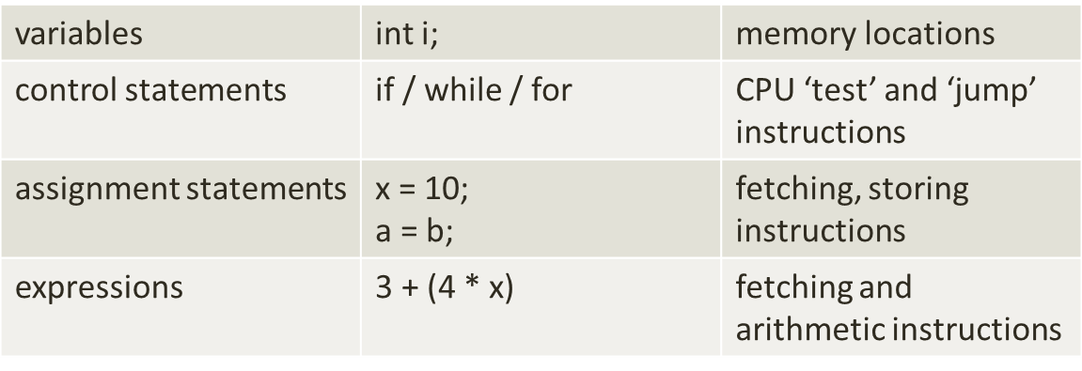
A Leaky Abstraction?
Most popular programming languages are loose representations of the computer architecture
  Includes imperative languages such as C, C++, Java, etc.
  Building blocks represent CPU and memory activities
Allows fine control over performance

Slide 5
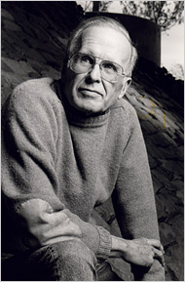
Von Neumann Languages
So designated in 1977 Turing-award paper: “Can Programming be Liberated from its Von Neumann Style?”
  Inspired a lot of research into FP
These languages focus on telling the computer to do something.
  We must think carefully about time and state, i.e. sequencing, sharing and changing
  Programs divided into statements and expressions
  Different from thinking about computation
Programs don’t have many useful mathematical properties.
  Difficult to formally reason about them, or prove things
John Backus, IBM

Slide 6
Von Neumann Languages, cont.
Backus proposed a language in which:
  Computations are mathematical functions
  Everything is an expression (no statements)
  Shared state is prohibited
  Mutable state is prohibited
  Programs had useful mathematical properties
  provably correct
  combined via composition
  automatic program simplification/reduction

Slide 7
Complexity
Consider the following code
// Need example here which shows:
We can’t fully comprehend what this code is doing without seeing more of the program
We can’t safely change the order of a computation
We can’t parallelize it safely
We’re not sure where the values are coming from
Spring context mess

Slide 8
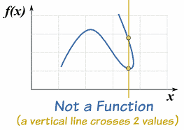
Functional Languages
Strive to allow most computations to be defined as mathematical functions
  deterministic
  idempotent
  side-effect free
Overriding benefit is simplicity
EXAMPLE

Slide 9
Functional Languages
  “In functional programming, programs are executed by evaluating expressions, in contrast with imperative programming where programs are composed of statements which change global state when executed. ”
-- http://www.haskell.org/haskellwiki/Functional_programming

Slide 10
‘Pure’ Functional Languages
Programs composed of referentially transparent expressions
Functions are pure and first class
Some functions are higher order
Values are immutable
Logic expressed declaratively (often recursively)
Reduction or elimination of state, especially global or shared
Reduction in the number of concepts, increase in their power
Hand sequencing replaced by composition (dependency graph)

Slide 11
Non-Pure Functional Programming
Some languages support some FP features, but not all
  They may allow shared state, mutability and side effects
  They support features such as higher-order functions, list comprehensions, etc.
  Ruby, Groovy, Scala and Java 8 all fall into this category
Can write nearly pure functional code in any of these languages
Or, you can simply leverage certain features as beneficial
Part of being an effective functional programmer is understanding what benefits come from purity, and making smart compromises

Slide 12
Additional FP Language Features
List comprehensions / maps, filters, folds
Pattern matching
Lazy evaluation
Partial application and currying
Composition
Range types

Slide 13
Expressions vs. Statements
Expressions:
Express (return) a value
Consist of values, operators and other expressions
Can be used where a value of the same type is expected
Can be composed into more complex expressions
1 + 2 // of type int
1 + x + foo(1)
bar(int x, int y)
bar(3, (x + foo(1)))
f(g(), h(1, “a”), j())

Slide 14
Expressions vs. Statements
Statements
Do not return a value
Are illegal in some places
Exist solely for the purpose of their side effect
Typically change some global state of the program or the system
Cannot be substituted for values
Thread.sleep(1000)
return (int y = 2)
System.out.println(“Hi”)
void save()
foo((int y = 2), 2)

Slide 15
Referential Transparency
An expression is referentially transparent if, once computed, its value can safely be substituted for the expression.
// Trivial case
int x = 1 + 2; // is 3
…
// could replace (1 + 2) with 3
int y = 3 * 5 – (1 + 2);
// Non-trivial case
int amount = order.total() * getDiscount() // is $34.00
…
// Can we safely replace the second term with $34.00?
int amount2 = dailyTotal() + (order.total() * getDiscount())
Cannot safely replace occurrences of an expression if its computation has side effects or hidden inputs

Slide 16
Referential Transparency, cont.
In mathematics, all functions have this property
Allows humans and compilers to reason more effectively about program behavior
Enables features such as
  Memoizing
  Parallelization
  Lazy Evaluation
  Common sub-expression elimination (simplification)
How to guarantee referential transparency?

Slide 17
Immutability
A value cannot be changed, once assigned
  Instead, new values are created
Required for referential transparency – mutable types make expressions referentially opaque
  Impossible / very hard to rule out side effects
  Be aware of this if you ‘sprinkle’ functional programming into OO

Slide 18
Immutability, cont.
Some problems go away entirely if values (objects) are immutable
A good strategy is to push mutability to the boundary of a module
  An API that accepts mutable types only at entry/exit points
  Allows advantages of pure FP within the module
  Good for integrating with legacy code, non-FP libraries and frameworks
FP Big Idea ™: Making entire categories of errors impossible to express

Slide 19
Declarative Programming
The opposite of imperative programming
Instead of telling the computer/language what to do, we tell it what we want
Easier to reason about correctness, perhaps harder to reason about performance
  SQL is an example – the DB plans the execution

Slide 20
First Class Functions
Functions can be treated as values
Can be given names like other values, x = …
Scala
val doubleIt = (x: Int) => x * 2
Groovy
def doubleIt = {int x -> x * 2}
Java 8
Function<Integer, Integer> doubleIt = (x) -> {return x * 2;};

Slide 21
Higher Order Functions
Goes hand-in-hand with first-class functions
Can be passed as parameters
Can be returned
Scala – Higher Order Functions
def isEven(n: Int) = {n % 2 == 0}
// Accepts a function
def checkNumber(n: Int, check: Int => Boolean) = {check(n)}
// Returns a function
def multiplyBy(m: Int) = (n:Int) => {n * m}
checkNumber(2, isEven) // true
multiplyBy(5)(6) // 30

Slide 22
Higher Order Functions, cont.
A form of inversion of control
Great for when you want to ‘wrap’ behavior around other behavior, e.g.
  Closing files or database connections
Scala
def doWithWriter(filename: String, f: PrintWriter => Any) = {
val writer = new PrintWriter(new File(filename))
try {
f(writer) // f doesn’t open or close the file
} finally {
writer.close
}
}
Also useful for other cross-cutting concerns like transactions, benchmarking, logging, etc.

Slide 23
Higher Order Functions, cont.
Valuable in processing collections (as we will see…)
Many OO patterns overlap with higher order functions
  Strategy
  Visitor
  Command
  Anonymous inner classes
  Template method
  Iterator
FP Big Idea ™: Simplicity through unification: statements vs. expressions, functions vs. values

Slide 24
Anonymous Functions
(Lambda Expressions)
Functions can be defined and called without a name
Scala
checkNumber(2, (number:Int) => {number % 2 != 0})
checkNumber(2, {_ % 2 != 0}) // Alternate syntax
Groovy
checkNumber(2, {n -> n % 2 != 0})
checkNumber(2, {it % 2 != 0}) // Alternate syntax
Often used for ad-hoc, simple computations, which don’t deserve a name
  Similar to some anonymous classes (e.g., comparators)

Slide 25
Closures
Lambdas are often (lexical) closures
Functions that retain bindings to their enclosing scope
Technically, anonymous functions don’t have to be closures
  But usually are
Groovy
def callWith3(Closure f) {f(3)}
def closureTest() {
int x = 5
callWith3({y -> x + y}) // 8, because x was bound to 5
}
Note that x is out of scope in callWith3
Closures + mutable types = possibility of surprising side effects

Slide 26
List Comprehensions
A way of performing arbitrary operations on list-like structures
  Largely replaces for and while loops
  Comes from ‘set-builder’ notation in mathematics:
  Encourages us to think more about the results, not the steps
Common to languages with functional programming support
Built on top of higher-order functions
A core set of list comprehensions are common to most FP languages

Slide 27
Filters & Maps
Filter selects items by a predicate function
Scala
List(1, 2, 3, 4, 5).filter({_ % 2 == 0}) // List(2, 4)
Groovy
[1, 2, 3, 4, 5].findAll({it % 2 == 0}) // [2, 4]
Map transforms items with a transformation function
Scala
List(1, 2, 3, 4, 5).map({_ * 2}) // List(2, 4, 6, 8, 10)
Groovy
[“a”, “b”].collect({it.toUpperCase()}) // [“A”, “B”]

Slide 28
Folds (Reductions)
Reduces a list to a single item
Common uses: totaling, averaging or other aggregation
Scala
List(1, 2, 3, 4, 5).foldLeft(0)((acc, n) => {acc + n})) // 15
Groovy
[1, 2, 3, 4, 5].inject(0, {acc, n -> acc + n}) // 15
The function argument takes an accumulator and the item
Accepts an initial value for the accumulator

Slide 29
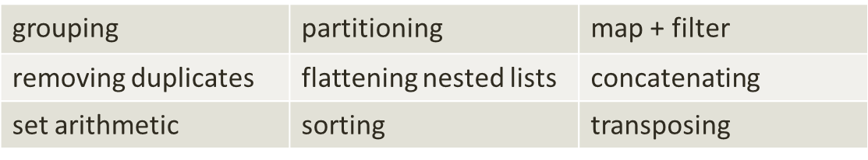
Others
Many others
Can dramatically simplify code
FP Big Idea ™: Expressing what we want, not the steps to do it

Slide 30
Pattern Matching
Allows us to specify behavior by matching values to patterns
In simple case, similar to if/else or switch
Scala
val result = myValue match {
case 1 => “one”
case _ => “other”
}
Patterns can be very concise
Scala
val result = myValue match {
case s: String if s.startsWith(“f”) => “starts with f”
case s: String => “other string, ” + s
case i: Int => “an int”
case _ => “other”
}

Slide 31
Pattern Matching, cont.
More powerful with immutable types (Scala case classes)
Scala
case class Order(cust: Customer, lines: [OrderLine])
case class Customer(email: String, addr: Address,
totalOrders: Int)
case class Address(line1: String, line2: String, city: String,
state: String, zip: String)
val shippingChargeAdjustment = order match {
case hawaiiOrder: Order(Customer(_, Address(_, _, _, “HI”, _)), _, _) => 1.5
case bigOrder: Order(_, l1:l2:l3:l4:l5:ls, _) => 0.9
case goodCustomerOrder: Order(c, _, _) if c.totalOrders > 10 => 0.8
case _ => 1.0 // Normal order
}

Slide 32
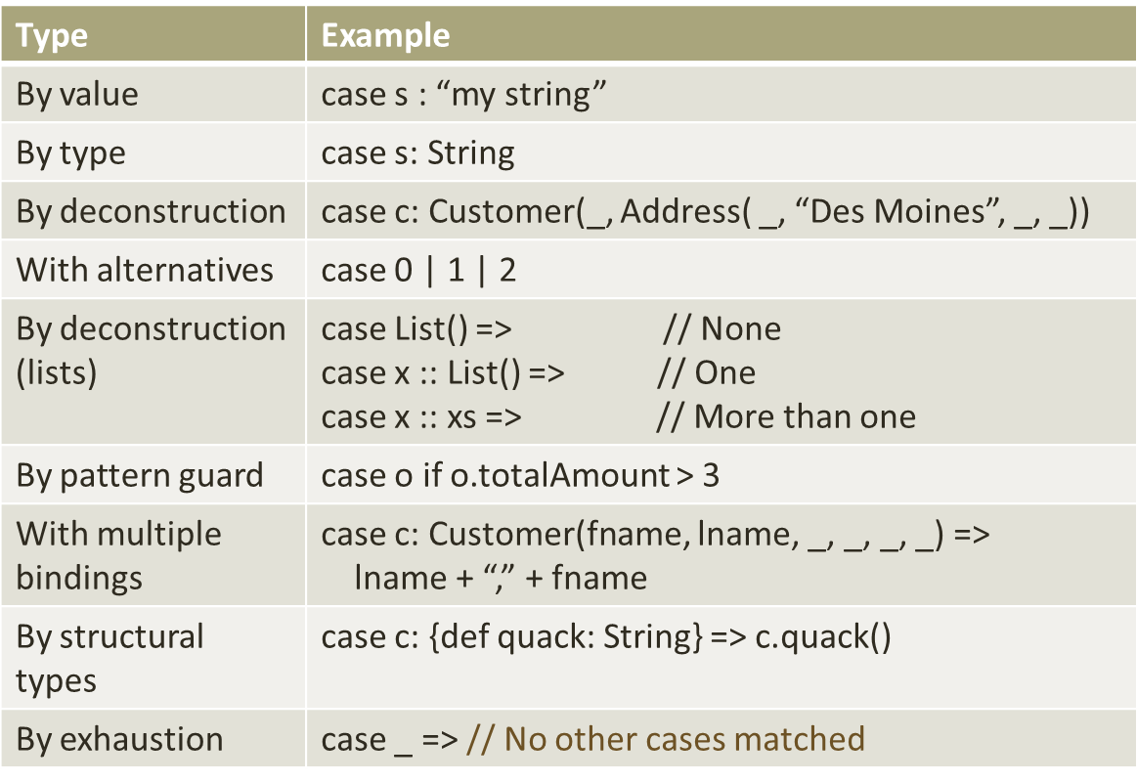
Pattern Matching Examples

Slide 33
Partial Application
A function may be partially applied by providing only some of its arguments
This fixes those arguments, producing a new function
Scala
def addEm(x: Int, y: Int) = {x + y}
def addFive = addEm(5, _:Int) // Fixes the first arg
addFive(3) // 8
Haskell is beautiful in this regard. Any function may be partially applied with no special syntax
Haskell
add x y = x + y // Function body
addFive = add 5
addFive 3 // 8

Slide 34
Lazy Evaluation

Slide 35
The ‘Killer Feature’ of Func. Prog.
(IMHO)
Allows us to think about computations, instead of computers
Gives us a way to write programs composed of subprograms
We can more easily understand a part of a program without understanding the whole (example)
Part of a historic trend toward a higher level of abstraction as hardware capabilities increase
Can leverage some of these ideas in non-functional languages (example)

Slide 36
The Killer Feature, cont.
Can more easily parallelize computations (example)
Can memoize computations (example)
Compilers can perform more kinds of optimizations
  Reordering computations
  Pulling things out of loops
  Tail call optimization (appropriate here ???)
Can use lazy evaluation
Can deal with infinite ranges

Slide 37
Good Candidates for FP

Slide 38
Complexity
Example: Shared state as complexity
Example: Mutable state as complexity
Example: Non-determinism as complexity
Example: Side-effects as complexity
Example: Sequencing as complexity

Slide 39
Java 8 Support for Func. Prog.
Lambda expressions supported through functional interfaces
  An interface with one abstract method, e.g. Runnable or Comparator
lambdas are instances of an Object subtypes
  Not necessarily well-behaved objects
Are type compatible with functional interfaces if the signatures match
Method references capture existing methods as lambdas
Not pure functions – can be done with void methods, and with side effects

Slide 40
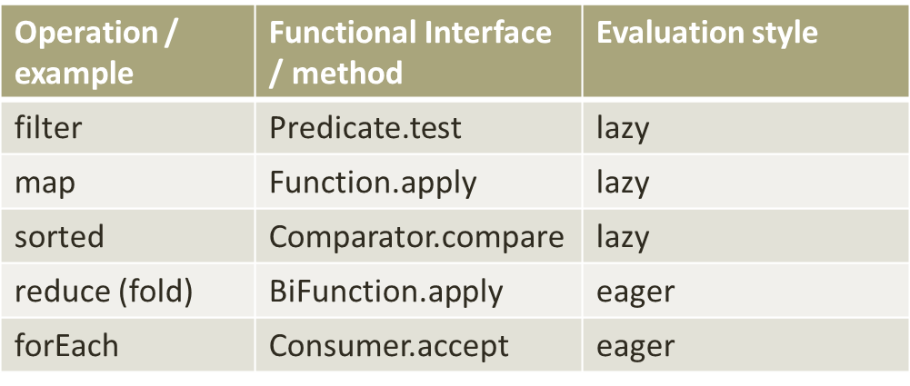
Java 8, cont.
List comprehensions / operations supported via streams
  Sequences which may or may not be finite
Functional interfaces define the type of higher order function accepted
Operations defined as intermediate (lazy) and terminal (eager)

Slide 41
Applying Functional Concepts in Non-Functional Languages
Can apply some of these concepts in non-functional languages
  Immutability
  Pure functions
    Determinism
    No side-effects
    Idempotency

Slide 42

Haskell
An purely-functional programming language
  Introduced in 1987
  All objects immutable
  All functions pure
    Models side effects (IO, etc.) as return values
Almost the reference implementation of functional programming
Very good way to learn functional programming fundamentals
Often, ‘if it compiles, it works’
Haskell Curry
1900 – 1982
American Mathematician and Logician

Slide 43
Haskell, cont.
Haskell
isBig n = n > 100
f = isBig
f(101) -- First class functions true
-- List comprehensions and
filter isBig [1, 3, 105] -- higher order functions and [105]
map (\n -> n/2) [2, 4] -- anonymous functions [1, 2]
take m ys = case (m,ys) of -- Pattern matching
(0,_) -> []
(_,[]) -> []
(n,x:xs) -> x : take (n-1) xs
add x y = x + y -- All functions are curried
addFive = add 5 -- and can be partially applied
addFive 3 -- 8

Slide 44
Haskell, cont.
Great, free online IDE: fpcomplete.com
  Includes ‘School of Haskell’ tutorials
Incredible free online book: learnyouahaskell.com
  Strong introduction to FP concepts, including advanced ones
  Even if learning Scala/Groovy/other, this is a great resource

Slide 45
Related, Interesting Topics
Non-Von Neumann computer architectures
Lambda calculus
Applying functional thinking outside your program
Logic programming

Slide 46
References
“Can Programming be Liberated from its Von Neumann Style?” (1977 Turing award paper/lecture by John Backus)
  http://www.thocp.net/biographies/papers/backus_turingaward_lecture.pdf
“Functional Thinking” series by Neal Ford
  http://nealford.com/functionalthinking.html
“Referential Transparency” – Wikipedia
  http://en.wikipedia.org/wiki/Referential_transparency_(computer_science)
Learn You a Haskell for Great Good! (Miran Lipovača)
  http://learnyouahaskell.com
Java 8 Lambda FAQ (Marice Naftalin)
  http://www.lambdafaq.org
An Introduction to Functional Languages by Ken Sipe (two parts)
  http://java.dzone.com/articles/introduction-functional
  http://java.dzone.com/articles/introduction-functional-0

Slide 47
Thank you!

