Slide 1
Cheap and
Mostly
Right
Introducing Probabilistic Metrics for Efficient Statistics on Large Streams

Slide 2
Why are we here?
Put probabilistic metrics on your ‘tech radar’
Show how we used HyperLogLog to improve key metrics by 99%
Introduce the ‘family’ of different probabilistic metrics

Slide 3
These metrics all do one magic trick:
Compute ‘set/stream’ metrics, e.g. # of unique values, freq. distribution, etc.
Without storing the whole set!
Instead, they store tiny, statistical sketches
Trade accuracy for storage space / speed
Aggregatable like sum/max/min/etc.
Cheap, and mostly right!
The TL;DR

Slide 4
Our problem
Some of our key metrics became unresponsive as we grew
  These involved counting distinct machines per minute
    A ‘cardinality’ metric
Let’s have a look…
  5 min IFDS overview (domain doc)
  Teams + machines graph
  Metrics entries, data volumes chart, monthly storage

Slide 5
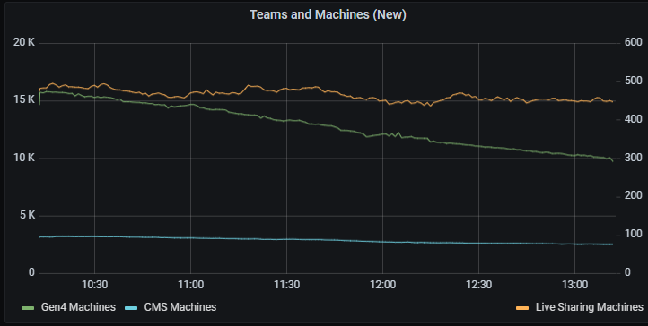
We count connected machines/time
This helps us spot problems and is an indicator of system usage and the number of customers which might be affected by any problem.`

Slide 6
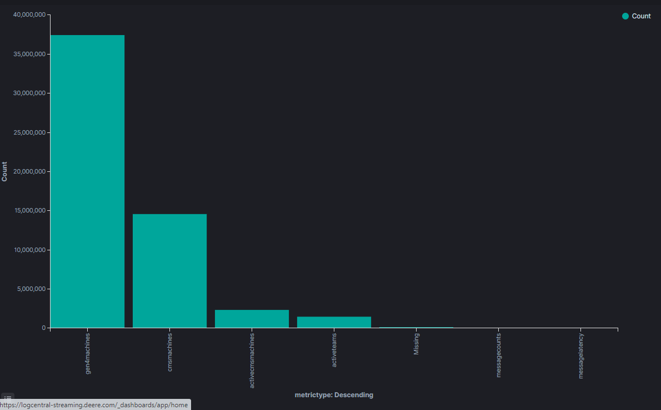
99% of our metrics are individual values
The four big buckets are mostly individual machine IDs logged by each instance of the app, e.g. ‘machines observed per minute’

Slide 7
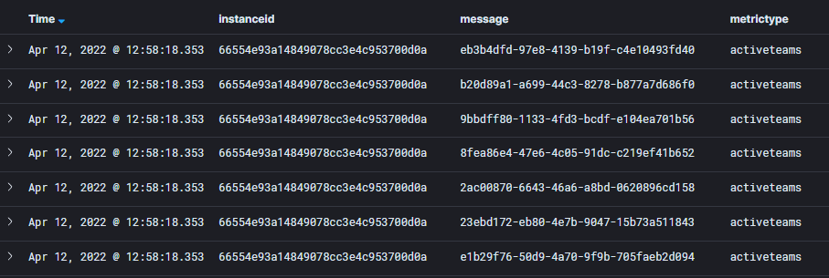
99% of our metrics are individual values
Here we see individual values (team ids) logged - to be counted later

Slide 8
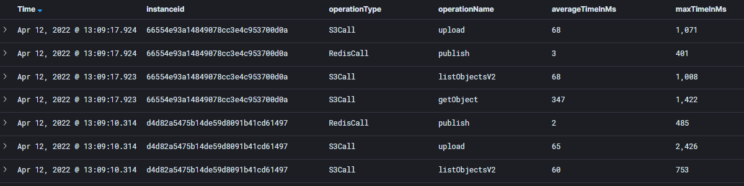
1% of our metrics are traditional
These metrics rows are logged in small numbers, once per minute per instance. They show message latency statistics, etc.

Slide 9
We have two kinds of metrics
Aggregatable metrics
Non-aggregatable metrics
1% of the storage
count, sum, min, max, p99
aggregation works ‘normally’
  can count/max/sum across instances and intervals
require very little storage
99% of the storage (> 500 GB/mo)
count distinct values, etc.
aggregation of instance-level counts seems impossible!
  ‘double counting’ errors
First solution: store all values and compute on-the-fly
Too big/slow for real-time metrics on very large streams!

Slide 10
Why are some metrics aggregatable and others not?

Slide 11
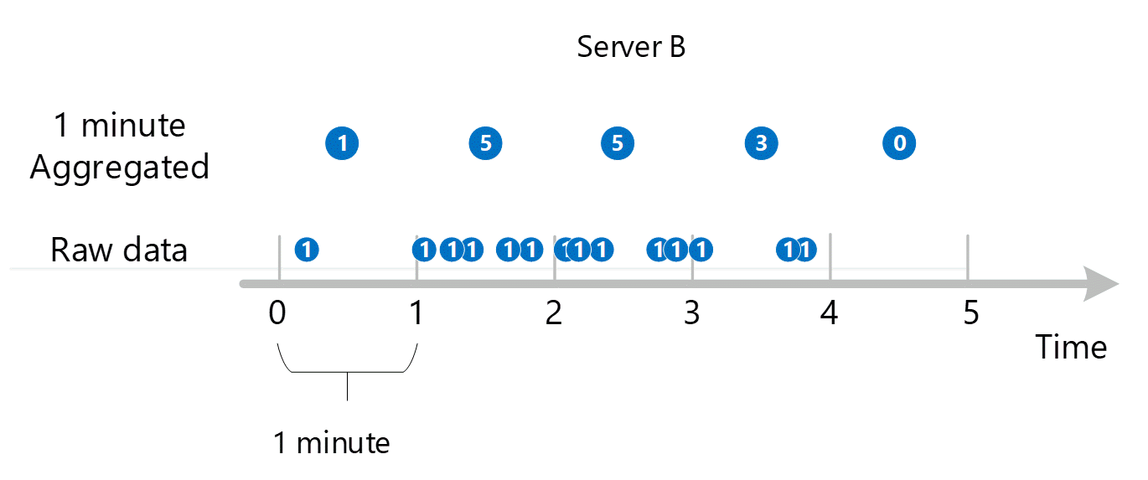
Aggregating counts within an instance

Slide 12
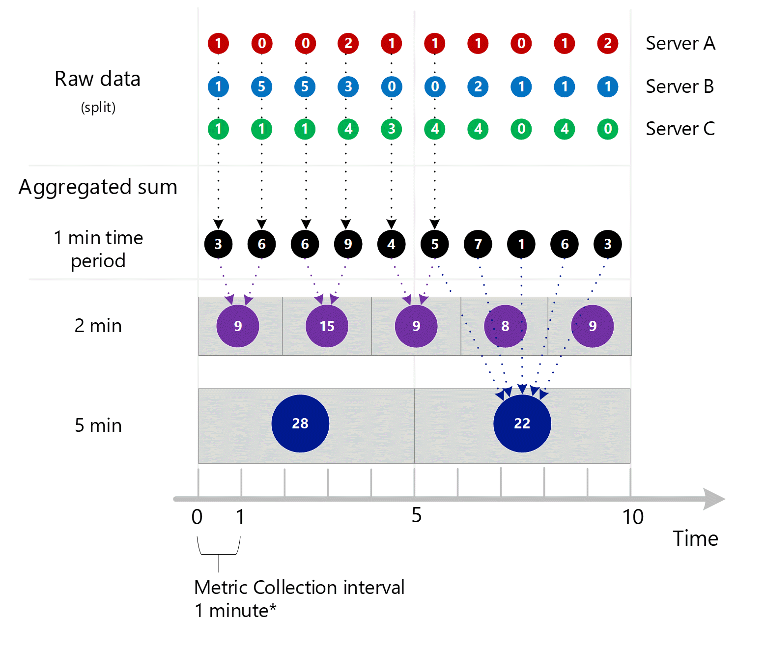
Aggregation during queries
<- In metrics db (ElasticSearch for us)
<- ElasticSearch queries aggregate across instances and minutes

Slide 13
What is the difference?
Aggregatable metrics all must:
fundamentally behave like addition:
  They combine two values of the same type
  The result is the same type
    sum(a: Sum, b: Sum): Sum
If this were not the case, how would you write this code?
// Sum must return the same type as its args,
// since total is used in both places
[1,2,3,4,5].foreach {i =>
total = sum(total,i)
}

Slide 14
What is the difference?
Aggregatable metrics all must:
have a value that ‘acts like zero’, e.g. a + 0 = a
total = 0
[1,2,3,4,5].foreach {i =>
total = sum(total,i)
}
// When maxing, -MAXINT is like zero
max = -MAXINT
[1,2,3,4,5].foreach {i =>
max = max(result,i)
}

Slide 15
What is the difference?
Aggregatable metrics all must:
not care how we partition, if we break the problem up
// given [1,2,3]
sum(sum(1,2),3)
// is the same as
sum(1,sum(2,3))
this is critical for distribution
  we don’t always partition the same way

Slide 16
What is the difference?
Aggregatable metrics all must:
not care about the order of arguments
// given [1,2,3]
sum(sum(1,2),3)
// is the same as
sum(3,sum(1,2))
this is critical for parallelization
  we don’t know which instances report first

Slide 17
What is the difference?
Aggregatable metrics all must:
fundamentally behave like addition
  a binary, closed function
    sum(a: Sum, b: Sum): Sum
    max(a: Max, b: Max): Max
  a + (b + c) = (a + b) + c
    associativity
  a + 0 = a (value that ‘acts like zero’)
    Identity element
  This gives us a monoid
  a + b = b + a
    commutativity
  This gives us a commutative monoid

Slide 18
There doesn’t seem to be a function to aggregate ‘distinct value counts’
//how could this work? add(a: DistinctCount, b: DistinctCount): DistinctCount

Slide 19
HyperLogLog is a monoid
a probabilistic data structure + algorithm
counts approximate distinct items
From wikipedia:
[...] able to estimate cardinalities of > 10^9 with a typical [...] std. error of 2%, using 1.5 kB of memory
Supported in Postgres, Redis, AWS Redshift, Databricks, BigQuery, Druid, ElasticSearch (via plugin), Presto, etc.

Slide 20
How can we count all the things without counting all the things?
― Everybody when introduced to HyperLogLog

Slide 21
Let’s dive in
How HLL works
HLL has three main operations
  add(hashedValue:Long) // O(1)
  count():Long //O(registers)
  union(a:HLL,b:HLL):HLL //O(registers)
    This is the monoid ‘+’ function
Storage grows as O(log(log(values)))
  very, very slowly

Slide 22
Let’s dive in
How HLL works
An HLL consists of a number of ‘buckets’
  tuneable for accuracy
buckets represent subsets of all values seen
incoming values are hashed to binary numbers
values ‘allocated’ to a bucket based on first few bits
each bucket holds the max number of leading zeroes observed in its values

Slide 23
Adding values
How HLL works
Using first 3 bits to determine bucket, there will be eight buckets (2^3).
Each bucket stores the maximum leading zeroes seen (MLZ)
Value Hashed/Binary
Foo → 0010111001011 → bucket 1, MLZ = 1
Bar → 0110010101110 → bucket 3, MLZ = 2
Baz → 0000001010101 → bucket 0, MLZ = 3
Buzz → 0110000111010 → bucket 3, MLZ = 4
Bucket: |0|1|2|3|4|5|6|7|8|
MLZ: |3|1|0|4|0|0|0|0|0|

Slide 24
Counting values
How HLL works
Counting values ‘averages’ the buckets:
Bucket: |0|1|2|3|4|5|6|7|8|
MLZ: |3|1|0|4|0|0|0|0|0|
Average (HM) = 3/(1/3 + 1/1 + 1/4) = 1.89
WTH? 1.89 != 4 :)
When few values have been seen, this isn’t accurate. Libraries use some other tricks to improve accuracy (see java-hll ‘promotion’).
Accuracy for us has been ~98%!

Slide 25
How HLL works
Merging HLLs
Combining two HLLs is simply taking the max of their bucket values:
Bucket: |0|1|2|3|4|5|6|7|8| HLL 1
MLZ: |3|1|0|4|0|0|0|0|0|
Bucket: |0|1|2|3|4|5|6|7|8| HLL 2
MLZ: |2|4|1|1|0|2|0|3|0|
Bucket: |0|1|2|3|4|5|6|7|8| Result
MLZ: |3|4|1|4|0|2|0|3|0|
This is very fast! It also avoids double-counting (try it!)

Slide 26
We didn’t have to implement HLL
How we added HLL metrics to
IFDS
We evaluated a few options and settled on Postgres’ HLL support + the java-hll library
Reasons for this included AWS support, team familiarity and the common storage spec used in these two.
  Also see js-hll and python-hll

Slide 27
HLLs in memory:
// Empty HLL with tuning params val gen4MachinesHLL = new HLL(11, 5)
// Add values as messages come in val hashed = hash(displaySerialNumber) gen4MachinesHLL.addRaw(hashed)
This is done every time a message comes in
new HLL(...) is the monoid ‘zero’ that we need
There is a ‘merge’ function for combining two HLLs
  This is the monoid ‘+’ function in java

Slide 28
Publishing to the metrics db:
// UPSERT Every minute insert into gen4_machines (minute_bucket, bucket_hll) values (date_trunc('minute', $bucketTime), $bucketHLL) on conflict (minute_bucket) DO UPDATE
SET bucket_hll = hll_union(gen4_machines.bucket_hll, EXCLUDED.bucket_hll);
There is a row (bucket) for each minute
We truncate the timestamp to get the minute bucket
hll_union function is the monoid `+` in SQL
Values from different instances are aggregated into the minute buckets

Slide 29
Looking in the db:
// Inside ‘gen4_machines’ metric table select * from gen4_machines limit 3; minute_bucket, bucket_hll
2021-12-21 14:02, \x148b7f088440002000001080000006008[...]
2021-12-21 14:04, \x148b7f1104420824304241a0211806208[...]
2021-12-21 14:03, \x148b7f110442048000c411a0240844208[...]
The HLL is a serialized form of the java hll
  This works because there is a shared storage specification
The HLLs here are about 2.6K each

Slide 30
Changes we made
How we added HLL metrics to
IFDS
We verified the hll extension is enabled in AWS Aurora Postgres
We created small tables to hold HLLs per minute for each metric
We changed the metrics collector to add values to the in-memory HLL
We changed the metrics publisher to add its HLL to the Postgres record for that minute
We added a grafana panel to aggregate HLL values

Slide 31
Results
How we added HLL metrics to
IFDS
We started using the HLL metrics on 12/21/21
On 4/7/22
  ~ 150K rows in each metric table
  496 MB (47 MB per month, per metric)
    Elastic search used ~1400 GB (est.)
    99.9% reduction
HLL panel in grafana is much faster
Accuracy seems around 98%

Slide 32
Now that you know HLL, meet the family
See Shawn’s gist
bloom filter: is X a member of the set?
count-min-sketch: how frequent is value X?
exponential histogram: how many times did we see value X in n-minute windows?
min hasher: how similar are two sets?
q tree: histogram of values

Slide 33


An incredible talk
Avi Bryant from stripe.com
https://www.infoq.com/presentations/abstract-algebra-analytics/

Slide 34
Resources
https://github.deere.com/v8znx3a/hyperloglog
  Has detailed instructions on how we experimented, data sets, timing results, etc.
Links to many other resources are found in the above repo.

Slide 35
Thank you!

