Slide 1
Logic: the study of truth

Slide 2
if(x && (y || !z)) {

Slide 3
Programming
Math
&&
||
!
/\
\/
~

Slide 4
/\
nd

Slide 5
/\
hhhhhhhh…

Slide 6
Propositional Logic
Notes:
The study of universal truths

Slide 7
TRUE, FALSE
Notes:
The study of universal truths

Slide 8
Exercises!
Notes:
The study of universal truths

Slide 9
Exercise 1
(x < 10) && (x > 2) && NOT (x % 5 > 3)
(x < 10) /\ (x > 2) /\ ~(x % 5 > 3)
/\ x < 10
/\ x > 2
/\ ~(x % 2 = 1)

Slide 10
Exercise 2
A \/ B \/ (C /\ D)
\/ A
\/ B
\/ /\ C
/\ D

Slide 11
Predicate Logic
Notes:
The study of universal truths

Slide 12
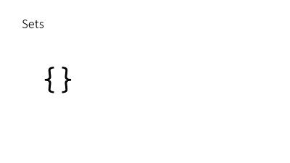

Do we need to cover sets?
Yeah
Nah

Slide 13
Does everyone
in the room
have a laptop?
∀p
∈ Room:
HasLaptop(p)
\A p \in Room: HasLaptop(p)

Slide 14
Is anyone in the room running Windows?
\E p \in Room: HasLaptop(p)

Slide 15
Who is someone in the room running Windows?
CHOOSE p \in Room: HasLaptop(p)
(Will only return one result)
Notes:
TLA+ Augments that one more construct of this form

Slide 16
Requirements
TODO
Notes:
Using these all to express requirements

Slide 17
Exercises!
Notes:
The study of universal truths

Slide 18



∈
?

Slide 19

∈
?

Slide 20
Temporal Logic
Notes:
Wanted to be able to explain how things changed

Slide 21
[]P True all the time
<>P True sometimes
[]<>P recurrently true
<>[]P settles on true
Notes:
<>"I'm asleep"
[]"I'm asleep"

Slide 22
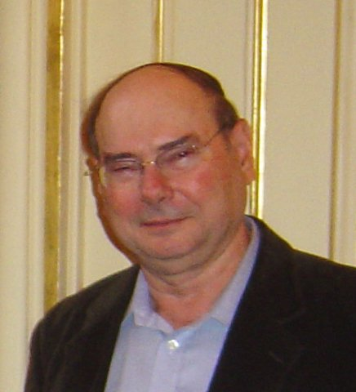
Notes:
Amir Pneuli

Slide 23
counter' = counter + 1
0000
0001

Slide 24
[] counter' = counter + 1
0000
0001
0002
0003
0004
0005
0006
0007

Slide 25
[] counter' = counter + 1 \/ counter' = 0
0000
0001
0002
0003
0004
0005
0006
0007
0000
0001
0002
0003
0004
0000
0001
0002
0000
0000
0000
0000
0000
0000
0000
[]counter >= 0?
<>counter = 5?

Slide 26
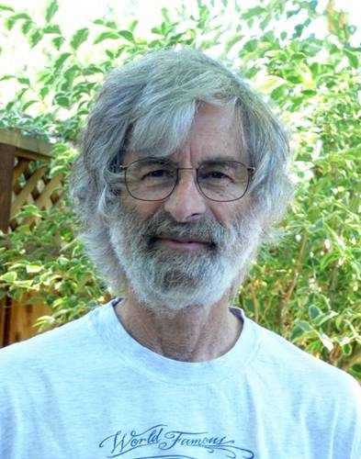

Slide 27
Sets
{}

Slide 28
{1}

Slide 29
%
{1,3}
={3,1}
={3,1,1,3}

Slide 30
{1,3}
\union{2,3}
={1,2,3}
\intersect{2,3}
={2}
\{2,3}
={1}

