Slide 1
TLA+ Workshop

Slide 2
def f(x):
y = x**2 + 1
z = y**2 + 1
return z

Slide 3
def f(x):
y = x**2 + 1
z = y**2 + 1
return z

Slide 5




Slide 6
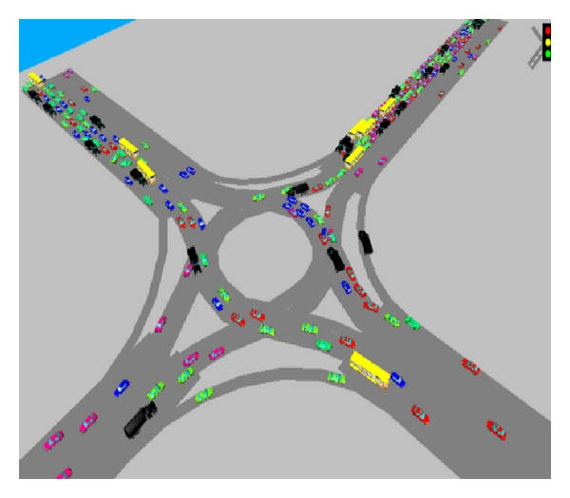
This Photo by Unknown Author is licensed under CC BY
This Photo by Unknown Author is licensed under CC BY

Slide 7
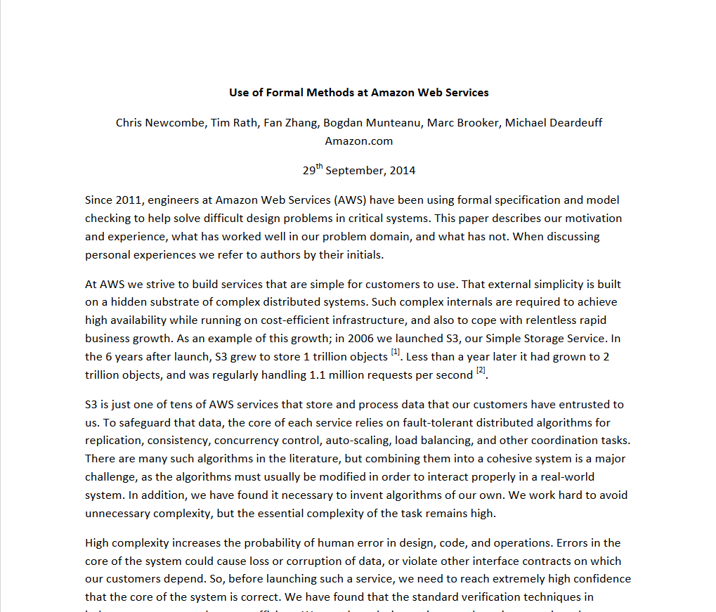

Slide 8
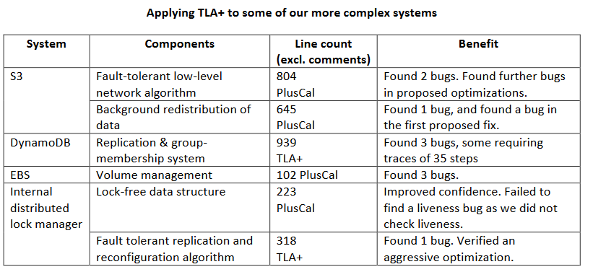

Slide 9
TLA+

Slide 10
TLA+ is hard.

Slide 11
Why TLA+ is Hard
The topic is complicated
The domain is difficult
The notation is unfamiliar
The tooling is unforgiving
Notes:
Ask them to pair up

Slide 12
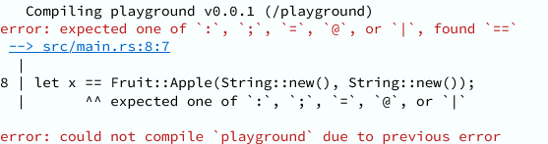


Slide 13

This Photo by Unknown Author is licensed under CC BY-SA-NC

Slide 14
Caveats
1. TLA+ is not code.

Slide 15
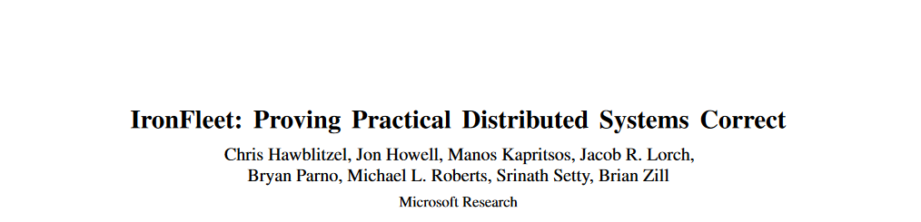
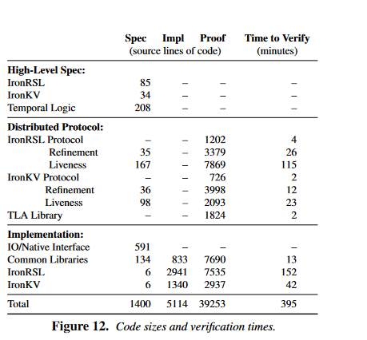

5114 lines of code
÷ 3.7 person years
= 3.8 loc/day

Slide 16
Caveats
1. TLA+ is not code.
2. TLA+ does not sync with code.

Slide 17
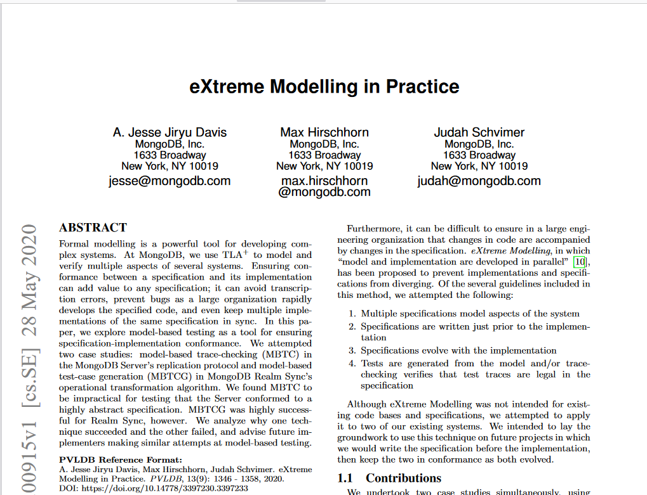

Slide 18
The Problem

Slide 19



Slide 20
Notes:
State Space: twelve different ways these people can land, each way has two paths

Slide 21



Slide 23
TLA+

Slide 24


Temporal Logic of Actions

Slide 25
Notes:
Just here to make the zoom work

Slide 26
Notes:
Click on it to switch

Slide 27
What we're going to model

Slide 28


Our First Model
Notes:
File goes here

Slide 29
{FILE} Seating__1

Slide 30
---- MODULE seating ----
EXTENDS Integers
VARIABLES sitting
vars == <<sitting>>
Sit ==
sitting' = TRUE
Stand ==
sitting' = FALSE
Init ==
/\ sitting = FALSE
Next ==
\/ Sit
\/ Stand
Spec == Init /\ [][Next]_vars
====

Slide 31
---- MODULE seating ----
EXTENDS Integers
VARIABLES sitting
vars == <<sitting>>
Sit ==
sitting' = TRUE
Stand ==
sitting' = FALSE
Init ==
/\ sitting = FALSE
Next == Sit \/ Stand
Spec == Init /\ []Next
====
Sit
Stand
Sit
Stand
Notes:
TODO write explanation of what's happening on paper

Slide 32
Sit
Stand
Sit
Stand
Notes:
Extraneous steps

Slide 33
Stand ==
/\ sitting
/\ sitting' = FALSE
Notes:
Actions are booleans

Slide 34
Stand ==
/\ sitting' = FALSE
/\ sitting

Slide 35
Swap ==
/\ x' = y
/\ y' = x
Notes:
This is a valid action

Slide 36
{FILE} Seating__2

Slide 37
Sit
Stand
Sit
Stand
Notes:
Removing extraneous steps causes problem

Slide 38


0
2
4
6
8
10
12
Notes:
Real world has a time scale, changing the scale breaks our spec, that's bad

Slide 39
Stuttering
A "stutter" should ALWAYS be valid.
This is called "stutter-invariance"
Next \/ UNCHANGED Vars
Spec == Init /\ []
[Next]_vars
Notes:
Definition of stutter step, all specs need to be stutter-invariant, box-action notation

Slide 40
Sit
Stutter
Stutter
Stand
Notes:
[Take a break after this]

Slide 41

Adding People
Notes:
This is going to take several steps. First, two people, then

Slide 42
Notes:
1: Just bob can stand and sit
2. Then alice can

Slide 43
Notes:
This is going to take several steps. First, two people, then

Slide 45
{FILE} Seating__3-4
Notes:
TODO do I need to explain sets more?

Slide 46
Next ==
\E p \in Person:
\/ Sit(p)
\/ Stand(p)

Slide 47
Next ==
\E p \in {"Bob", "Alice"}:
\/ Sit(p)
\/ Stand(p)
\/ Stand(A)
\/ Sit(B)
Notes:
Click green square to move it
N N G NG G G N N

Slide 48
{FILE} Seating__5

Slide 49
Notes:
We'll add a chair counter

Slide 50
Invariant
A statement checked on EVERY state

Slide 51
{FILE} Seating__6

Slide 52
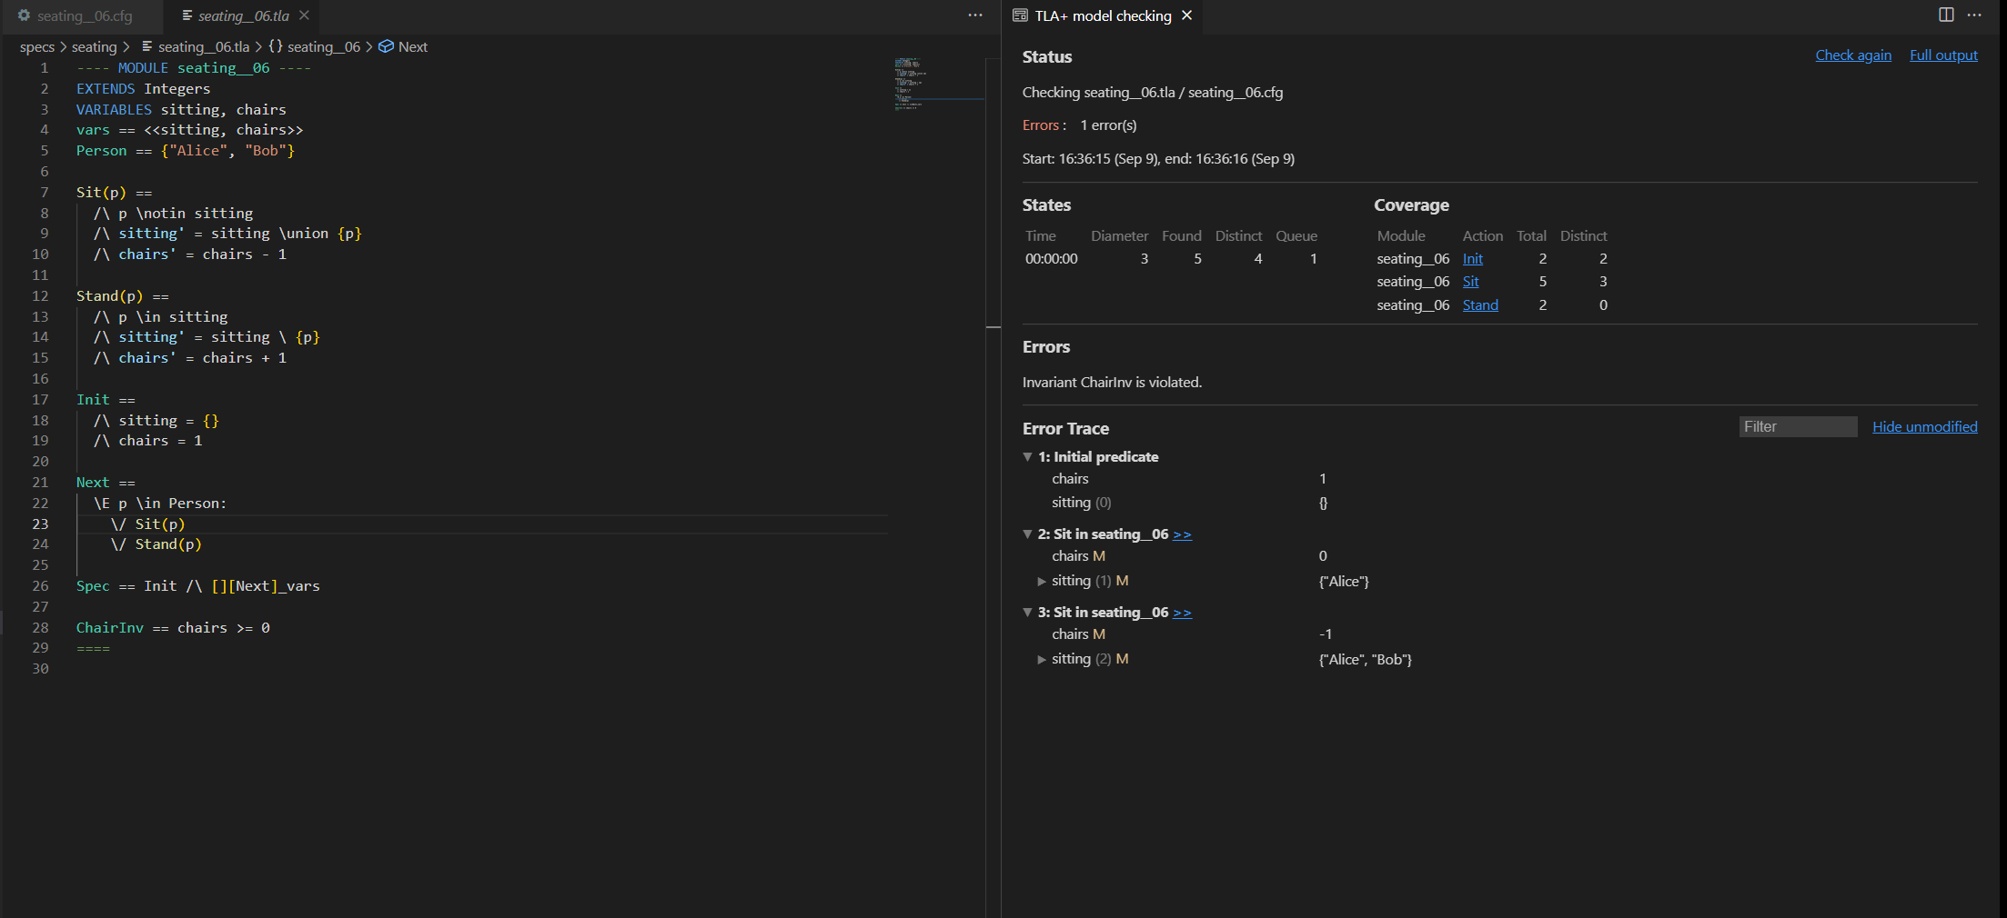

Slide 53
{FILE} Seating__7

Slide 54
Notes:
We've built this system, but why do we care? Let's switch to something more useful.

Slide 55



Slide 56
{FILE} Threads__1
Notes:
TODO do I need to explain sets more?

Slide 57



Slide 58
{
has_token: bool
times_ran: int
}
Notes:
Now let's say we don't just care about whether the thread has the token, but how many times it acquired the token, too.

Slide 59
0
has_token
This is silly
1
2
Notes:
And then of course we'd have to add an invariant saying that the same thread can't be in two different sets at once and has to be in at least one set

Slide 60
{x:x*2 for x in {2,3,4}}
[x \in {2,3,4} |-> x*2]
{2: 4,
3: 6,
4: 8}
2 :> 4 @@
3 :> 6 @@
4 :> 8
Notes:
Explaining functions. Python map.
Click top for python version, etc

Slide 61
{FILE} Threads__1.5
Notes:
TODO do I need to explain sets more?

Slide 62
0
1
0
0
tr
tr'
tr[1]' = tr[1] + 1

Slide 63


tr[1]' = tr[1] + 1
0
1
0
0
1
-26
1
a
0
🔪
Notes:
This describes the transition 1 0, but also 0 -26 and 1 0 a knife

Slide 64

tr[1]' = tr[1] + 1
tr' = [tr EXCEPT ![1] = tr[1] + 1]
@ + 1]
Notes:
We actually have to write… drumroll, this. Yes, it's stupid

Slide 65
{FILE} Threads__2
Notes:
TODO do I need to explain sets more?

Slide 66
GetToken(t) ==
/\ t \notin has_token
/\ tokens > 0
/\ times_ran[t] < 3
/\ has_token' = has_token \union {t}
/\ tokens' = tokens – 1
/\ UNCHANGED times_ran
has_token
times_ran
has_token
times_ran
0
972
GetToken(1)
0
0
abc
0
Notes:
Next states must be fully described

Slide 67
{FILE} Threads__3
Notes:
TODO do I need to explain sets more?

Slide 68


GetToken(t) ==
/\ t \notin has_token
/\ tokens > 0
/\ times_ran[t] < 3
/\ has_token' = has_token \union {t}
/\ tokens' = tokens - 1
ReleaseToken(t) ==
/\ t \in has_token
/\ has_token' = has_token \ {t}
/\ tokens' = tokens + 1
/\ times_ran' = [times_ran EXCEPT ![t] = times_ran[t] + 1]
Next ==
\E t \in Threads:
\/ GetToken(t)
\/ ReleaseToken(t)
3
3
has_token
~ENABLED Next

Slide 69
{FILE} Threads__4
Notes:
TODO do I need to explain sets more?

Slide 71
Notes:
What's even the todo?

Slide 72



Notes:
Back to chairs
Multiple people and multiple chairs

Slide 73


Notes:
Two people can't sit in the same chair

Slide 74
{FILE} Seating__8?
Notes:
TODO do I need to explain sets more?

Slide 75
New Invariant
TypeInv ==
\A p \in Person:
sitting_in[p] \in
Chairs \union {0}
Notes:
Extra credit, can we add a type invariant for the threads spec?

Slide 76
ChairInv ==
\A p1, p2 \in Person:
sitting_in[p1] #
sitting_in[p2]

Slide 77
ChairInv ==
\A p1, p2 \in Person:
sitting_in[p1] # sitting_in[p2]
sitting_in[p2] = 0
sitting_in[p1] = 0

Slide 78
ChairInv ==
\A p1, p2 \in Person:
sitting_in[p1] # sitting_in[p2]
\/ sitting_in[p1] = 0
Why not sitting_in[p2] = 0?

Slide 79
ChairInv ==
\A p1, p2 \in Person:
sitting_in[p1] # sitting_in[p2]
\/ ~(sitting_in[p1] # 0)

Slide 80
Implication
A => B ≡ ~A \/ B

Slide 81
~(sitting_in[p1] # 0)
\/
sitting_in[p1] # sitting_in[p2]

Slide 82
sitting_in[p1] # 0
=>
sitting_in[p1] # sitting_in[p2]

Slide 83
IsPrime(x) ==
\A m, n \in 2..x:
m*n # x
ChairInv ==
\A p1, p2 \in Person:
sitting_in[p1] # 0
=> sitting_in[p1] # sitting_in[p2]
sitting_in[p2] = 1
sitting_in[p1] = 1

Slide 84
IsPrime(x) ==
\A m, n \in 2..x:
m*n # x
ChairInv ==
\A p1, p2 \in Person:
sitting_in[p1] # 0
=> sitting_in[p1] # sitting_in[p2]
sitting_in[p2] = 1
sitting_in[p1] = 1
Notes:
9 isn't prime, because m=n=3

Slide 85
IsPrime(x) ==
\A m, n \in 2..x:
m*n # x
ChairInv ==
\A p1, p2 \in Person:
sitting_in[p1] # 0
=> sitting_in[p1] # sitting_in[p2]
sitting_in[p2] = 1
sitting_in[p1] = 1

Slide 86
ChairInv ==
\A p1, p2 \in Person:
/\ sitting_in[p1] # 0
/\ p1 # p2
=> sitting_in[p1] # sitting_in[p2]
sitting_in[p2] = 1
sitting_in[p1] = 1

Slide 87
What's left?
A Lot.
Notes:
We only scratched the surface of a small amount of TLA+

Slide 88
What's left?
Liveness and Fairness
Action properties
LET-IN
Recursive Operators
Pluscal
CONSTANTS
Sequences and Structures
Fairness
The Standard Library

Slide 89
Further Reading
www.learntla.com
Specifying systems

Slide 90
Hire me lol
I do corporate workshops
3 day workshops
And maybe 1 day if this one worked out well
Talk to me!

Slide 91
Fast examples!
CONSTANTS
Liveness and Fairness
Refinement

Slide 92
Constants

Slide 93
Refinement

Slide 95





