Slide 1
Analysis of the Impact of Economic Status on Nutrient Deficiency and Related Chronic Diseases
By Bradley Hepburn, Mololuwa Fatoki, and Abigail Janvier

Slide 2
Background
Nutrient Deficiency
Defined as an inadequate supply of essential nutrients such as vitamins and minerals in the diet resulting in malnutrition or disease
Related Diseases
Anemia
Certain cancers
Prostate
Breast
Colorectal
Thyroid
Osteoporosis
Causes
Poor diet/ food scarcity
Insufficient nutrient absorption in the body
Most affected regions
Sub-Saharan Africa
South Asia

Slide 3
Objective
To understand the role economic status plays in the prevalence of nutrient deficiency, our project seeks to analyze the relationship between economic status and the presence of nutrient deficiency and related chronic diseases on three separate scales.
Global
National – United States of America
Local – Greater Houston Area

Slide 4
Hypothesis
There will be an increase in the prevalence of nutrient deficiency and related chronic diseases as the median income value decreases per country, state, and zip code in Houston.

Slide 5
Median Income v. Nutritional Deficiency
Distribution of median income converted to USD per country
Sub–Saharan Africa, Southern Asia, some of Eastern Europe, and the Pacific Islands
Median income from less than $10,000 to $20,000 a year
Low presence of undernourishment (high in India)
South America, Northern Asia, and some parts of Western Europe
Median income ranging around $30,000 to $45,000 a year
Negligible presence of undernourishment except Brazil
Australia, Canada, Northern Europe
Median income ranging around $50,000 to $80,000 a year
Negligible presence of undernourishment

Slide 6
Undernourishment and Cardiovascular Disease
Geographical data displays a low distribution of cardiovascular disease globally
Eastern Europe and Russia present a high rate of cardiovascular disease
Statistical analysis shows a negative correlation between cardiovascular disease and undernourishment
Pearson coefficient of -0.28 demonstrates a weak negative relationship

Slide 7
Cardiovascular Disease v Income
Geographical data displays a high distribution of cardiovascular disease nationally
Eastern and Southern states present more cases of cardiovascular disease
Statistical analysis shows a negative correlation between cardiovascular disease and median household income
Pearson coefficient of -0.09 demonstrates a weak negative relationship

Slide 8
Diabetes v. Undernourishment
Geographical data displays a low distribution of diabetes globally
Asian countries (China and India) present more cases of diabetes
Statistical analysis shows a negative correlation between diabetes and prevalence of undernourishment
Pearson coefficient of -0.09 demonstrates a weak negative relationship

Slide 9
Diabetes v. Income
Geographical data displays a relatively high distribution of diabetes nationally
Southern states present more cases of diabetes
Statistical analysis shows a negative correlation between diabetes and median household income
Pearson coefficient of -0.16 demonstrates a weak negative relationship

Slide 10
Question 1
Does economic status significantly impact the prevalence of nutrient deficiency and related chronic diseases in a population?
Negative linear regression
Pearson Coefficient -0.33
Limitations
Too many variables
Limited data resources
Outliers

Slide 11
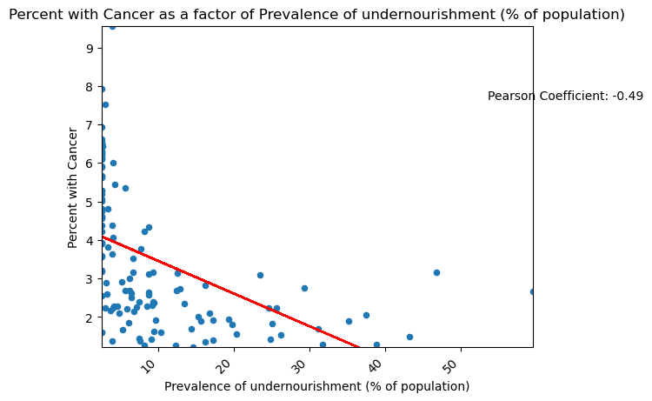
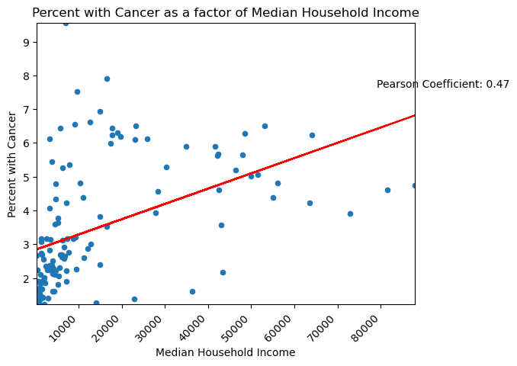
Question 2
Do more affluent areas experience less cases of nutrient deficiency related diseases than impoverished communities?
No correlation found between cardiovascular disease and diabetes and nutrient deficiency
Negative relationship between the prevalence of disease and median household income
Limitations
Collected data did not relate to nutrient deficiency
Couldn’t find data in proper format for analysis

Slide 12
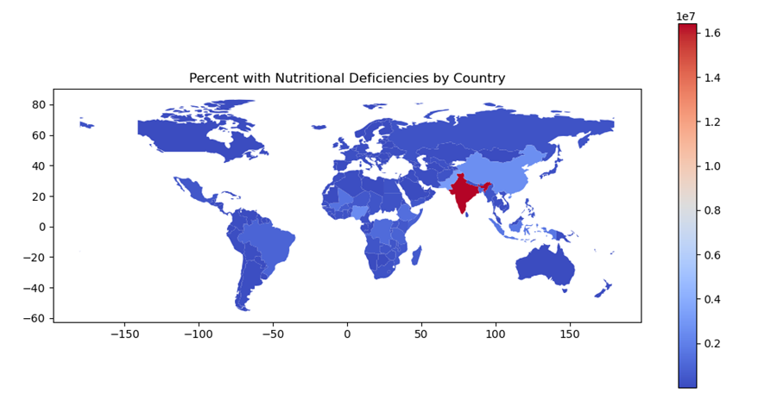
Question 3
What is the economic status of the regions most affected by nutrient deficiency and its related chronic diseases?
Southern Asia
India
China
Economic Status
$10,000 - $20,000
Limitations
Data doesn’t account for disparities between income brackets within countries

Slide 13
Conclusion
Hypothesis was partially correct due to limitations in data resources that would have allowed analysis of Houston area
Correlations were weak to moderate at best due to a host of variables not included in the scope of this study
Cardiovascular disease and diabetes presented a negative correlation to median household income

