Slide 1
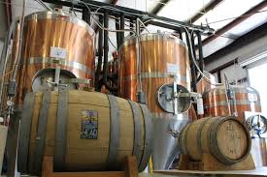
Anheuser-BusCh Market analysis
Holmes and Schwan

Slide 2

Brewer and beer style forecast
Our mission is to analyze Anheuser-Busch’s competition
OPTIMAL opportunities in the craft beer market
Notes:
Thank you
In this short 5 minutes we will show you the results of our mission to analyze Anheuser-Busch completion
Look for optimal opportunities for you in the craft beer market.

Slide 3
Agenda
What and how did we produce this market analysis?
What is your competition?
What kind of beer are they producing?
What issue did we find in your data?
What style and where are your competitors producing beers?
What states does the ABV and IBU matter?
What ABV metrics are available?
What is the relationship between the ABV and IBU values?
What conclusion have we come to?
What can be done in future market analysis with the right data?
Notes:
We will quickly go over these questions asked by your companies data analyst

Slide 4

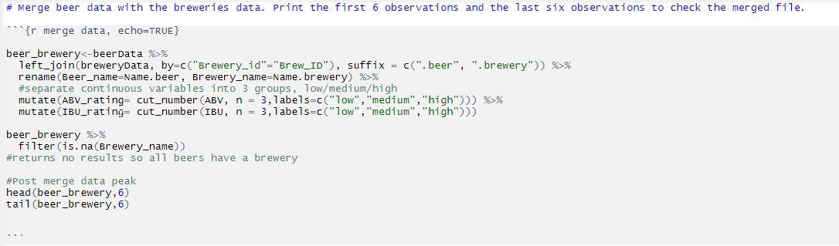
Market statistics tools
R Language used by the majority of data scientist

Slide 5
States With the Most Breweries
State | Number_of_breweries
CO | 47
CA | 39
MI | 32
OR | 29
TX | 28
Notes:
Most in CO and CA

Slide 6
First Breweries Combined Beer
Beer_name | Beer_ID | ABV | IBU | Brewery_id | Style | Ounces | Brewery_name | City | State | ABV_rating | IBU_rating
Pub Beer | 1436 | 0.050 | NA | 409 | American Pale Lager | 12 | 10 Barrel Brewing Company | Bend | OR | low | NA
Devil's Cup | 2265 | 0.066 | NA | 178 | American Pale Ale (APA) | 12 | 18th Street Brewery | Gary | IN | high | NA
Rise of the Phoenix | 2264 | 0.071 | NA | 178 | American IPA | 12 | 18th Street Brewery | Gary | IN | high | NA
Sinister | 2263 | 0.090 | NA | 178 | American Double / Imperial IPA | 12 | 18th Street Brewery | Gary | IN | high | NA
Sex and Candy | 2262 | 0.075 | NA | 178 | American IPA | 12 | 18th Street Brewery | Gary | IN | high | NA
Black Exodus | 2261 | 0.077 | NA | 178 | Oatmeal Stout | 12 | 18th Street Brewery | Gary | IN | high | NA

Slide 7
What Data Was Missing?
ABV > 2.57% IBU > 41.7% Style > 0.21%
Notes:
There was missing data in the files that we were given. The highest percentage missing is the bitterness IBU which makes sense since the US has just started getting into more bitter beers.

Slide 8
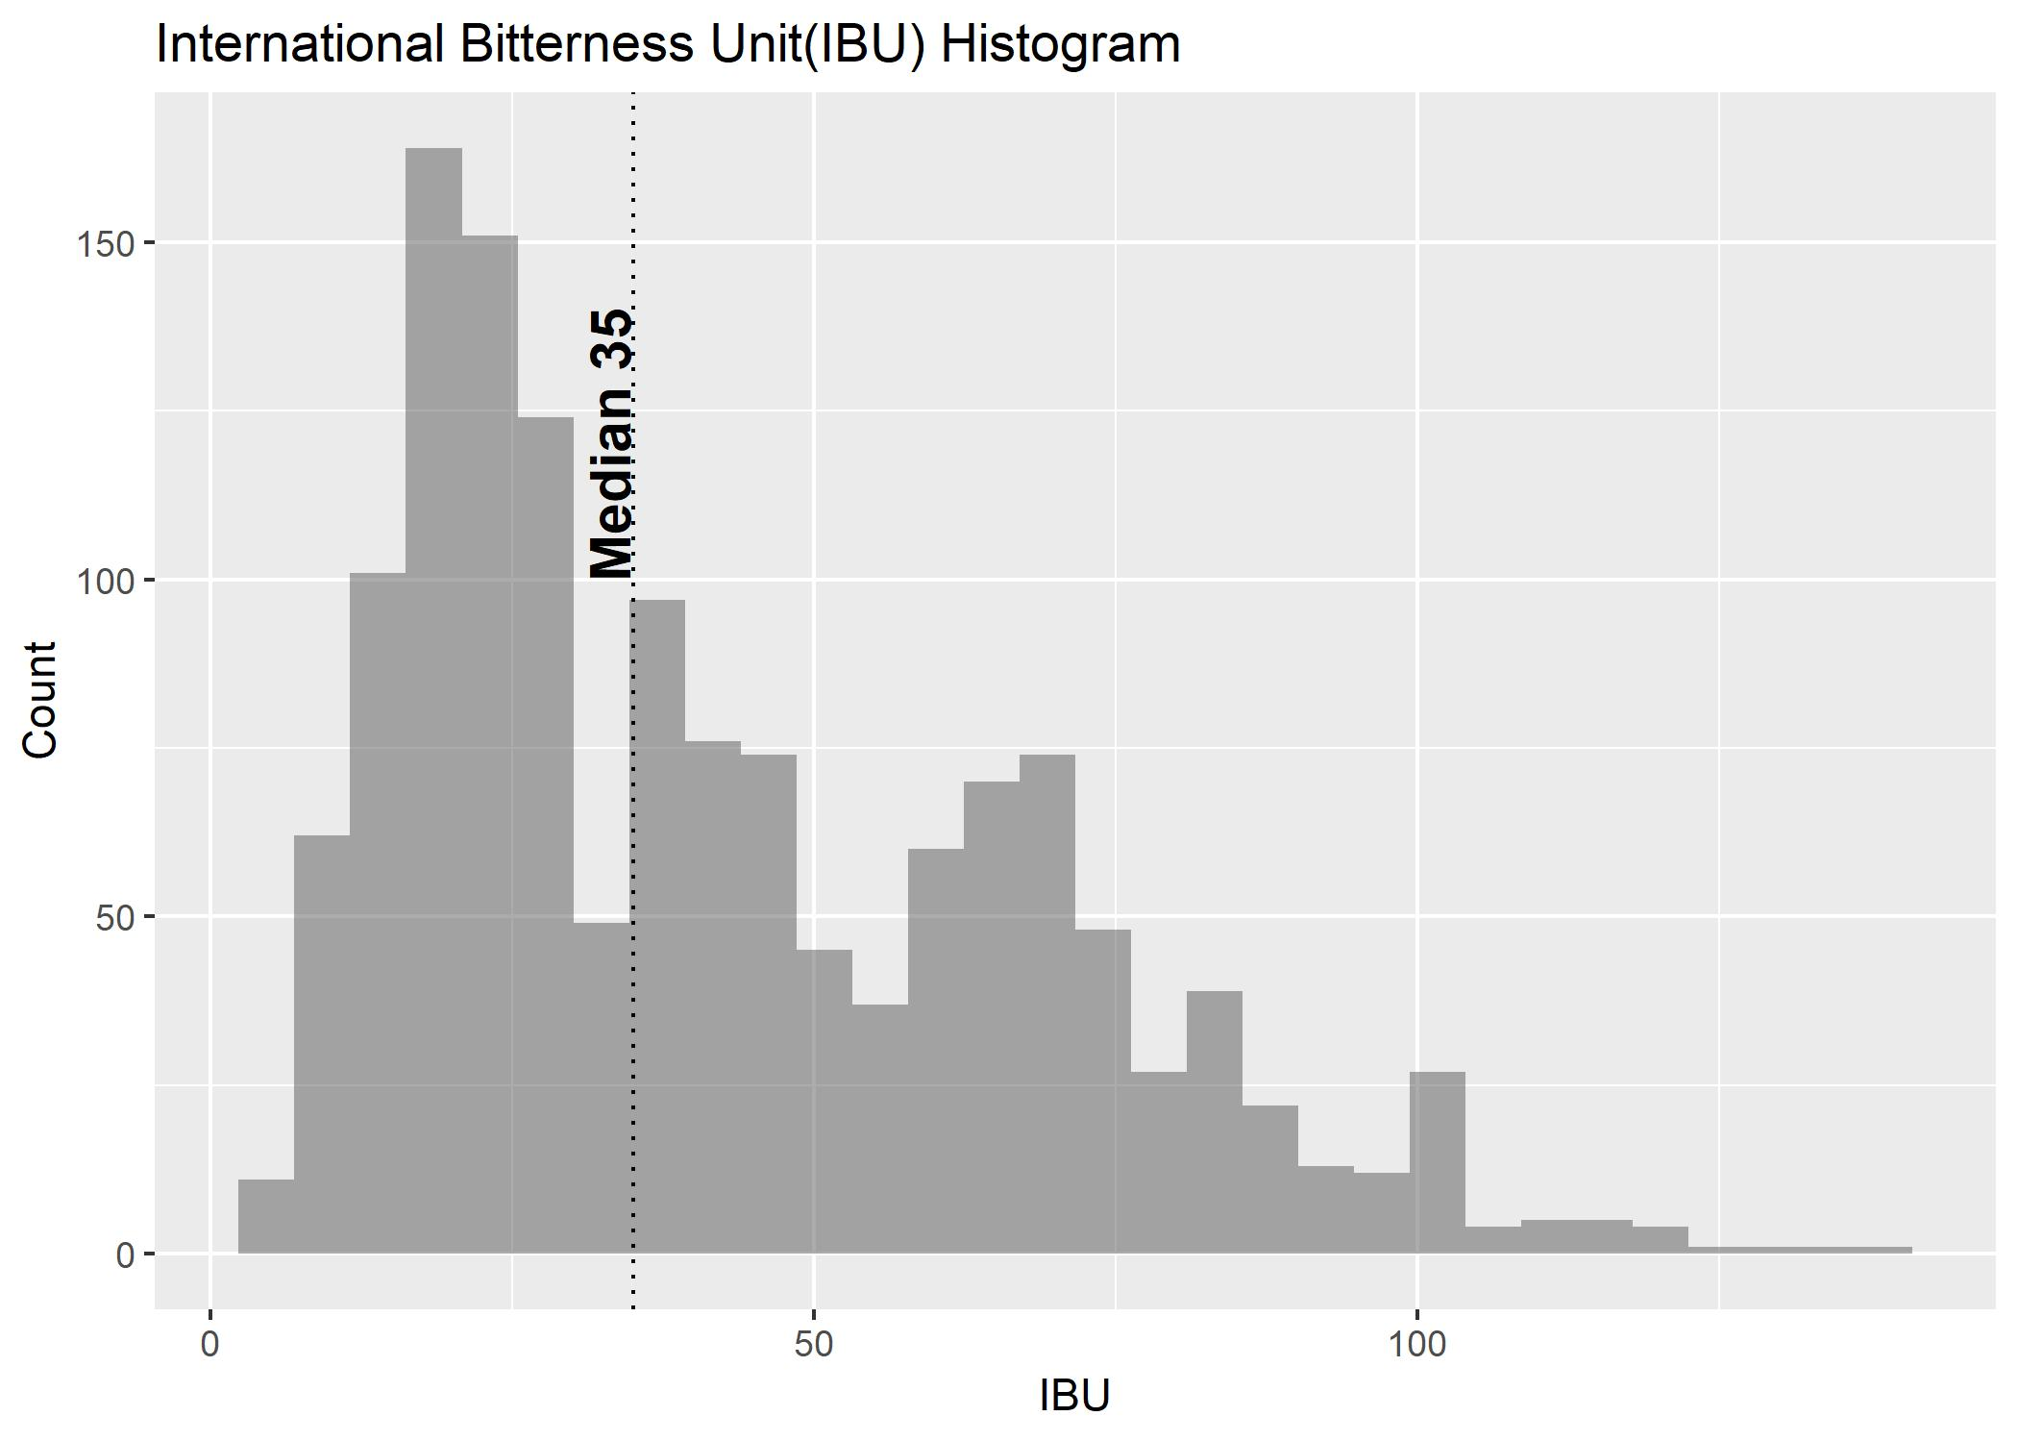
Bitterness by Volume

Slide 9
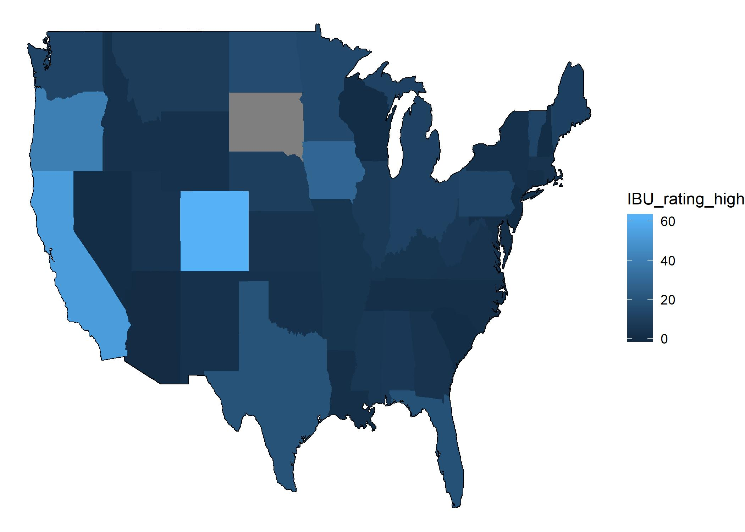
States IBU High
Notes:
Now in focus on the states with the high bitterness manufacturing Co and Ca stand out again.

Slide 10
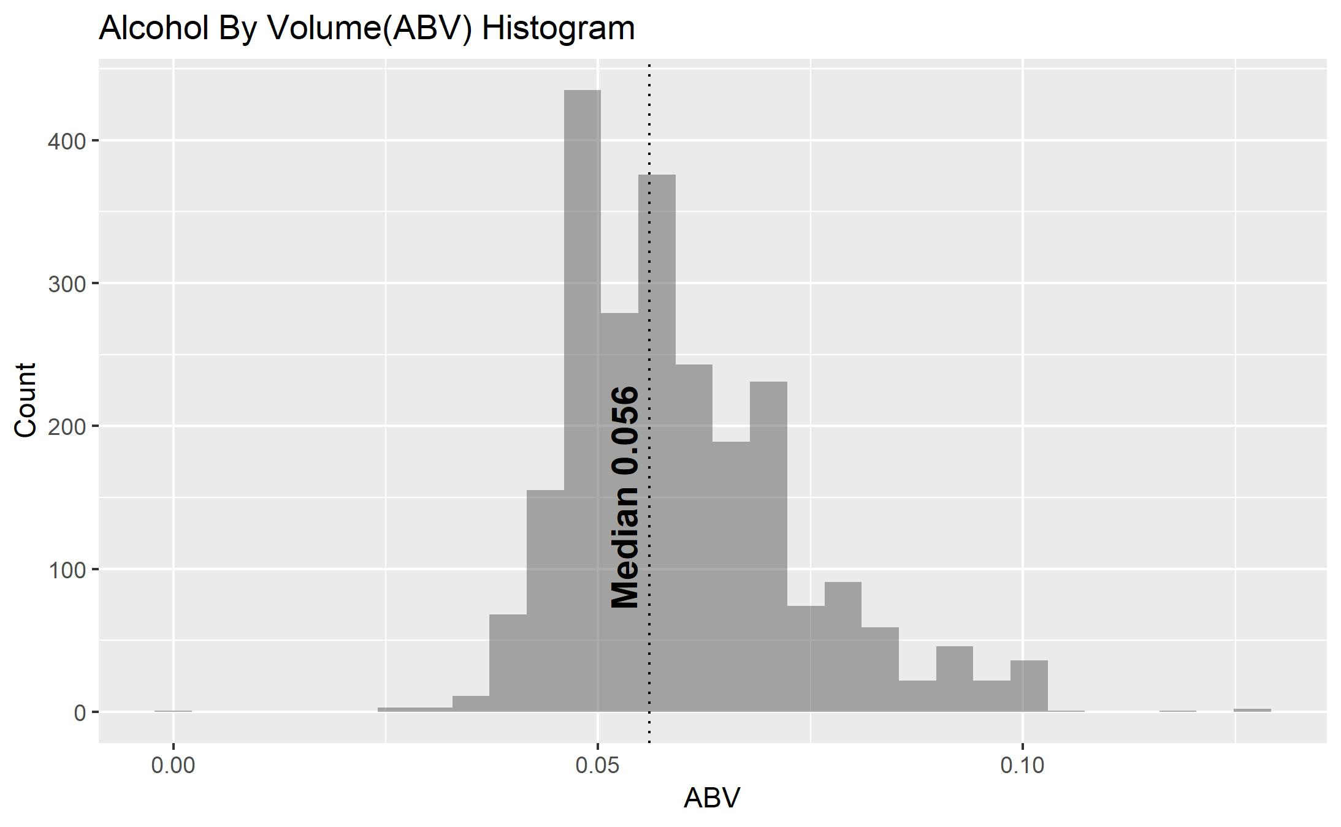
Alcohol by Volume

Slide 11
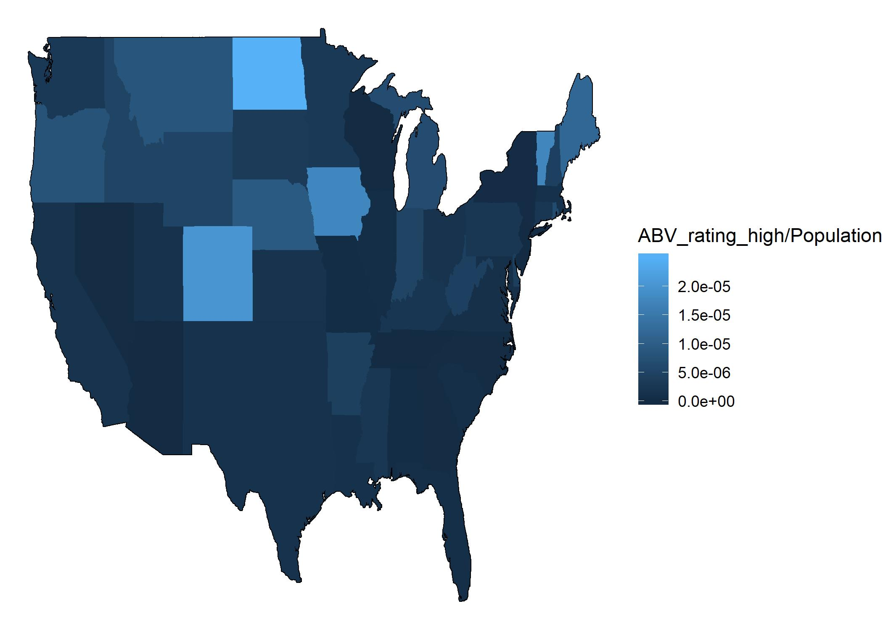
States ABV High
Notes:
Notice in this map that CA alcohol production per population in extremely low for its population.

Slide 12
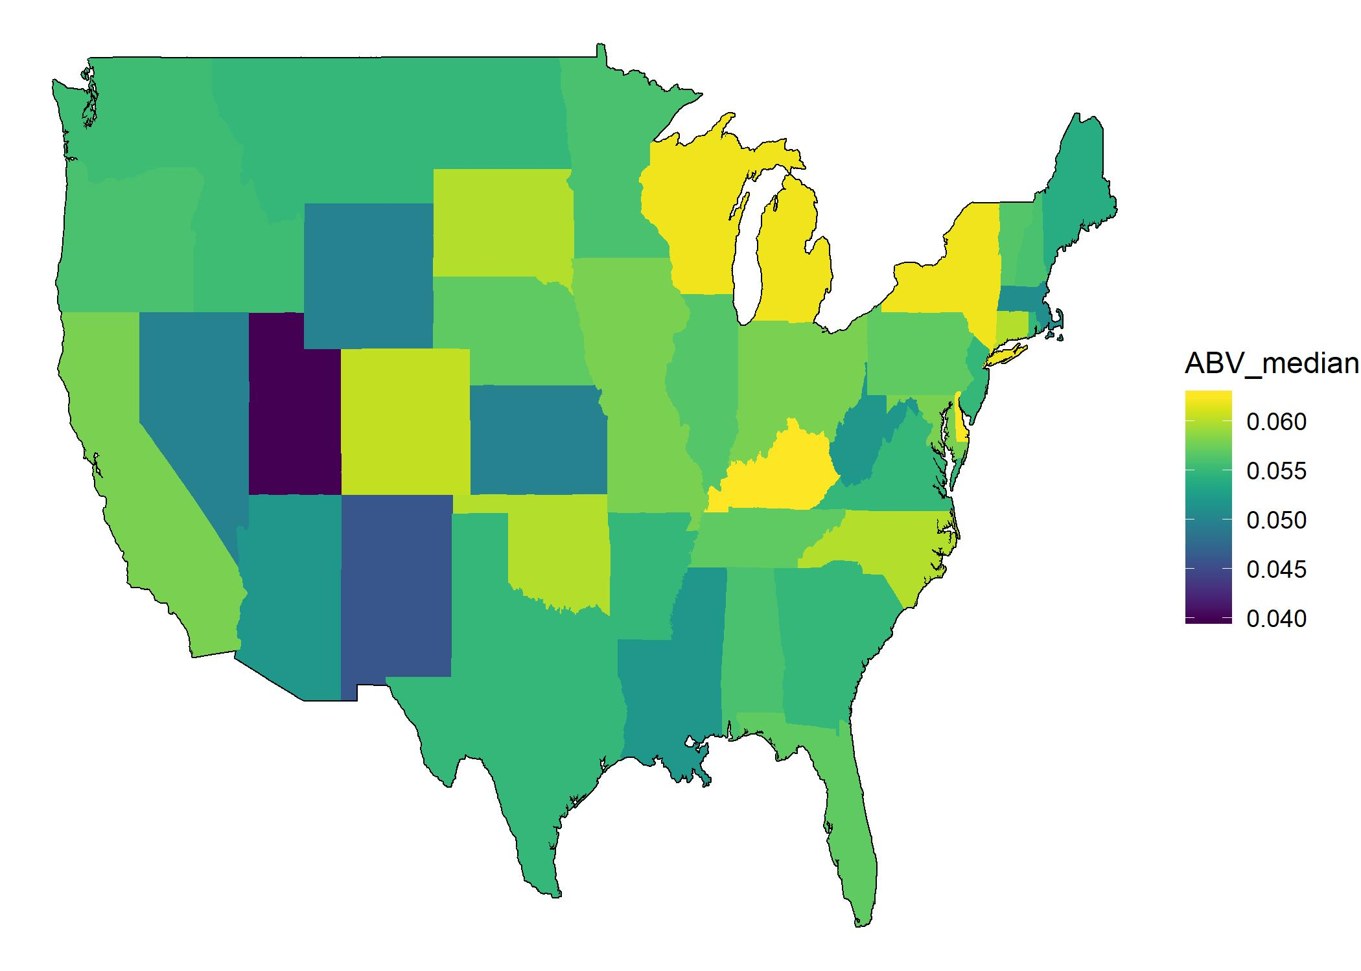
States ABV Ratings
Notes:
Now if we look just at the median of the ABV values for the producers in CA we will notice that they actually above the .055

Slide 13
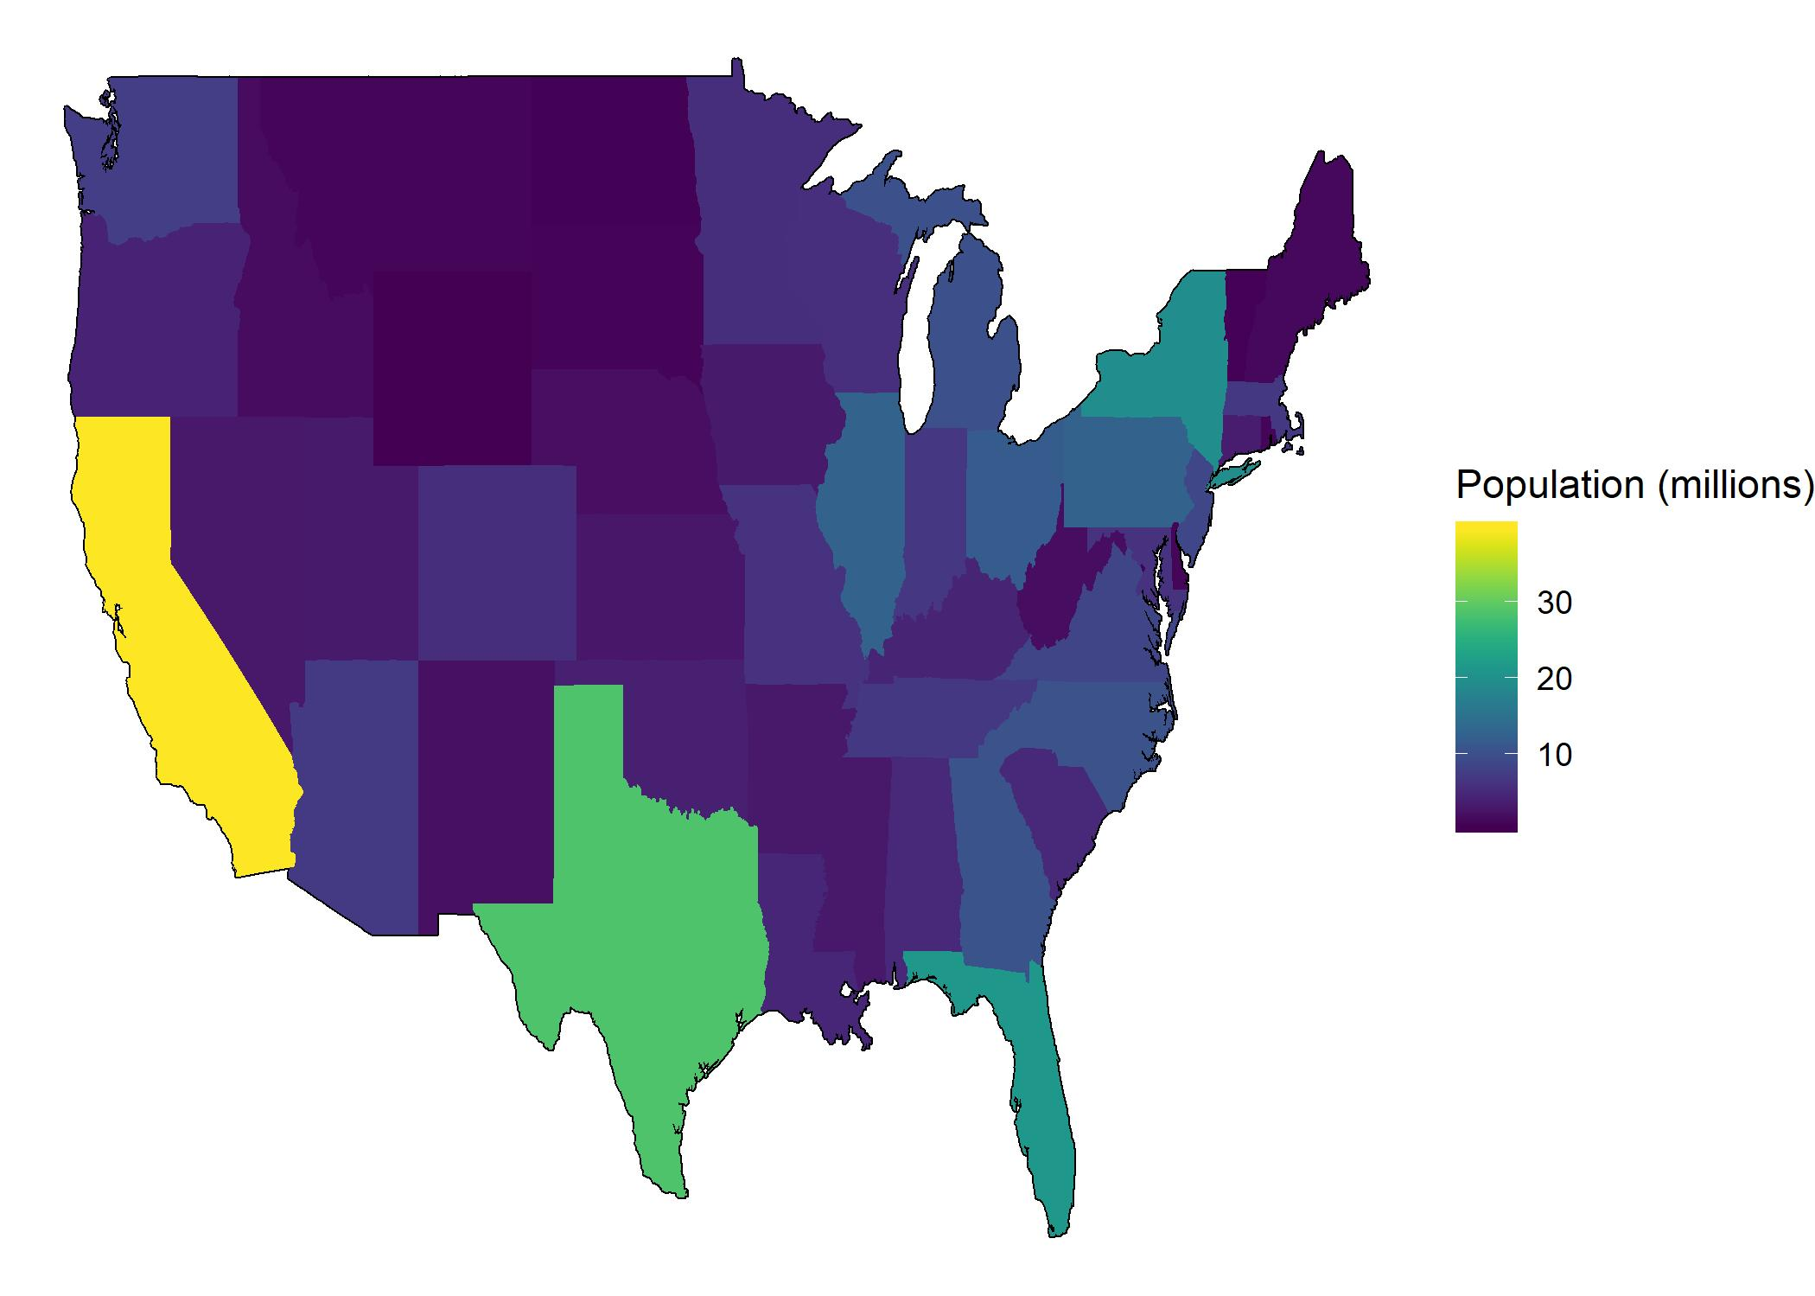
States Population

Slide 14
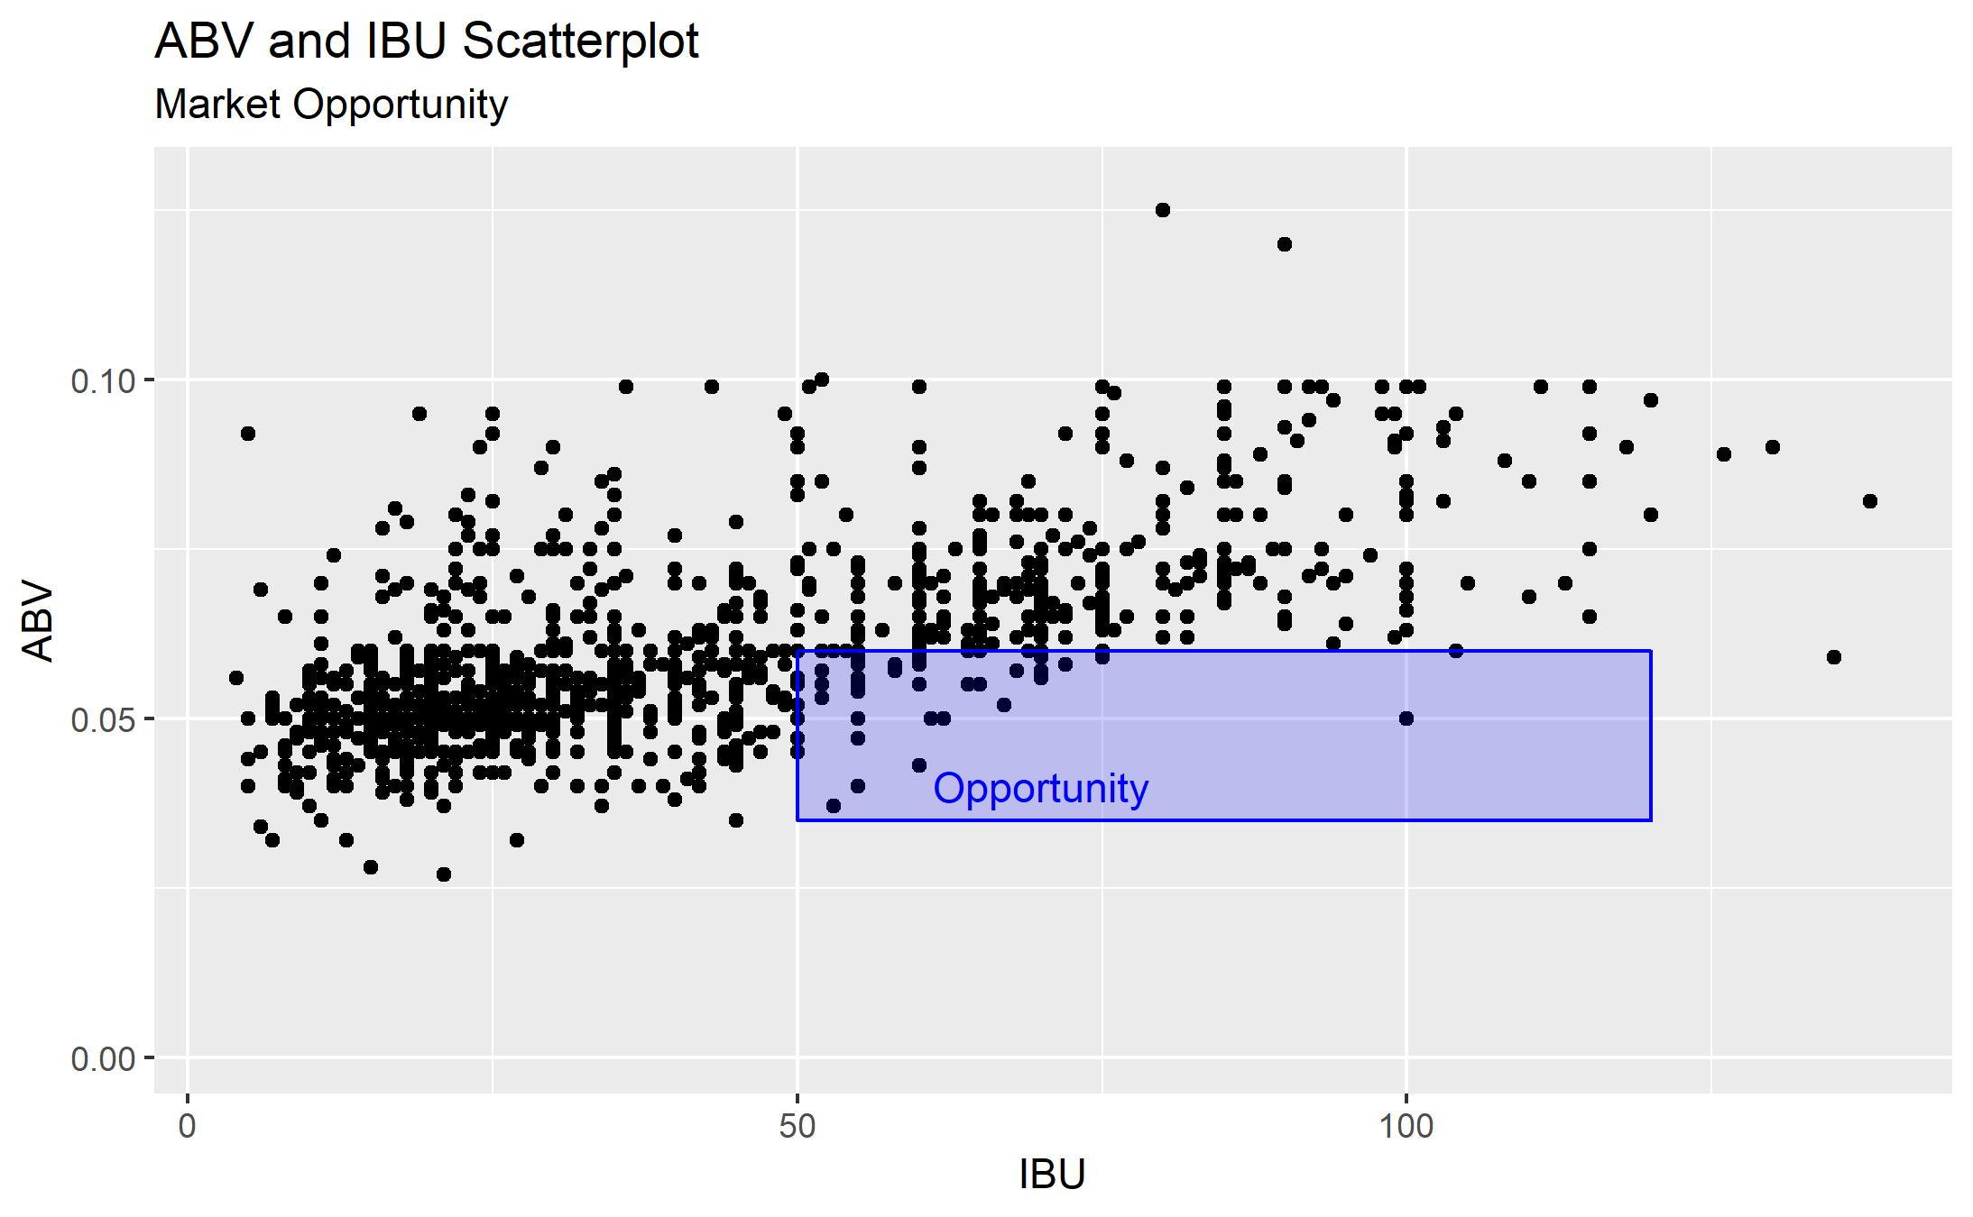
Relationship Between ABV and IBU

Slide 15
Summary and opportunities
Next Steps
California and Colorado are the most active brewery states
Brewing styles are trending towards higher bitterness
Populations are trending towards higher bitterness and lower alcohol
OPPORTUNITY
Capture the High Bitterness
Low Alcohol Market in California
Next Step: Research and Analysis of the California Market

Slide 16
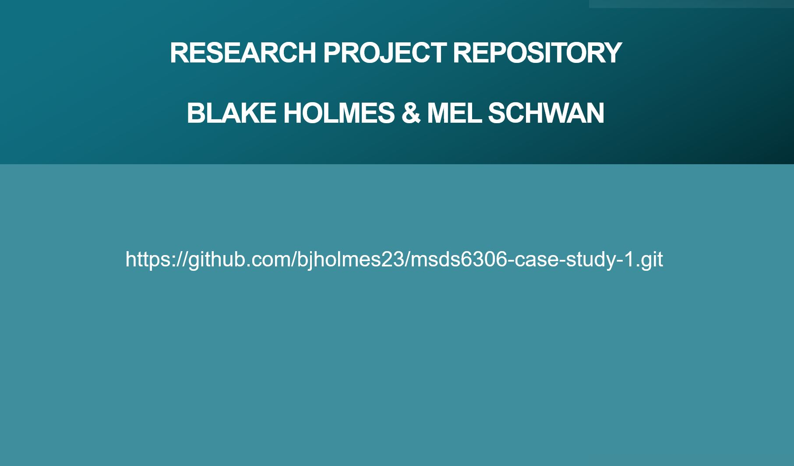

Slide 17

Thank You
Mel Schwan
Data Analyst
mschwan@smu.edu
1-949-584-6588

