Slide 1
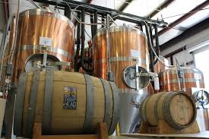
Anheuser-BusCh Market analysis
Blake Holmes and Mel Schwan

Slide 2

Brewer and beer Data Analysis
Our mission is to analyze Anheuser-Busch’s brewery and beers looking for opportunities in the craft beer market

Slide 3
Agenda
What kinds of beer are being produced?
Where are the beers being produced?
What is the relationship between the ABV and IBU values?
What market opportunities should be explored?
What can be done in future market analysis with the right data?

