Slide 1
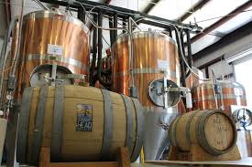
Anheuser-BusCh Market analysis
Blake Holmes and Mel Schwan

Slide 2

Brewer and beer Data Analysis
Our mission is to analyze Anheuser-Busch’s brewery and beers looking for opportunities in the craft beer market

Slide 3
Agenda
What kinds of beer are being produced?
Where are the beers being produced?
What is the relationship between the ABV and IBU values?
What market opportunities should be explored?
What can be done in future market analysis with the right data?

Slide 4
States With the Most Breweries
State name | Number of breweries | Number of beers | Number of styles
Colorado | 46 | 265 | 61
California | 39 | 183 | 46
Michigan | 32 | 162 | 46
Oregon | 29 | 125 | 29
Texas | 28 | 130 | 46
Pennsylvania | 24 | 100 | 42
Maine | 23 | 82 | 33
Washington | 23 | 68 | 23
Iowa | 22 | 139 | 47
Nebraska | 19 | 59 | 25

Slide 5
States With the Least Breweries
State name | Number of breweries | Number of beers | Number of styles
New Mexico | 3 | 8 | 6
Tennessee | 3 | 6 | 5
Arizona | 2 | 5 | 5
District of Columbia | 2 | 2 | 2
Missouri | 2 | 11 | 8
North Carolina | 2 | 11 | 10
Delaware | 1 | 8 | 8
Nevada | 1 | 3 | 3
South Dakota | 1 | 7 | 7
Wisconsin | 1 | 2 | 2

Slide 6
What Data Was Missing?
ABV > 2.57% IBU > 41.7% Style > 0.21%

Slide 7
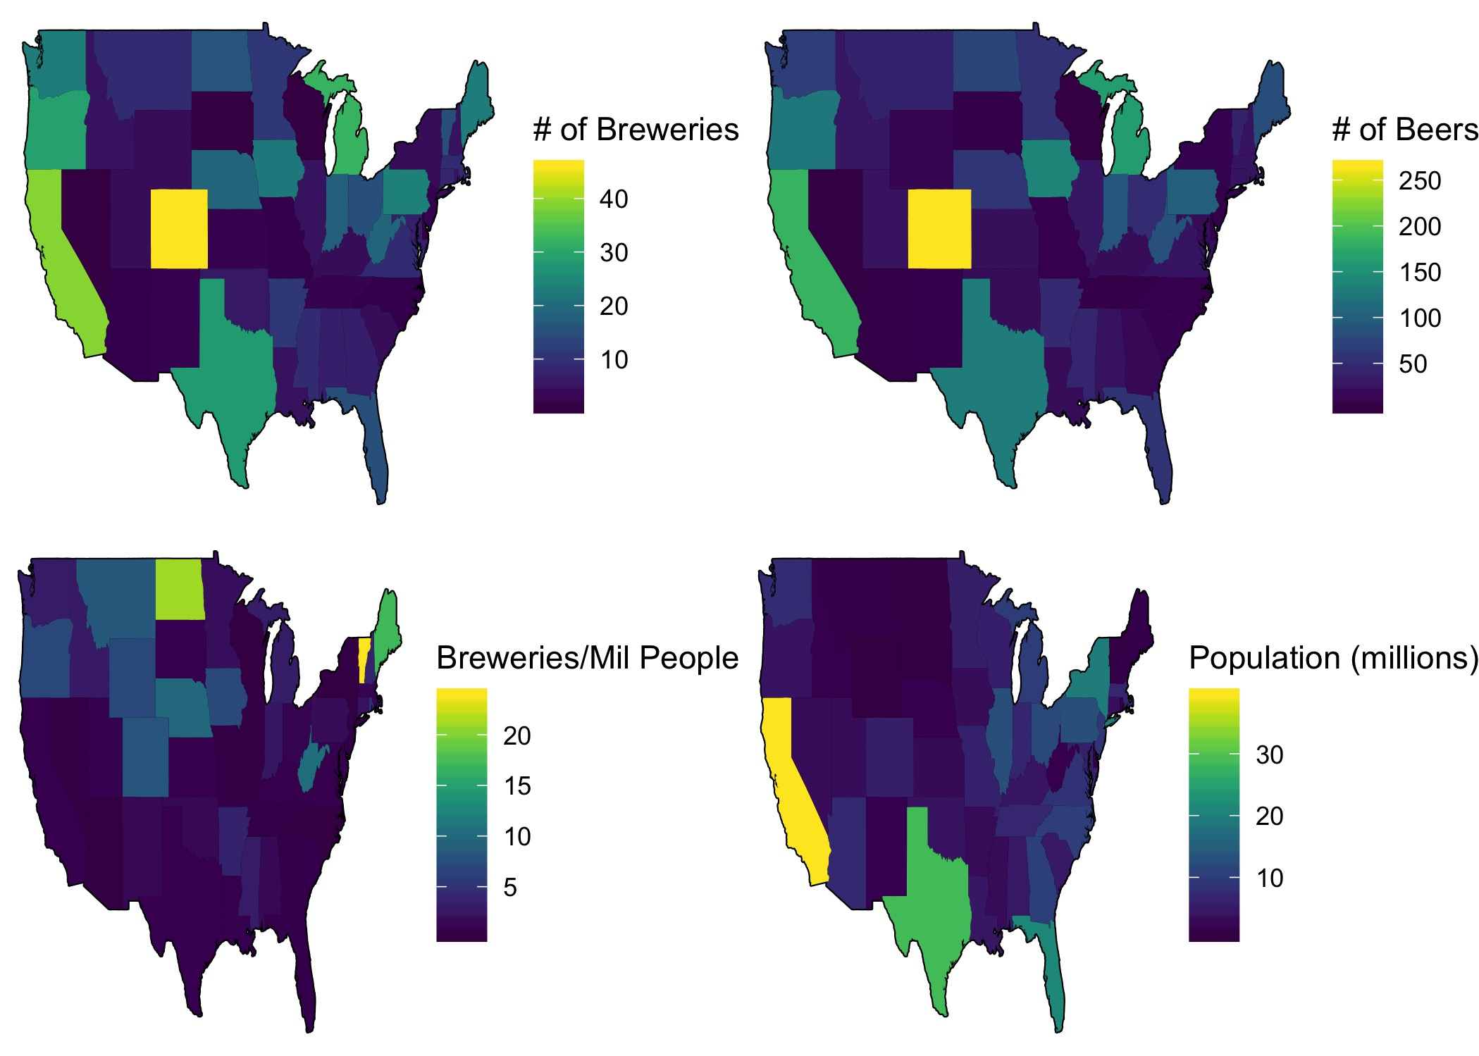
General Beer Statistics Map

Slide 8
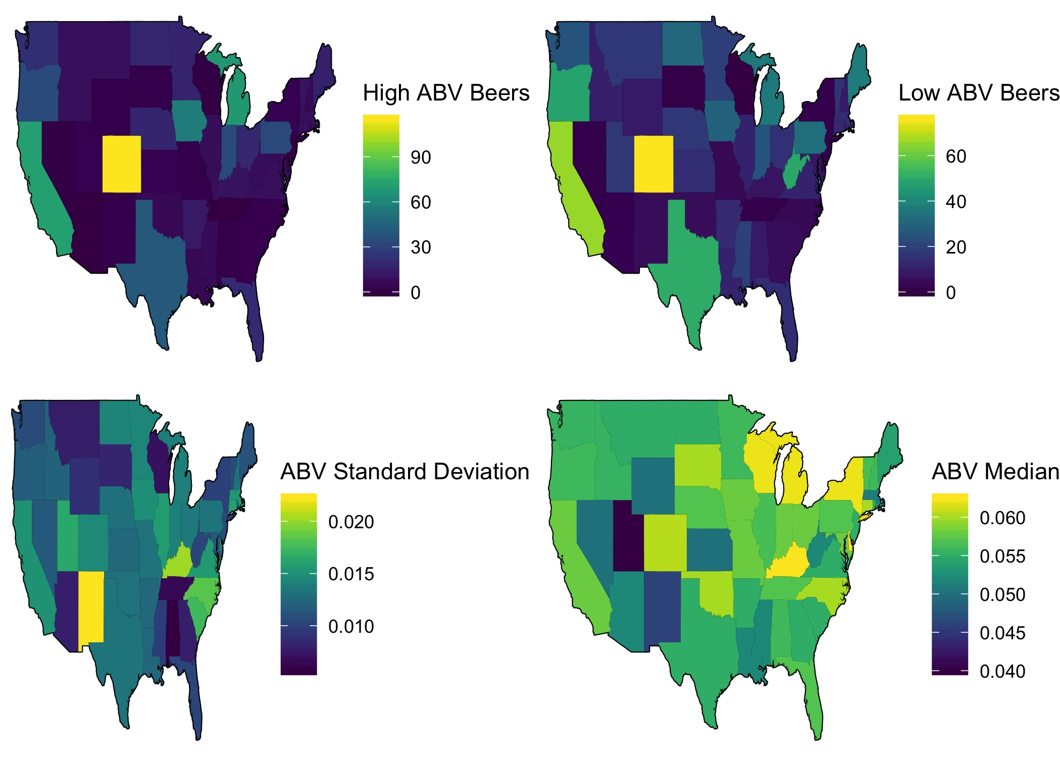
ABV by State

Slide 9
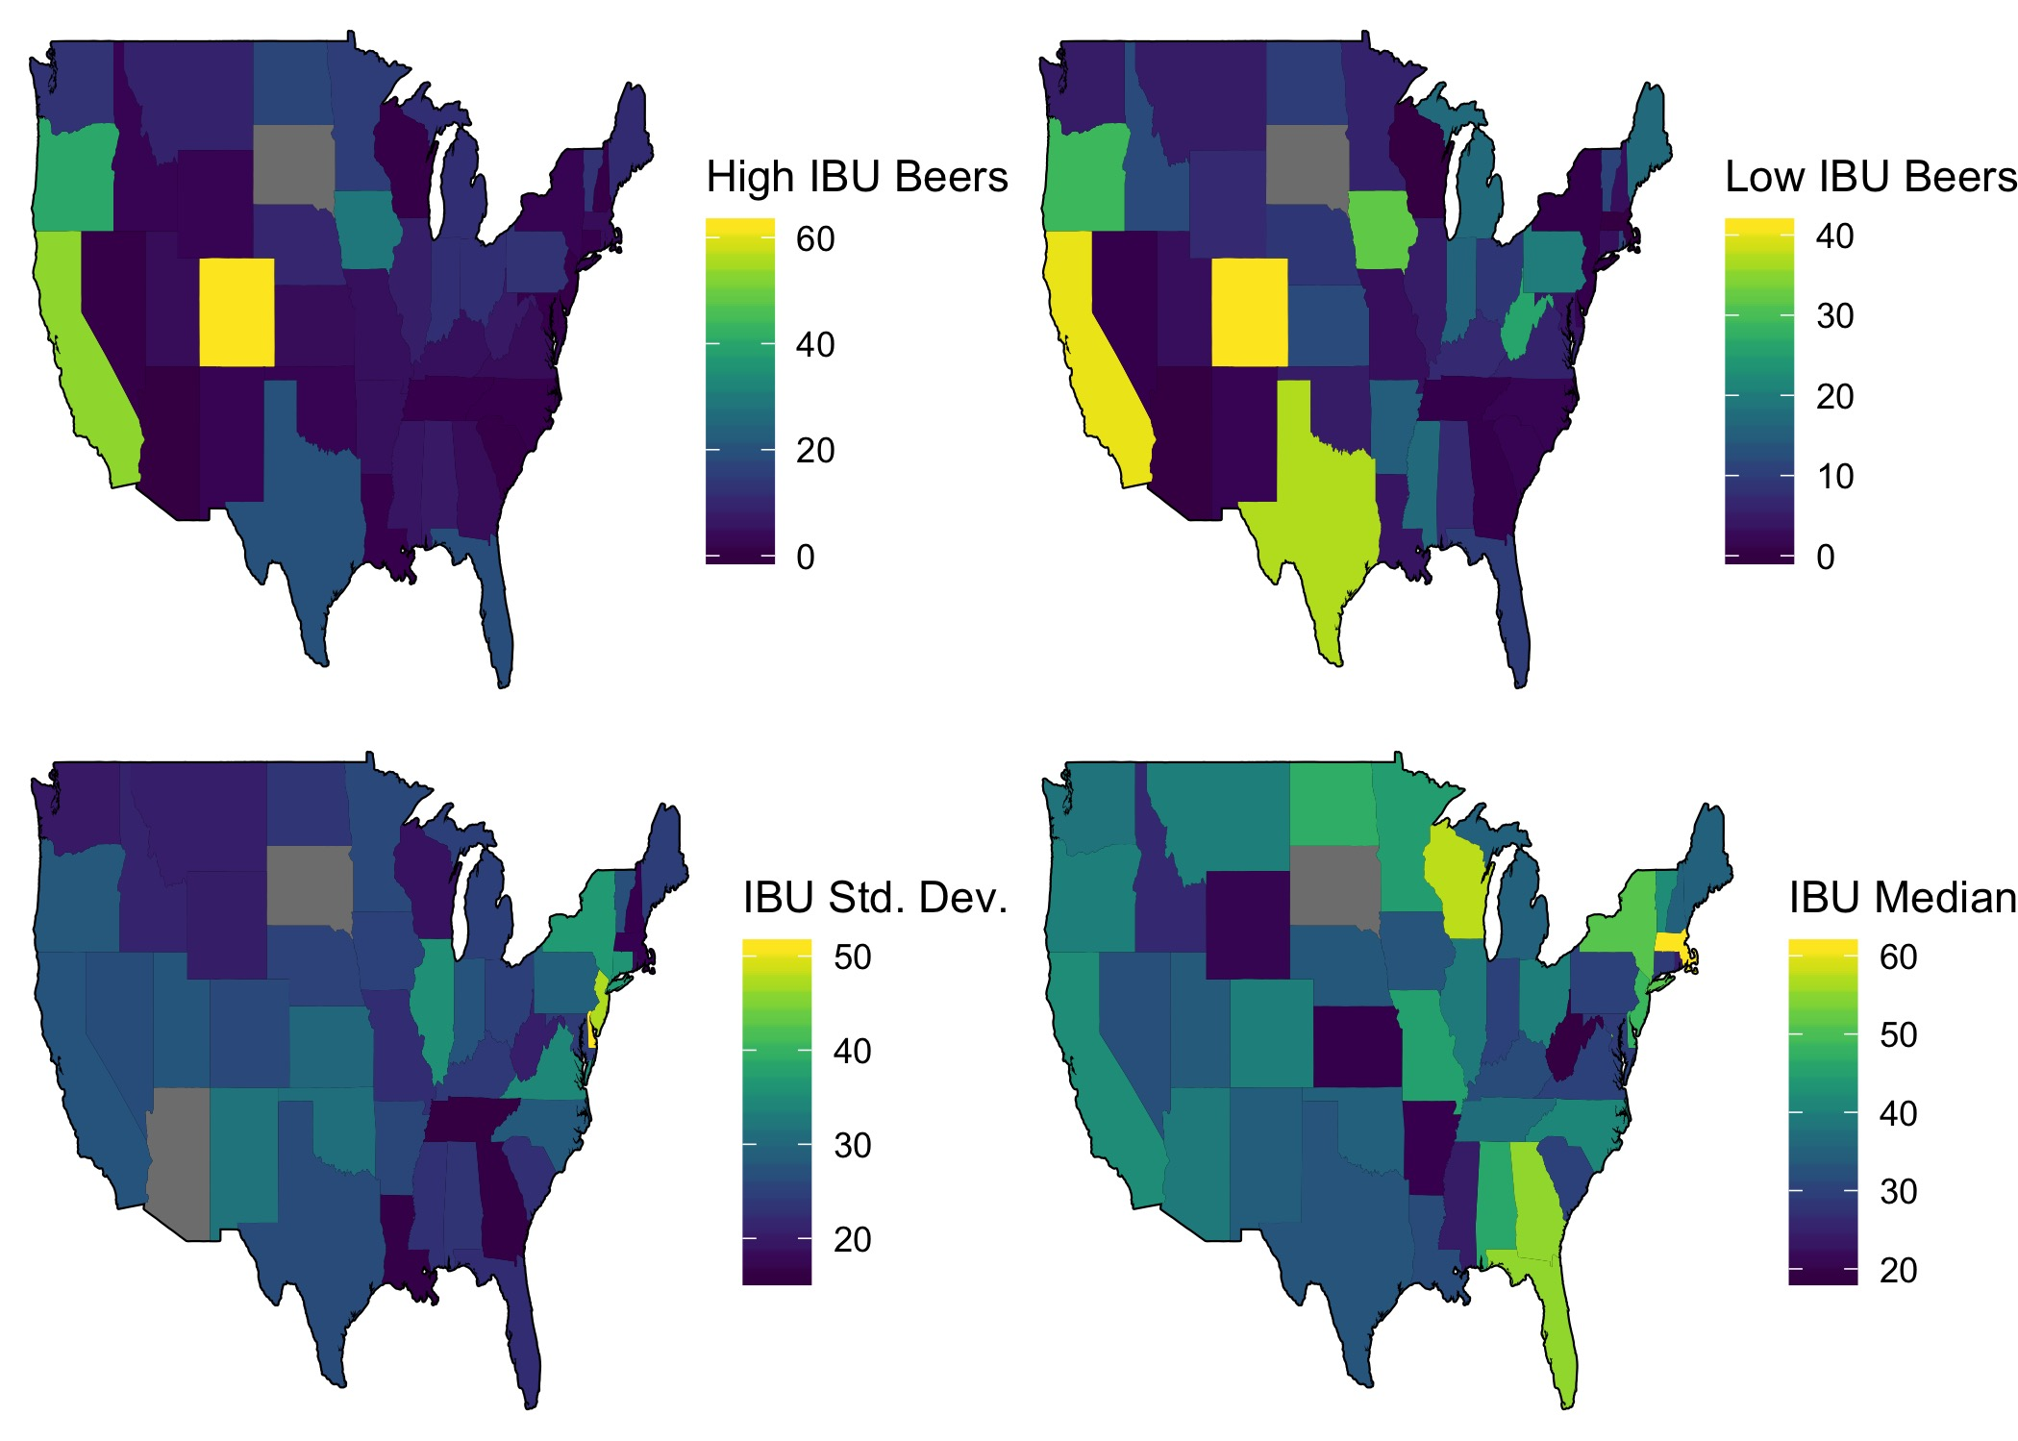
IBU by State

Slide 10
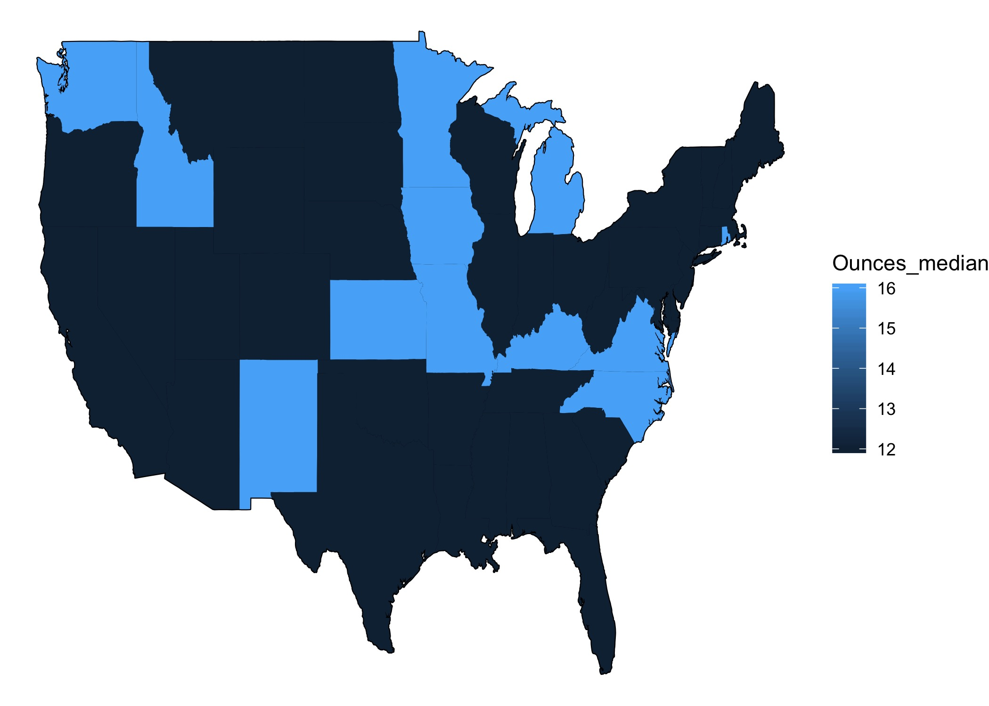
Ounces by State

Slide 11
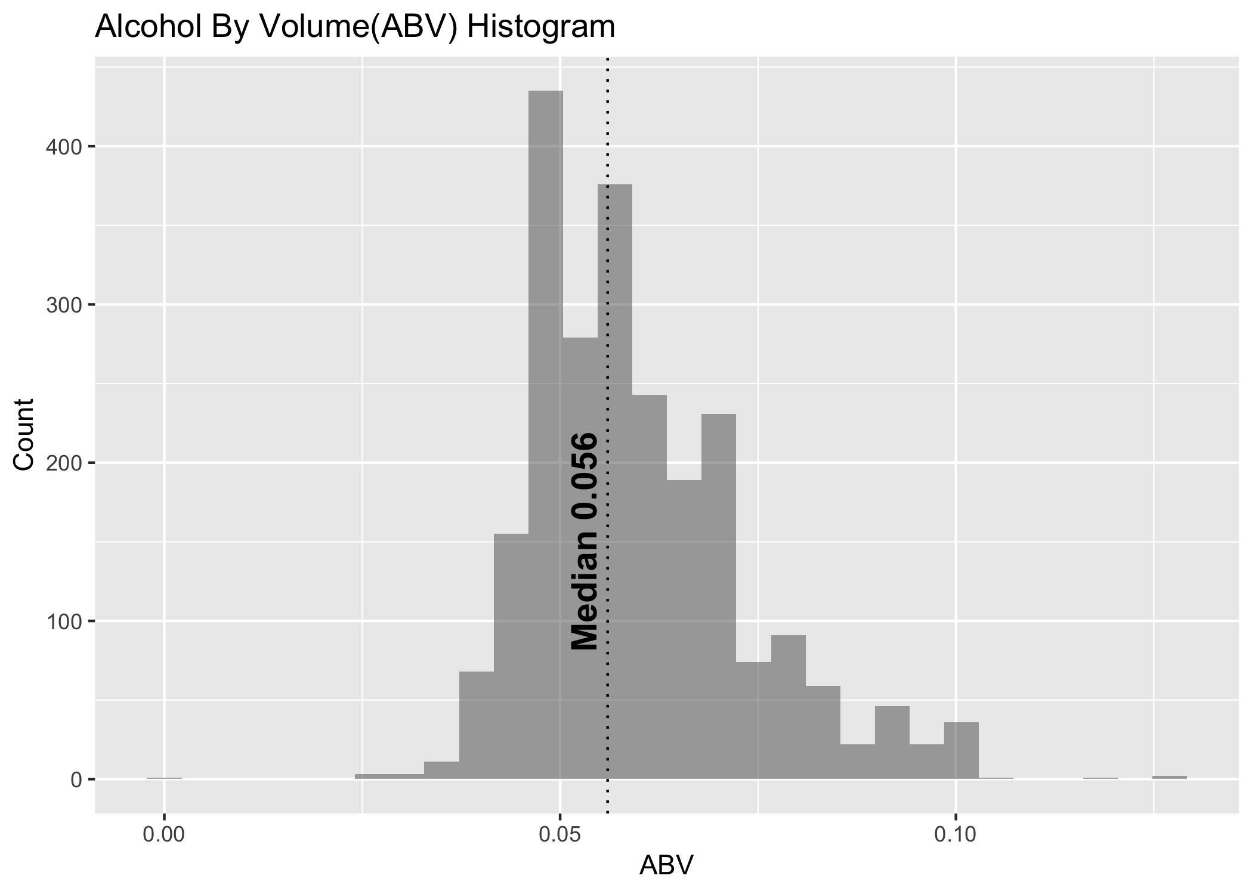

Slide 12
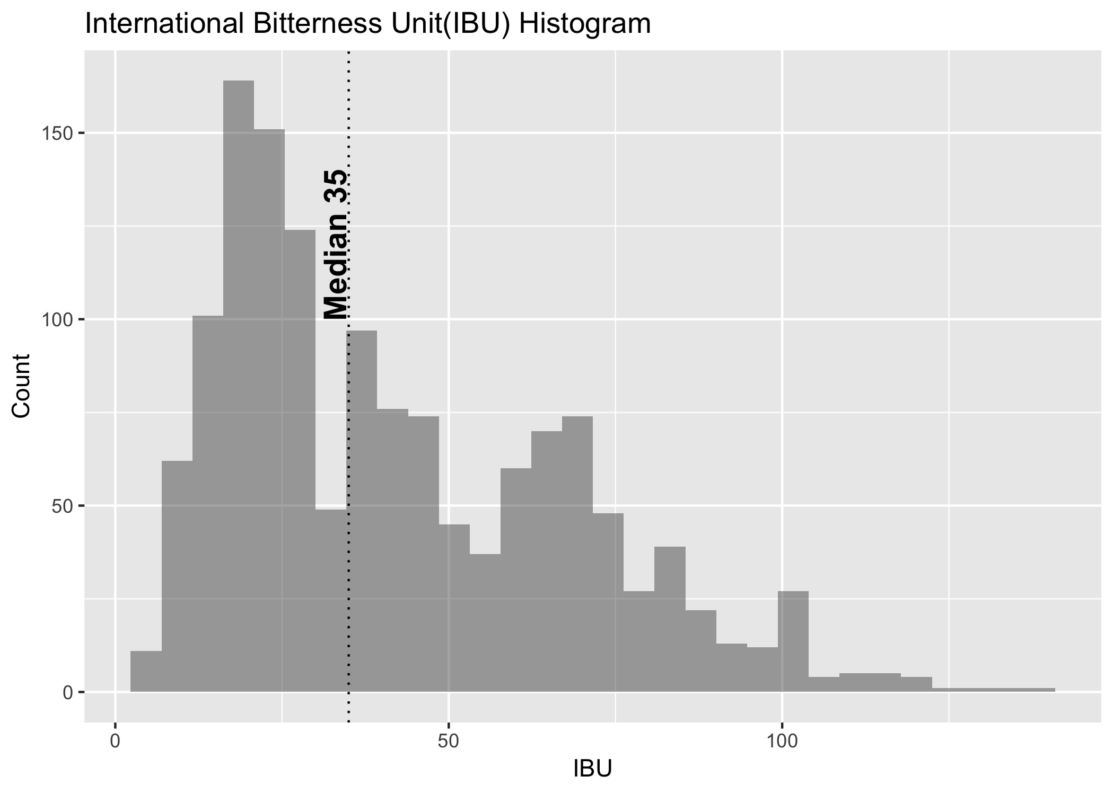

Slide 13
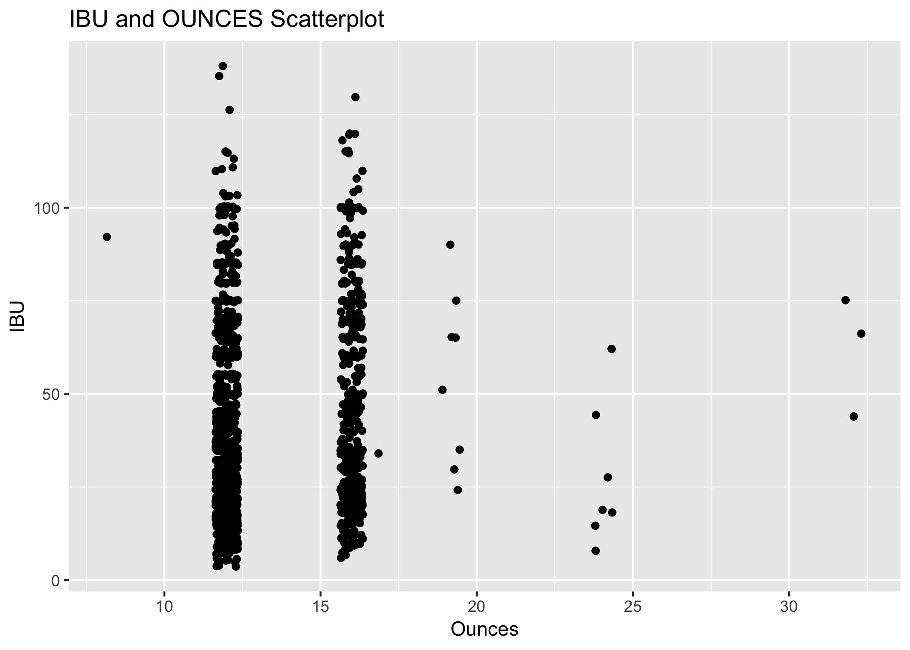
Relationship between Ounces and IBU

Slide 14
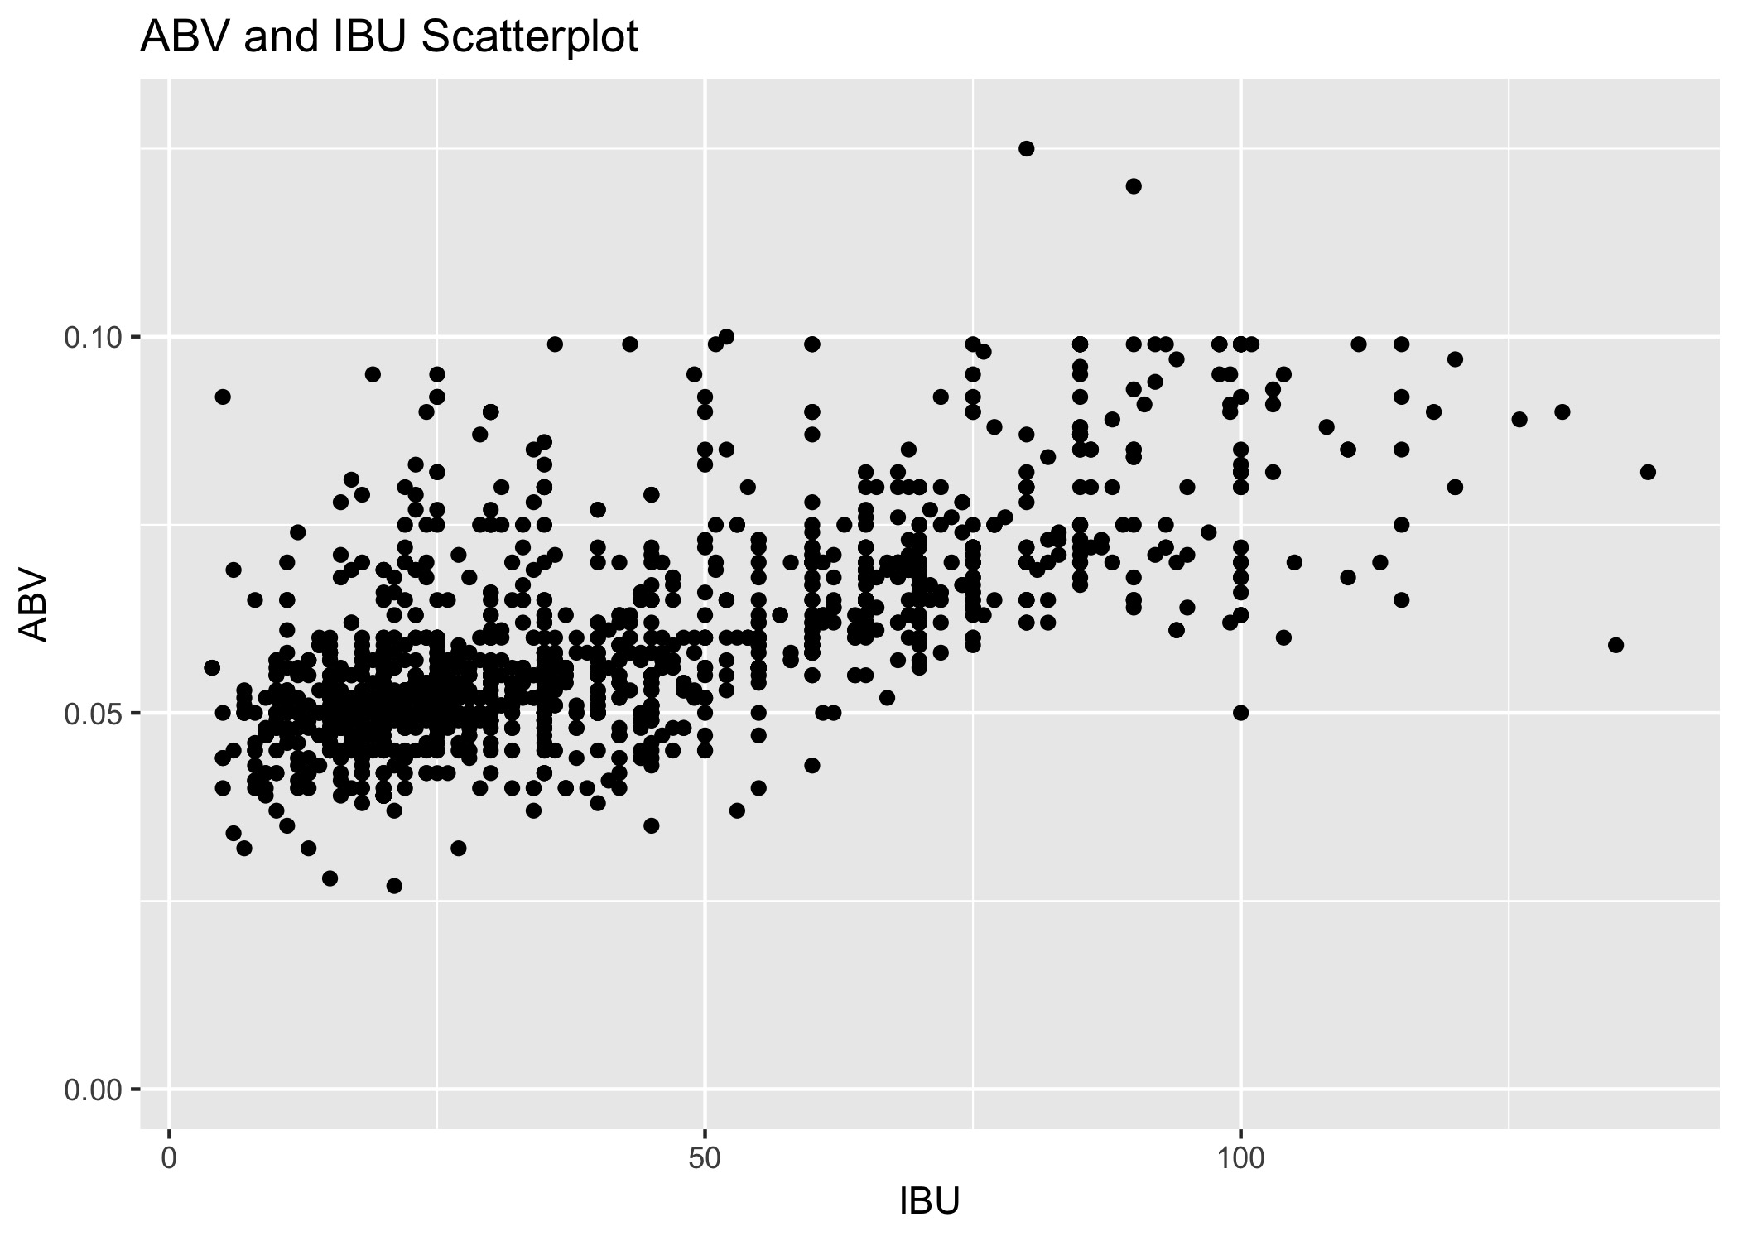
Relationship Between ABV and IBU

Slide 15
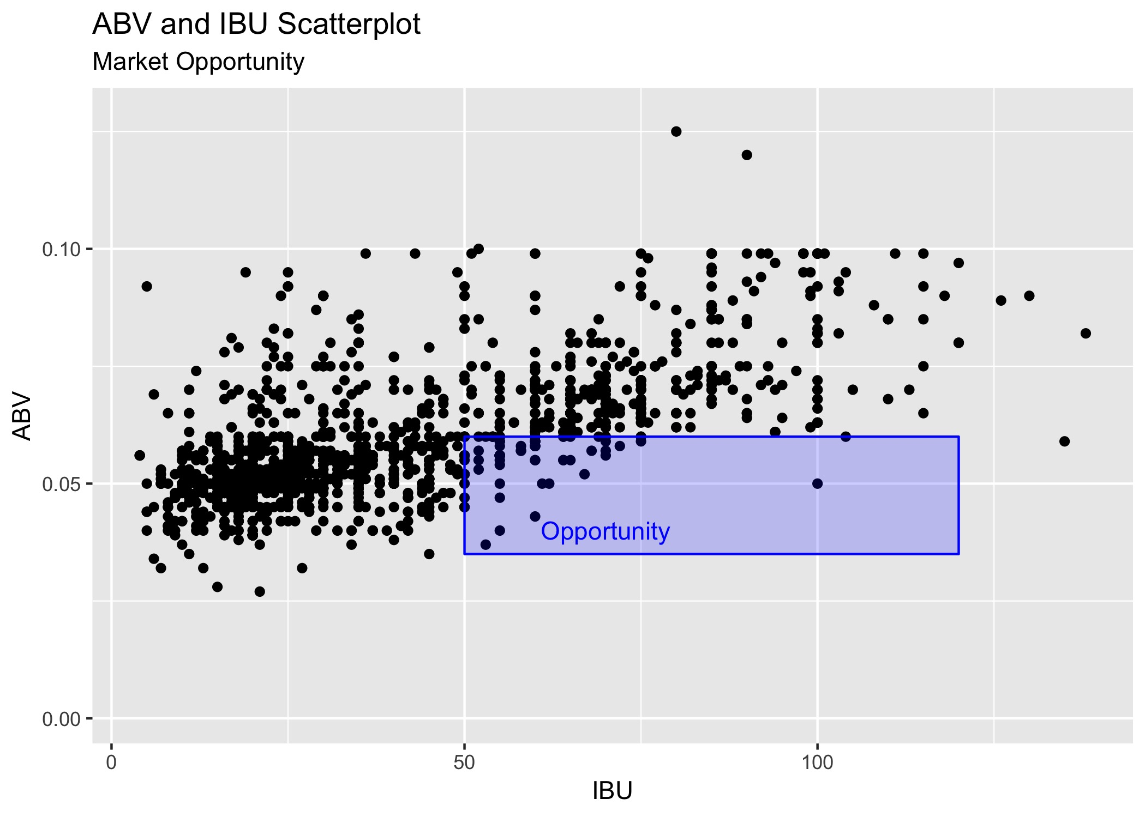
Relationship Between ABV and IBU

Slide 16
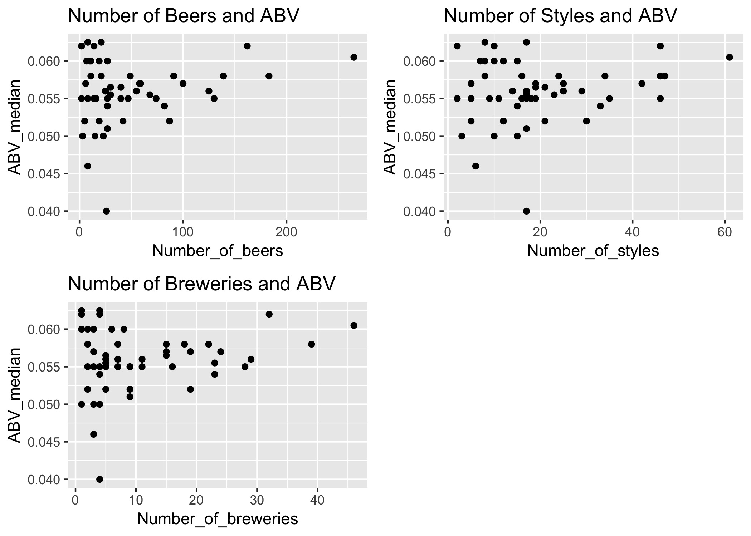
State beer production and ABV

Slide 17
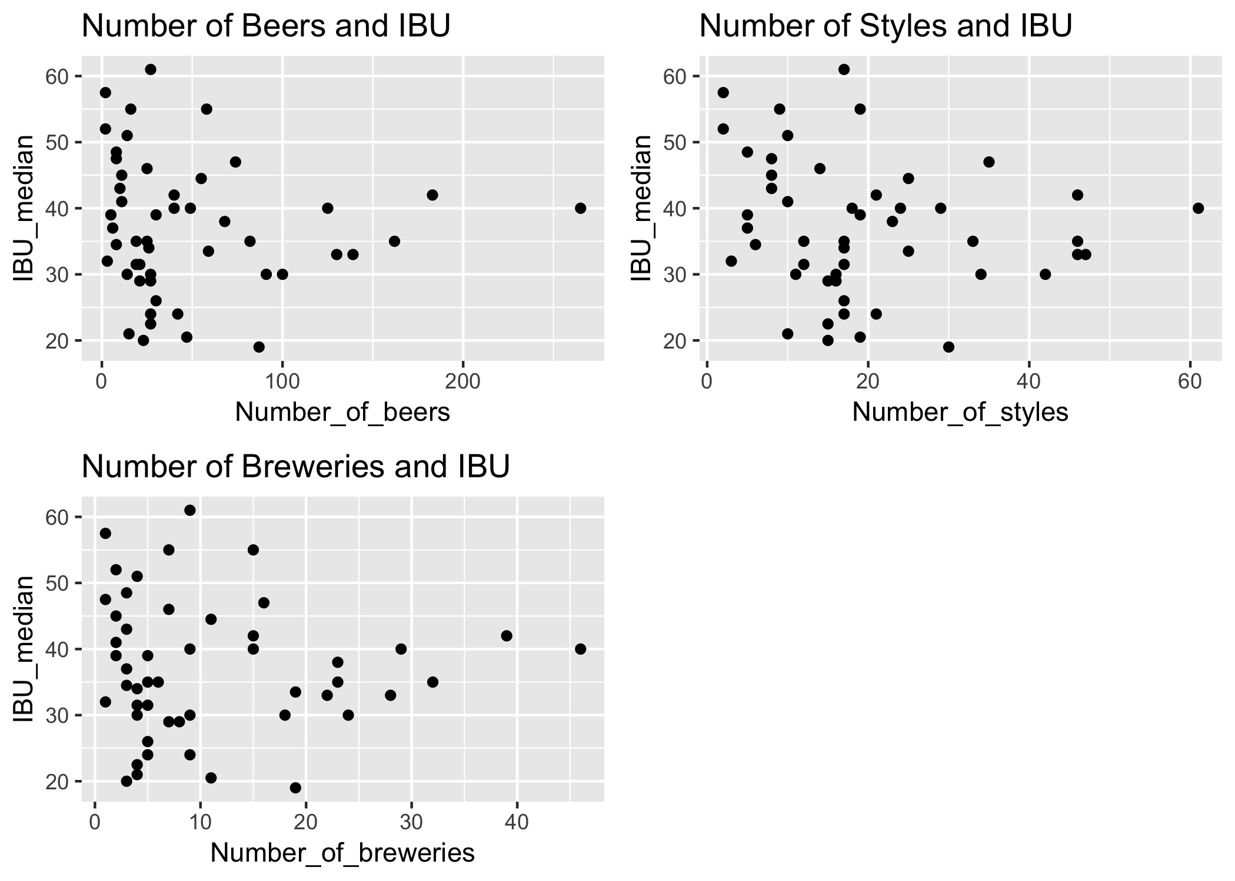
State beer production and IBU

Slide 18
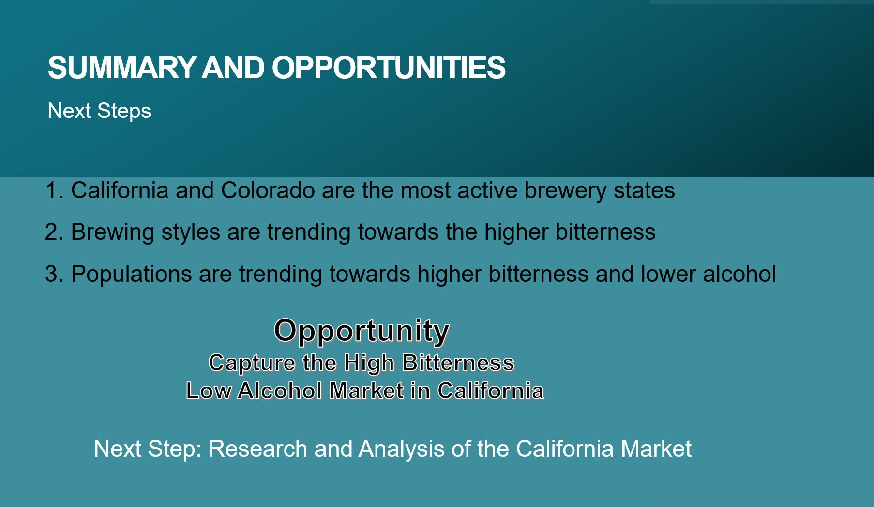
Summary and Opportunities

Slide 19


